Slide 1
Data Efficient Lithography Modeling with Residual Neural Networks and Transfer Learning
Yibo Lin¹, Yuki Watanabe², Taiki Kimura², Tetsuaki Matsunawa², Shigeki Nojima², Meng Li¹, David Z. Pan¹
¹ECE Department, University of Texas at Austin
²Toshiba Memory Corporation
http://yibolin.com
Notes:
Howdy everyone, I am Yibo Lin from UT Austin. My talk today is about…
1

Slide 2
Outline
8/31/15
2
Introduction
Problem Formulation
Related Work
Data Efficient Lithography Modeling
Experiment Results
Conclusion
Notes:
2

Slide 3
Advanced Lithography with Scaling
[Courtesy Mentor Graphics]
Notes:
https://blogs.mentor.com/calibre/blog/2017/01/25/will-euv-kill-multi-patterning/
But with further scaling, the requirement to process is growing.
Lithography needs to adopt multiple patterning which repeats multiple times of litho-etch process for only one metal layer.
EUV is also expected for 5nm technology node and beyond.
The cost, of course, increases dramatically.
Assuming for single patterning, which only has one litho-etch process for one metal layer, the cost is 1.
Then multiple patterning requires 2-4 times higher cost.
The cost of EUV is 4 times of single patterning with 193i lithography, which is comparable to triple patterning.

Slide 4
Design and Manufacturing Challenges
Design Closure
Lithography aware physical design
Reduce turn-around time
Manufacturing/yield Closure
Pre-silicon verification, e.g., hotspot detection
Fast and effective mask optimization, e.g., SRAF, OPC
Litho-Aware Physical Design
Layout/Mask
Layout/Mask
Lithography
Model
SRAF&OPC
Hotspot Detection
Mask Optimization
Pre-silicon Verification
Fast & Accurate
Modeling
Notes:
The purpose of scaling is not only for performance, but more for cost reduction.
The industry will try everything to shrink the cost.
Cost reduction can be achieved in many ways.
If you still remember the equation of die cost I have shown, improving wafer yield is a natural way.
Another way for cost reduction is to reduce the turn-around time, which speedup design closure.
I will then introduce two case studies from these perspectives to reduce design cost.

Slide 5
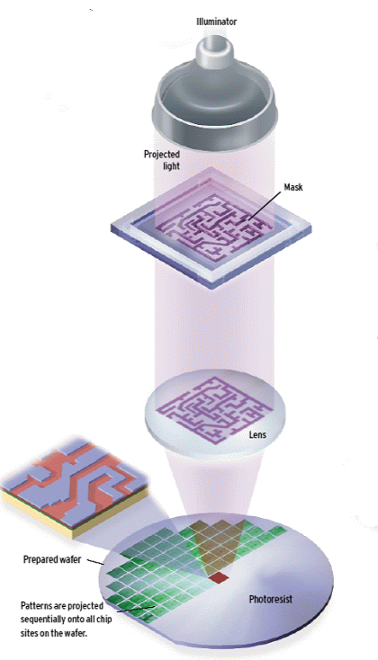
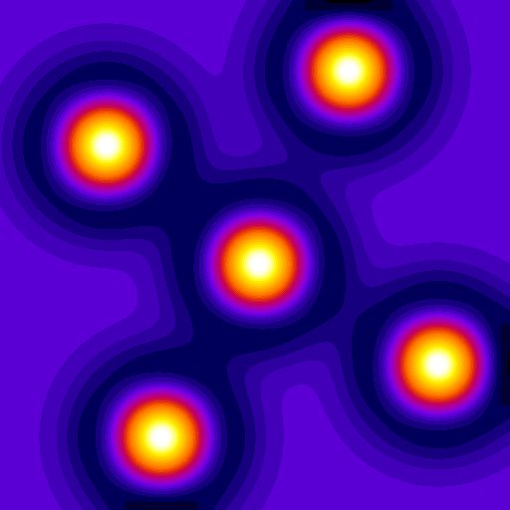
Contact Mask
Aerial Image
(Light intensity map)
Resist Pattern
Notes:
I have slightly talked about lithography in the introduction.
A silicon wafer is prepared with photoresist on top of it.
A lithography system sheds light through a mask and remove photoresist exposed to light.
For example, we have a layout with 5 contacts to print.
When the light goes through the mask and reaches the photoresist, it has different light intensity at different locations of the layout.
In this figure, lighter color denotes stronger light intensity.
This light intensity map is called aerial image.
The resist pattern will then be formed according to aerial image and property of photoresist.
What we are interested in is the dimension of the printed contacts, like the width and height.

Slide 6
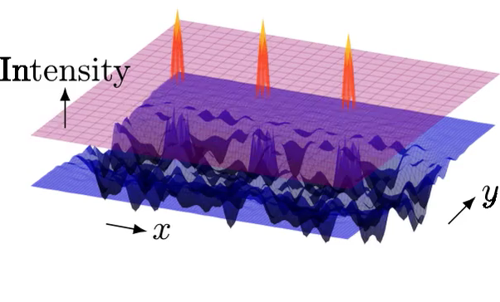

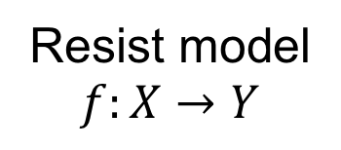
Modeling Photoresist
Resist model
$$f:X→Y$$
Predicted Pattern
Threshold
Match CD
Actual Pattern
Notes:
To compute the size of printed patterns, we define resist model as a function mapping X to Y.
X is the aerial image or light intensity map. Here we use a 3D plot.
Y is a threshold value that cuts the light intensity.
Location with stronger intensity than the threshold will be printed; otherwise, it will not be printed.
The objective of resist modeling is to match the size of predicted patterns with that of actual patterns.
Be aware that for each given layout clip, we only want to know predict the threshold for the center pattern.
It is ok if the other patterns do not match with this threshold.

Slide 7
Challenges in Lithography Modeling
Rigorous
Simulation
Compact
Model
Accuracy
High
Medium
Prediction Efficiency
Low
High
Data Demands
Medium
High
Rigorous simulation: physics-level simulation, e.g., Synopsys Sentaurus Lithography
Compact model: e.g., Mentor Graphics Calibre, machine learning models
Notes:
There are two types of modeling.
One is rigorous simulation, which pursues accuracy.
It is a physics-level simulation which is very time consuming, but accurate.
It is not easy to develop the model as well.
The other one is compact model, which aims at fast prediction with acceptable accuracy.
It has good efficiency, but demands large amount of data to calibrate.

Slide 8

Prediction Efficiency
For 1K 2x2 um² clips
Data Demanding
Compact Model
High target accuracy $→$ Require big training data
A 1x1 mm² chip contains
250K such clips
Intel Ivy Bridge 4C: 160mm²
Expensive to prepare data
Time consuming
Manufacturing cost
>15h
< 1s
Notes:
This plot compares prediction efficiency of rigorous model and compact model.
Rigorous simulation requires more than 15 hours to compute the thresholds for about 30K 2x2 um clips.
A 1x1 mm clip contains 250K such clips, which not affordable at all.
Let alone a real chip like Intel Ivy Bridge is much larger.
The accuracy of compact model is highly correlated to amount of training data.
To achieve high accuracy, big data is required.
However, it is not always easy to prepare data, because collecting data is not only time consuming but also expensive.

Slide 9
Previous Study on ML-based Modeling
Convolutional neural networks
[Watanabe+, SPIE’17]
Task: threshold prediction
3 convolutional layers
2 fully connected layers
Artificial neural networks
[Shim+, SPIE’17]
Task: resist height prediction
5 hidden layers
Neural networks are getting deeper for higher accuracy
AlexNet-8, VGG-19, ResNet-101, ResNet-1202
“You just keep on adding layers, until the test error doesn’t improve anymore.”
⎯ Yoshua Bengio
Notes:
Previous work has explored the power of machine learning in lithography modeling.
The SPIE’17 paper constructed a CNN with 3 convolutional layers and 2 fully connected layers to predict threshold.
It showed better accuracy than models in Mentor Calibre.
Another paper from SPIE’17 constructed an ANN with 5 hidden layers to predict the height of resist after exposition.
Both these neural networks are quite shallow.
Usually deeper neural networks will provide higher accuracy, like the famous neural networks for image recognition.
Yoshua Bengio even suggested to keep on adding layers until the test error does not improve.

Slide 10
Pitfalls in Deeper Neural Networks
Larger model capacity
CNN-5
[Watanabe+, SPIE’17]
CNN-10
Notes:
We extend the 5-layer CNN from the SPIE’17 paper to a 10-layer CNN.
The deeper CNN provides us more capacity of the model, which is supposed to offer higher accuracy.

Slide 11
Pitfalls in Deeper Neural Networks
Larger model capacity
Gradient vanishing
Notes:
However, the deep neural networks do not work as expected.
We observe that even the training error fails to decrease due to gradient vanishing in deep networks.
As a result, the testing error is not as good as the shallow network.
When we vary the amount of training data, CNN-5 provides better results in most cases.

Slide 12
Pitfalls in Deeper Neural Networks
Shortcut
connection
Larger model capacity
Gradient vanishing
ResNet
Overfitting
Require MORE data
[He+, CVPR’16]
ResNet-10
Notes:
To solve the gradient vanishing problem, we add shortcut connection to building blocks of the neural network and form a residual neural network.
ResNet is able to alleviate the gradient vanishing issue.
However, it is still not able to outperform shallow CNN for small amount of training data.
We observe that ResNet actually gets better accuracy for 50% training set than CNN.
It is a bit difficult to see the difference due to the scale of y axis.
This indicates that if given more training data, ResNet has the potential to further improve accuracy.
But we have already used all the training data and it is too expensive to get more.

Slide 13
Do We Have Big Data?
Yes, but old data
Different design rules
Different manufacturing configurations
Can We Use Old Data?
It depends…
How different the old data is from the new data?
Worth trying
Our customer has a new chip to synthesize. It is quite different from the previous one.
Sure, let’s first try the previous recipe.
Notes:
We first need to ask: do we have big data?
The answer must be yes. Otherwise, the story won’t continue☺
But that’s old data from old technology nodes with different design rules and manufacturing conditions.
Can we use these data?
Well, it depends on how different the old data is from the new data, but it might worth trying.
In practice, engineers do very similar things.
When they work on a new design, they often start from old recipes, no matter how different the designs are.

Slide 14
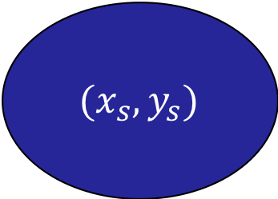
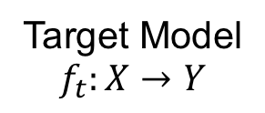
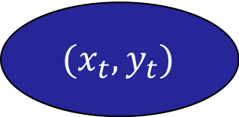
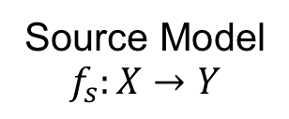
Transfer Learning from Source to Target
Source Domain
$$(x_{s},y_{s})$$
Train
Source Model
$$f_{s}:X→Y$$
Starting point
Target Domain
$$(x_{t},y_{t})$$
Fine-tune
Target Model
$$f_{t}:X→Y$$
Notes:
Inspired by the working style of engineers, we develop a transfer learning scheme to migrate knowledge from the source domain to the target domain.

Slide 15
Transfer Learning from Source to Target
TF_{k} Scheme
Notes:
More specifically on a neural network, we define a TF_k scheme with a parameter k to denote the number of fixed layers.
We first train the neural network for the source domain and use it as a starting point for the target domain network.
When we train the target network with TF_k scheme, the first k layers are fixed and only the rest layers will be updated.

Slide 16


Technology Transition from N10 to N7
Contact Layer Design Rules [Liebmann, SPIE’15]
 | N10 | N7
Patterning | LELE | LELELE
Pitch (nm) | 64 | 45
Mask pitch (nm) | 128 | 135
Litho-target (nm) | 60 | 60
 | N10 | N7_{a} | N7_{b}
Design Rule | A | B | B
Optical Source | A | B | B
Resist Material | A | A | B
Optical Sources
Resist Materials
N10
N7
Resist A
Resist B
Different dissolution slopes
Notes:
Verify the transfer learning scheme, we consider the technology transition from N10 to N7.

Slide 17
Technology Transition from N10 to N7
Python 2.7
Tensorflow 1.2.1
GeForce GTX 1080
SRAF, OPC, Aerial image: Mentor Graphics Calibre
Rigorous simulation: Synopsys Sentaurus Lithography
Average 10 trials of different random seeds
~30K clips for each N10 and N7 dataset
Notes:
Verify the transfer learning scheme, we consider the technology transition from N10 to N7.

Slide 18
Explore Knowledge Transfer
From N10 to N7
2X
10%
From N7_{a} to N7_{b}
3X
Notes:
Exciting

Slide 19
Data Reduction from Knowledge Transfer
From N10 to N7_{b}
2.6X
2~10X reduction on training data
4X
3X
2X
10X
From N7_{a} to N7_{b}
8X
8~20X reduction on training data
20X
15X
10X
10X

Slide 20
Explore Knowledge Transfer
 | N10➔N7_{b} | N7_{a}➔N7_{b}
Dataset Similarity | Medium | High
Knowledge Transfer | Medium | High
Data Reduction | 2~10X | 8~20X
Improve data efficiency
Less cost for data preparation
Less turn-around time
Prototyped by Toshiba Memory Corp.

Slide 21
Conclusion
Labelled Source
Domain Data
Labelled Target
Domain Data
Data Augmentation
Data Augmentation
Source Model Training
Knowledge
Transfer
Target Model Training
Transfer learning & ResNet
Improve data efficiency
2~10X reduction of training data
Reduce turn-around time
Increase modeling accuracy
Can we do better?

Slide 22
Future Directions
Transfer
Learning
Active
Learning
Semi-supervised
Learning
Labelled Old Data
✔︎
Labelled New Data
✔︎
✔︎
Label Querying
✔︎
ML for SRAF&OPC
P & R…
ML is more than classification/regression
Better understanding about data
Notes:
We have leverage transfer learning and active learning to improve data efficiency in this work.
However, we are actually making assumptions to the datasets.
Transfer learning assumes the availability of labelled old data.
Active learning assumes query labels for unlabeled data is possible.
Then, what if we are given arbitrary datasets with some labelled data, and we can not query additional labels, nor can we access any old data?
In this case, the only information we have except for labelled data is the unlabeled data in the dataset.
Whether we can utilize these unlabeled data becomes critical to improve data efficiency.
This task falls into a semi-supervised learning problem.
ML is more than classification/regression.
Better understanding about data.
Other directions include various machine learning applications in mask optimization problems.
Since a mask is essentially an image, various techniques for image recognition may help with mask synthesis.

Slide 23
Thanks

