Slide 1
Triple/Quadruple Patterning Layout Decomposition via Novel Linear Programming and Iterative Rounding
Yibo Lin¹, Xiaoqing Xu¹, Bei Yu², Ross Baldick¹, David Z. Pan¹
¹ECE Department, University of Texas at Austin
²CSE Department, Chinese University of Hong Kong
This work is supported in part by NSF and SRC
Notes:
Hi everyone, my presentation is about …
I’m Yibo Lin from …
1

Slide 2
Outline
8/31/15
2
Introduction
A New Framework for Layout Decomposition
ILP → LP relaxation with iterative rounding
Experimental Results
Conclusion
Notes:
I’ll go through my presentation in this order…
2

Slide 3
Triple Patterning Lithography (TPL)
An example of TPL conflict graph and decomposition
Layout decomposition is a fundamental problem for multiple patterning
Notes:
Here is a more complicated 2D layout for triple patterning.
For such kind of general 2D layout, the layout decomposition is very similar to a graph coloring problem.
Each feature can be represented by a vertex in a graph.
If two features are too close to each other, that is, within the coloring distance, a conflict edge is inserted to connect the two features.
For example, the distance of a and b is smaller than coloring distance. Then we connect them with a conflict edge.
The layout decomposition process is to color the vertices such that no vertices of an edge share the same color.

Slide 4
Quadruple Patterning Lithography (QPL)
An example of QPL layout decomposition (coloring) and conflict graph
Notes:
Here is an example of quadruple patterning layout decomposition.
Not all graphs can be colored with given number of colors.
In TPL, we have three total colors, and in QPL, we have four colors.
Note that in this example, there is a four-way clique in the decomposition graph; that is, a, b, c and d are all connected to each other.
We are not able to color them with three colors, so the fourth color is introduced to resolve the conflicts.

Slide 5
Stitch Insertion
Stitch may be inserted to resolve conflict
However, strongly discouraged due to misalignment and yield loss
In this work, we do not allow stitch insertion

Slide 6
Current State of MPL Decomposition
ILP or SAT: [Cork+, SPIE’08], [Yu+, ICCAD’11], [Cork+, SPIE’13]
Greedy or heuristic: [Ghaida+, SPIE’11], [Fang+, DAC’12], [Kuang+, DAC’13], [Fang+, SPIE’14]
SDP or graph search: [Yu+, ICCAD’11], [Chen+, ISQED’13], [Yu+, ICCAD’13], [Yu+, DAC’14]
[Yu+, SPIE’14]
Notes:
Previous work has proposed various approaches for layout decomposition.
They can be summarized to three groups.
The first group is ILP or SAT, which is essentially brute-force approach and they can usually guarantee optimality.
The second group includes greedy or heuristic algorithms, which are usually very fast.
The third group contains approaches such as semi-definite programming and graph algorithms.
Although they often cannot guarantee optimality like ILP or SAT, the runtime is much acceptable.
All these three groups show a trade-offs between solution quality and runtime.

Slide 7
Major Contributions of This Work
A new layout decomposition framework for TPL/QPL
ILP → novel linear programming (LP) based algorithm with iterative rounding scheme
An odd-cycle based technique to enhance LP solution quality (which can be better mapped to ILP solution)
Our experiments obtain comparable quality cf. previous state-of-the-art, but are 26x to 600x faster than ILP, and 1.8x to 2.6x faster than SDP

Slide 8
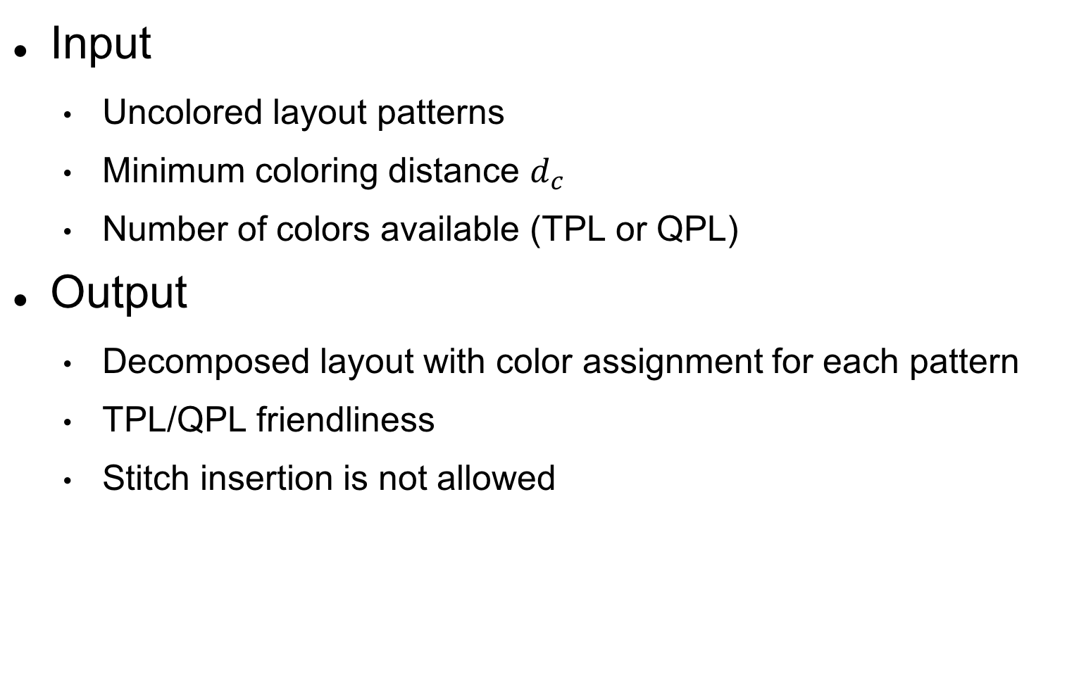
Problem Formulation
Input
Uncolored layout patterns
Minimum coloring distance $d_{c}$
Number of colors available (TPL or QPL)
Output
Decomposed layout with color assignment for each pattern
TPL/QPL friendliness
Stitch insertion is not allowed
Notes:
In our problem formulation we take uncolored layout patterns and minimum coloring distance as input.
Both TPL and QPL are supported.
Our framework will decompose the layout and generate color assignment to minimize conflicts.
We don’t consider stitch insertion in this work.

Slide 9
Initial ILP Formulation
Represent color with two binary variables
(0, 0) (0, 0)
Additional constraint for TPL
(0, 1) (0, 1)
…
Notes:
The first step of our algorithm is to come up with the ILP formulation for graph coloring.
Two binary variables are needed to represent the color of a vertex.
(0, 0) denotes color 0;
(0, 1) denotes color 1;
(1, 0) denotes color 2;
(1, 1) denotes color 3.
\begin{subequations}
\begin{align}
(x_{i1}, x_{i2}) & \rightarrow \textrm{color} \notag \\
(0, 0) & \rightarrow 0 \notag \\
(0, 1) & \rightarrow 1 \notag \\
(1, 0) & \rightarrow 2 \notag \\
(1, 1) & \rightarrow 3 \notag
\end{align}
\end{subequations}
\begin{equation}
x_{i1}+x_{i2} \le 1 \notag
\end{equation}

Slide 10
ILP Formulation
The goal is to meet all the constraints
Only for TPL
Notes:
\begin{subequations}
%\centering
\label{eq:ilp}
\begin{align}
\textrm{min} \quad & Objective \label{eq:ilp:obj} \\
\textrm{s.t.} \quad & x_{i1} + x_{i2} \le 1, \label{eq:ilp:c1}\\
& x_{i1} + x_{i2} + x_{j1} + x_{j2} \geq 1, \quad \forall e_{ij} \in E_c, \label{eq:ilp:c2}\\
& x_{i1} + \bar{x}_{i2} + x_{j1} + \bar{x}_{j2} \geq 1, \quad \forall e_{ij} \in E_c, \label{eq:ilp:c3}\\
& \bar{x}_{i1} + x_{i2} + \bar{x}_{j1} + x_{j2} \geq 1, \quad \forall e_{ij} \in E_c, \label{eq:ilp:c4}\\
& \bar{x}_{i1} + \bar{x}_{i2} + \bar{x}_{j1} + \bar{x}_{j2} \geq 1, \quad \forall e_{ij} \in E_c, \label{eq:ilp:c5}\\
& \bar{x}_{i1} = 1-x_{i1}, \quad \forall i \in V, \label{eq:ilp:c6} \\
& \bar{x}_{i2} = 1-x_{i2}, \quad \forall i \in V, \label{eq:ilp:c7} \\
& x_{i1}, x_{i2} \in \{0, 1\}, \quad \forall i \in V. \label{eq:ilp:c8}
\end{align}
\end{subequations}

Slide 11
LP Relaxation
Relax integer to continuous variables
Notes:
\begin{subequations}
%\centering
\label{eq:ilp}
\begin{align}
\textrm{min} \quad & Objective \label{eq:ilp:obj} \\
\textrm{s.t.} \quad & x_{i1} + x_{i2} \le 1, \label{eq:ilp:c1}\\
& x_{i1} + x_{i2} + x_{j1} + x_{j2} \geq 1, \quad \forall e_{ij} \in E_c, \label{eq:ilp:c2}\\
& x_{i1} + \bar{x}_{i2} + x_{j1} + \bar{x}_{j2} \geq 1, \quad \forall e_{ij} \in E_c, \label{eq:ilp:c3}\\
& \bar{x}_{i1} + x_{i2} + \bar{x}_{j1} + x_{j2} \geq 1, \quad \forall e_{ij} \in E_c, \label{eq:ilp:c4}\\
& \bar{x}_{i1} + \bar{x}_{i2} + \bar{x}_{j1} + \bar{x}_{j2} \geq 1, \quad \forall e_{ij} \in E_c, \label{eq:ilp:c5}\\
& \bar{x}_{i1} = 1-x_{i1}, \quad \forall i \in V, \label{eq:ilp:c6} \\
& \bar{x}_{i2} = 1-x_{i2}, \quad \forall i \in V, \label{eq:ilp:c7} \\
& x_{i1}, x_{i2} \in \{0, 1\}, \quad \forall i \in V. \label{eq:ilp:c8}
\end{align}
\end{subequations}

Slide 12
LPIR
Linear programming and iterative rounding (LPIR)
Non-integer solutions
Fewer non-integers mean closer to optimal solutions of ILP
Prune non-integer solutions in the feasible set
Reduce
non-integers
Notes:
Intuition: the fewer non-integers, the closer we can get to the optimal solution.
\begin{subequations}
%\centering
\label{eq:ilp}
\begin{align}
\textrm{min} \quad & Objective \label{eq:ilp:obj} \\
\textrm{s.t.} \quad & x_{i1} + x_{i2} \le 1, \label{eq:ilp:c1}\\
& x_{i1} + x_{i2} + x_{j1} + x_{j2} \geq 1, \quad \forall e_{ij} \in E_c, \label{eq:ilp:c2}\\
& x_{i1} + \bar{x}_{i2} + x_{j1} + \bar{x}_{j2} \geq 1, \quad \forall e_{ij} \in E_c, \label{eq:ilp:c3}\\
& \bar{x}_{i1} + x_{i2} + \bar{x}_{j1} + x_{j2} \geq 1, \quad \forall e_{ij} \in E_c, \label{eq:ilp:c4}\\
& \bar{x}_{i1} + \bar{x}_{i2} + \bar{x}_{j1} + \bar{x}_{j2} \geq 1, \quad \forall e_{ij} \in E_c, \label{eq:ilp:c5}\\
& \bar{x}_{i1} = 1-x_{i1}, \quad \forall i \in V, \label{eq:ilp:c6} \\
& \bar{x}_{i2} = 1-x_{i2}, \quad \forall i \in V, \label{eq:ilp:c7} \\
& x_{i1}, x_{i2} \in \{0, 1\}, \quad \forall i \in V. \label{eq:ilp:c8}
\end{align}
\end{subequations}

Slide 13
Simple Observation
Suppose $x_{i1}=x_{j1}=0$
The second bits must be different
Notes:
Prune out native non-integer solutions in the feasible set.
\begin{subequations}
%\centering
\label{eq:ilp}
\begin{align}
& x_{i1} + x_{i2} + x_{j1} + x_{j2} \geq 1, \quad \forall e_{ij} \in E_c, \label{eq:ilp:c2} \tag{1c} \\
& x_{i1} + \bar{x}_{i2} + x_{j1} + \bar{x}_{j2} \geq 1, \quad \forall e_{ij} \in E_c, \label{eq:ilp:c3} \tag{1d} \\
& \bar{x}_{i1} + x_{i2} + \bar{x}_{j1} + x_{j2} \geq 1, \quad \forall e_{ij} \in E_c, \label{eq:ilp:c4} \tag{1e} \\
& \bar{x}_{i1} + \bar{x}_{i2} + \bar{x}_{j1} + \bar{x}_{j2} \geq 1, \quad \forall e_{ij} \in E_c, \label{eq:ilp:c5} \tag{1f} \\
& \bar{x}_{i1} = 1-x_{i1}, \quad \forall i \in V, \label{eq:ilp:c6} \tag{1g} \\
& \bar{x}_{i2} = 1-x_{i2}, \quad \forall i \in V \label{eq:ilp:c7} \tag{1h}
\end{align}
\end{subequations}

Slide 14
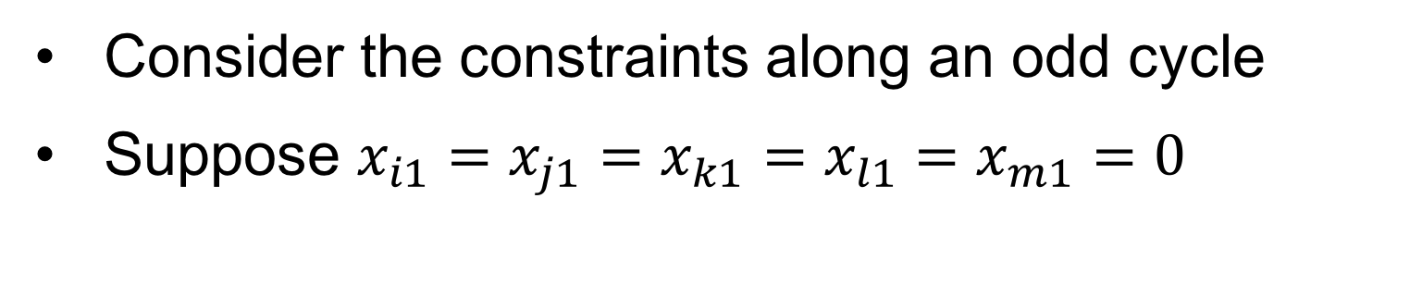
Non-integers along Odd Cycles
Consider the constraints along an odd cycle
Suppose $x_{i1}=x_{j1}=x_{k1}=x_{l1}=x_{m1}=0$
intuition?
Notes:
\begin{subequations}
\begin{align}
& x_{i2} + x_{j2} = 1, \notag \\
& x_{j2} + x_{k2} = 1, \notag \\
& x_{k2} + x_{l2} = 1, \notag \\
& x_{m2} + x_{i2} = 1 \notag
\end{align}
\end{subequations}
\begin{subequations}
\begin{align}
x_{i2} = x_{j2} = x_{k2} = x_{l2} = x_{m2} = 0.5 \notag
\end{align}
\end{subequations}

Slide 15
LPIR – Add Odd Cycle Constraints
Additional constraints
Prune non-integer solutions from feasible set
Help resolve potential non-integers in the second bits

Slide 16
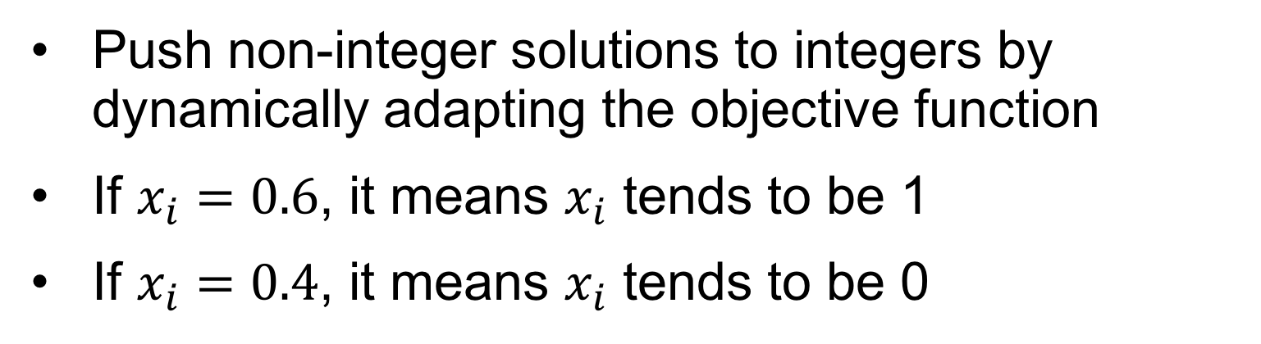
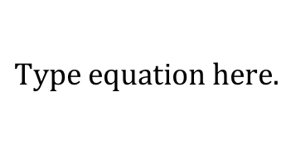
LPIR – Objective Function Biasing
Push non-integer solutions to integers by dynamically adapting the objective function
If $x_{i}=0.6$, it means $x_{i}$ tends to be 1
If $x_{i}=0.4$, it means $x_{i}$ tends to be 0
Cannot handle (0.5, 0.5)
Notes:
If $x_i > 0.5$, $\textrm{obj} \leftarrow \textrm{obj} + (1-x_i)$.
If $x_i < 0.5$, $\textrm{obj} \leftarrow \textrm{obj} + x_i$.

Slide 17




LPIR – Binding Constraints Analysis
Try to handle $\left(x_{i1},x_{i2}\right)=(0.5, 0.5)$
Try pushing $x_{i1}$ to 0
Try pushing $x_{i2}$ to 1
Check $\left(x_{i1},x_{i2}\right)=(0, 1)$

Slide 18
Graph Simplification – Iterative Vertex Removal
Iterative vertex removal
Density aware recovery

Slide 19
Graph Simplification: Bi-connected Component Extraction
Color recovery
Color rotation on each component
Color rotation is needed

Slide 20
Overall Flow
Notes:
Here’s the overall flow of our algorithm.
Given input layout, conflict graph is constructed and we perform graph simplification which will remove some vertices and generate a set of simplified components.
Then it comes the kernel coloring algorithm with LPIR.
After solving each component, it is necessary to recover colors for those vertices removed from graph simplification.
The kernel coloring algorithm works with each simplified component separately.
It first construct ILP with zero objective and we relax the ILP to LP.
Then we start the loop of adjusting LP with odd cycle constraints and objective biasing and solving LP iteratively until the number of non-integers stops to reduce.
Be aware that in the first iteration, we directly solve the LP without any additional constraints.
From the second iteration, odd cycles are detected for each non-integer vertices together with objective biasing.
The loop exits with coloring solutions for a single component.

Slide 21
Experimental Environment Setup
Implemented in C++
8-Core 3.4GHz Linux server
32GB RAM
ISCAS benchmark from [Yu+, TCAD’15]
LP solver Gurobi was used

Slide 22
Experimental Results on TPL
TPL conflict#
TPL runtime
Baseline 1: ILP [Yu+, TCAD’15]
Baseline 2: SDP [Yu+, TCAD’15]
LPIR achieves almost the same conflict numbers as ILP and SDP, but 26x faster than ILP and 1.8x faster than SDP
Notes:
We first compare our algorithm for TPL with ILP and SDP from Yu’s TCAD 2015 work.
For all these benchmarks, we can achieve almost the same number of conflicts as ILP and SDP, but much faster runtime.
Our algorithm is on average about 26x times fater than ILP and 1.8x faster than SDP.

Slide 23
Experimental Results on QPL
QPL conflict#
QPL runtime
ILP failed to finish
Baseline 1: ILP [Yu+, DAC’14]
Baseline 2: SDP [Yu+, DAC’14]
LPIR achieves less than 2% degradation in conflict numbers than SDP, but 600x faster than ILP and 2.6x faster than SDP
Notes:
We also compare with ILP and SDP for QPL.
The runtime benefit is more significant.
Our algorithm is more than 600x faster than ILP and 2.6x faster than SDP, with only 2% degradation of performance from SDP.
Please note that for large benchmarks, ILP fails to finish within an hour, so the result is not shown.

Slide 24
Conclusion
This paper proposes a new layout decomposition framework for TPL/QPL
Novel linear programming (LP) based algorithm with iterative rounding
Odd-cycle based pruning technique to enhance LP quality
Very good results cf. previous state-of-the-art decomposer
Future work
Lithography impacts (e.g., hotspots) from different decomposition solutions
Decomposition friendliness from early design stages like placement and routing

Slide 25
Thanks!

