Slide 1
MET 150 Project 1
Plotting

Slide 2
Goal
Showcase your capacity to present your analysis on weather data with different types of plot.
Use different colors, various line types to clearly present your message.
Either Python or/and GrADS or/and other softwares of your choice.

Slide 4
Part 1: Wind/T data
Find/download the hourly temperature (T), dew point temperature (Td), and wind speed data at two sites for year 2021.
If you get the 5-min data, you can get the hourly average first.
Site Selection
Find two sites with clear contrast
Coastal vs desert/inland
Mountain top vs valley or plains
Rural vs urban center
Forest vs desert
Geographic distance
Give brief introduction on your selection
What are the major difference between the two sites
What is the expected meteorological / climate difference.
Recommended if:
Relevant to your ongoing project/research

Slide 5
Analysis
Calculate/plot the diurnal cycle of T, Td, and wind
Use the local time for solar angle impact on temperature and wind.
You can ignore the standard time and daylight saving time difference.
You can use UTC – longitude/15 for consistency.
Whole year (yearly average)
Three parameters on one chart
Two y-axes (T/Td on one side, wind on another)
Clear distinction of each parameter (by color, line styles, etc)
Two sites on the same chart
Clear distinction of the two sites (by color, line styles, etc.)
For each month
One chart per site per variable
One line per month to show the diurnal cycle variation from month to month
Using color to show the change of months (cool color to warm to cool, winter-summer-winter)

Slide 6
Analysis
Calculate and plot the monthly mean of T, Td & wind
Plot 1
Three parameters at both sites on the same chart
One y-axis for T/Td and another y-axis for wind
Clear distinction of each parameter and at each site.
Plot 2
Plot the monthly mean T of two sites
Clear distinction of the two sites.
Add error bar (standard deviation) to both parameters.

Slide 7
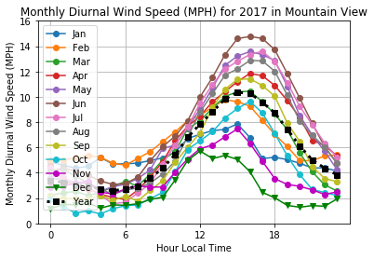
Sample: Monthly Diurnal Cycle of Wind Speed
You can do better than this. Consider to use cool color for cold months, and warm color for warmer months.

Slide 8
Part 2: sounding data
Find and download sounding data from University of Wyoming website:
http://weather.uwyo.edu/upperair/sounding.html
Choose one site you interested
Choose a place with clearly winter vs summer difference
Find data for both January and July of 2021

Slide 9
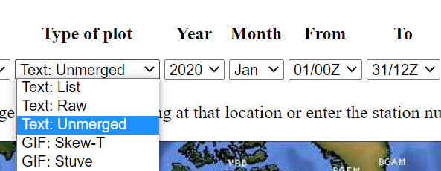
Download the data
Download the ‘Text: Unmerged’, which have data listed in different sessions.

Slide 10
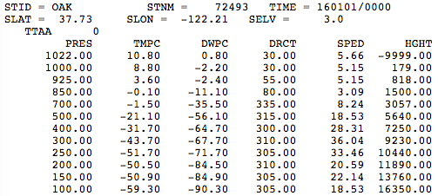
Part 2: read in ‘TTAA’ portion

Slide 11
Part 2: sounding data: Analysis & Plot
Calculate
Variables: temperature, dew point, and their difference
Monthly average for both January and July
Plot all 6 variables on the same figure
Use different colors/line styles/labels to distinguish variables (T vs Td vs T-Td) and time (Jan vs July).
Pressure as y-axis
From surface (higher pressure) to upper level (lower pressure)
Pressure decrease on log scale.

Slide 12
Part 3 NCEP data
Find and download NCEP reanalysis data
Surface air temperature monthly mean
https://www.esrl.noaa.gov/psd/data/gridded/data.ncep.reanalysis.surface.html
Choose data 10 years
See next page on years you need to cover

Slide 13
Decade you need to study
 | Decades
Jeremy | 1950-1959
Marc | 1955-1964
Kathleen | 1960-1969
Kate | 1965-1974
Christopher | 1970-1979
Joshua | 1975-1984
E’lysha | 1980-1989
Justin | 1985-1994
Tyler | 1990-1999
Kiera | 1995-2004
Derek | 2000-2009
Howard | 2005-2014
Dao | 2010-2019

Slide 14
Part 3_a
Calculate the decadal mean temperature of each month
Temperature [Jan]
= mean[Temperature[Jan, 2000:2009]]
Plot decadal monthly mean temperature
January, April, July, October

Slide 15
Part 3_b
Calculate the temperature anomaly of the 1st and 10th year of your decade.
Temp_anomaly(Jan, 2000) = Temp(Jan, 2000) –average(Temp(Jan, 2000:2009))
Plot the temperature anomaly of Jan/Jul of 1st and 10th year of your decade.

Slide 16
Part 3_c
Please visit NOAA website for Oceanic Nino Index:
https://origin.cpc.ncep.noaa.gov/products/analysis_monitoring/ensostuff/ONI_v5.php
Find the peak of warm (red) and cold (blue) month.
If it is highest in SON, then chose October.
1957, December (warmest).
1955, November (coldest).
Plot the surface temperature anomaly of that month
Calculate the temperature anomaly similarly as in Part 3_b
One plot for the warm month, one for the cold month.

Slide 17
Part3_d (graduate student only)
Get the 3D monthly mean NCEP reanalysis data of air temperature.
Calculate and plot the mean temperature at 850 hPa and 100 hPa for 1991-2020.
Jan, Jul
Calculate and plot the temperature anomaly for the warmest and coldest ONI months between 1991-2020
2015 November (warmest)
2000 January (Coldest)
https://origin.cpc.ncep.noaa.gov/products/analysis_monitoring/ensostuff/ONI_v5.php
850 hPa and 100 hPa

Slide 18
Due day
Due Mar 22, 11:59pm, Tuesday
Presentation
Mar 23, Wednesday.
10 min presentation, 5 min discussion.

Slide 19
Grads
80% about your plots
25/25/30 for part 1/2/3
70% required components
Variables, unit, title
30% clear presentation
Line style/thickness, string size, labels, colors
20% discussion
Critic of your classmates’ plots
Missing components, mistakes.
Things to improve

