Slide 1
Weekly Meeting 10/14/22
By: Jeremy Benik

Slide 2
Last Week To do
Finish up FF_med simulations
With the knowledge I have of the different wind speeds, z0, I can get the final simulation running
Test the Balbi model for backfire ROS
Complete at: https://docs.google.com/spreadsheets/d/1UyLDvxIrN9w5RV9439ka19G-Do0ME705IbqF1NmYmu4/edit#gid=0
Test the Rothermel and Balbi model for 164
In progress
Write the paper for LLNL about my progress
Begin writing my thesis
Lit review, intro, abstract, etc.
Add more points to the lower levels to force the model
5.77m winds are the most important, we can sacrifice 10 and 20 a bit
Complete

Slide 3
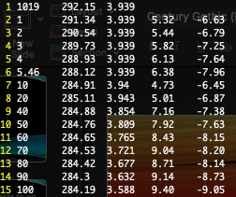
Modified Sounding
To “force” the simulation to match observations, I added in a few more levels to help push the lower levels to match observations

Slide 4
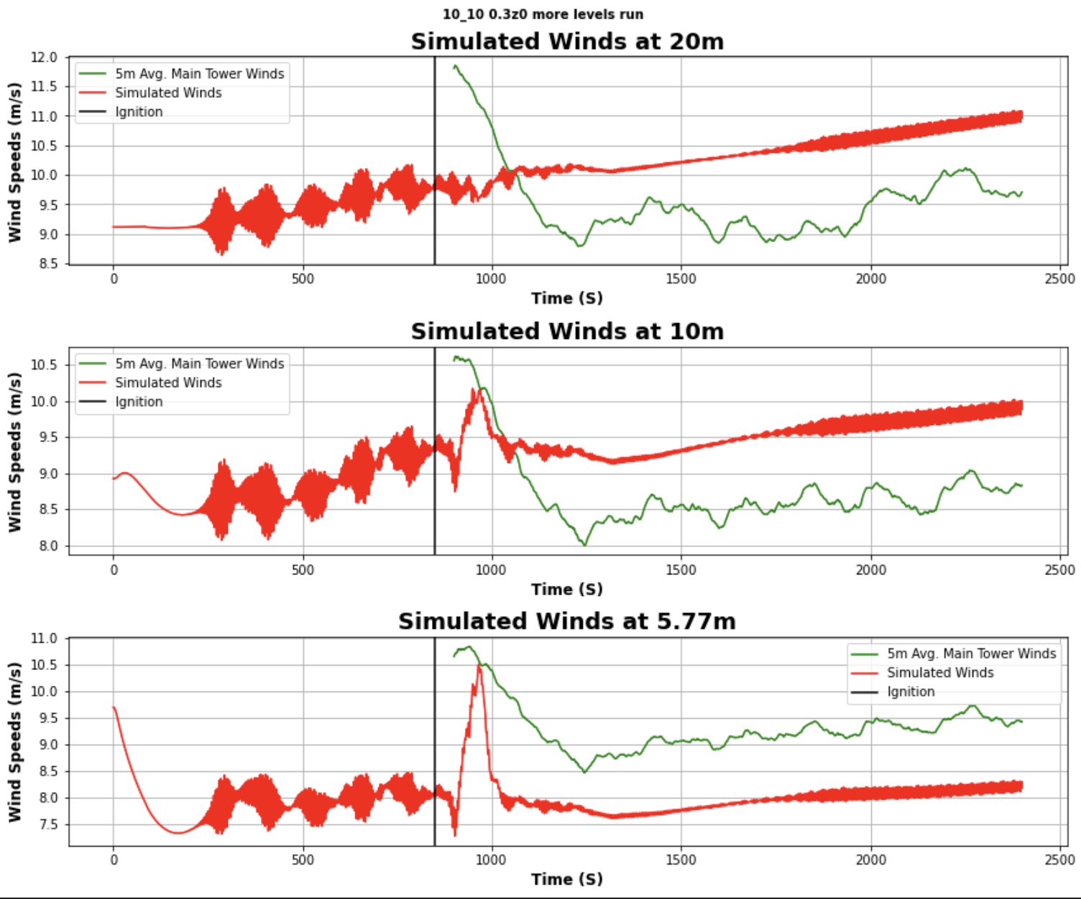
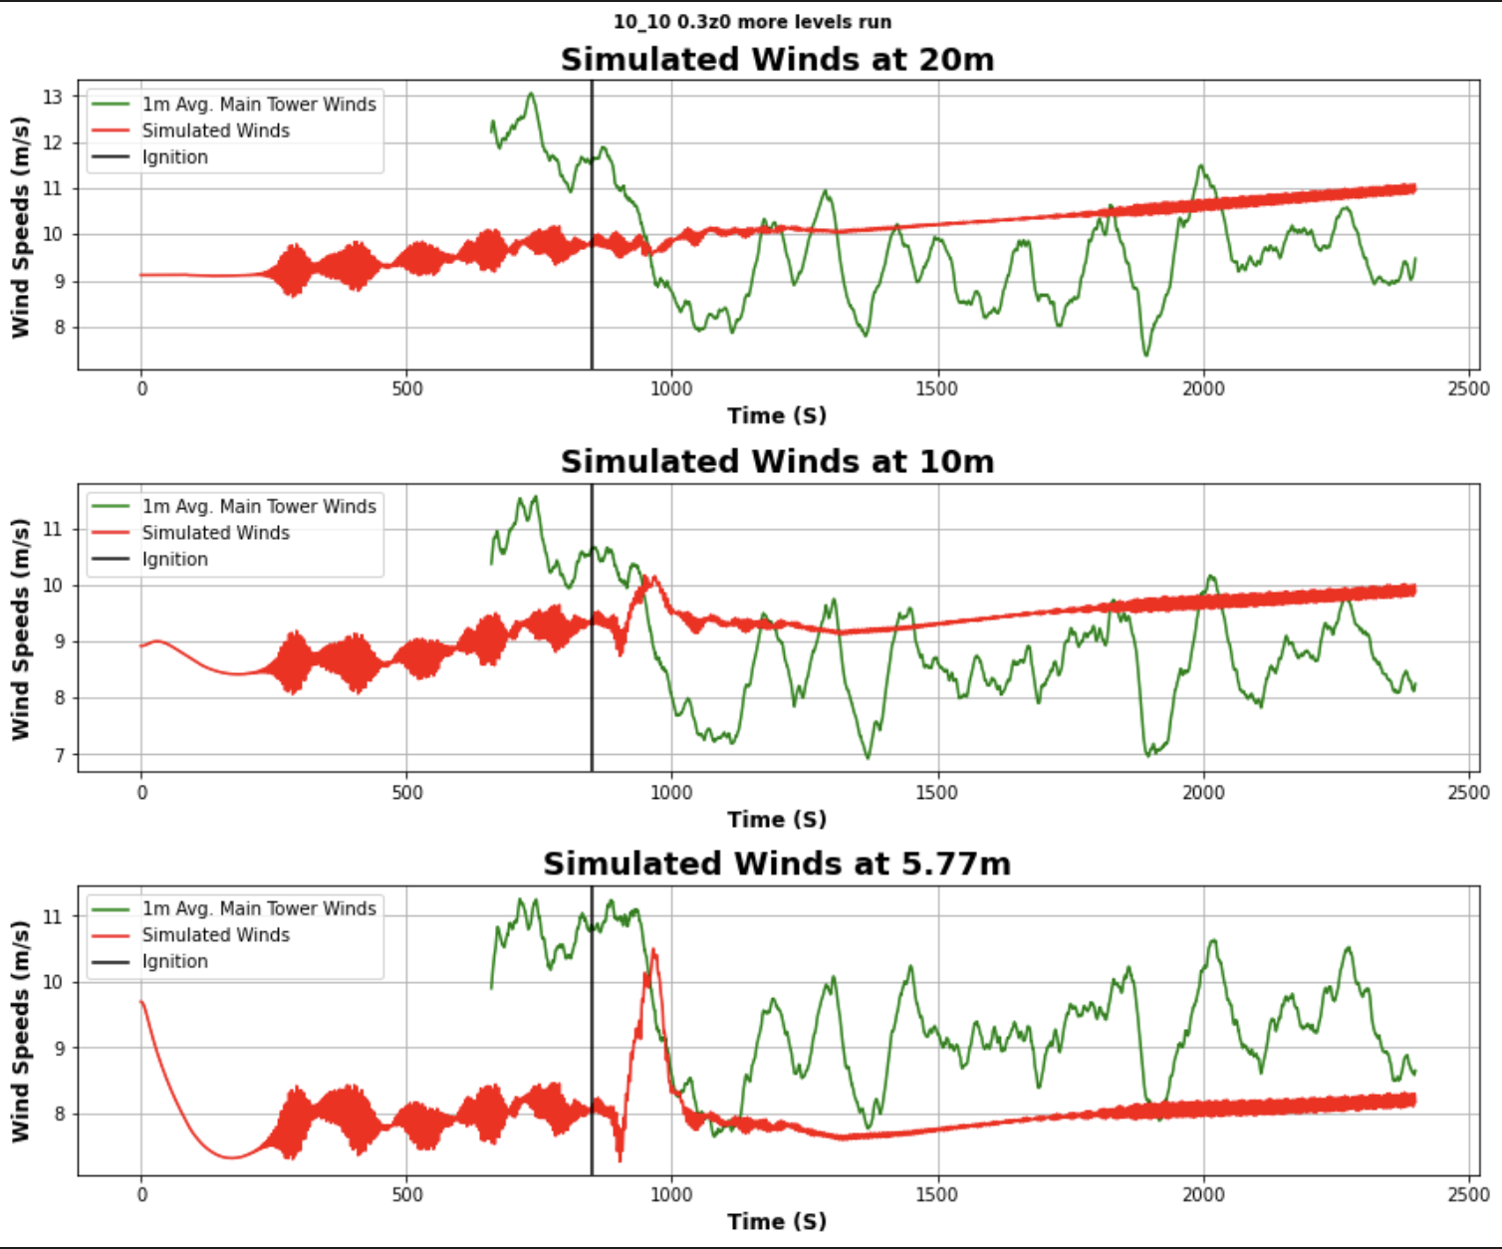
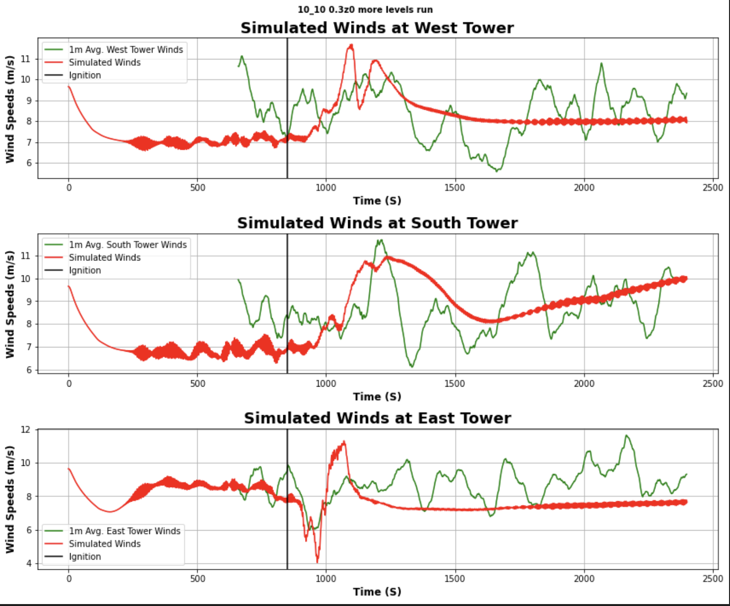
Modified Sounding Results

Slide 5
Modified sounding results
These results are definitely promising and will likely lead to the simulation matching the observations
With the “forcing”, I can much easily manipulate the wind speeds
The South, East, and West tower look really close as well which is a promising sign

Slide 6
Testing the balbi model for backfire ROS
To see how the model behaves when there are negative components as an input, I ran multiple experiments with varying wind speeds and slope
Everything from 0m/s to 10m/s and slopes varying from 0-80 degrees in both the positive and negative were tested

Slide 7
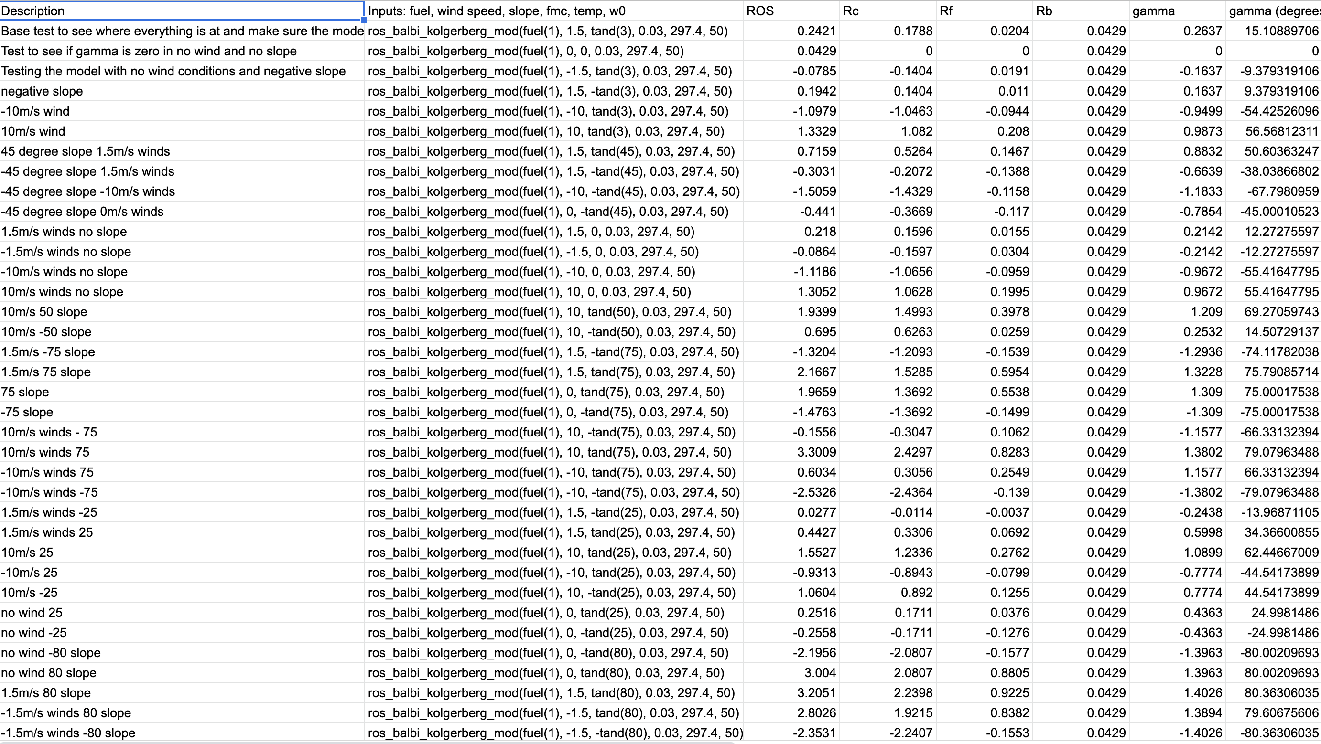
results
Here are the results of the experiment
https://docs.google.com/spreadsheets/d/1UyLDvxIrN9w5RV9439ka19G-Do0ME705IbqF1NmYmu4/edit#gid=0

Slide 8
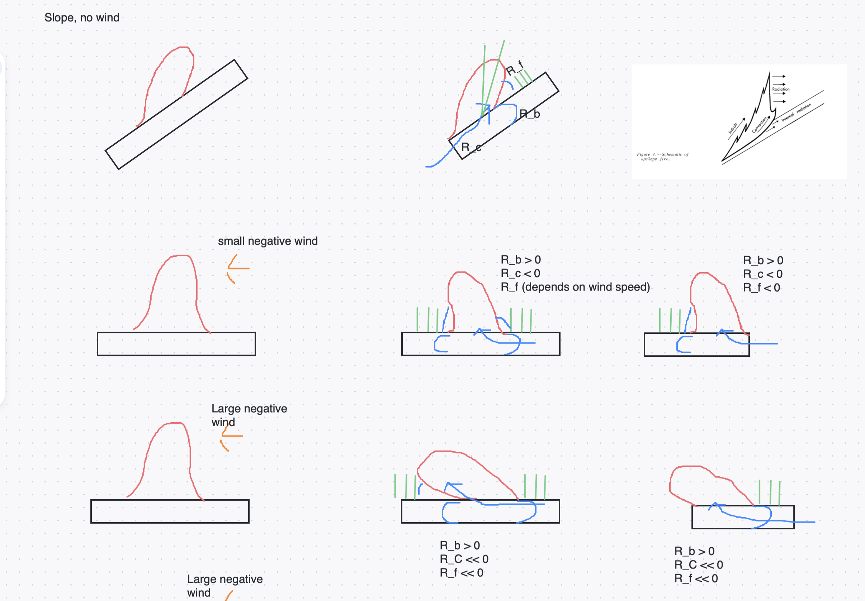
Results (conceptually)
The main question we were looking for in this spreadsheet is how do all the components react to a negative component
To attempt to figure out which part should be contributing I created a zoom whiteboard with a bunch of figures to help visualize it
https://us02web.zoom.us/wb/doc/3j-3n7GiSC23tbM_kwMk3A

Slide 9
Findings
I found that the convective component is the main contributor to the backfire ROS in the Balbi model
Conceptually, I’m not sure I agree with this as I would think the convective component wouldn’t contribute as much as it does, and I thought the flame base radiation would be the main contributor
After looking further into the code, there is a slope and wind component (along with an exponential) in the convective component so any small change there seems to get amplified

Slide 10
Priorities
Finish up FF_med simulations
With the knowledge I have of the different wind speeds, z0, I can get the final simulation running
Test the Balbi model for backfire ROS
Complete
Test the Rothermel and Balbi model for 164
Complete
Write the paper for LLNL about my progress
Begin writing my thesis
Lit review, intro, abstract, etc.
Add more points to the lower levels to force the model
Complete

Slide 11
To do
Finish up FF_med simulations
With the knowledge I have of the different wind speeds, z0, I can get the final simulation running
Test the Rothermel and Balbi model for 164
Learn about containers in Unix
Read the paper sent to me about containers
Run the hill case on the nasa cluster
Learn how to login to an interactive node
Learn how to use mpi execute commands on that cluster
Learn how to use their job submitting script
Install Anaconda on Nasa cluster
Write the paper for LLNL about my progress
Begin writing my thesis
Lit review, intro, abstract, etc.

