Slide 1
LLNL Presentation 9/2/22
By: Jeremy Benik

Slide 2
Outline
FireFlux_med simulation with a different roughness length and 5m wind speed
Statistics comparing the new simulation with previous simulations and the input_sounding
New FireFlux_med simulation with another change to roughness length and an increase in 5m wind speed
Comparison of the simulations

Slide 3
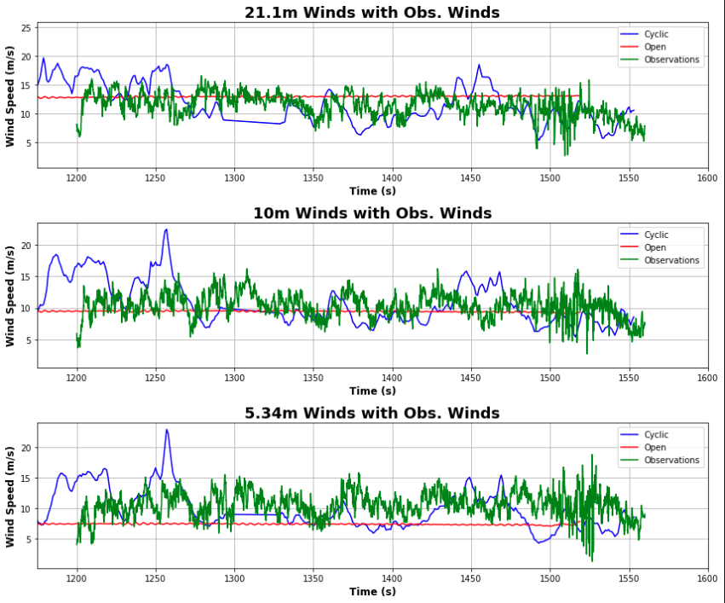
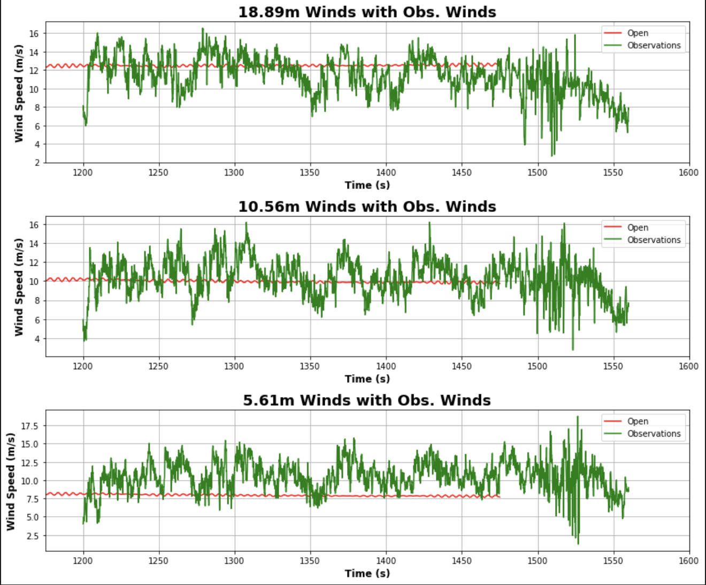
New input_sounding and z0 Comparison
Base Run (0.5 z0 and observations for sounding)
New Run (0.4 z0 and 1m/s added to 5.46m in sounding)

Slide 4
Statistics
For the new simulation, I decreased the z0 by .1 (0.4 instead of 0.5), and I increased the overall wind speed at 5.46m by 1m/s
Old sounding and z0
New sounding an z0
Input_sounding
Height | Wind Speed
21.1m | 12.81
10m | 9.50
5m | 7.41
Height | Wind Speed
22m | 13.11
10m | 10.17
5m | 8.12
Height | Wind Speed
20m | 11.91
10m | 10.61
5.46m | 9.15
Something to keep in mind, the levels are different since the heights vary with the simulations
Just focusing on the 5m winds here, these changes increased the winds by about 0.71

Slide 5
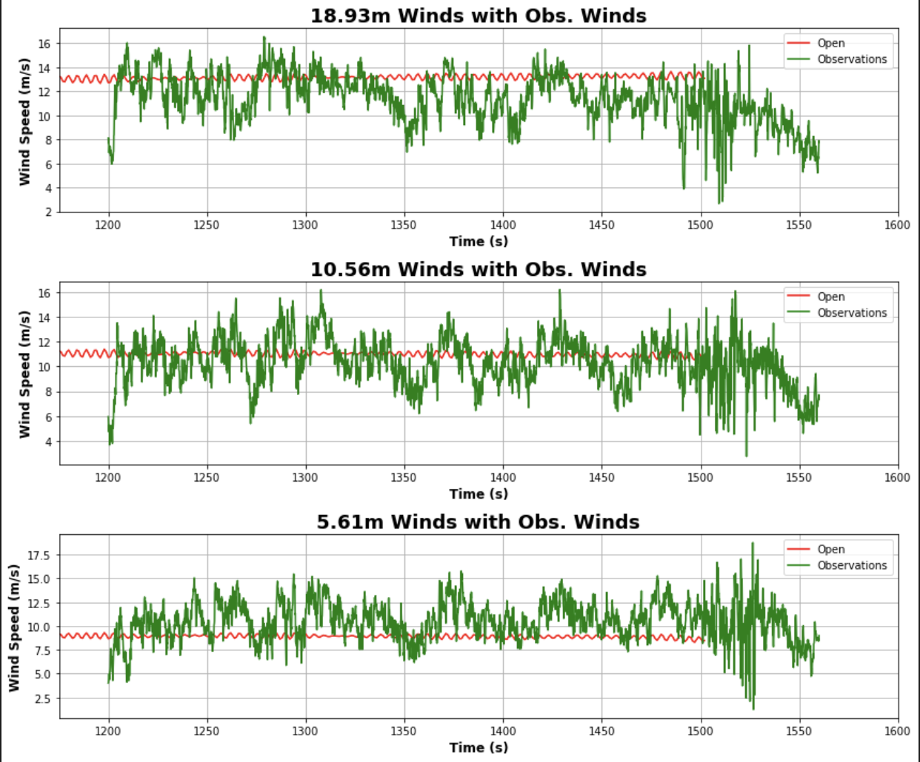
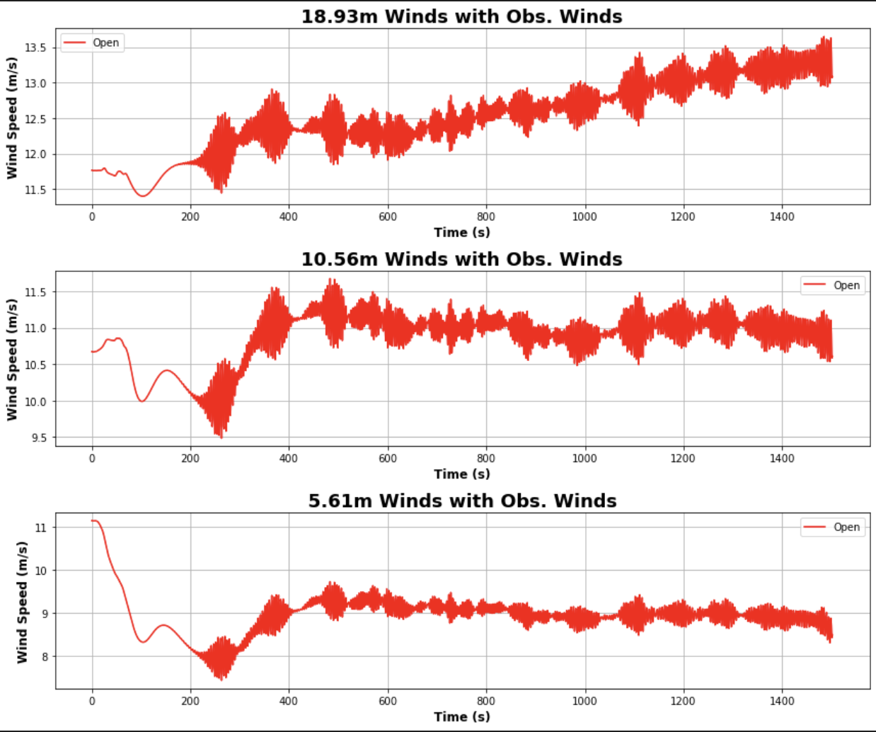
New z0 and input_sounding
1m/s added to the already modified 5.46m winds and 0.3 z0

Slide 6
New z0 and input_sounding
This last run proved promising since the 5m winds are close to the average observed values
One change is the 20m winds
Before the winds decreased with time, however these winds increased with time

Slide 7
Comparing runs
0.3 z0
0.4 z0

