Slide 1
Weekly Meeting 08/12/22
Jeremy Benik

Slide 2
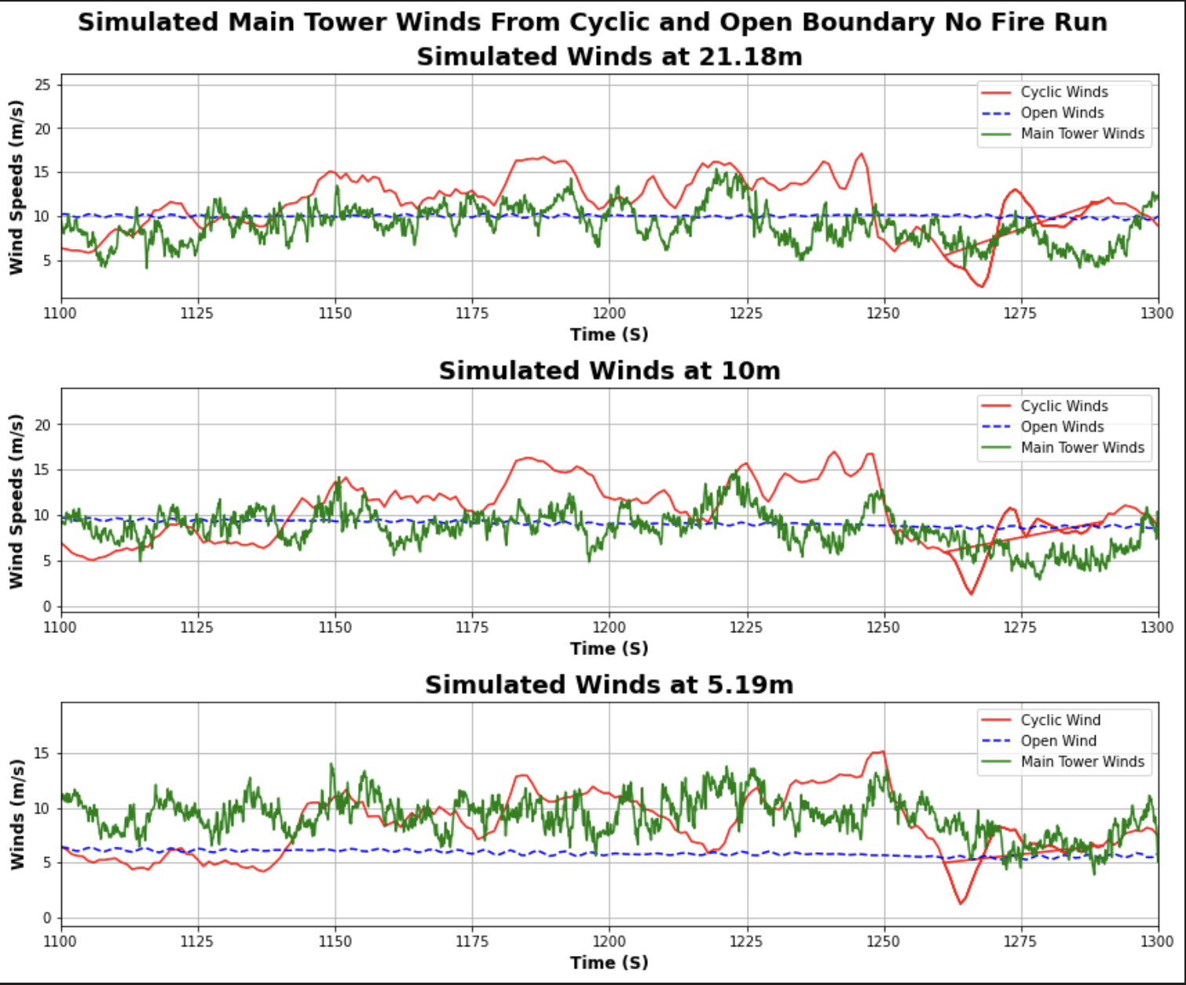
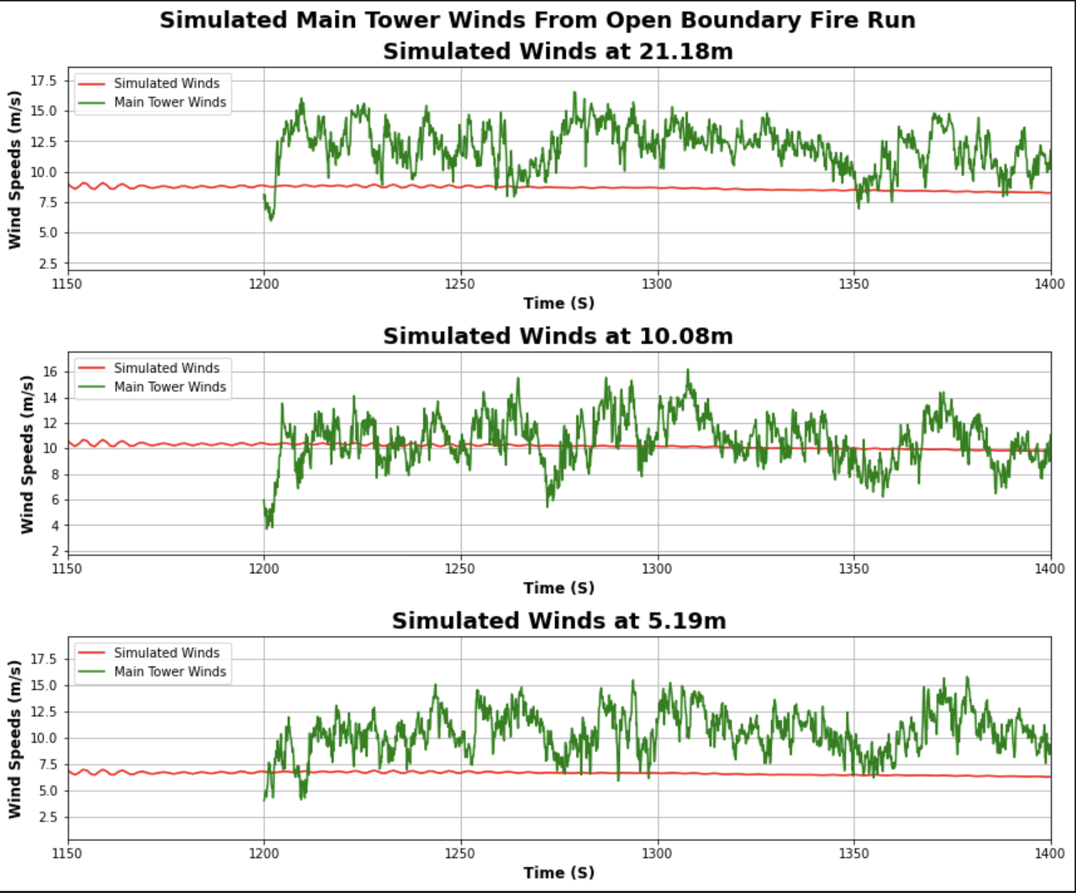
Original sounding
New Sounding
Values
Obs 20m at 1200s: 10.074452838740177
Obs 10m at 1200s: 9.176949384190804
Obs 5.77m at 1200s: 7.578555271290169
Model 20m at 1200s: 9.839414
Model 10m at 1200s: 9.047514
Model 5.19m at 1200s: 5.77198
Values
Model 20m at 1200s: 8.861061
Model 10m at 1200s: 10.399845
Model 5.19m at 1200s: 6.771331

Slide 3
Closer look at the data
With the new sounding, I increased the 20m and all the measurements below 10m by 2m/s (account for direction as well), and the 10m wind by 1m/s since it was already close to the observations. With increasing winds at 10m, It increased the winds by 1.3 m/s, below 10m, 3m increase yielded a 1m/s increase, and 20m yielded a 1m/s increase
With this knowledge, to reach the observations, I will need to increase the base winds by about 6m/s from the baseline, the 10m winds I will need to decrease slightly (closer to 0.25 m/s increase), and the 20m winds I may need to increase them further or decrease them further to see results.
Values
Obs 20m at 1200s: 10.074452838740177
Obs 10m at 1200s: 9.176949384190804
Obs 5.77m at 1200s: 7.578555271290169
Model 20m at 1200s: 9.839414
Model 10m at 1200s: 9.047514
Model 5.19m at 1200s: 5.77198
Values
Model 20m at 1200s: 10.975852
Model 10m at 1200s: 10.399845
Model 5.19m at 1200s: 6.771331

