Slide 1
Weekly Meeting 10/21/22
By: Jeremy Benik

Slide 2
Last Week To do
Learn about containers in Unix
Read the paper sent to me about containers
Compile WRF-SFIRE on nasa server
In progress
Install Anaconda on Nasa cluster
In progress
Write the paper for LLNL about my progress
In progress
Begin writing my thesis
Lit review, intro, abstract, etc.
Run the 10_11 simulation on Cheyenne
Complete, however I’ve been unable to access it due to the maintenance
Setup FF2 simulation for Backfire ROS for Jan on Cheyenne
In progress. Cheyenne was down for maintenance

Slide 3
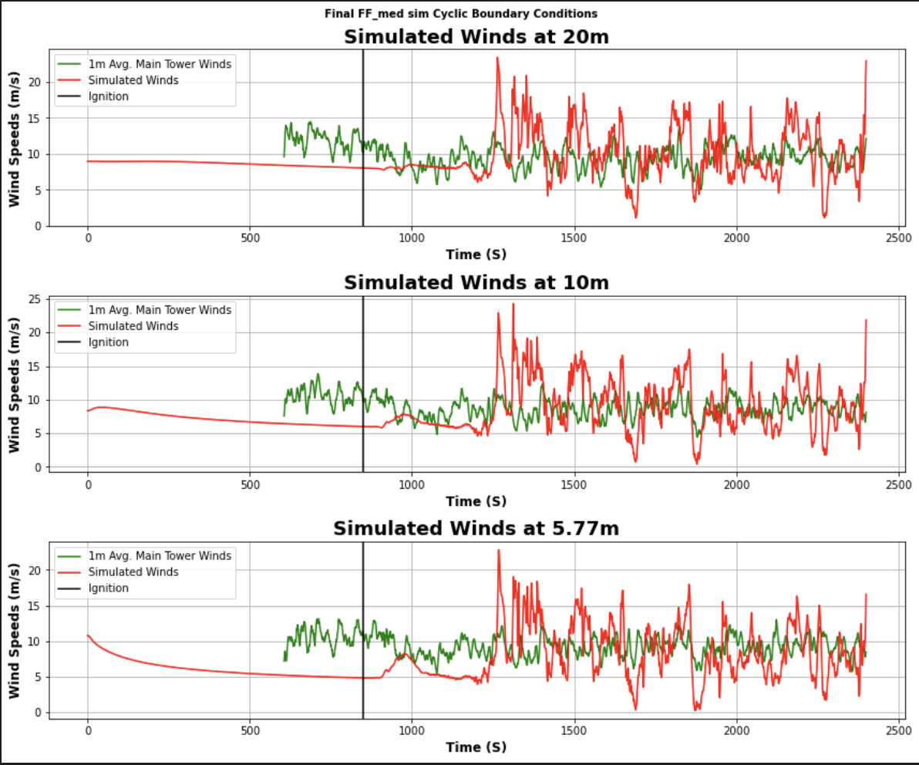
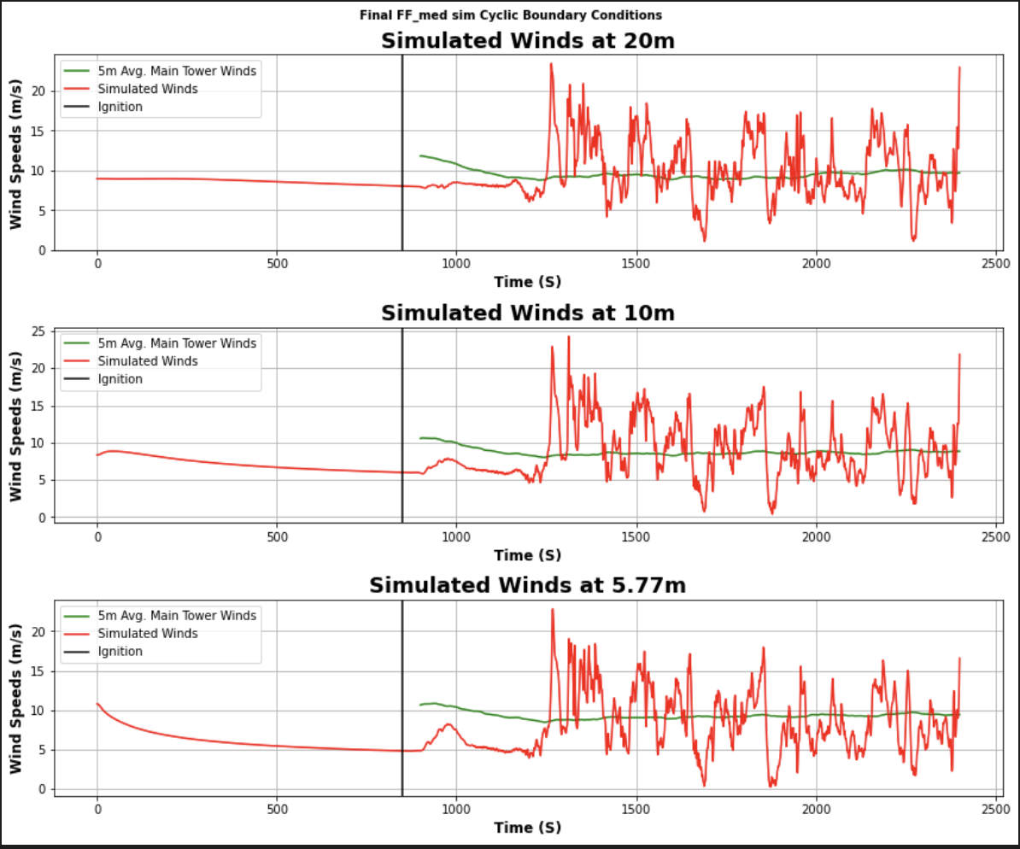
Cyclic Boundary conditions

Slide 4
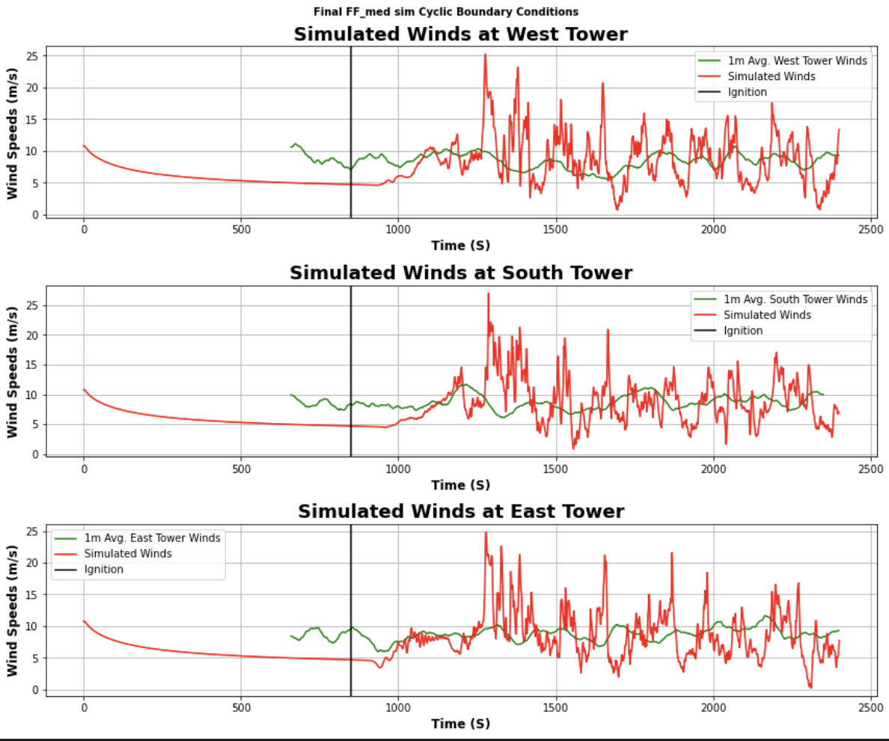
Cyclic Boundary conditions

