Slide 1
Weekly Meeting 11/04/22
By: Jeremy Benik

Slide 2
Tasks for Last Week
Compare the thermocouple data to the simulation
Complete
Perform an in-depth analysis on the 2009 Balbi paper (like what we did in our meeting Aurélien)
Learn about LaTeX
Complete
Analyze the wind speeds from the 10m and 5m resolution simulations
Analyze the fire-induced circulations at the head fire (using the main tower and East tower)
Look at flanks/backfire of the burn (wind speed, temperature, ROS)

Slide 3
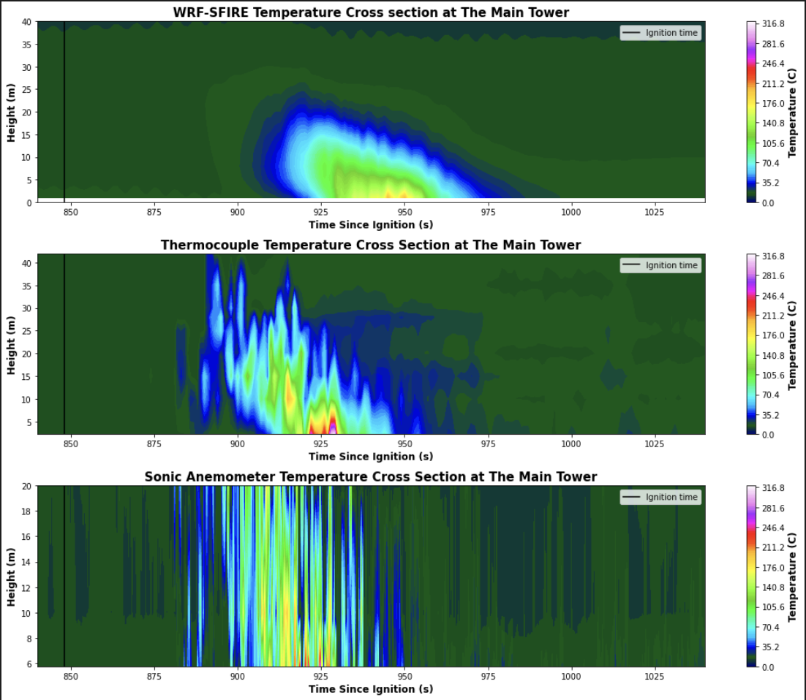
Compare the Thermocouple data to the simulation

Slide 4
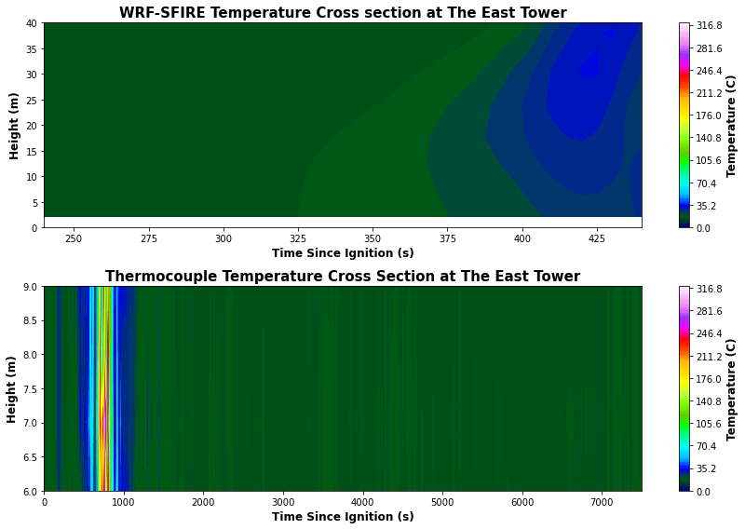
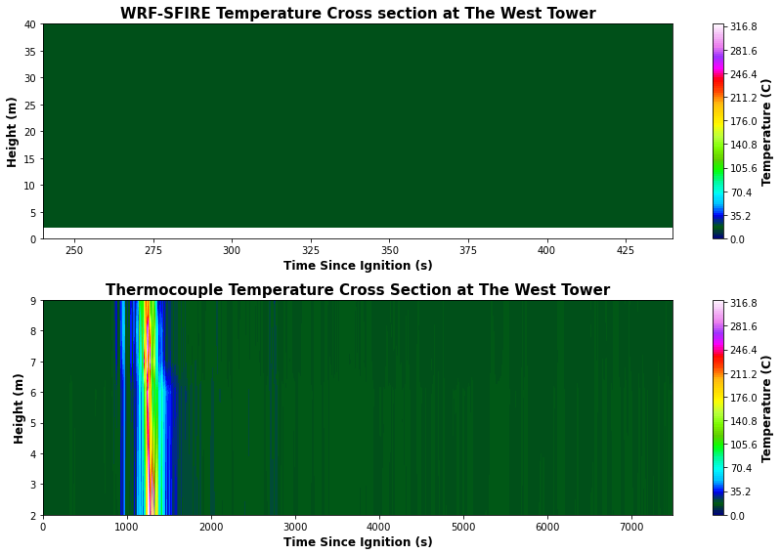
Compare the Thermocouple data to the simulation

Slide 5
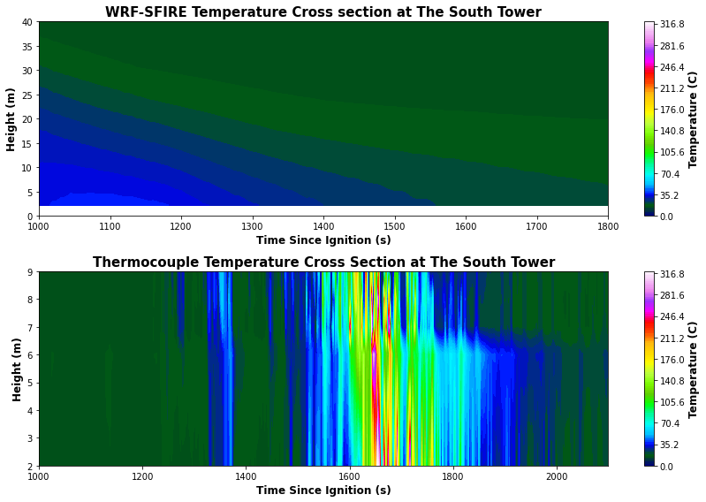
Compare the Thermocouple data to the simulation

Slide 6
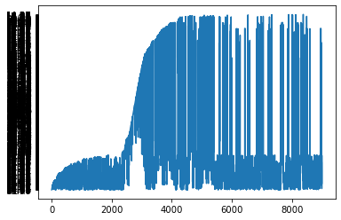
Problems with tc data
A lot of the lower level data contains NAN values, which produces plots that look like
I have tried to remove the nan values but I’m not sure if this data can be used so I left it out for now

Slide 7
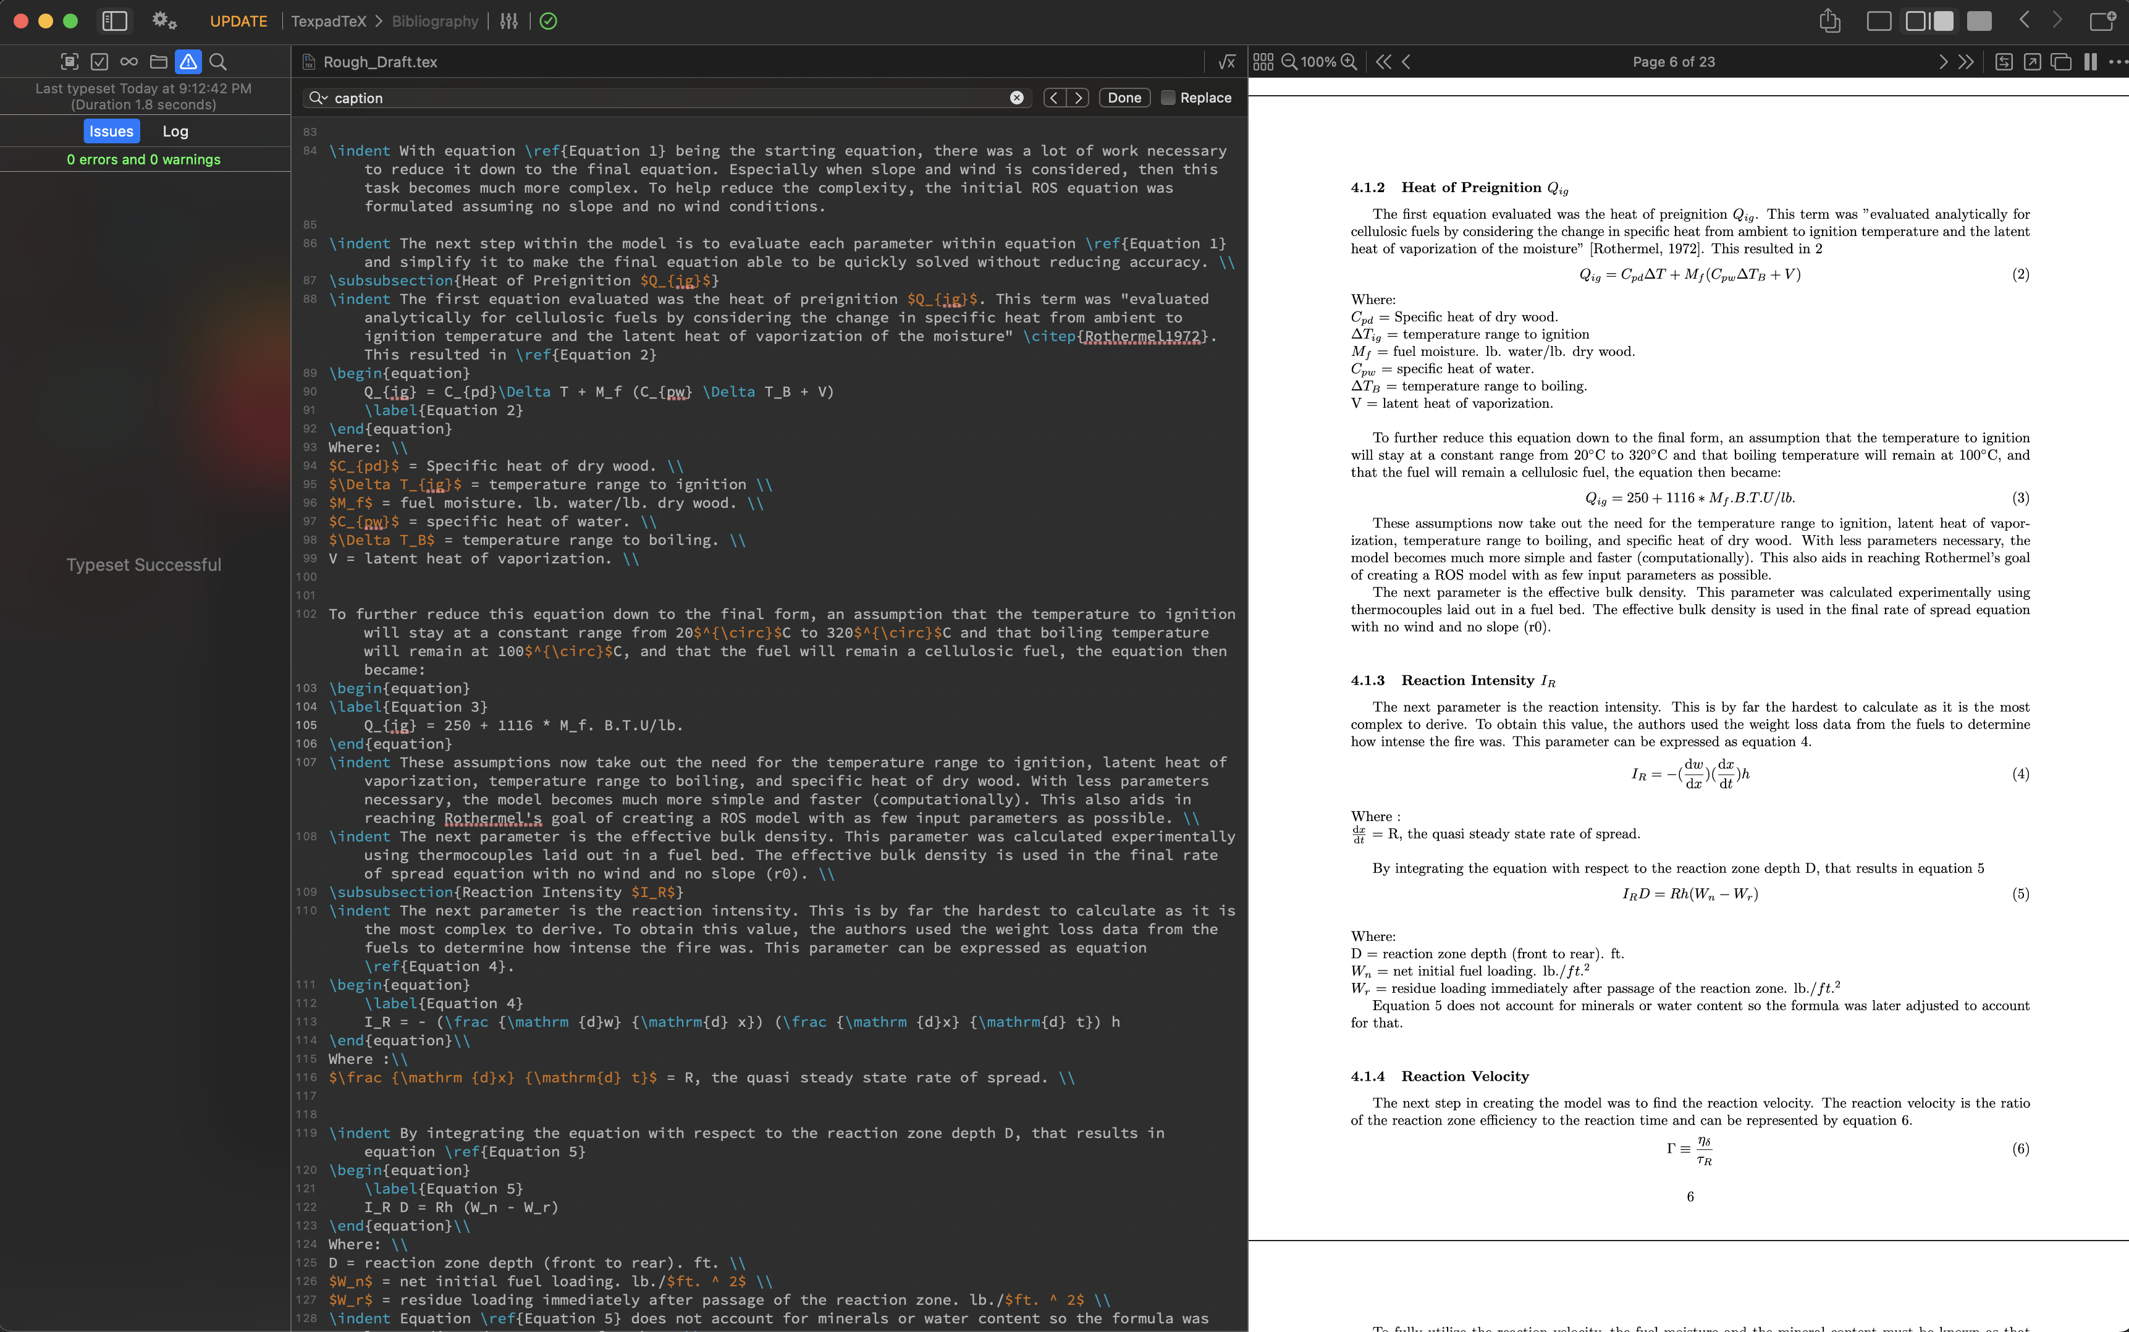
Progress on LaTex
In my meeting with Aurélien, he showed me latex and I really wanted to learn it since it looked more professional
With the recent 164 project, I decided to write it all in latex

Slide 8
Nasa server
I was limited by the number of files in my nobackupp10 directory (it was mainly due to anaconda)
WPS_GEOG was also becoming a problem since it too has a lot of files
I moved a bunch of files to my swbuild directory in hopes I could relieve my nobackupp10 directory but this didn’t work
I emailed support and within the same day I got my quota increased to 900000 files
As a result, I should be able to start building wrfxpy
I removed anaconda and installed miniconda as well and I put that on my home since that’s currently empty

Slide 9
Tasks for next week
Perform an in-depth analysis on the 2009 Balbi paper (like what we did in our meeting Aurélien)
Analyze the wind speeds from the 10m and 5m resolution simulations
Analyze the fire-induced circulations at the head fire (using the main tower and East tower)
Look at flanks/backfire of the burn (wind speed, temperature, ROS)
Begin working on nasa server now that I have more storage

