Slide 1
Weekly meeting 09/09/22
By: Jeremy Benik

Slide 2
Last week to do
Read paper about Rothermel
Write report on pressure sensors
Waiting for final FF2 simulation before I can write the report
Add SODAR Data to the sounding
completed
Get final ff2 simulation
In progress
Compute ROS with Rothermel model
In progress
Compute ROS with Balbi model (once that’s implemented)
Make powerpoint about Balbi paper
Play with w_0 in balbi model
Run a case and change that and see what we get

Slide 3
Adding sodar data to sounding
To add the SODAR data to the sounding, I created a plot of the potential temperature and mixing ratio from 20m to 260m
With this plot I linearly fit the missing values
With these values, I input them into the input_sounding file
To decrease the upper level wind speeds, I decreased the upper level winds by 1m/s (accounting for direction)
I used matlab for this process as zooming in graphs is much easier on that platform

Slide 4
Adding sodar data to sounding

Slide 5
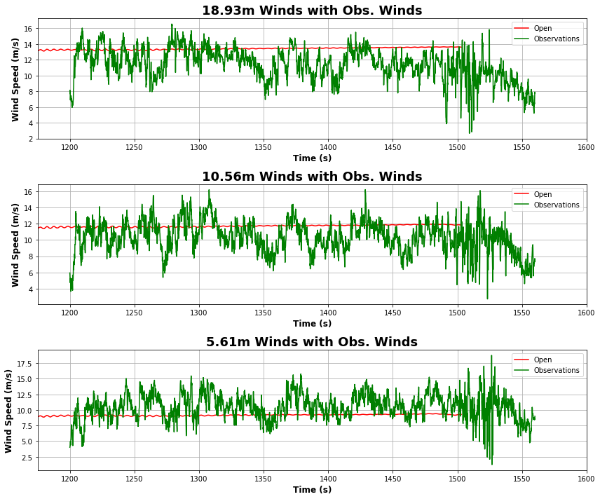
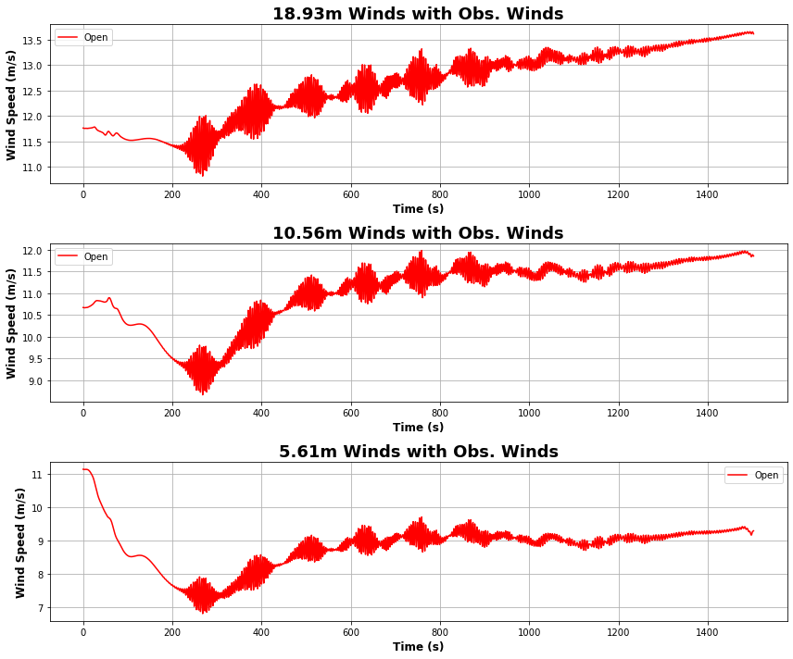
New sim with SODAR data

Slide 6
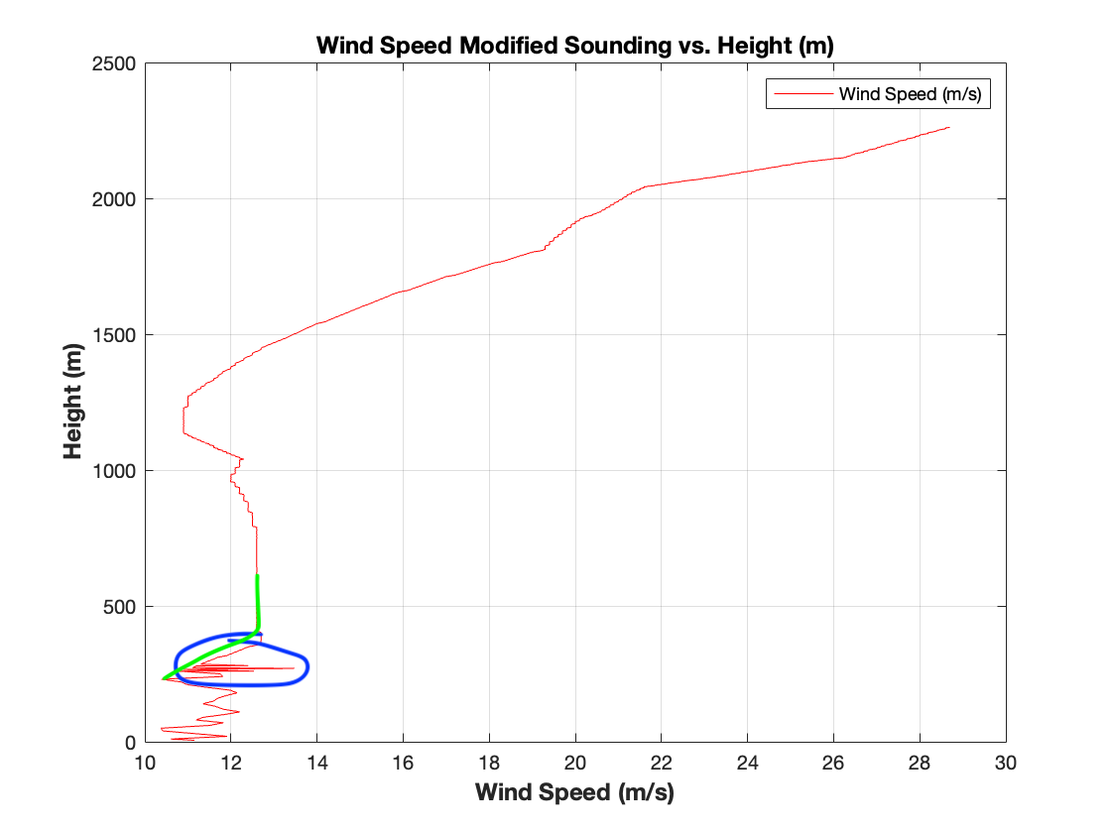
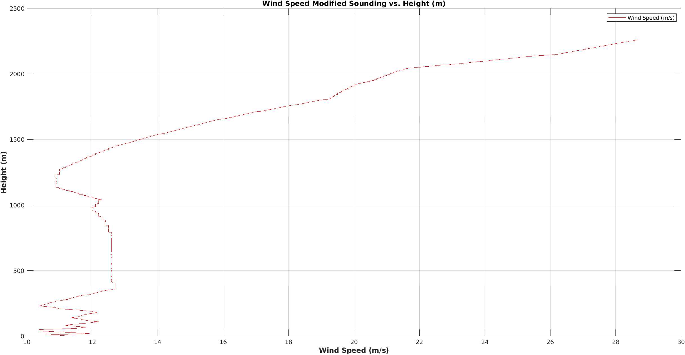
Smoothing out sodar data
In the input_sounding, the SODAR data had a few rough spots where the wind speeds changed rapidly with height

Slide 7
Simulation with modified sodar data
With the new smoothed out SODAR data, I ran another simulation and this simulation is by far the best simulation we currently have
I’m still not satisfied with the 18.89m winds as they still increase with time, but the graph is much smoother, and the change isn’t as drastic as the previous simulations

Slide 8
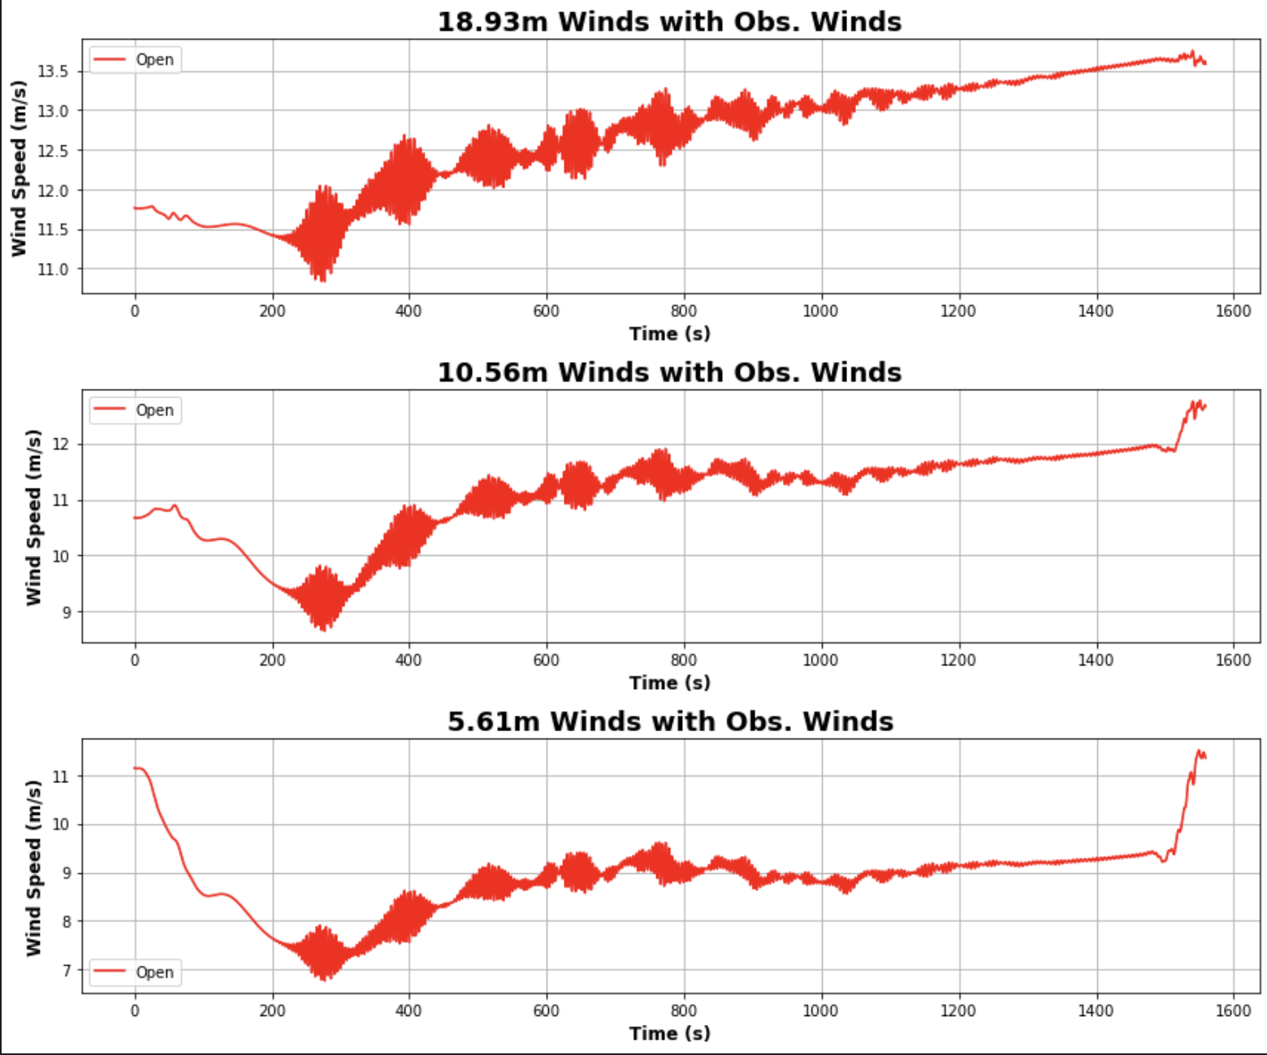
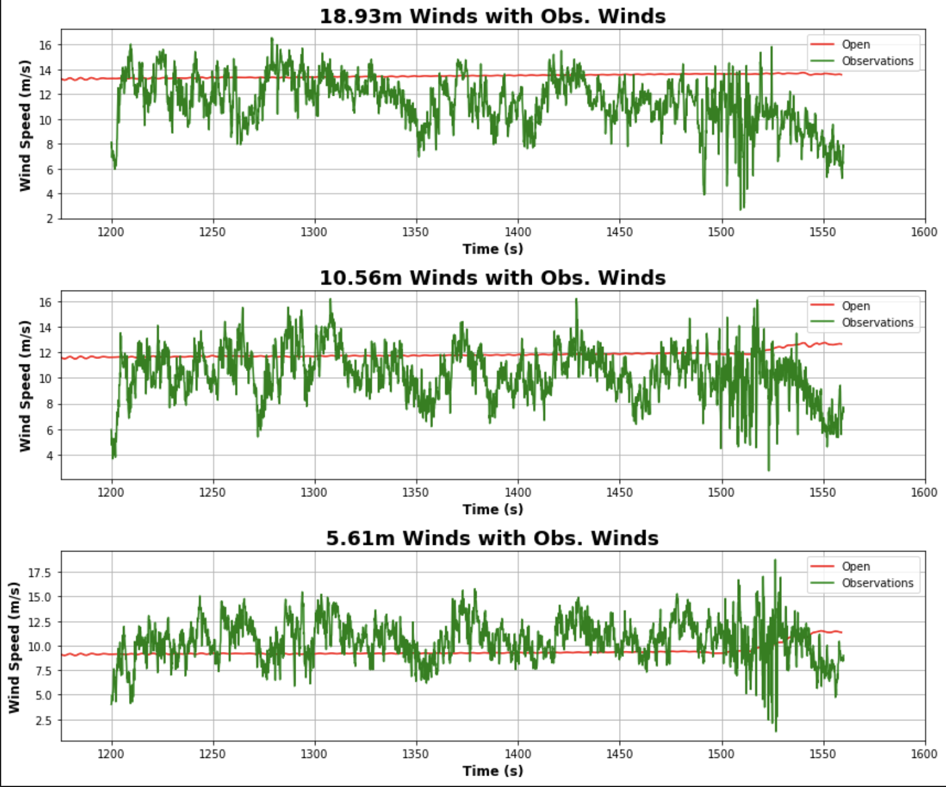
Simulation with modified sodar data

