Slide 1
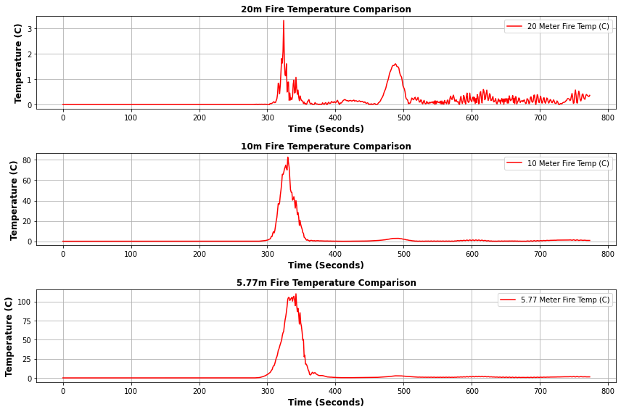
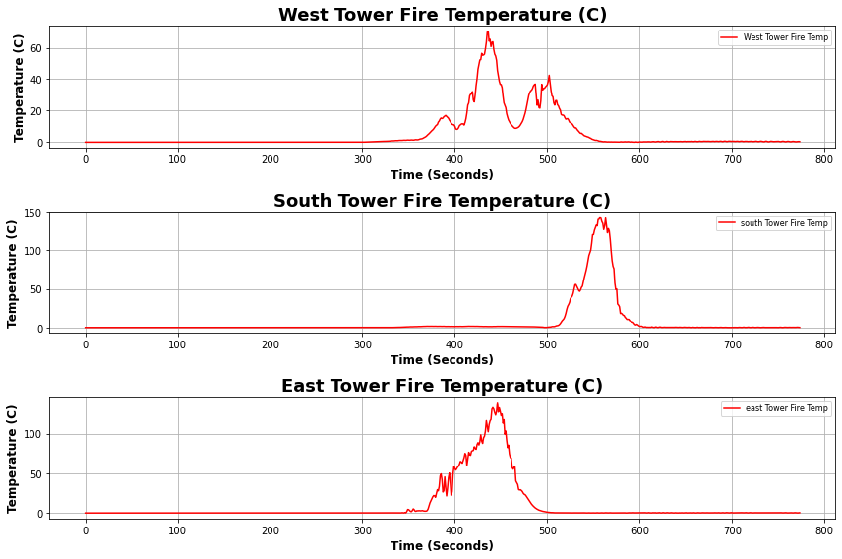
Temperature
Main Tower
Short Towers
With the main tower being hit by the head of the fire, it experienced much hotter temperatures than that of the flanks
The highest temperature recording occurred at 5.77m and decreased with height
The short towers experienced different levels of heat exposure from the fire
The East tower likely got hit by the head of the fire and the West tower and South Tower were both on the Flanks of the fire
The South tower was hit much later in the burn so the fire may have been hotter by then or slight wind shifts caused the increase in temperature

Slide 2
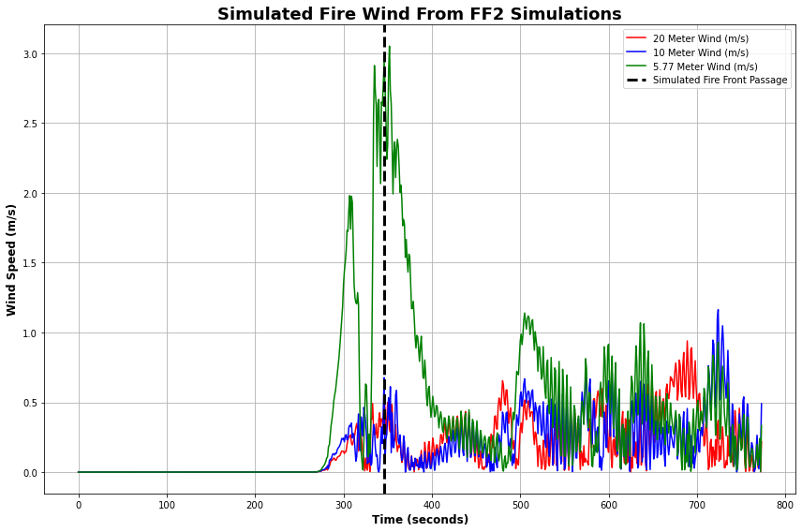
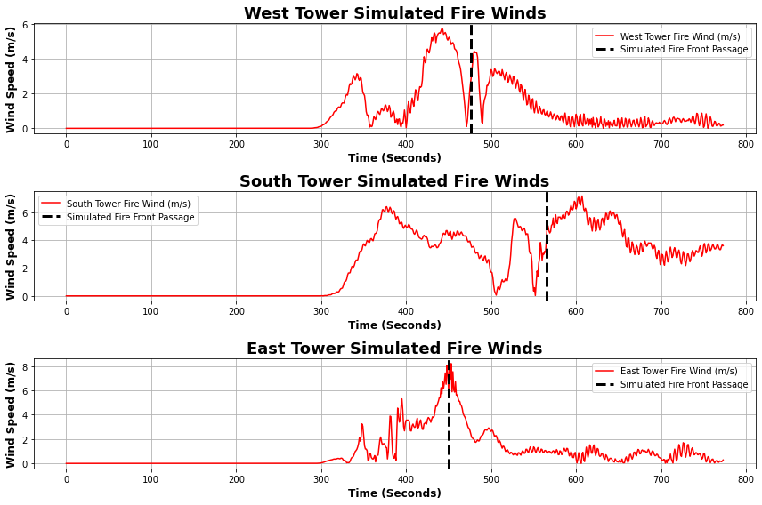
Winds
Short Towers
Main Tower
The lower levels of the Main tower saw the largest increase in fire induced winds with firefront passage
As heights increase, the fire-induced winds decrease
The tower (East Tower) hit by the head fire had much higher fire-induced winds than those that were hit by the flanks with nearly 2m/s differences

Slide 3
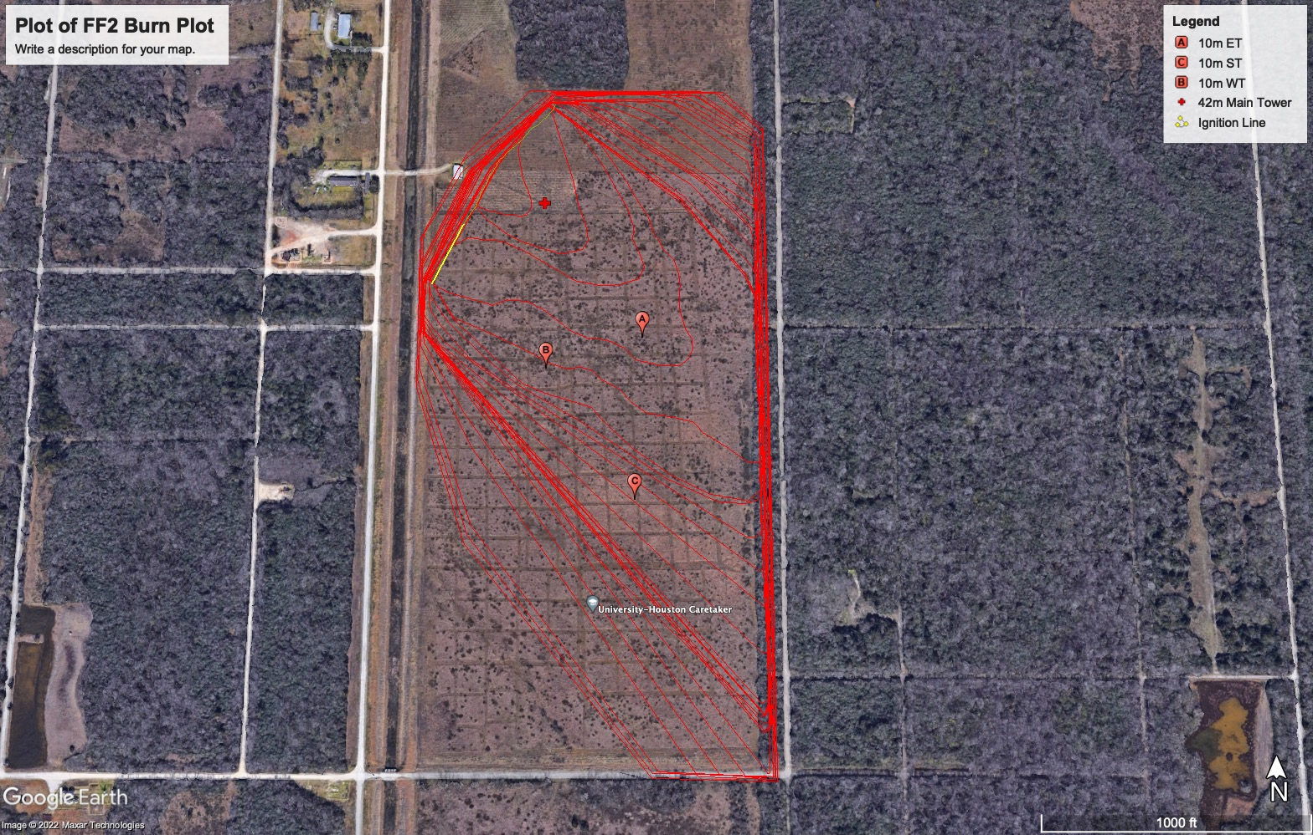
Google Earth Burn Plot Image

