Slide 1
Weekly Meeting 08/26/22
By: Jeremy Benik

Slide 2
Last week to do
Write my abstract
Submitted
Finish Z_0 calculation
Finished and implemented
Modify the input_sounding
Verify the wrfinput file
Run the new sounding with open and cyclic boundary conditions
Both fire_atms = 0
Waiting for z_0 calculation and modifying sounding
Interpolate pot. temperatures for the SODAR data for the sounding
SODAR data doesn’t have any temperature data, it’s all 999.99
Finish powerpoint for Jan
In progress and can be found at:
Write report on pressure sensors
Waiting for final FF2 simulation before I can write the report

Slide 3
Abstract
Analysis of Fire-Induced Circulation during the FireFlux 2 Experimental Burn
Jeremy Benik, Adam Kochanski, Angel Farguell Caus, Jeff Mirocha
Despite the recent increase in fire activity associated with larger and more intense fires, the fire-atmosphere mechanisms that lead to fast propagating wildfires are not being systematically studied. This knowledge gap adversely affects fire management through surprising civilian fire management crews when wildland fires propagate unexpectedly fast. In this work, we utilized observational data and numerical simulations performed with a coupled fire-atmosphere model WRF-SFIRE. This data comes from the FireFluxII prescribed burn which occured in Texas in 2013. There were multiple sensors within the burn plot that provided data of the fire micrometeorology impacted both by the ambient conditions and the fire activity itself. However, this data did not allow us to quantify the effects of the fire atmospheric interactions itself. We analyzed how fire presence impacted local micrometeorology and how the fire behaved without atmospheric interactions by comparing simulations with and without fire-atmosphere feedback. This data allowed us to quantify the fire impact on local circulations along the head versus the flanks. We found the fire-induced winds differed from the flanks to the head of the fire. The flanks measured stronger fire-induced winds compared to the head fire.

Slide 4
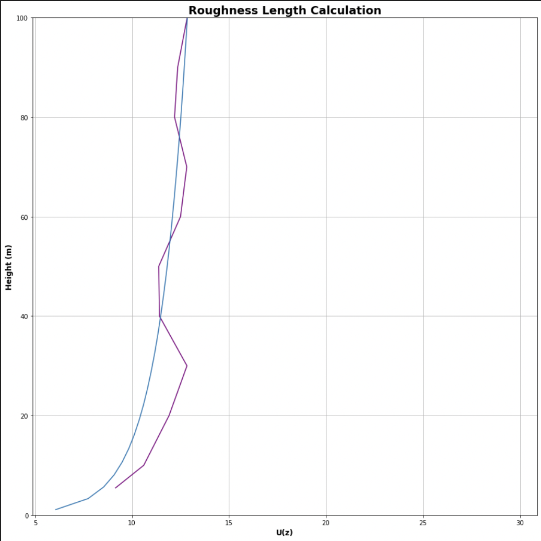
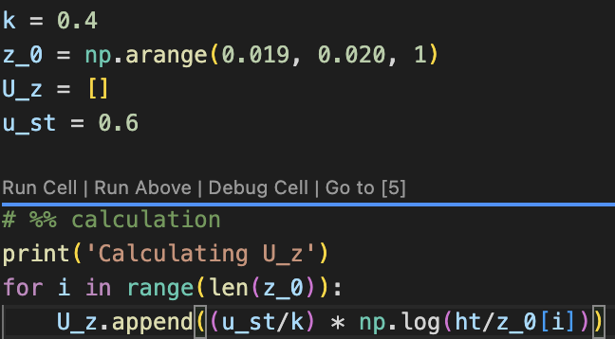
Z_0 calculation
Using the equation, I condensed the z_0 down to the line that fits the input_sounding profile the best
I added in my calculation as well

Slide 5
Questions for Adam
Show him excel sheet
Show him checking z_0 code /home/jbenik/FireFlux2/Codes_and_Data/Codes/wrf_codes/checking_z0.py
Show him my calculations (line 32 and 33)
Explain how I calculated z_0
Where do we go from here?
Should I run a new simulation with the base sounding since we have updated the z_0 in the winter section?
Should I change the z_0 since it seems like it’s hovering around 0.02?

Slide 6
To do
Run the new sounding with open and cyclic boundary conditions
Both fire_atms = 0
Interpolate pot. temperatures for the SODAR data for the sounding
Finish powerpoint for Jan
Write report on pressure sensors
Waiting for final FF2 simulation before I can write the report

