Slide 1
Weekly Meeting 09/02/22
By: Jeremy Benik

Slide 2
Last Week to do
Modify the input_sounding
Add SODAR data to it
Interpolate the temperatures and mixing ratios
Finish powerpoint for Jan
Completed: It can be found at: https://github.com/Jeremy-Benik/Meeting_Notes/blob/main/Presentations/Adjustment_Factors.pptx
Write report on pressure sensors
Waiting for final FF2 simulation before I can write the report
Fix the VPN (It was giving me a weird error and it took me all day Wednesday to fix the issue)
Abstract for 164
Completed
Read 2022 Balbi Paper
Completed
If you want a small presentation of the paper, please let me know and I would be happy to make one
Read Rothermel Paper
In progress

Slide 3
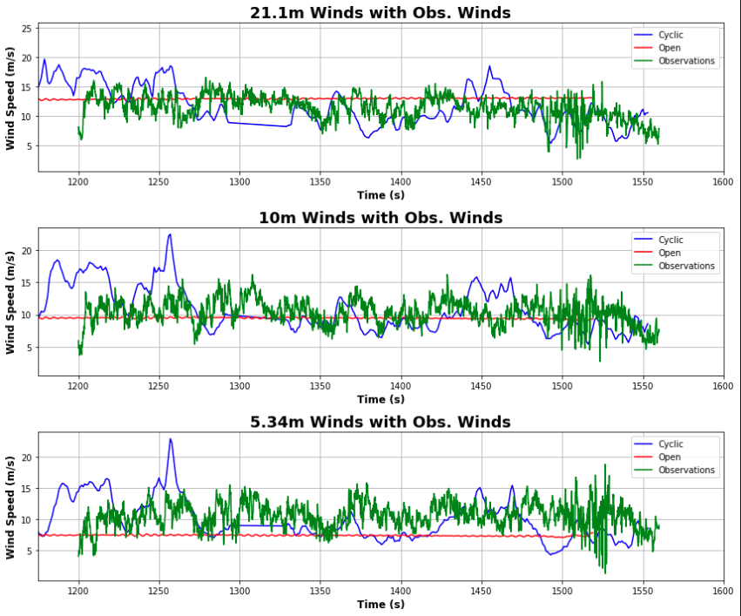
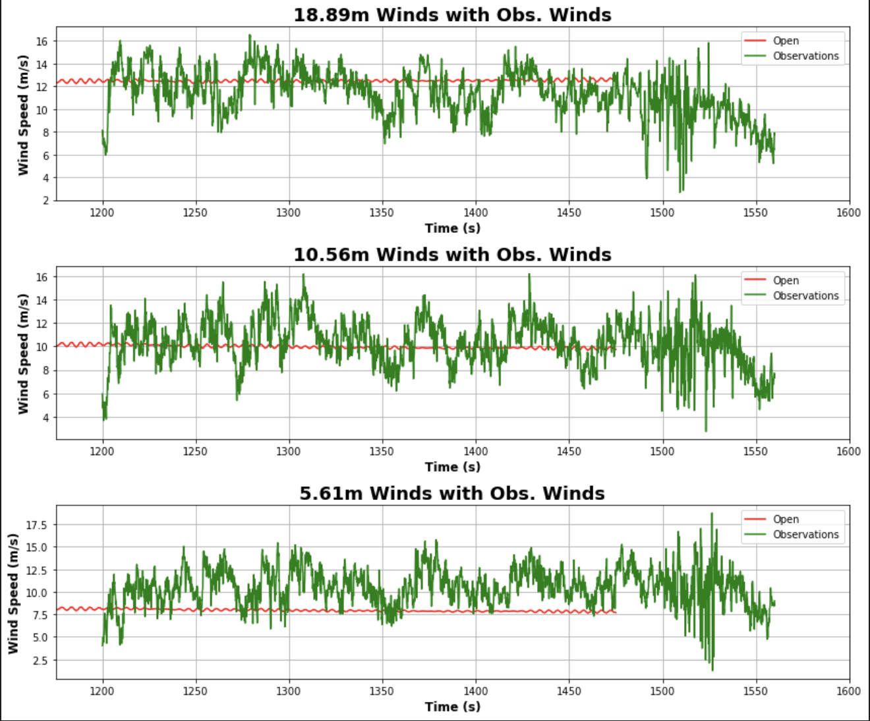
New input_sounding and z0 Comparison
Base Run (0.5 z0 and observations for sounding)
New Run (0.4 z0 and 1m/s added to 5.46m in sounding)

Slide 4
Statistics
For the new simulation, I decreased the z0 by .1 (0.4 instead of 0.5), and I increased the overall wind speed at 5.46m by 1m/s
Old sounding and z0
New sounding an z0
Input_sounding
Height | Wind Speed
21.1m | 12.81
10m | 9.50
5m | 7.41
Height | Wind Speed
22m | 13.11
10m | 10.17
5m | 8.12
Height | Wind Speed
20m | 11.91
10m | 10.61
5.46m | 9.15
Something to keep in mind, the levels are different since the heights vary with the simulations
Just focusing on the 5m winds here, these changes increased the winds by about 0.71

Slide 5
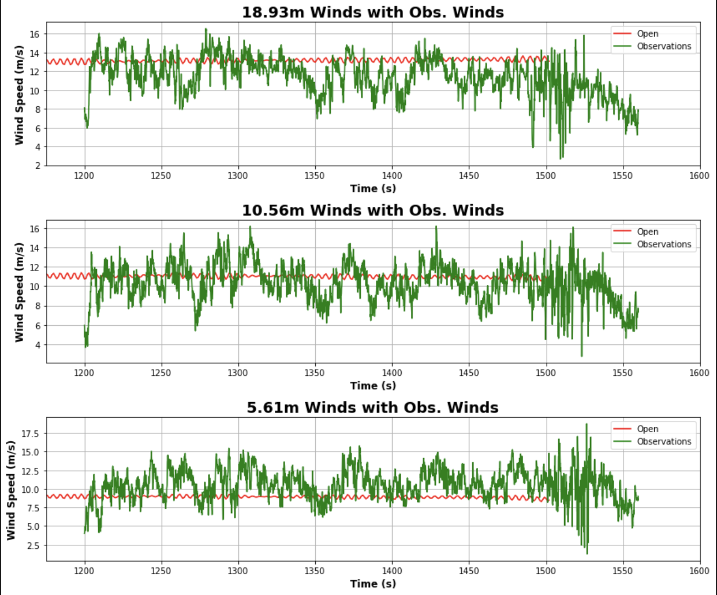
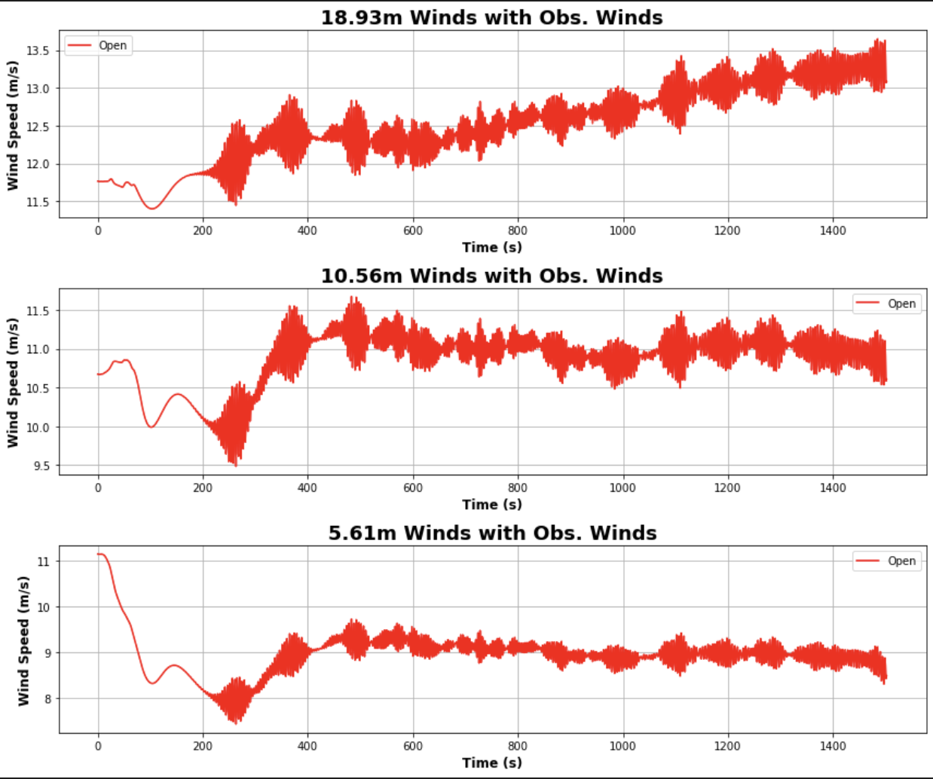
New z0 and input_sounding
1m/s added to the already modified 5.46m winds and 0.3 z0

Slide 6
Statistics
For the new simulation, I decreased the z0 by .1 (0.4 instead of 0.5), and I increased the overall wind speed at 5.46m by 1m/s
Old sounding an z0
New sounding and z0
Input_sounding
Height | Wind Speed
22m | 13.11
10m | 10.17
5m | 8.12
Height | Wind Speed
22m | 13.56409
10m | 11.05
5m | 8.97
Height | Wind Speed
20m | 11.91
10m | 10.61
5.46m | 9.15
Something to keep in mind, the levels are different since the heights vary with the simulations
Just focusing on the 5m winds here, these changes increased the winds by about 0.71

Slide 7
New z0 and input_sounding
This last run proved promising since the 5m winds are close to the average observed values
One change is the 20m winds
Before the winds decreased with time, however these winds increased with time

Slide 8
Comparing runs
0.3 z0
0.4 z0

Slide 9
Interpolating SODAR data
To interpolate the data, I took the average of the first and last points before the empty values and filled the data with that

Slide 10
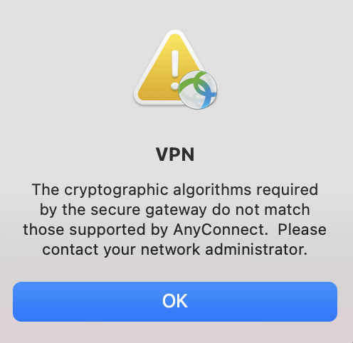

VPN Access
With the vpn ”outage” that took about a day to fix
Turns out my windows machine has the old url that worked
For anyone experiencing this issue, you must have asm- added to the url

Slide 11
To DO
Read Rothermel Paper
Write report on pressure sensors
Waiting for final FF2 simulation before I can write the report
Add SODAR Data to the sounding
Get final ff2 simulation
Compute ROS with Rothermel model
Compute ROS with Balbi model (once that’s implemented)
Make powerpoint about Balbi paper if Dr. Kochanski wants me to
This is necessary for thesis
Play with w_0 in balbi model
Run a case and change that and see what we get

