Slide 1
Weekly meeting 09/09/22
By: Jeremy Benik

Slide 2
Last week to do
Read paper about Rothermel
Working on balbi PowerPoint then I will read this
Write report on pressure sensors
In progress
Add SODAR Data to the sounding
completed
Get final ff2 simulation
Done, currently running
Compute ROS with Rothermel model
In progress
Compute ROS with Balbi model (once that’s implemented)
Make powerpoint about Balbi paper
In progress
Play with w_0 in balbi model
Run a case and change that and see what we get
Done

Slide 3
Adding sodar data to sounding
To add the SODAR data to the sounding, I created a plot of the potential temperature and mixing ratio from 20m to 260m
With this plot I linearly fit the missing values
With these values, I input them into the input_sounding file
To decrease the upper level wind speeds, I decreased the upper level winds by 1m/s (accounting for direction)
I used matlab for this process as zooming in graphs is much easier on that platform

Slide 4
Adding sodar data to sounding

Slide 5
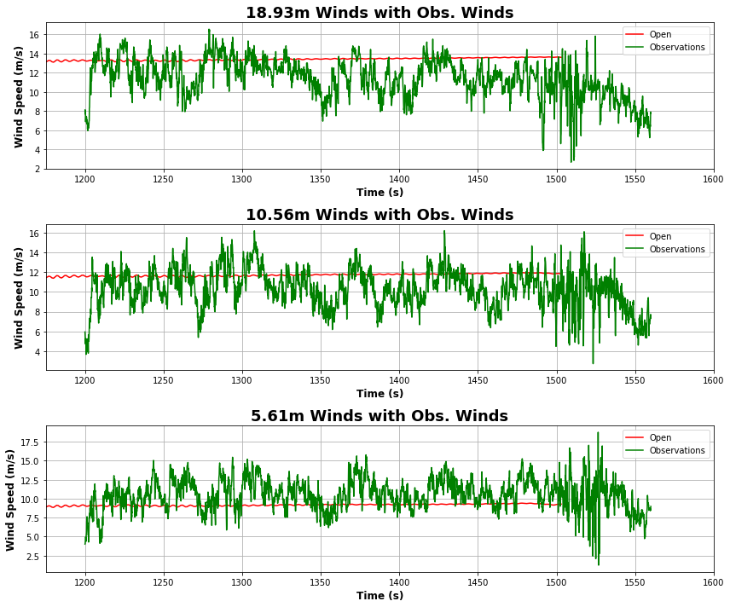
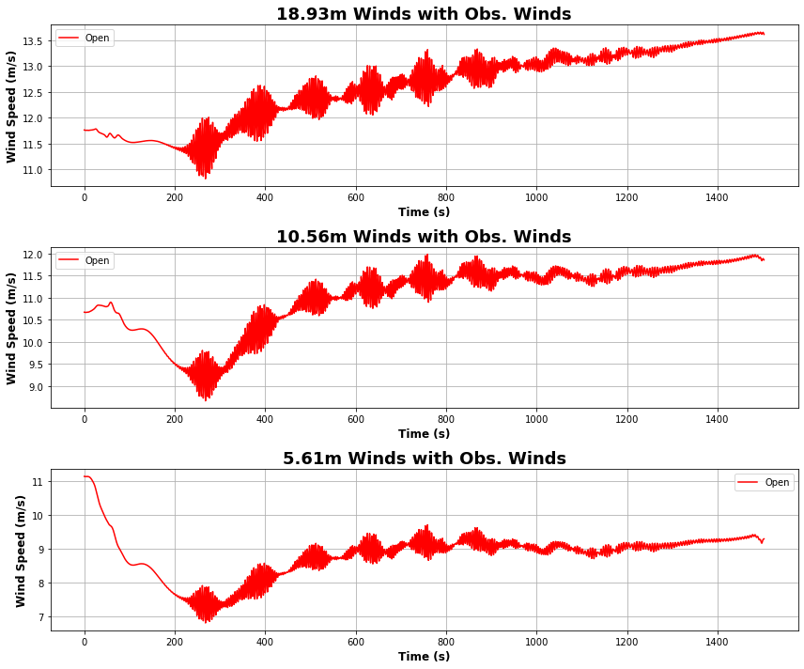
New sim with SODAR data

Slide 6
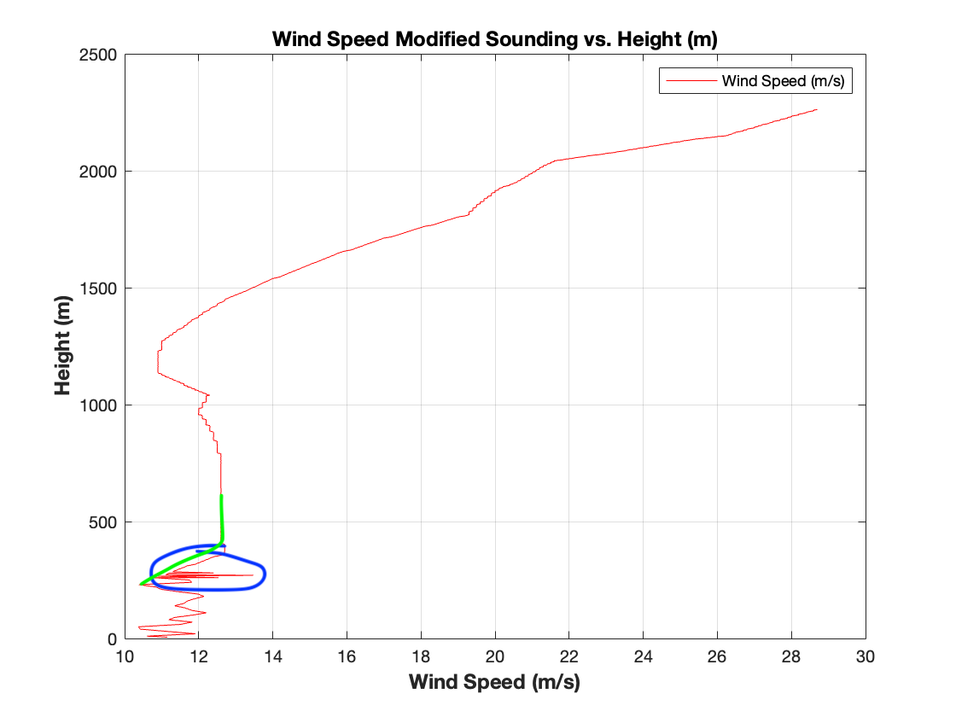
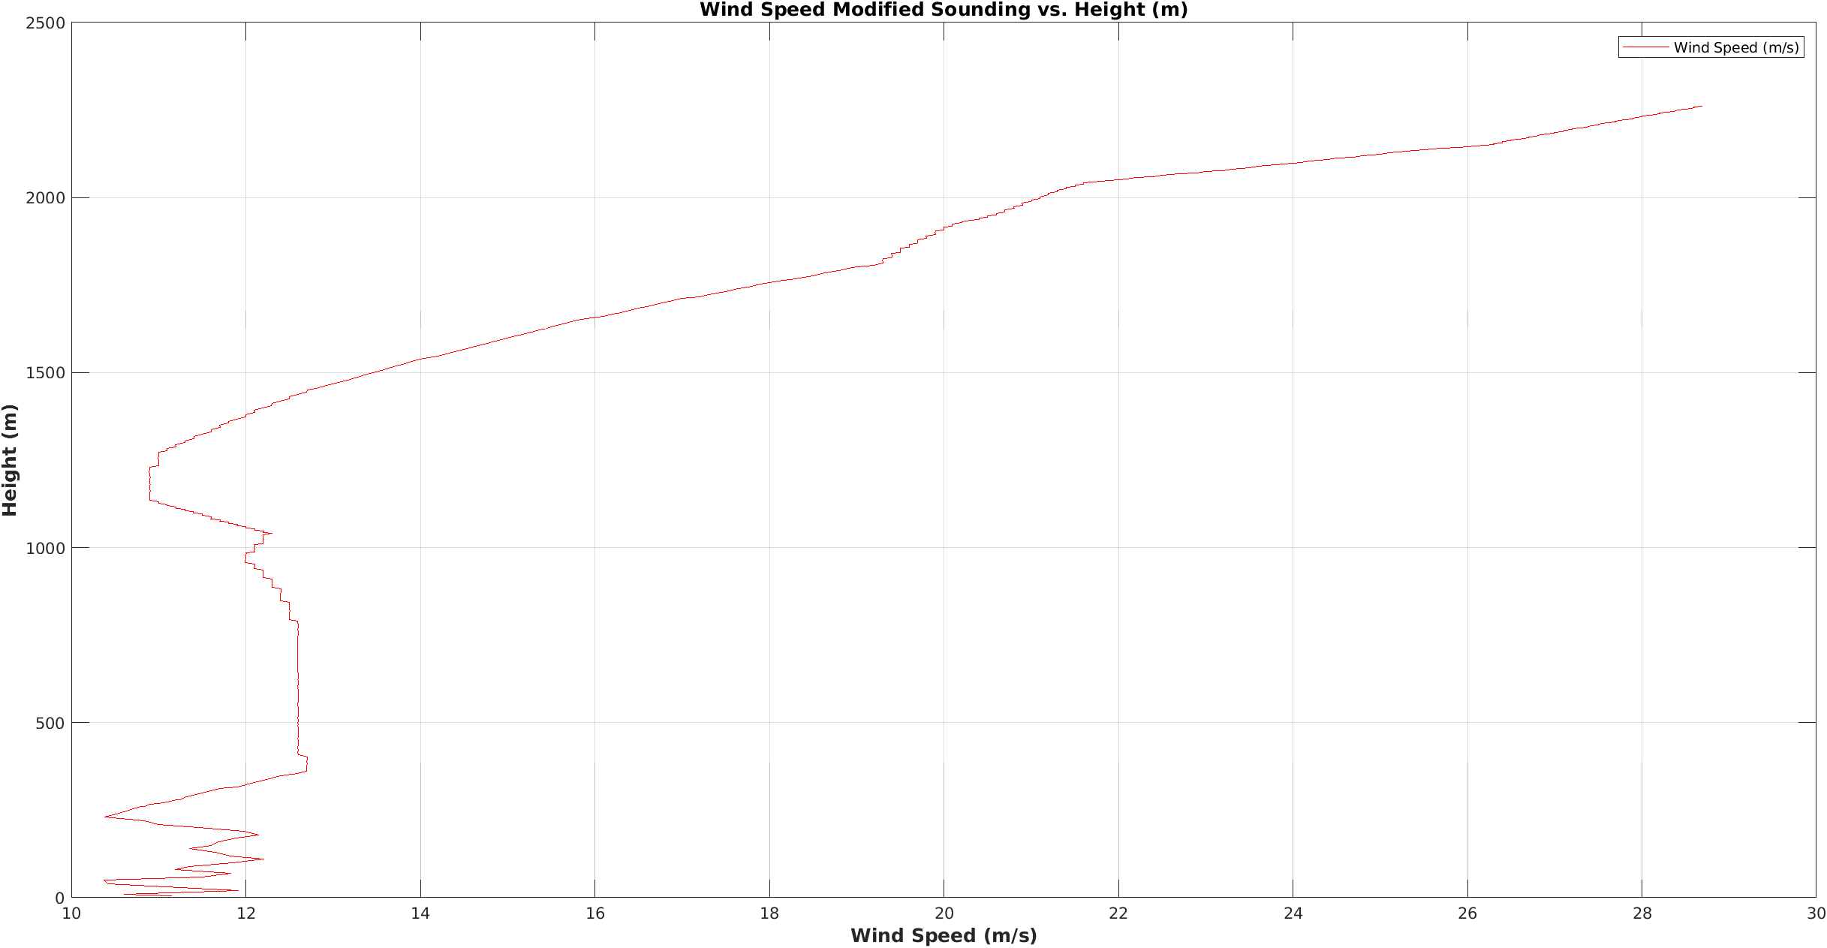
Smoothing out sodar data
In the input_sounding, the SODAR data had a few rough spots where the wind speeds changed rapidly with height

Slide 7
Simulation with modified sodar data
With the new smoothed out SODAR data, I ran another simulation and this simulation is by far the best simulation we currently have
We noticed 600 seconds into the simulation may be a point to start the run, so the namelist.input was adjusted (along with the ignition times) to change the initialization to 600 seconds instead of 1200

Slide 8
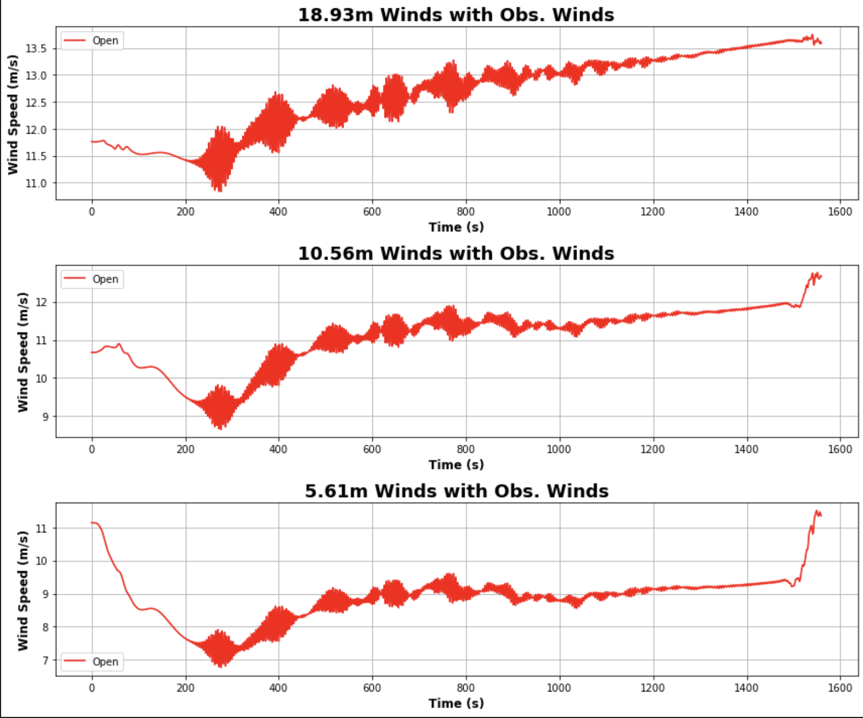
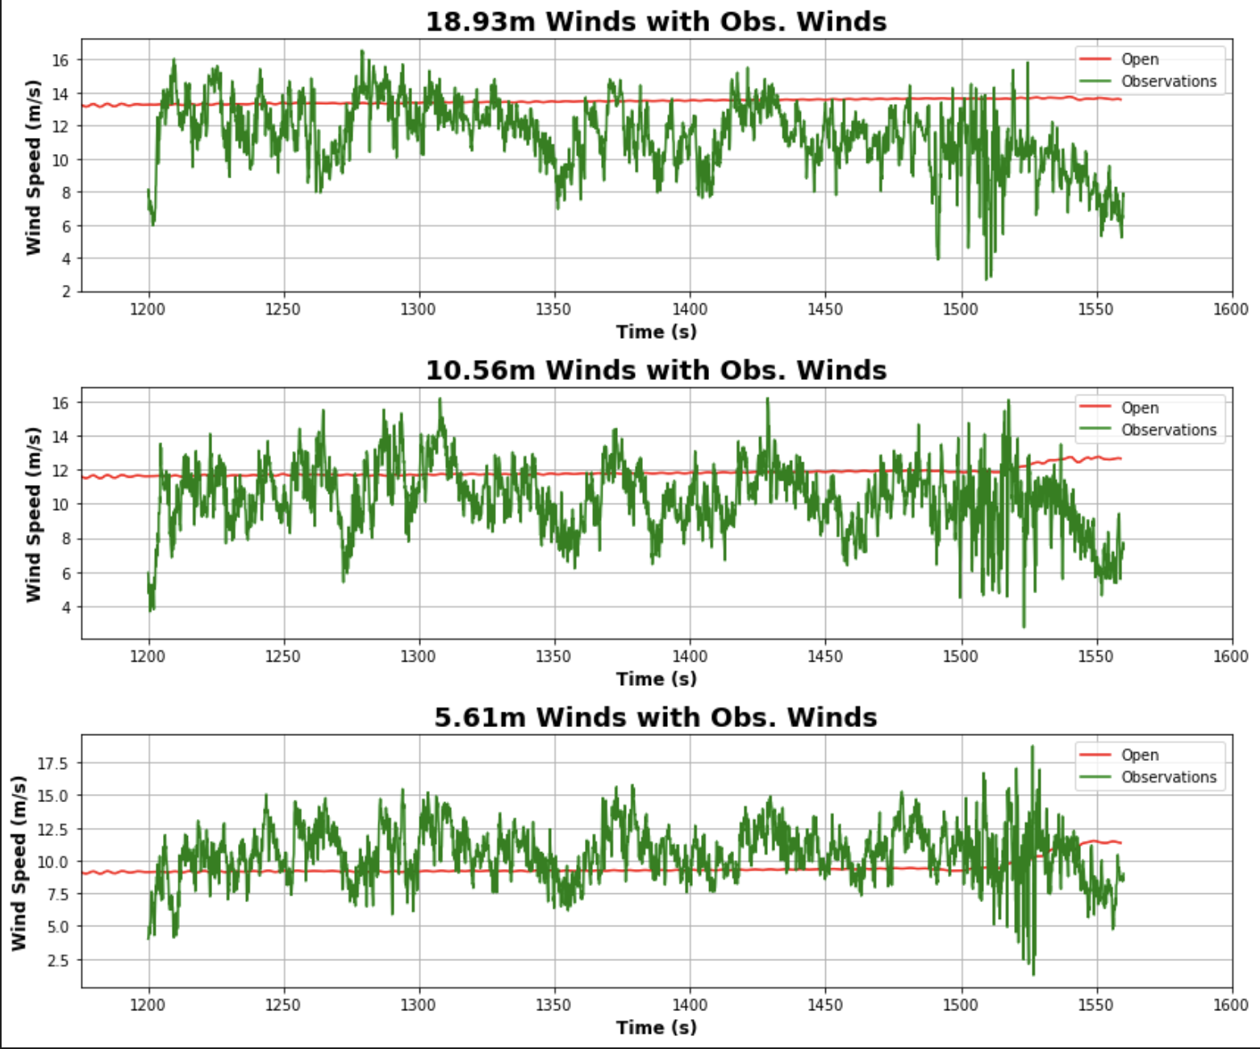
Simulation with modified sodar data

Slide 9
Balbi w_0 sensitivity
After looking through the code and meeting with John and Dr. Kochanski, the w_0 can not be omitted and assumed to be 50
This mainly applies to ideal simulations with a small ignition line in the beginning as larger fires will likely have too large of an ignition line
The graph shows there’s a linear fit for w_0 which comes as a surprise since there is an exponential in the r_c equation
Testing was done on the matlab balbi code (2021 update) with varying w_0 to see how much it change the ROS

Slide 10
Balbi w_0 sensitivity

Slide 11
Final ff2 simulation
Currently on Cheyenne, I’m running the final FF2 simulation
Over the past few months, tests have been run on a modified version of the FF2 simulation to match initial conditions between the simulation and observations
Since this run is at 5m, it takes much longer to run, so the run is currently being done on Cheyenne at: /glade/scratch/jbenik/FF2_Final_Sim_09_08_22

Slide 12
to do
Read paper about Rothermel
Working on balbi PowerPoint then I will read this
Write report on pressure sensors
In progress
Compute ROS with Rothermel model
In progress
Compute ROS with Balbi model (once that’s implemented)
Make powerpoint about Balbi paper
In progress
Create the surface plot for balbi with 3 dimensions

