Slide 1
Extension of the Balbi fire spread model to include the field scale conditions of shrubland fires
By: Jeremy Benik

Slide 2
Goal of balbi model
The goal of the Balbi model is to provide a simplified rate of spread model that can computed quickly and accurately for accurate simulations of fire propagation for fire managers use under operational conditions
The balbi model is a fully physics based model, and this version accounts for both radiation and convective heat transfer
This model accounts for outdoor fires
The goal of the balbi model is to provide a “simplified rate of spread model aimed at providing computationally fast and accurate simulations of fire propagation that can be used by fire managers under operational conditions” (Balbi 2022, abstract)
This version accounts for both radiation and convective heat transfer
The difference between this paper and the 2021 paper is this accounts for outdoor fires rather than just laboratory fires
This model remains “physics-based and is faster than real time and fully predictive” (Balbi 2022, abstract)

Slide 3
History of the balbi model
The first balbi model was presented in 2007 and followed the assumptions that radiation was the main heat transfer mode
With the next two versions of the model, there were improvements in the physical basis of the model
Incorporating the equation for vertical momentum applied to the flame and introduction of a fresh cooling air provided better modeling of the radiative fraction
Then Chatelon developed a convective model for well ordered and vertically oriented fuel beds

Slide 4
Model idealisation
Some of the 2020 assumptions kept are
Fresh airstream enters the flame base
Hot gasses from the upper layer are driven to the top of the flame base and create the free flame structure above the vegetal stratum
Mixed air pyrolysis gases from the lower layer go out through the front panel of the fuel-burning particles area and create an internal, or combustion zone, flame that directly contacts the unburnt fuel
Energy contributions
Flame base radiation, flame radiation, convective cooling, convective heating

Slide 5
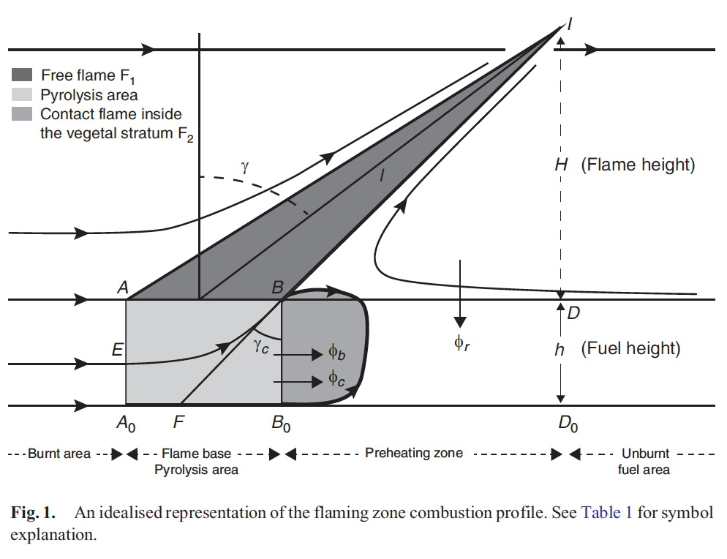

Main equation
R = R_b + R_c + R_r

Slide 6

Changes from lab
In eq6, the factor 2 is removed since it is assumed that at a field scale the soil absorbs a part of the flame base radiative flux
The optical depth is inversely proportional to the fuel porosity
The leaf areas ratio is added to the scaling factor a_b since the heat release affects the live fuel and spread of ignition mainly depends on the catalytic effect of dead fuel
Combustion of live fuels does not directly contribute to movement of the ignition interface and so does not create the fire dynamics but takes part in the flame base combustion anyway. Its contribution is added in the model as a ratio between dead and total packing ratio

Slide 7
A_r & a_c
This is related to the flame radiation heat flux
Only the absorption of this heat flux by the unburnt fuel is concerned
A_c is related to the convective heat flux is now in three contributions which are mostly energy losses
These factors are the heat provided to the unburnt live fuel a_liv
A_lat are heat losses on lateral edges of the fire front
This depends on the fireline width w_0
A_up amount of pyrolysis gases produced by the air stream below the streamline that enters the flame base at E
The second part is the heat remaining in the fuel-burning particles when the hear is released to the upper part of the fuel is removed

Slide 8
data
To calibrate the model, shrublands in Turkey were used to estimate the a_m parameter (fitted model parameter)
The a_m parameter is among the 4 model parameters needed for the total ROS equation
Since everything else is known from Balbi 2020, this is the last parameter that needs to be fit for the ROS equation to be used at field scales
For a sensitivity analysis, different fuel parameters were tested on the model R, which allows an analysis of the most influential variables in the R output

Slide 9
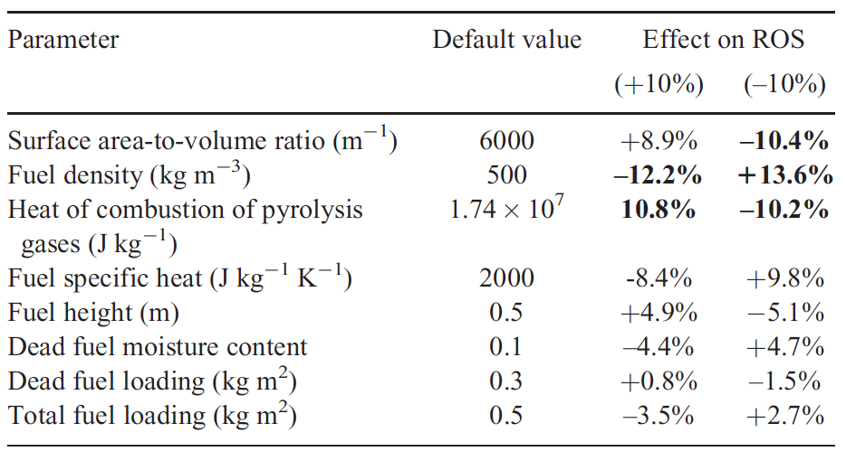
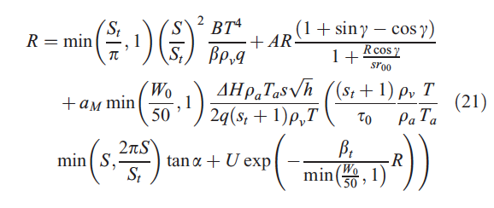
Data

Slide 10
Testing the model
To benchmark the data, the model was compared to other models using the same dataset
Some of these models are old balbi models and the Anderson model

Slide 11
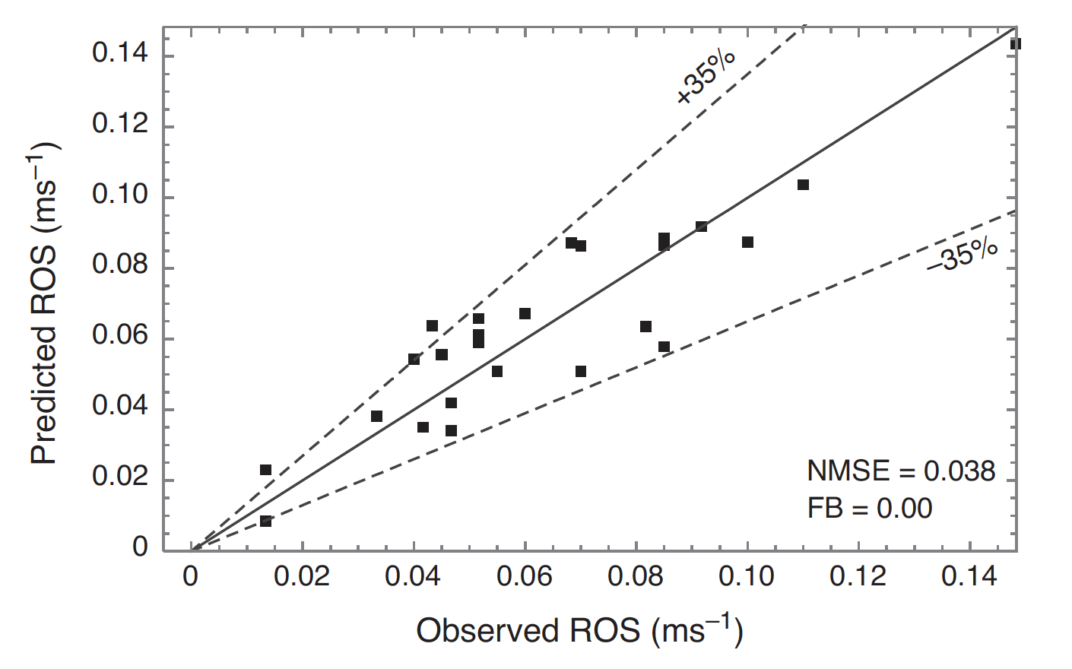
Numerical results
A_m remains at 0.025
R increased linearly with wind speed for the lower fuel loads
For heavier fuel loads, slow increase in ROS with lower wind speeds, then past 2.5m/s there is a much steeper increase in ROS
With increasing fuel load, ROS increases
Fuel load, fuel height, bulk density are connected

Slide 12

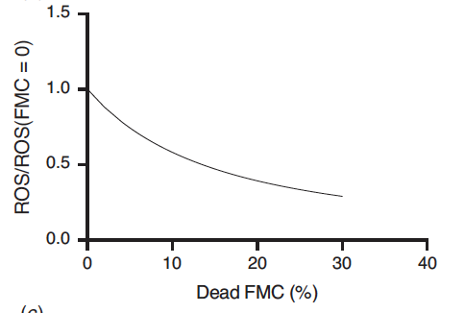
Numerical results
FMC on ROS

Slide 13
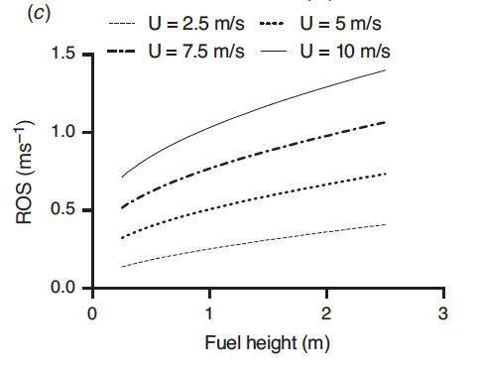
Numerical results
Fuel bed height on ROS
ROS is found to increase with fuel height independent of the wind speed
A doubling of fuel height 1m to 2m increased ROS by 31% (more pronounced for low wind speeds)

Slide 14
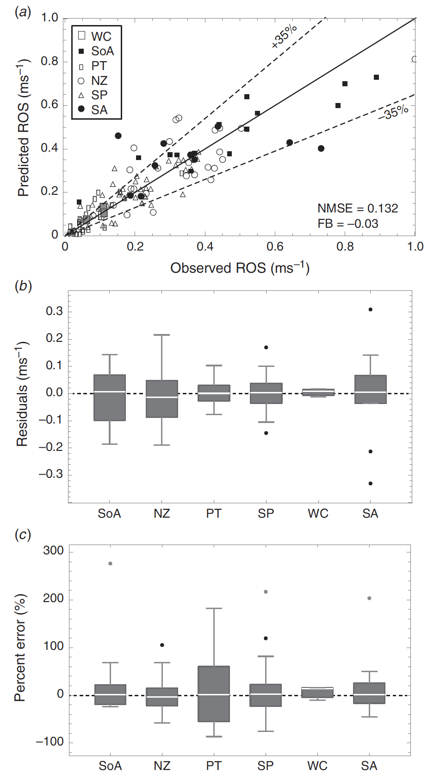
results
Tests were done in New Zealand, Australia, Portugal, Spain, and South Africa
Overall, there was a good agreement between the model and the observations with a NMSE of 0.132 and a sight underestimation of the predicted ROS (FB = -0.03)
The model tends to underpredict the ROS by about 0.05 to 0.3m/s
However, the percentage error is still the lowest of the four R classes (avg. -20%)

Slide 15
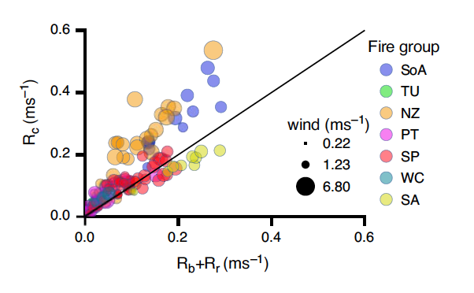
results
Convection was the most influential heat transfer mechanism driving the fire propagation except for fires with little to no wind, then radiative heat transfer largely dominated fire propagation

Slide 16
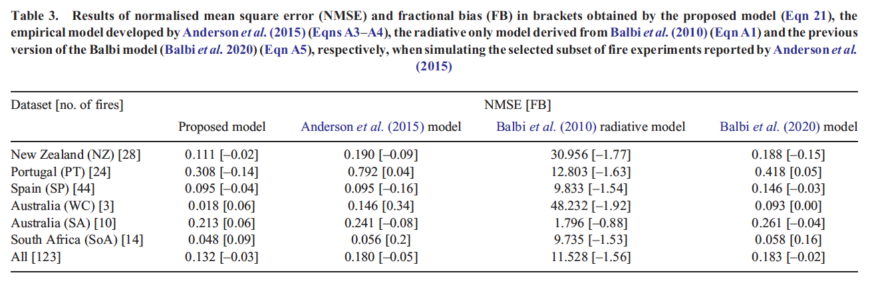
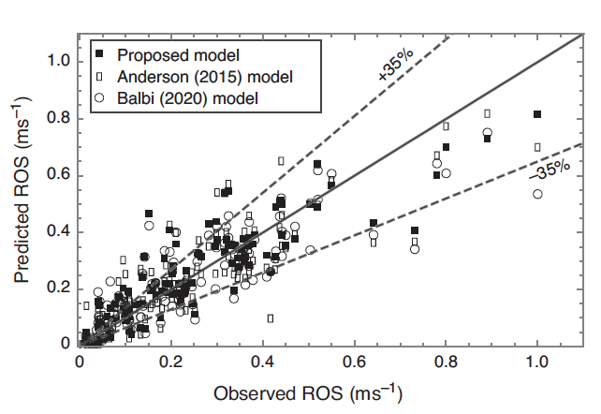
Comparison of other models
Other models were tested against the dataset
This included the 2010 balbi model, the Anderson model, and the 2020 balbi model
The 2010 Balbi model performed the worst, Anderson model performed similar to the curret Balbi model (which makes sense since the Anderson model was used in developing the Balbi model)

Slide 17
Discussion
With an increase in wind speed, yields an increase in ROS
However the wind speed effect depends on other fuel characteristics due to the effect of structural fuel characteristics on heat transfer processes
Ex: fuel load affects radiative coefficient which is dependent on the wind speed as well
With zero wind speed, the convective effect and radiative contribution are both zero on flat ground or close to zero on slopes, meaning the fire is driven by flame base radiation
With an increase in wind speed, the convective and radiative components contribution increases

Slide 18
Discussion
Fuel height is dependent on other fire environmental variables
The model sensitivity with regards to the fuel characteristics show that the fuel characteristics don’t cause a large error on the ROS output, which is encouraging from an operational fire simulation setting
With the good agreement between predicted and observed ROS, this suggests the model is able to be used to calculate the ROS in an operational setting

Slide 19
conclusion
The ROS is calculated through a series of non linear equations that must go through iterations to be solved
Living part of the fuel is mainly taken into account through the contribution of live fuel load
The model is not able to be run with multiple layers of fuel
It can be used at an operational scale and with more data, more fuel parameters can be used in the future

