Slide 1
Weekly meeting 09/16/22
By: Jeremy Benik

Slide 2
Last week to do
Test the matlab code Jan gave me
Completed
Read paper about Rothermel
Working on balbi PowerPoint then I will read this
Write report on pressure sensors
In progress
Compute ROS with Rothermel model
In progress
Compute ROS with Balbi model (once that’s implemented)
Make powerpoint about Balbi paper
Completed at: https://github.com/Jeremy-Benik/Meeting_Notes/blob/main/Presentations/Balbi_2022_presentation.pptx
Create the surface plot for Balbi with 3 dimensions
Completed

Slide 3
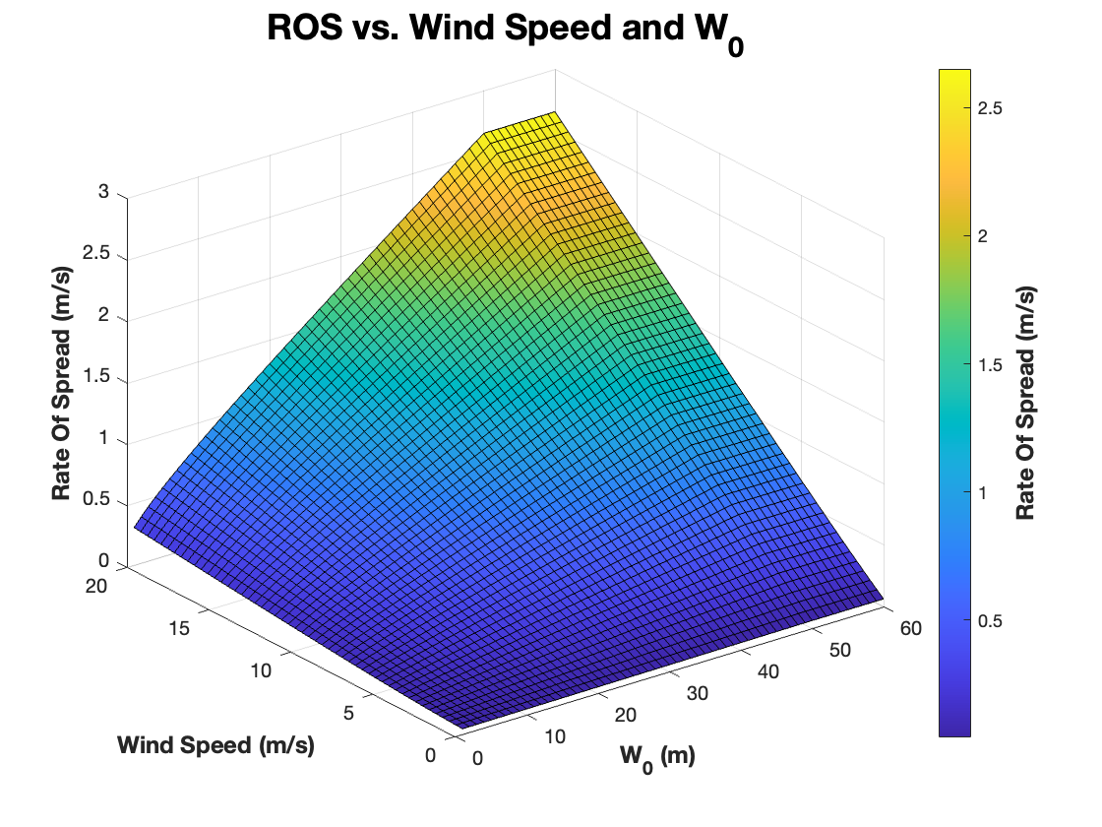
Create surface plot for Balbi model
This is a surface plot of how w_0 and wind speed affects the overall ROS
For this plot, I used w_0 from 1-60m, and wind speeds from 0-20m/s (with 100 intervals)
With an increase in winds, there is an increase in ROS which follows common beliefs
The w_0 does play a slight role in the ROS with wind speed as with a greater w_0 the ROS increases

Slide 4
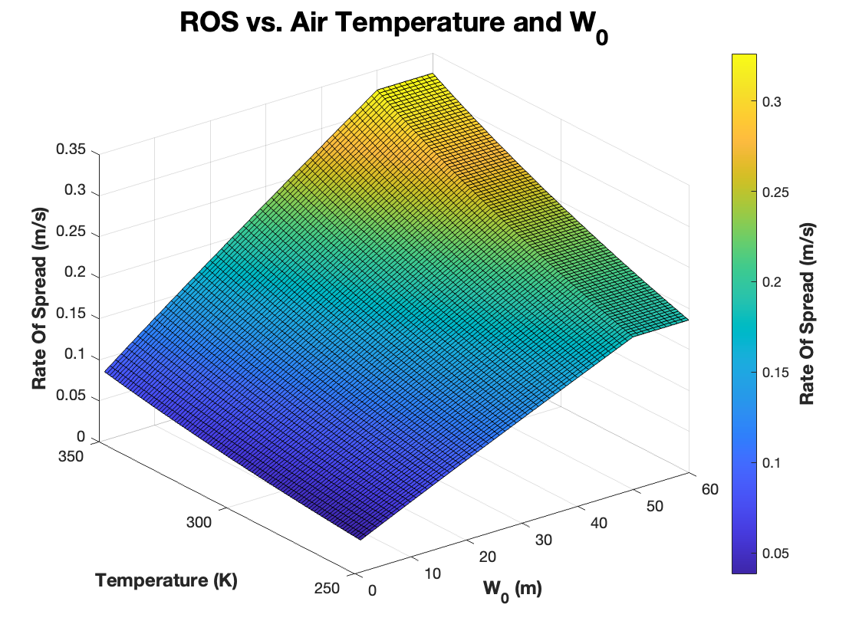
Create surface plot for Balbi model
This is a surface plot of how w_0 and air temperature affects the overall ROS
For this plot, I used w_0 from 1-60m, and air temperature from 250-350k
With an increase in air temperature, there is an increase in ROS
With an increase in w_0, there is also an increase in ROS with constant temperature
The w_0 and air temperature do correlate in that with an increase in both, yields an increase in ROS

Slide 5
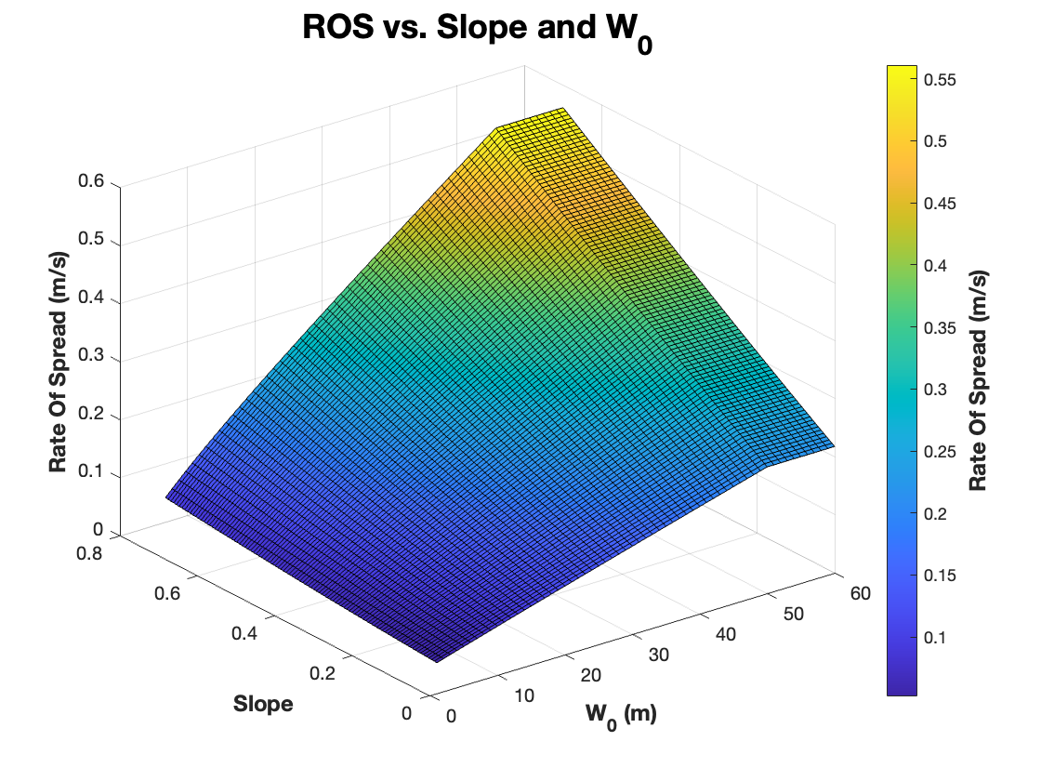
Create surface plot for Balbi model
This is a surface plot of how w_0 and wind speed affects the overall ROS
For this plot, I used w_0 from 1-60m, and wind speeds from 0-20m/s (with 100 intervals)
With an increase in winds, there is an increase in ROS which follows common beliefs
The w_0 does play a slight role in the ROS with wind speed as with a greater w_0 the ROS increases

