Slide 1
Weekly Meeting 08/19/22
By: Jeremy Benik

Slide 2
Last Week To Do
Rerun FireFlux_med with new sounding
Currently being worked on
Re-test the Rothermel code
Done
Write report on pressure sensors
Waiting for final FF2 simulation before I can write the report
Fix xquartz
Reset my laptop and that worked
Finish powerpoint for Jan
Now that the Rothermel code is finished, I can start working on this and showing him the errors
Be sure to mention how I calculated the backfire ROS for the FF2 simulations
Write my abstract
In progress
SODAR Data
Read into python and added to original sounding

Slide 3
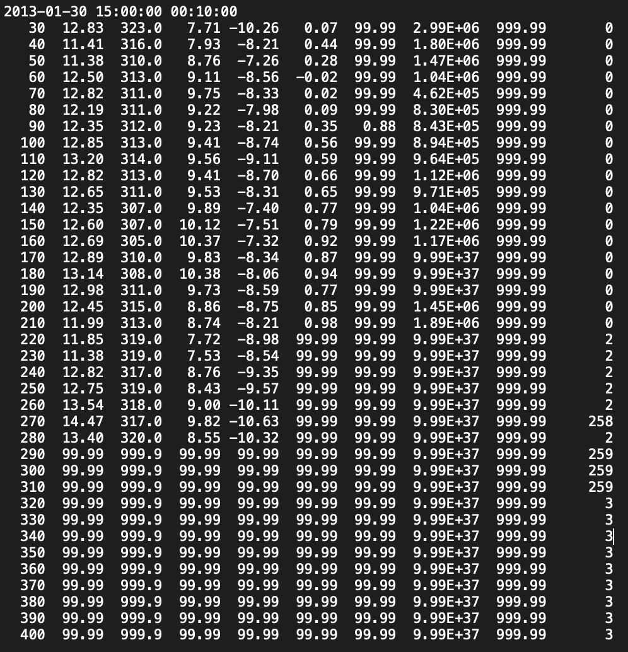
SODAR Data
Since the SODAR data only has data from 30m - 280m (there are nan values after 280m), those are the heights I added into the sounding
The sounding only goes up until 20m, then increases to 259.9m which is a large jump without any wind data
Now I must find the potential temperature and the water vapor mixing ratio for all those heights before it can be implemented into the sounding
One issue is the data has a lot of nan values, meaning I may need to pick a time other than 15:00 so there aren’t as many nan values

Slide 4
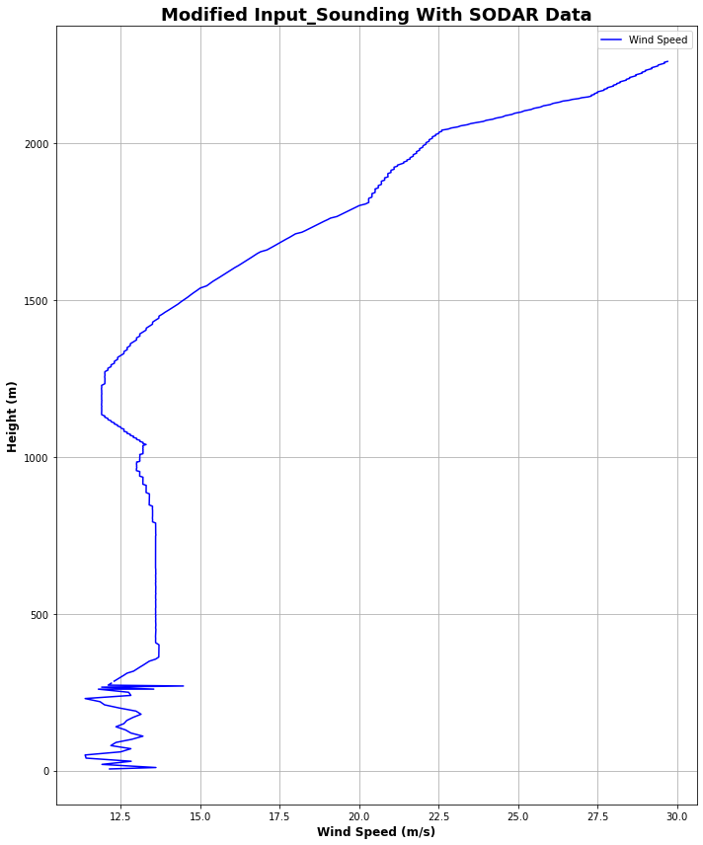
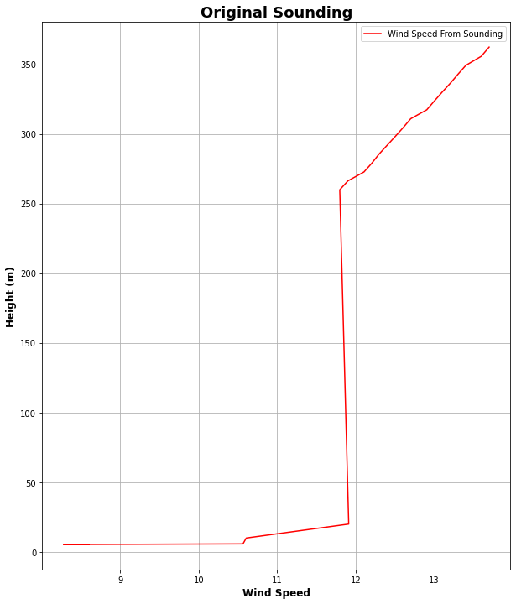
SODAR Data
I added in the data from Jan 30, 15:00 to the original input_sounding to see how it would affect it

Slide 5
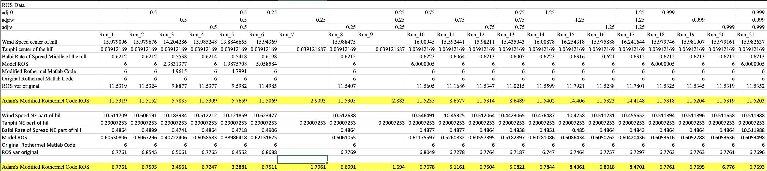
Rothermel Code
After modifying the code to take in the adjustment factors as inputs, and adding them to the code, there is a much greater difference among the rate of spread
Now adjustment factors will better change the variables in the code
I.e. 0.5 adjw will cut the wind speeds in half

Slide 6
Checking my initial Z0 value
Since z_0 was put in the incorrect location in the file, I changed it to be in the winter location of the LANDUSE.TBL (line 91)
To verify the z_0 value, I input them into the roughness length equation with the different height values

Slide 7
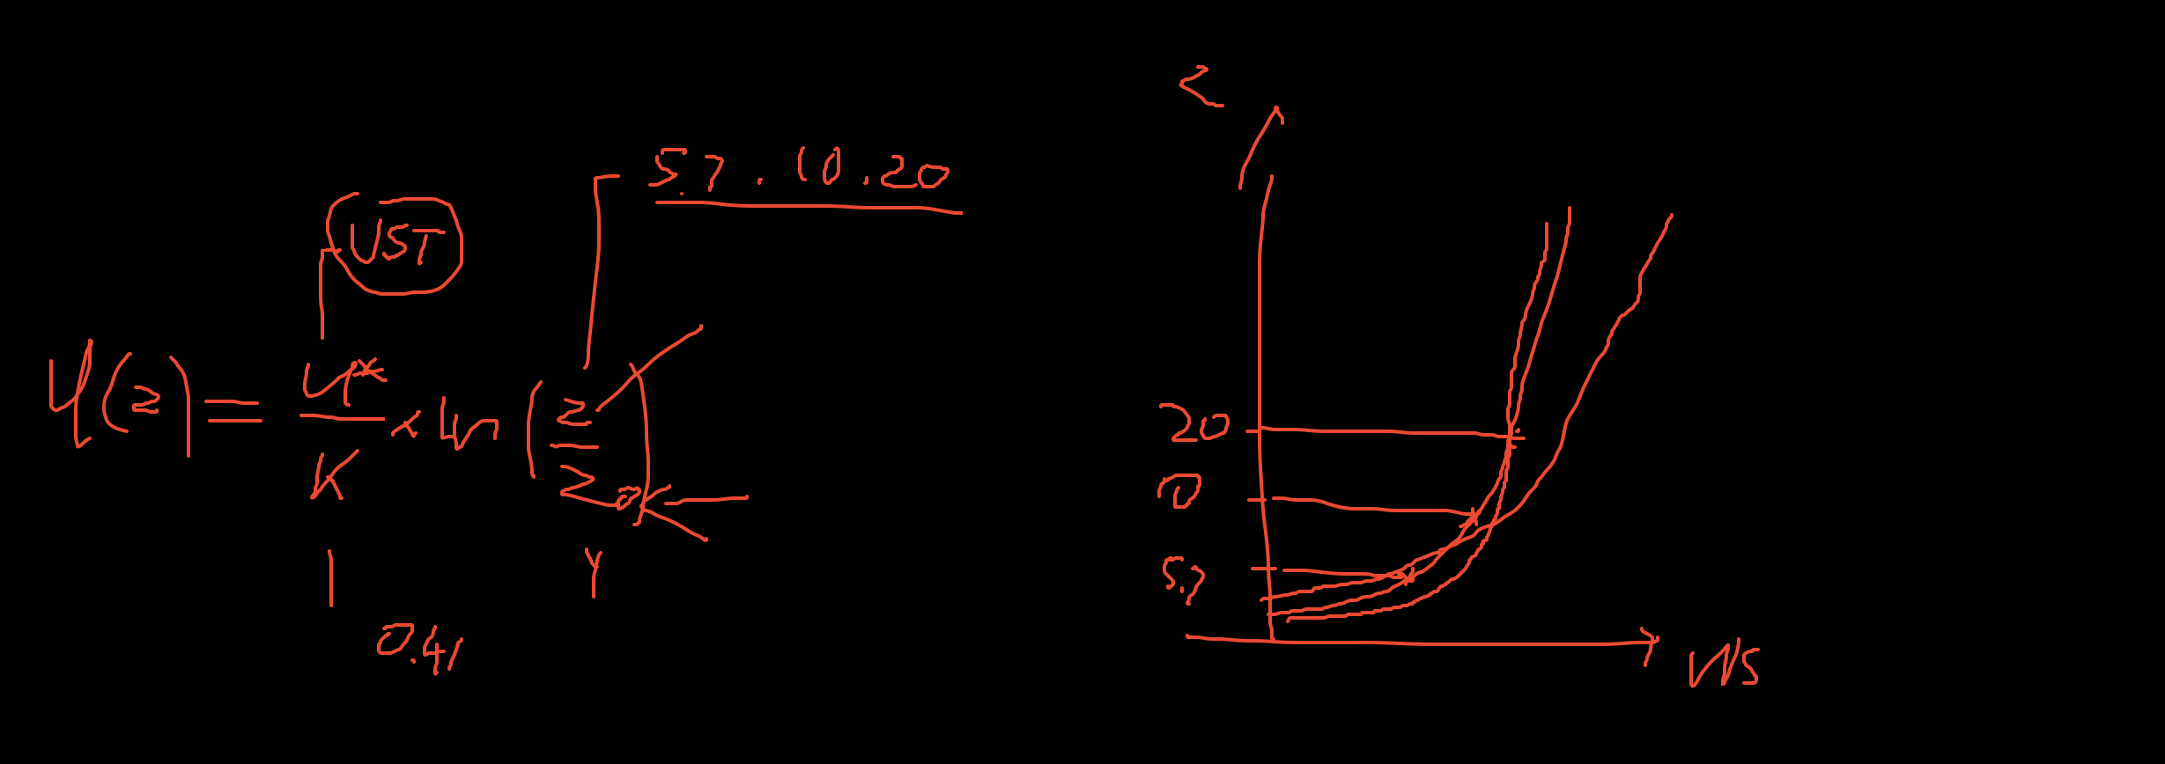
Roughness Length Calculation
https://www.eol.ucar.edu/content/calculation-roughness-length-and-displacement-height

Slide 8
To Do
Run the new sounding with open and cyclic boundary conditions
Both fire_atms = 0
Finish Z_0 calculation
Modify the input_sounding
Verify the wrfinput file
Interpolate pot. temperatures for the SODAR data for the sounding
Write my abstract
Finish powerpoint for Jan
Write report on pressure sensors
Waiting for final FF2 simulation before I can write the report

