Slide 1
LLNL Presentation 08/12/22
Jeremy Benik

Slide 2
Updates since last meeting
Balbi code implementation into WRF-SFIRE
Comparing Pressure Sensors along the burn plot to observations
Creating final FireFlux2 setup

Slide 3
Balbi Code implementation into WRF-SFIRE
John Stuart and I have created a Balbi model written in python that matches the Kolgerberg Dataset
It is being converted to fortran as well for implementation
With this new code, there are new parameters needed for the model to run
Ignition line length (W_0)
Air Temperature (T_a)
This model is currently being implemented into WRF-SFIRE
Once it’s implemented, a new FF2 simulation will be run on the Balbi model and compare the output to the Rothermel model (Current WRF-SFIRE)

Slide 4
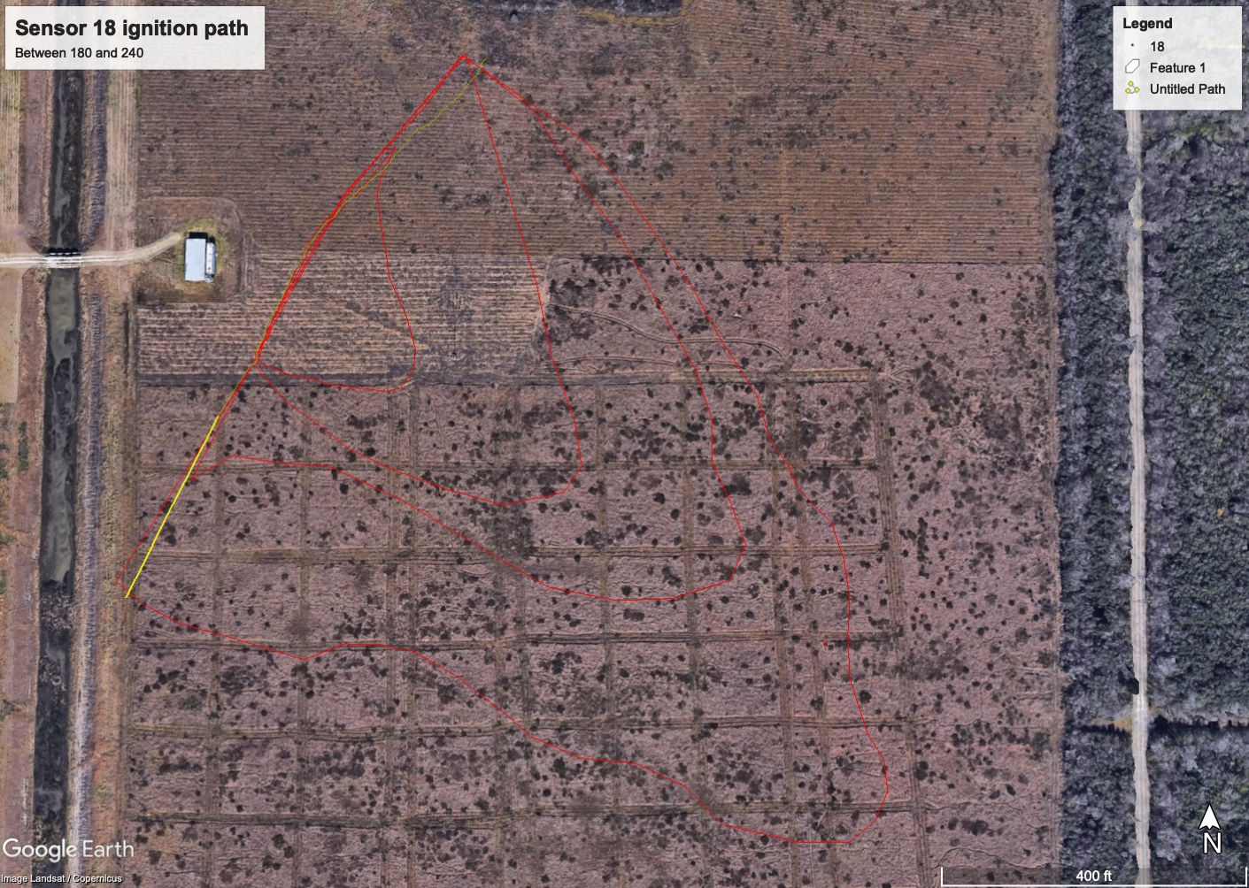
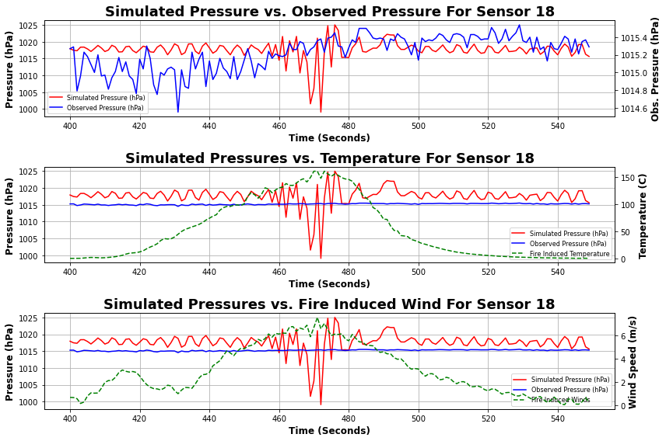
Comparing Pressure Sensors

Slide 5
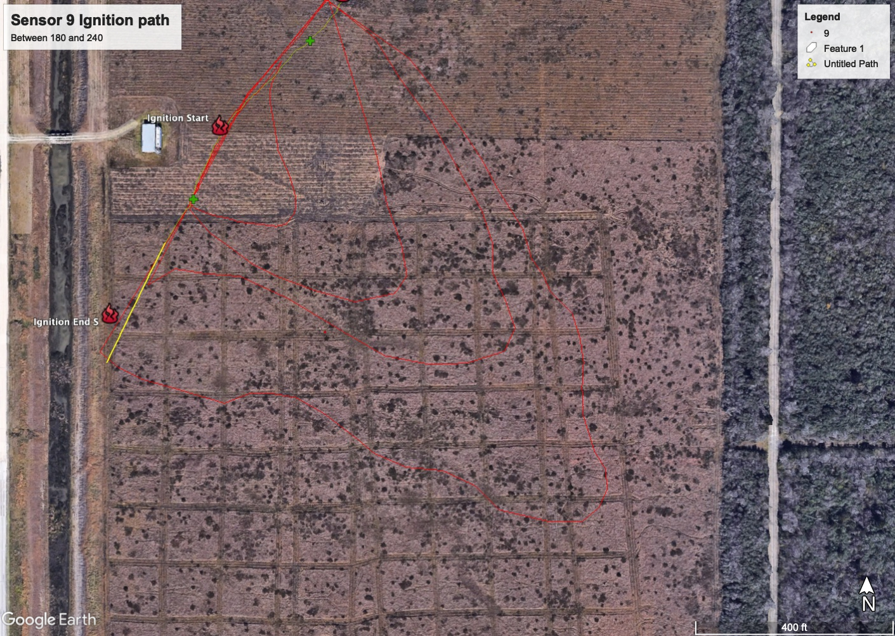
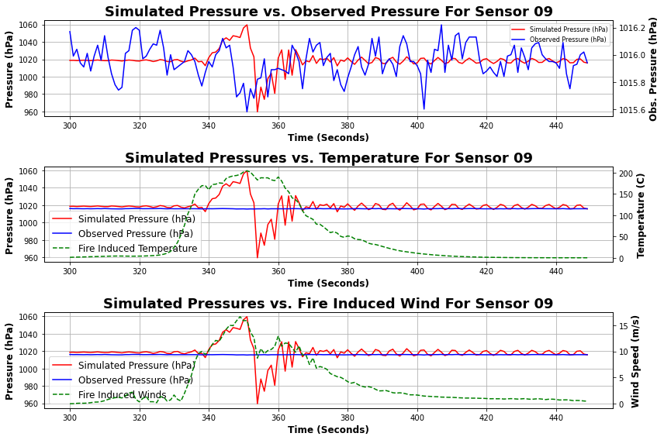
Comparing Pressure Sensors

Slide 6
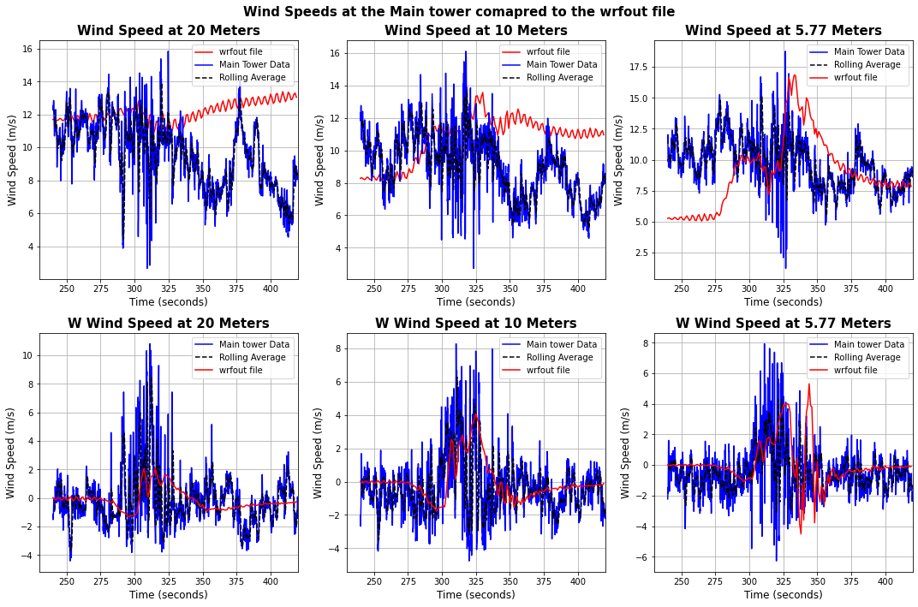
Creating Final FireFlux2 setup
In the current setup, there is a large dip in the initial winds in the simulation which messes up the ambient conditions
To better match the simulation to the observations, the initial winds are being increased and there is added spin up time for the simulation to equilibrate
To check if the simulation matches the observations, we are using a modified variation of the FF2 simulation (dx and dy = 10 instead of 5) to speed things up and not take as much run time on Cheyenne

