Slide 1
LLNL Presentation 08/19/2022
By Jeremy Benik

Slide 2
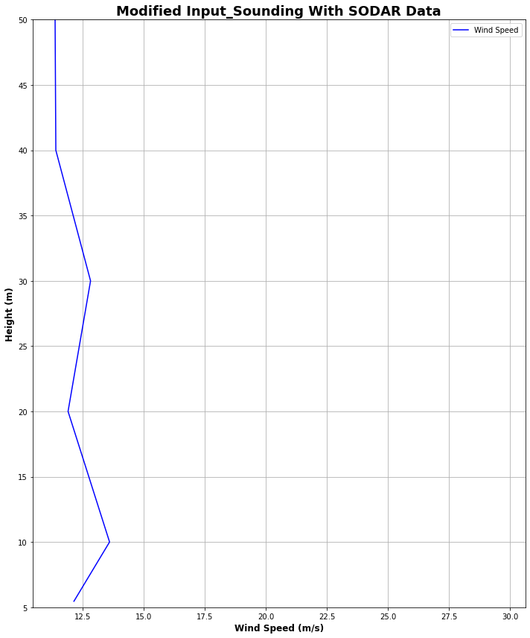
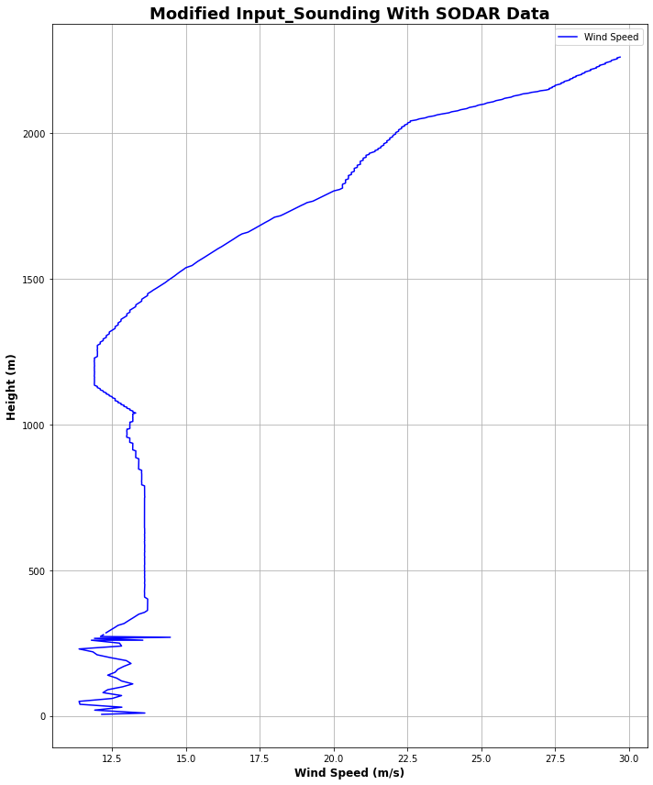
SODAR Data
Using SODAR Data collected during the burn, I added those winds to the sounding file to fill in the gaps between 20m and 259m since the original sounding had a gap there

Slide 3
Checking my initial Z0 value
Since z_0 was put in the incorrect location in the file, I changed it to be in the winter location of the LANDUSE.TBL (line 91)
To verify the z_0 value, I input them into the roughness length equation with the different height values

Slide 4
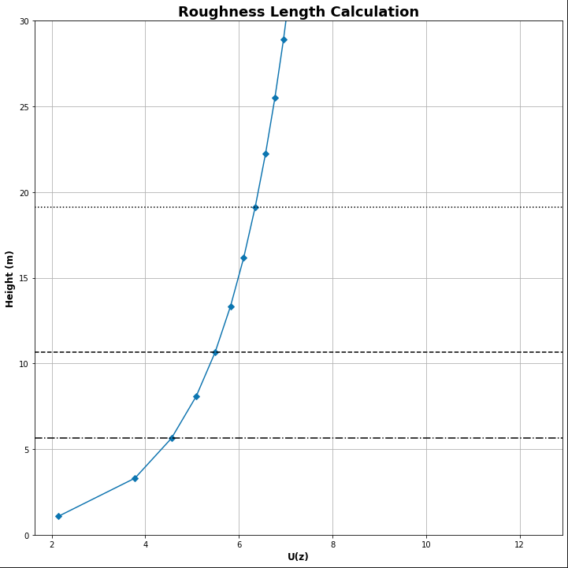
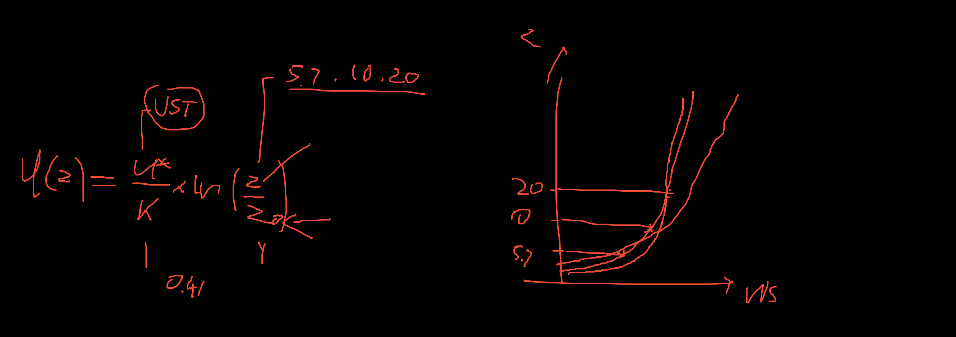
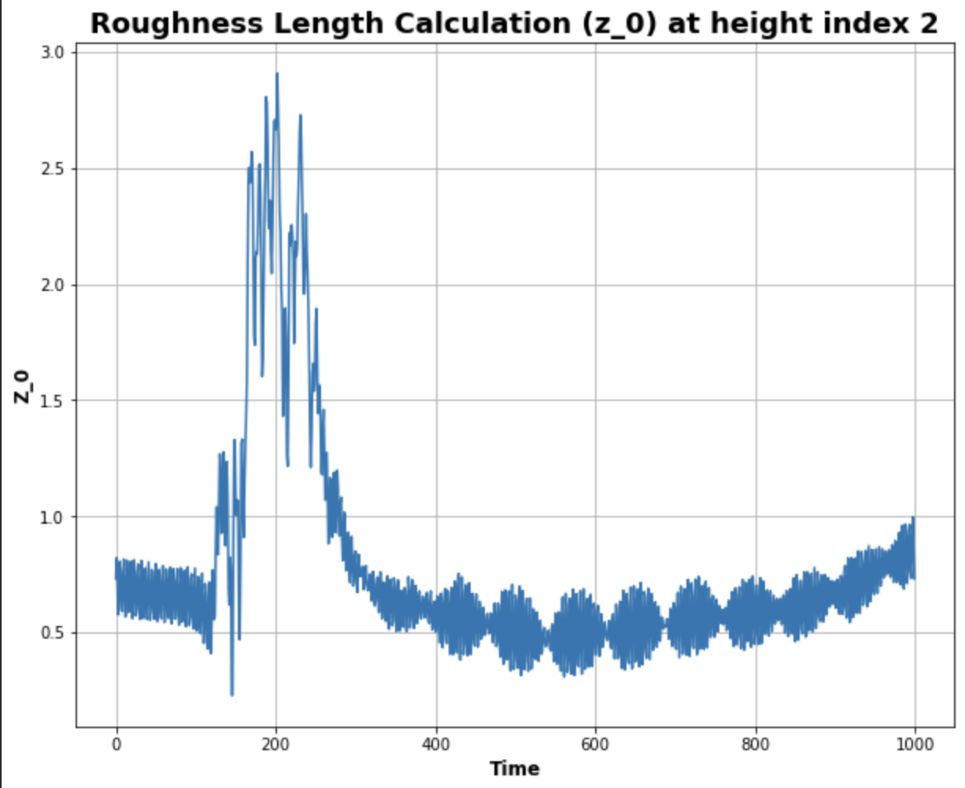
Roughness Length Calculation
https://www.eol.ucar.edu/content/calculation-roughness-length-and-displacement-height

Slide 5
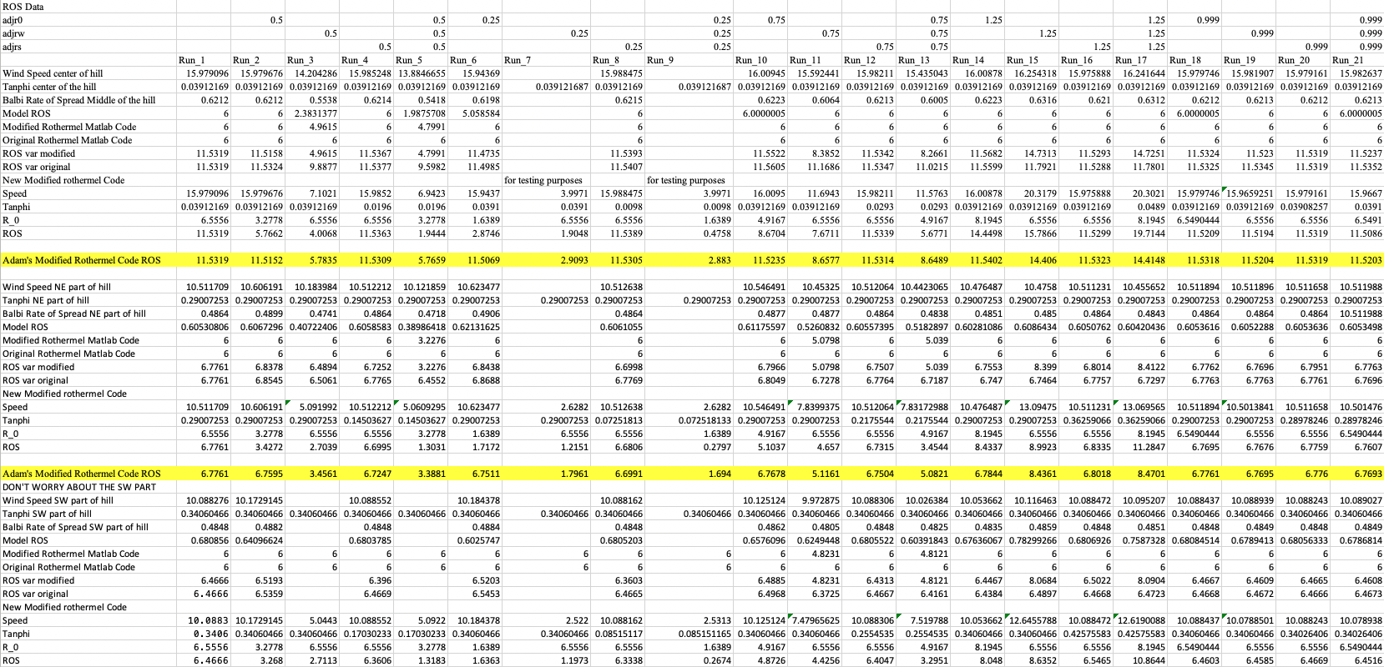
Rothermel Code
After modifying the code to take in the adjustment factors as inputs, and adding them to the code, there is a much greater difference among the rate of spread
Now adjustment factors will better change the variables in the code
i.e. 0.5 adjw will cut the wind speeds in half

Slide 6
To Do
Run the new sounding with open and cyclic boundary conditions
Both fire_atms = 0
Modify the input_sounding
Verify the wrfinput file
Write report on pressure sensors
Waiting for final FF2 simulation before I can write the report

