Slide 1
Weekly Meeting 08/26/22
By: Jeremy Benik

Slide 2
Last week to do
Write my abstract
Submitted
Finish Z_0 calculation
Finished and implemented
Modify the input_sounding
Verify the wrfinput file
Finished, awaiting to see if sounding needs changes
Run the new sounding with open and cyclic boundary conditions
Simulation run
Interpolate pot. temperatures for the SODAR data for the sounding
SODAR data doesn’t have any temperature data, it’s all 999.99
Finish powerpoint for Jan
In progress and can be found at:
Write report on pressure sensors
Waiting for final FF2 simulation before I can write the report

Slide 3
Abstract
Analysis of Fire-Induced Circulation during the FireFlux 2 Experimental Burn
Jeremy Benik, Adam Kochanski, Angel Farguell Caus, Craig Clements, Jeff Mirocha
Despite the recent increase in fire activity associated with larger and more intense fires, the fire-atmosphere mechanisms that lead to fast propagating wildfires are not being systematically studied. This knowledge gap adversely affects fire management by surprising civilian fire management crews when wildland fires propagate unexpectedly fast. In this work, we utilized observational data and numerical simulations performed with a coupled fire-atmosphere model WRF-SFIRE. This data comes from the FireFlux 2 prescribed burn which occurred in Texas in 2013. The experiment provided a comprehensive observational dataset including fire front mapping, local in-situ micrometeorology sampled by multiple towers equipped with sonic anemometers and thermocouples, as well as sodar and a radiosonde providing vertical profiles of winds, temperature, and moisture. The sensors deployed within the experimental burn plot provided the fire micrometeorology impacted both by the ambient conditions and the fire activity itself. However, this data does not allow us to directly quantify the effects of the fire atmospheric interactions. To assess the small-scale impacts of fire on local micrometeorology, we used a set of coupled fire-atmosphere simulations using WRF-SFIRE coupled fire-atmosphere model. The model was run in idealized mode, at 5 m horizontal resolution with initialization based on the tower and SODAR wind measurements, and the radiosonde vertical profiles. The baseline simulation was executed in a coupled mode in which the heat and moisture fluxes emitted from the fire were injected into the atmosphere. In the second, no-coupled scenario, the atmosphere wasn’t affected by the fire. The difference between these two simulations (which can be attributed to the fire effects) was used to analyze and quantify the fire impacts on the circulation at different sections of the fire front. We analyzed how fire presence impacted local micrometeorology at 5, 10, and 20 m above ground. The initial results suggest that the fire-released heat fluxes resulted in vertical velocities as high as 10.81 m/s. The strongest vertical velocities were observed at the highest measurement level (20m AGL). The strength of the updraft was gradually diminishing closer to the ground with the weakest updrafts at 5.33 m. The fire-induced winds (computed as the difference between the coupled and uncoupled simulation) indicated the strongest fire-induced flow at the lowest measurement levels (as high as 3.05 m/s) gradually decreasing to less than 1 m/s at 20m above the ground. The analysis of the simulated flow indicates also significant differences between the fire-induced circulation at the fire head and on the flanks. The head experienced stronger vertical velocities compared to the flanks (5m/s vs. 3m/s) while the temperature increase was twice as high at the head (~110ºC) than at the flanks (~50ºC).

Slide 4
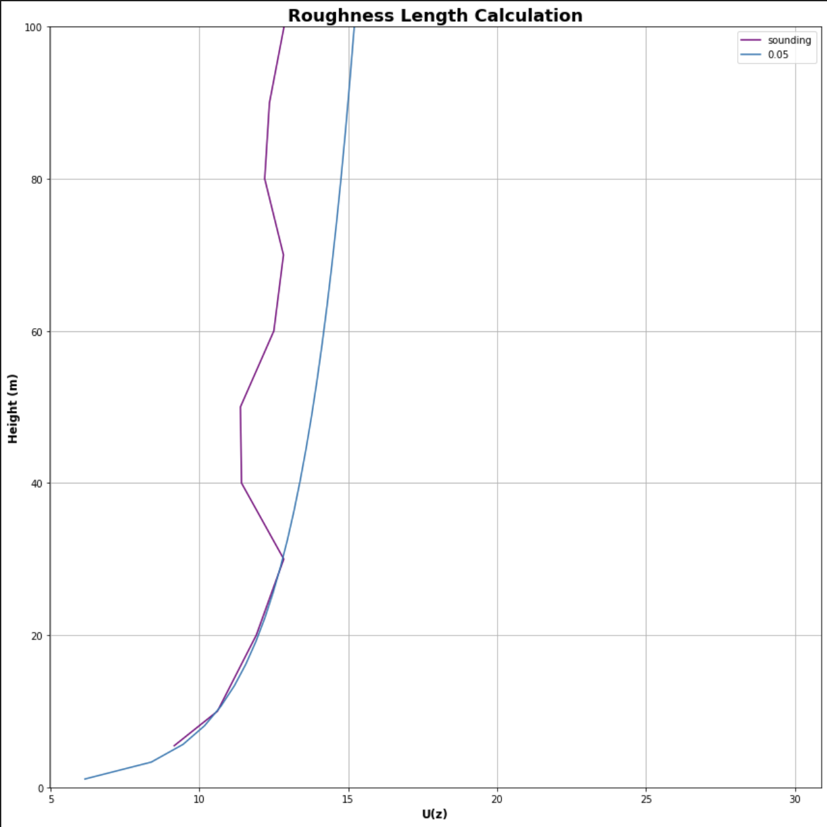
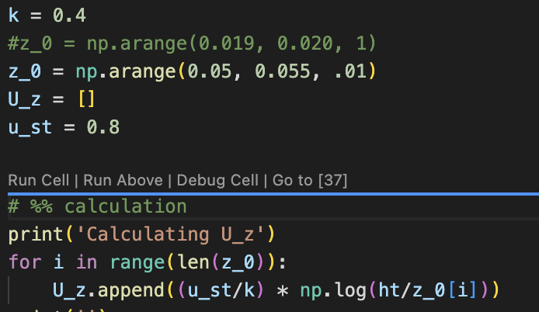
Z_0 calculation
Using the equation, I condensed the z_0 down to the line that fits the input_sounding profile the best
I added in my calculation as well
I attempted to calculate it in excel as well, but that
lead to a negative value

Slide 5

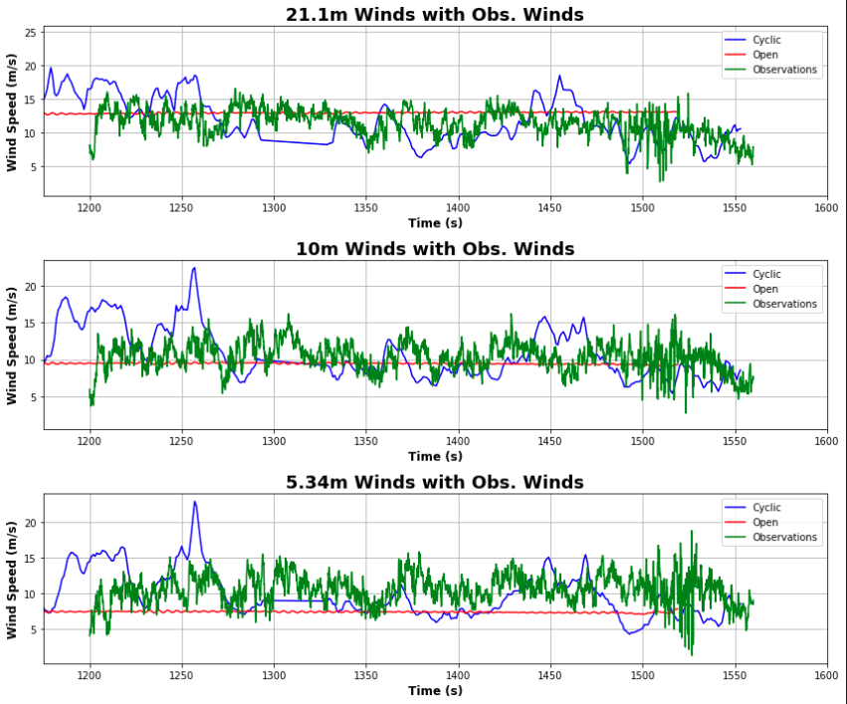
ff_med run
With the modified z_0 value, I reran the ff_med simulation with both cyclic and open boundary conditions to see how the new sounding would impact the run
This graph is much closer to the observations than previous runs, indicating the roughness length has an impact on the wind speeds

Slide 6
Modify the input_Sounding
With how close the recent ff_med run was, I figured there may not be a lot of adjustments needed, so I created these plots to verify the sounding with the wrfinput file from the open run

Slide 7
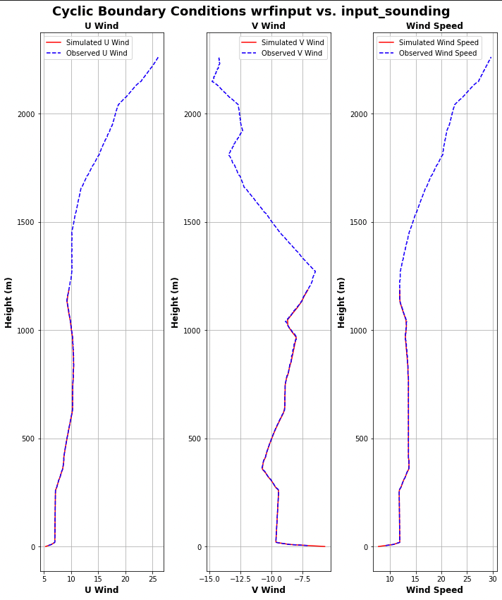
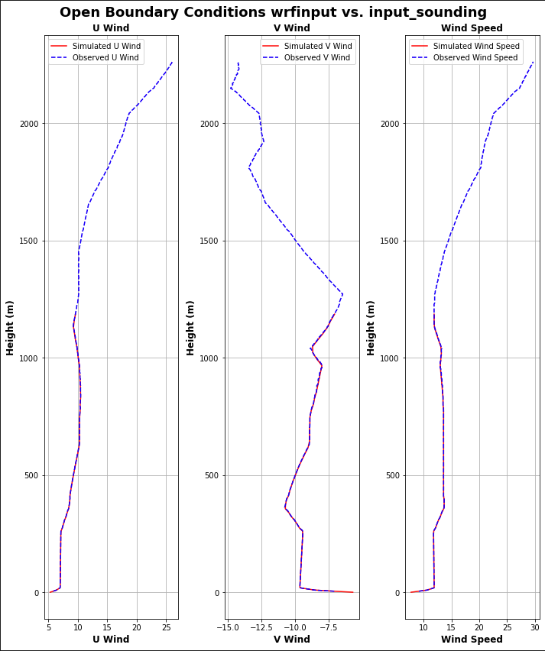
Verify the input_sounding with wrfintput file

Slide 8
To do
Modify the wrfinput file
Finish powerpoint for Jan
In progress and can be found at: Meeting_Notes/Presentations/Adjustment_Factors.pptx
Write report on pressure sensors
Waiting for final FF2 simulation before I can write the report

Slide 9
Abstract
Analysis of Fire-Induced Circulation during the FireFlux 2 Experimental Burn
Jeremy Benik, Adam Kochanski, Angel Farguell Caus, Jeff Mirocha
Despite the recent increase in fire activity associated with larger and more intense fires, the fire-atmosphere mechanisms that lead to fast propagating wildfires are not being systematically studied. This knowledge gap adversely affects fire management through surprising civilian fire management crews when wildland fires propagate unexpectedly fast. In this work, we utilized observational data and numerical simulations performed with a coupled fire-atmosphere model WRF-SFIRE. This data comes from the FireFluxII prescribed burn which occured in Texas in 2013. There were multiple sensors within the burn plot that provided data of the fire micrometeorology impacted both by the ambient conditions and the fire activity itself. However, this data did not allow us to quantify the effects of the fire atmospheric interactions itself. We analyzed how fire presence impacted local micrometeorology and how the fire behaved without atmospheric interactions by comparing simulations with and without fire-atmosphere feedback. This data allowed us to quantify the fire impact on local circulations along the head versus the flanks. We found the fire-induced winds differed from the flanks to the head of the fire. The flanks measured stronger fire-induced winds compared to the head fire.

