Slide 1
Progress on Balbi Implementation
By: Jeremy Benik

Slide 2
Accomplishments thus far
Creating a code that matches the given dataset
Sensitivity analysis on w_0
Testing the Balbi model in WRF-SFIRE
Identifying the issue and running multiple experiments to determine how the model reacts in negative slope/wind environments
Comparison to the Rothermel model (class project but still useful)

Slide 3
Creating a code that matches the given dataset
The initial task was to modify and verify our Balbi code
To do this, we obtained the Kolgerberg dataset and the ROS values the developers of the code obtained
We created a new fuels category for testing our code based on the fuel data given to us in the Kolgerberg dataset
Their fuel consisted of South African Fynbos
After modifying the code extensively and meeting with the developers of the Balbi model, we were able to get matching values

Slide 4
Links to the codes and data
Kolgerberg dataset
https://github.com/Jeremy-Benik/FireFlux2/blob/main/FireFlux2-main/Data/ROS_Files/Kogelberg%20Fires.xlsx
Fuels code containing the new fuels parameter
https://github.com/Jeremy-Benik/FireFlux2/blob/main/FireFlux2-main/Codes/ROS_Codes/fuels_mod.m
Balbi code after modifications
https://github.com/Jeremy-Benik/FireFlux2/blob/main/FireFlux2-main/Codes/ROS_Codes/ros_balbi_kolgerberg_mod.m

Slide 5
Sensitivity analysis on w_0
W_0 is the ignition line width in the Balbi model
This was by far the hardest part of implementing the Balbi model into WRF-SFIRE as calculating the fire line width in the model is complicated
To determine if the parameter is necessary in smaller scales, a sensitivity analysis was performed with the different input parameters to see if it changed the output by a significant amount

Slide 6
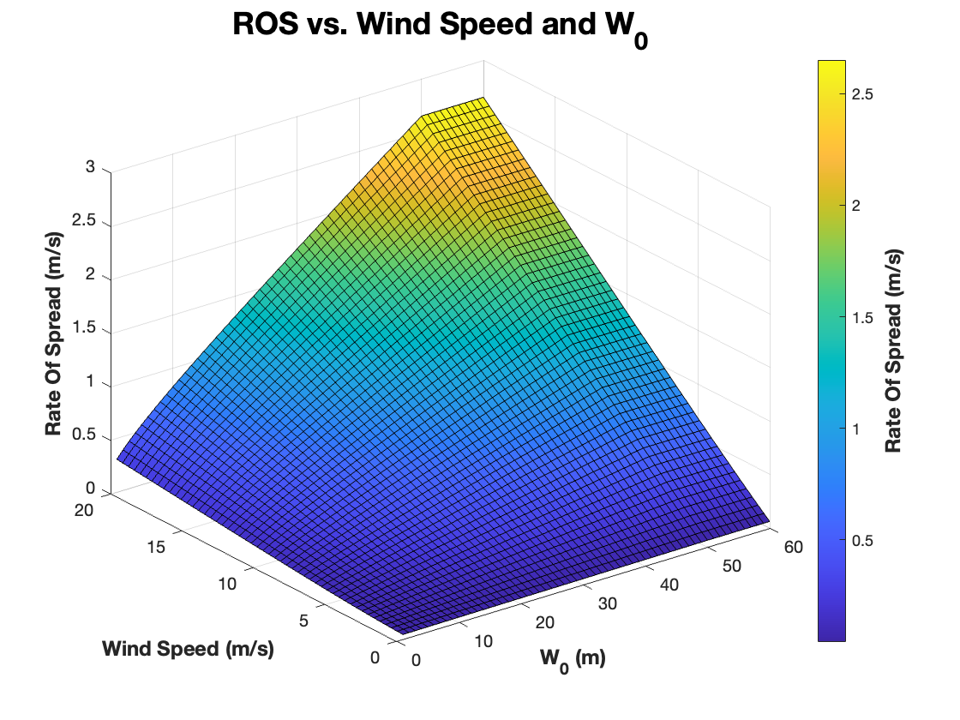
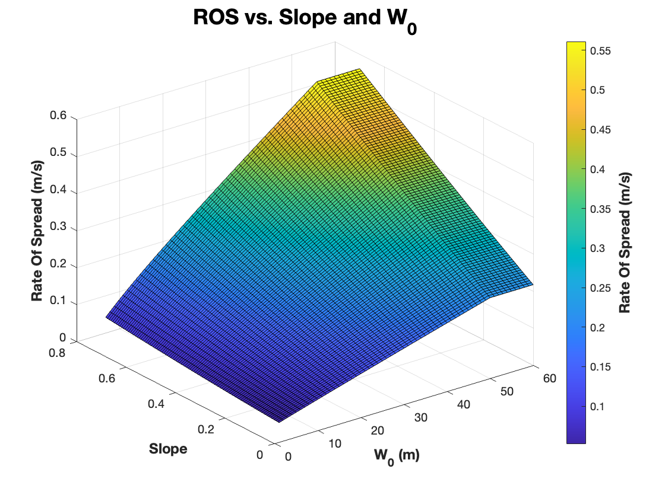
Sensitivity analysis on w_0

Slide 7
Sensitivity analysis on w_0
After creating the surface plots, it’s evident the parameter influences the ROS
That is until the new Balbi model paper (2022) came about and the authors always assumed w_0 = 50, which simplifies implementing the model into WRF-SFIRE

Slide 8
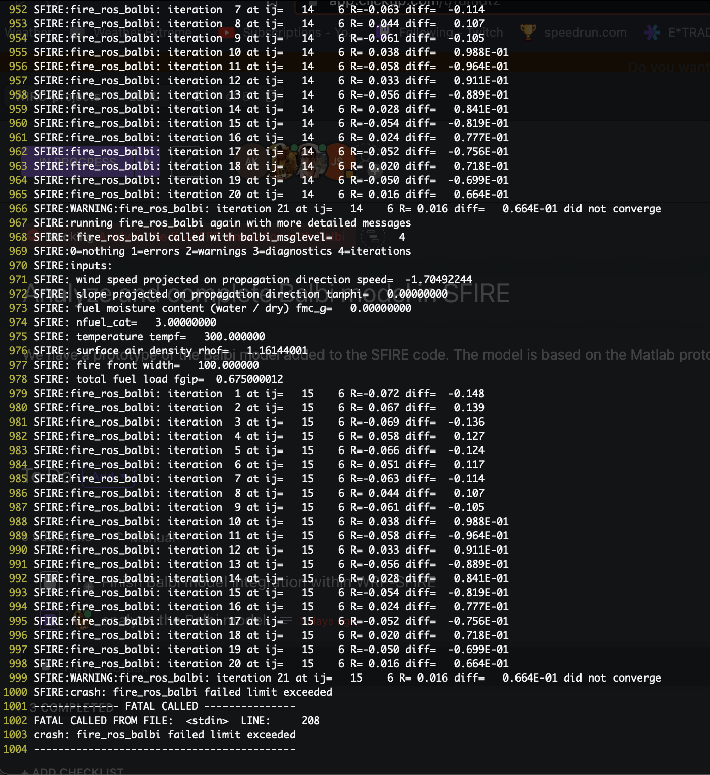
Develop-45
After the Balbi model was converted into fortran, it was implemented into WRF-SFIRE in the develop-45 branch
In this branch, I compiled the code and ran the small hill test case on the model
It unfortunately crashed
The reason behind this crash is due to the iterative method in the model
To keep the model faster than real time and to make it as accurate as possible, the developers implemented an iterative method in the model which requires a first guess for the rate of spread before it can run the full model
This model uses the base radiation as the first guess then the model iterates off that
To combat this, efforts are currently underway to not only remove the iterative method (which is accomplished in the newest Balbi model), but improve the model in terms of backfire ROS calculations

Slide 9
Negative slope and wind
To test how the model handles these conditions, experiments were conducted on the model
The full sheet can be found at:
https://docs.google.com/spreadsheets/d/1UyLDvxIrN9w5RV9439ka19G-Do0ME705IbqF1NmYmu4/edit?usp=sharing
We found that in normal and extreme conditions, the flame tilt is not tilting toward the unburnt fuel behind the fire
The convective component appears to be the main contributor to the backfire ROS, however conceptually this does not make sense

Slide 10
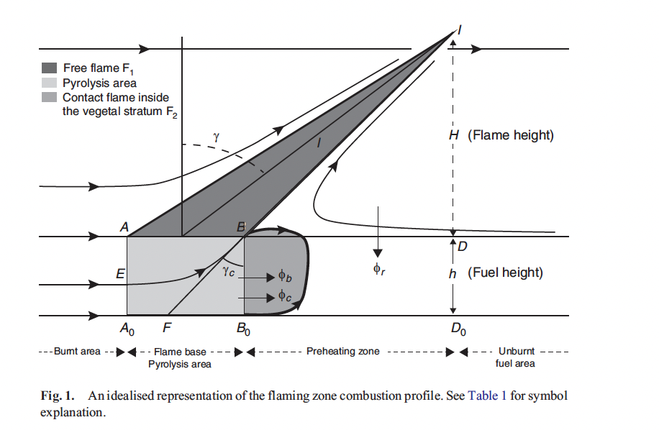

Backfire ROS diagram
Balbi model
No fuel
Flame base radiation
Fuel

Slide 11
Backfire ROS
The backfire ROS should mostly be spread by the radiative component of the fire since the flame tilt angle (gamma) should never become negative
With gamma remaining positive, and there being a lack/no fuel ahead of the fire front, then the convective component would not be contributing to the backfire ROS since it’s still contributing to the burnt fuel
The flame tilt parameter would also remain closer to the burnt fuel with a positive flame tilt angle
This indicates the Balbi model may not be able to properly calculate the backfire ROS with negative inputs
This problem has been noted in the previous slides as with the iterative process, the model has a much more difficult time converging with a negative ROS

Slide 12
Comparison between the Rothermel model
This is a part of a class project but it’s still relevant for my research, so I figured I’d include it here
This document is still in the works, but it compares the underlying assumptions from the Rothermel model to the Balbi model and goes over how they were created
https://github.com/Jeremy-Benik/164/blob/main/Assignments/draft/Rough_Draft.tex

