Slide 1
Weekly Meeting 11/11/22
By: Jeremy Benik

Slide 2
Tasks for next week
Perform an in-depth analysis on the 2009 Balbi paper (like what we did in our meeting Aurélien)
Analyze the wind speeds from the 10m and 5m resolution simulations
Analyze the fire-induced circulations at the head fire (using the main tower and East tower)
Complete
Look at flanks/backfire of the burn (wind speed, temperature, ROS)
Create powerpoint highlighting my work on the Balbi model
Complete
Begin working on nasa server now that I have more storage

Slide 3
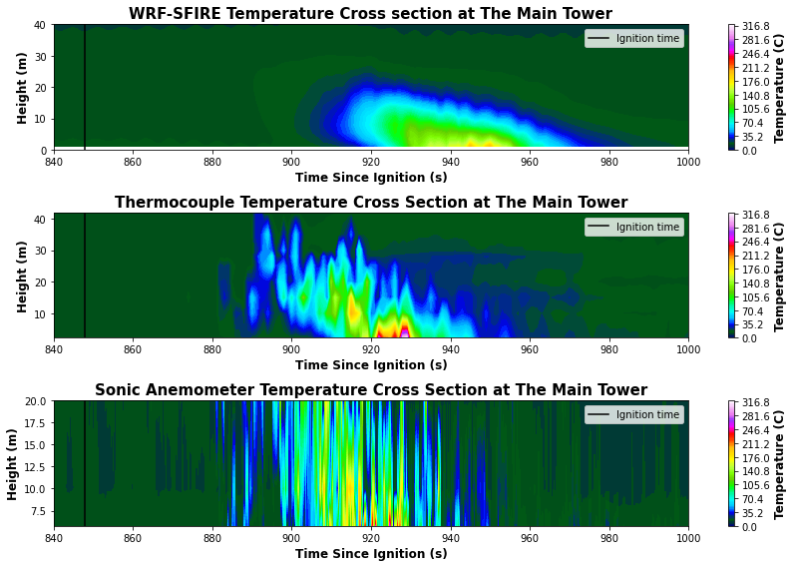
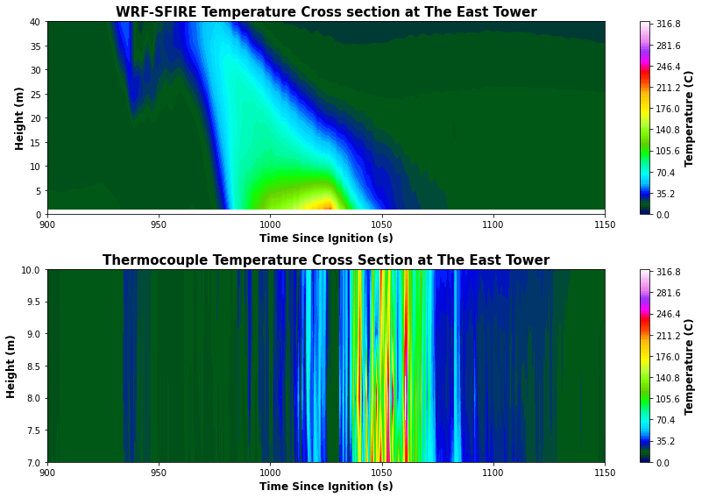
Thermocouple plots

Slide 4
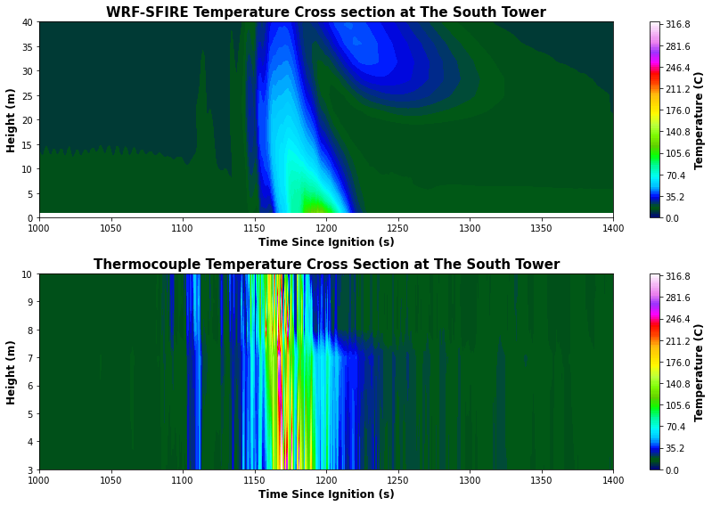
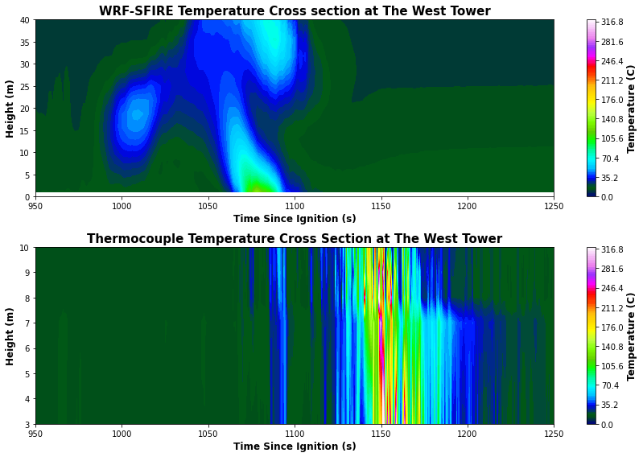
Thermocouple plots

Slide 5
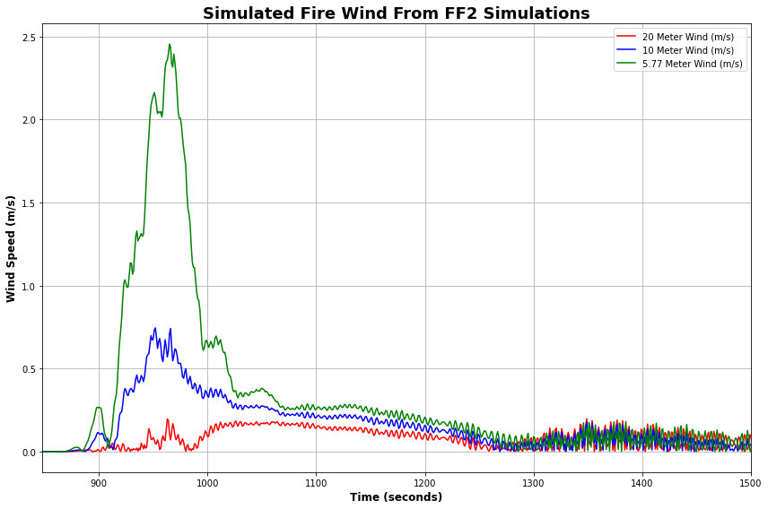
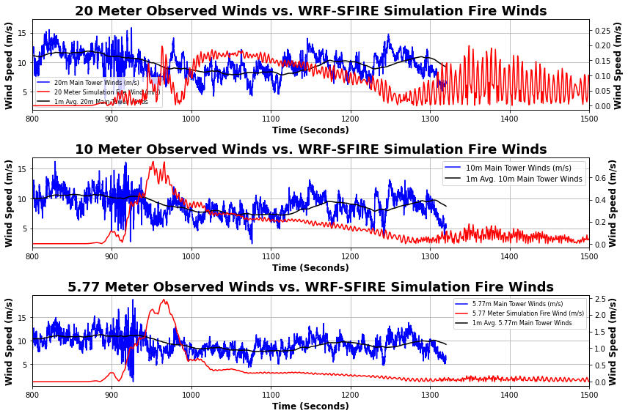
Analysis of the fire-induced circulations at the head fire

Slide 6
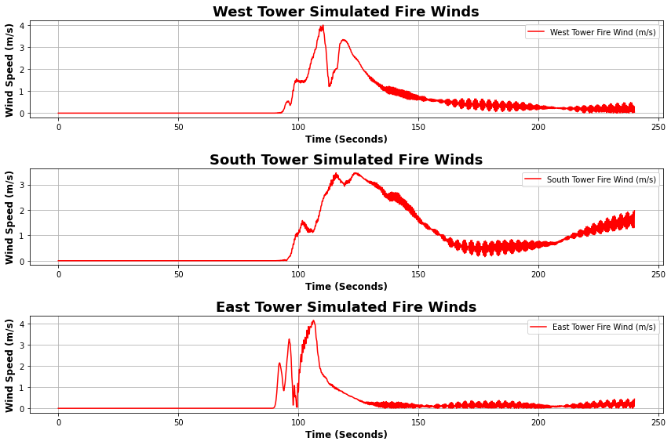
Analysis of the fire-induced circulations at the head fire

Slide 7
A document containing my analysis can be found at:

