Slide 1
Weekly Meeting 08/12/22
Jeremy Benik

Slide 2
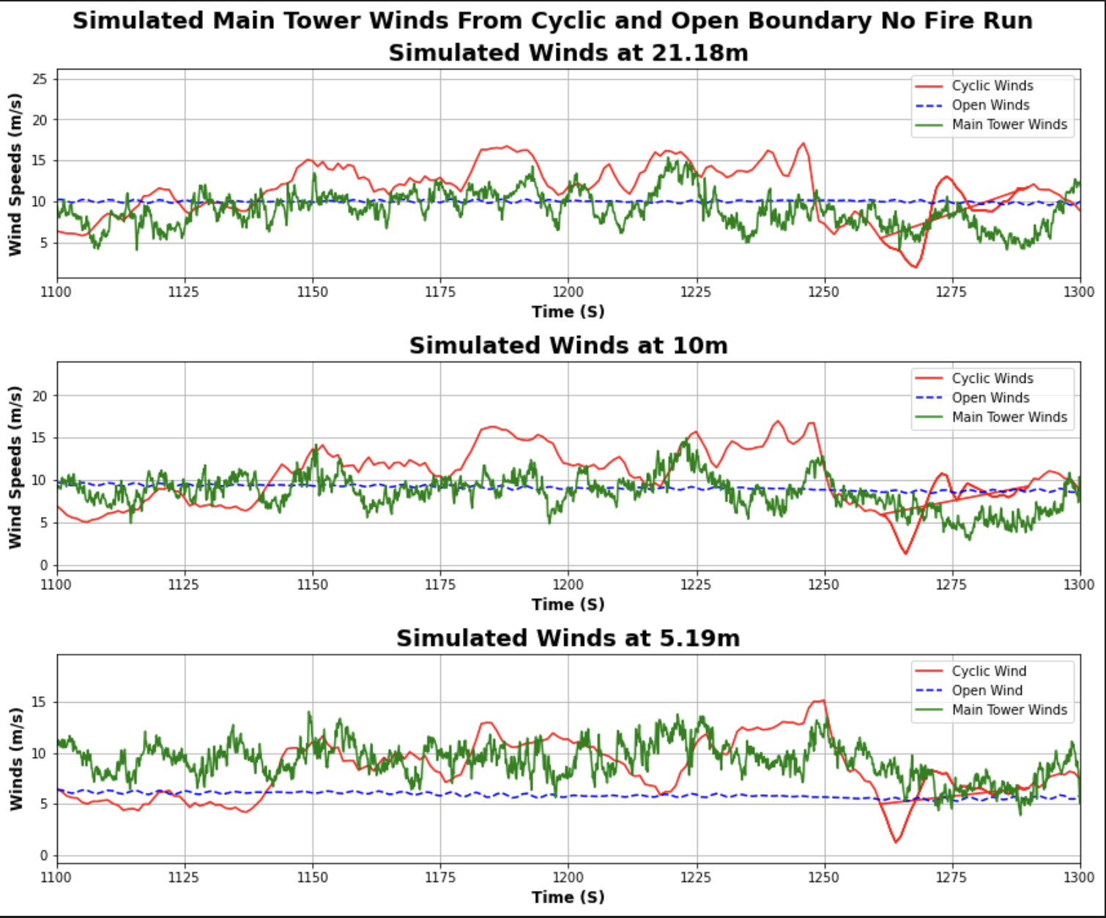
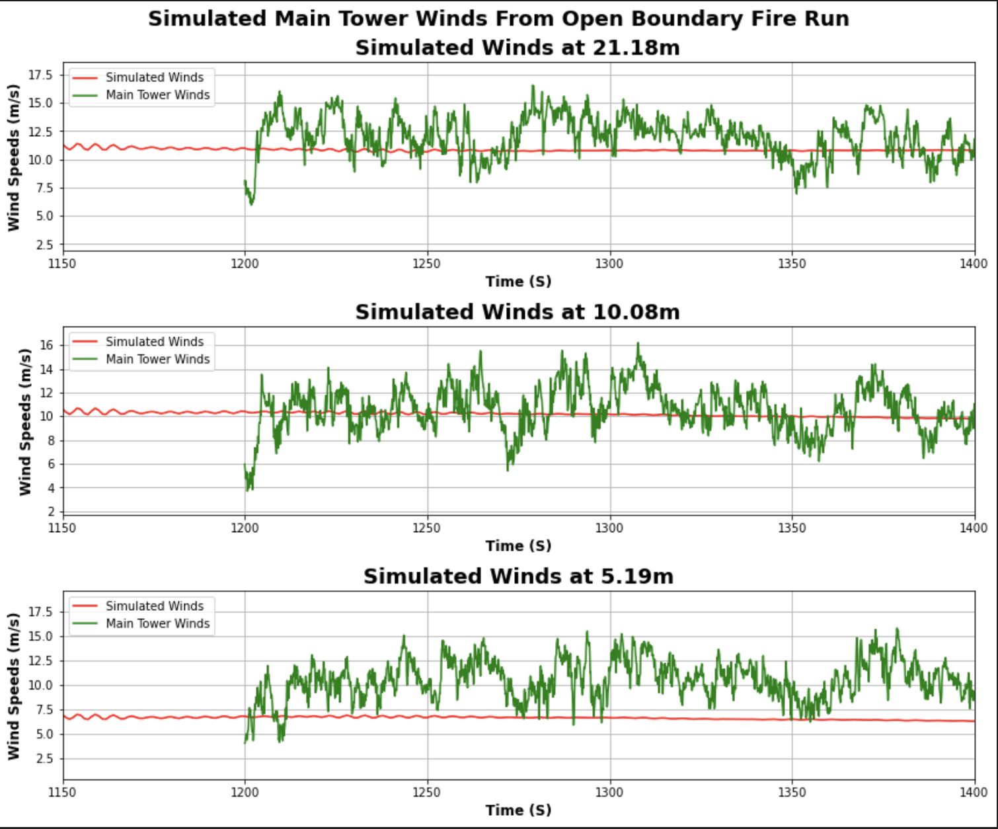
Original sounding
New Sounding
Values
Obs 20m at 1200s: 10.074452838740177
Obs 10m at 1200s: 9.176949384190804
Obs 5.77m at 1200s: 7.578555271290169
Model 20m at 1200s: 9.839414
Model 10m at 1200s: 9.047514
Model 5.19m at 1200s: 5.77198
Values
Model 20m at 1200s: 8.861061
Model 10m at 1200s: 10.399845
Model 5.19m at 1200s: 6.771331

Slide 3
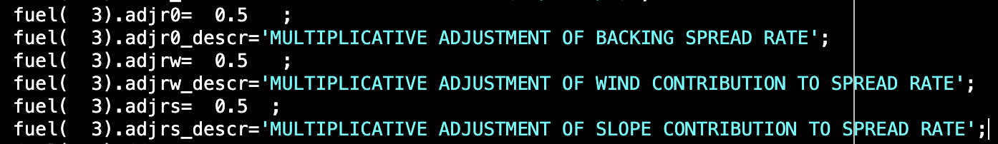
Rothermel model
Here are the changes I made to the model to get results other than 6m/s
I changed the formula to include the 0.00508 adjustment factor, and I read in the other adjustment factors and multiplied the wind, slope, and r_0 by those adjustment factors to get my results
Equation used to calculate the ROS
ros = (r_0 * .00508 * fuel_adjr0) + ((r_0 * phiw * fuel_adjw) * .00508) + ((r_0 * phis * fuel_adjs) * .00508)

Slide 4
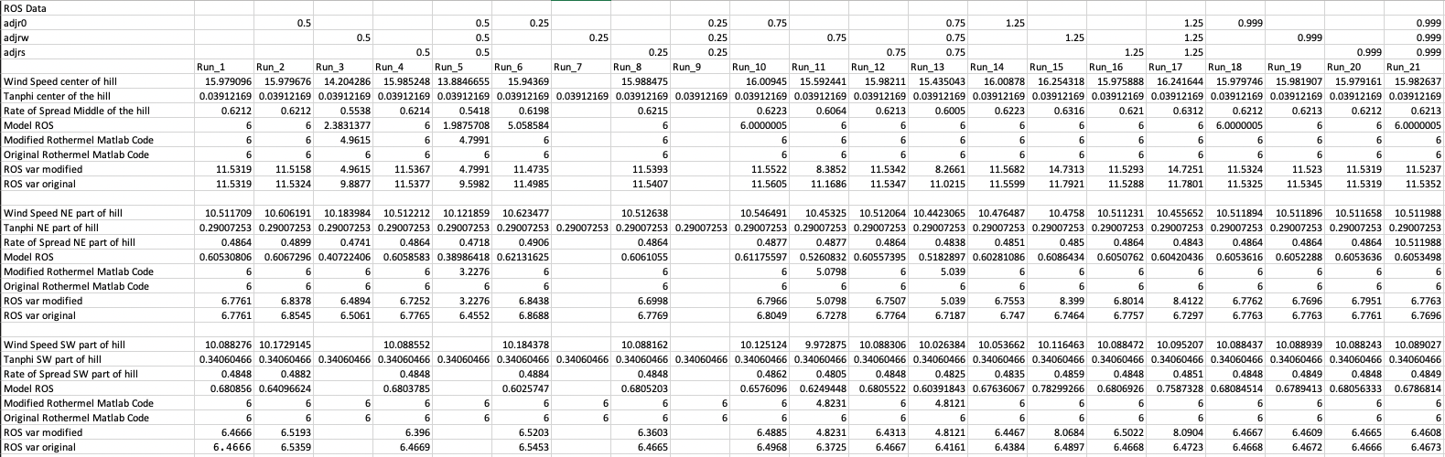
Rothermel Results

