Slide 1
Weekly Meeting 10/21/22
By: Jeremy Benik

Slide 2
Last Week To do
Compile WRF-SFIRE on nasa server
In progress
Install Anaconda on Nasa cluster
In progress
Write the paper for LLNL about my progress
Complete
Run the 10_11 simulation on Cheyenne
Complete
Setup FF2 simulation for Backfire ROS for Jan on Cheyenne
In progress. Cheyenne was down for maintenance

Slide 3
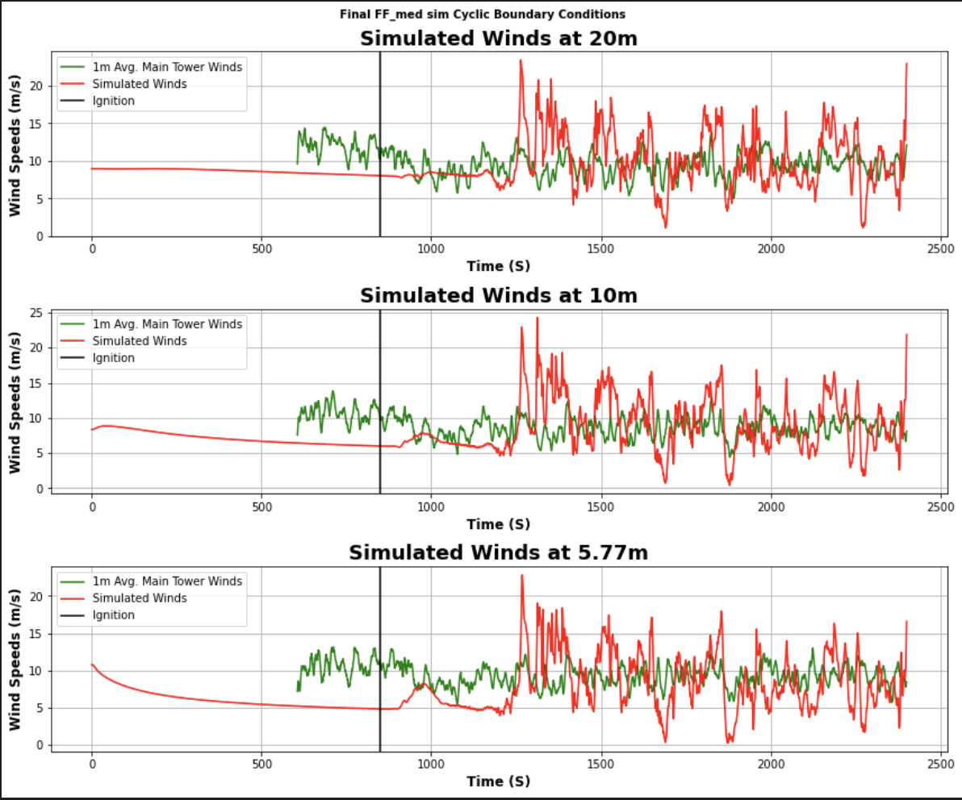
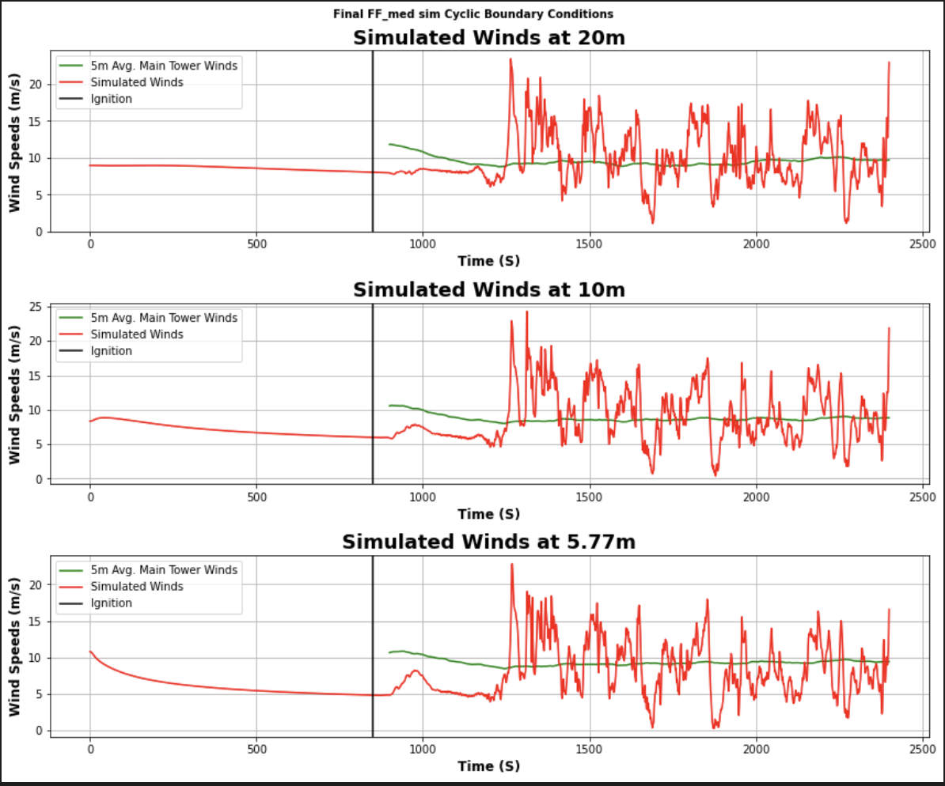
Cyclic Boundary conditions

Slide 4
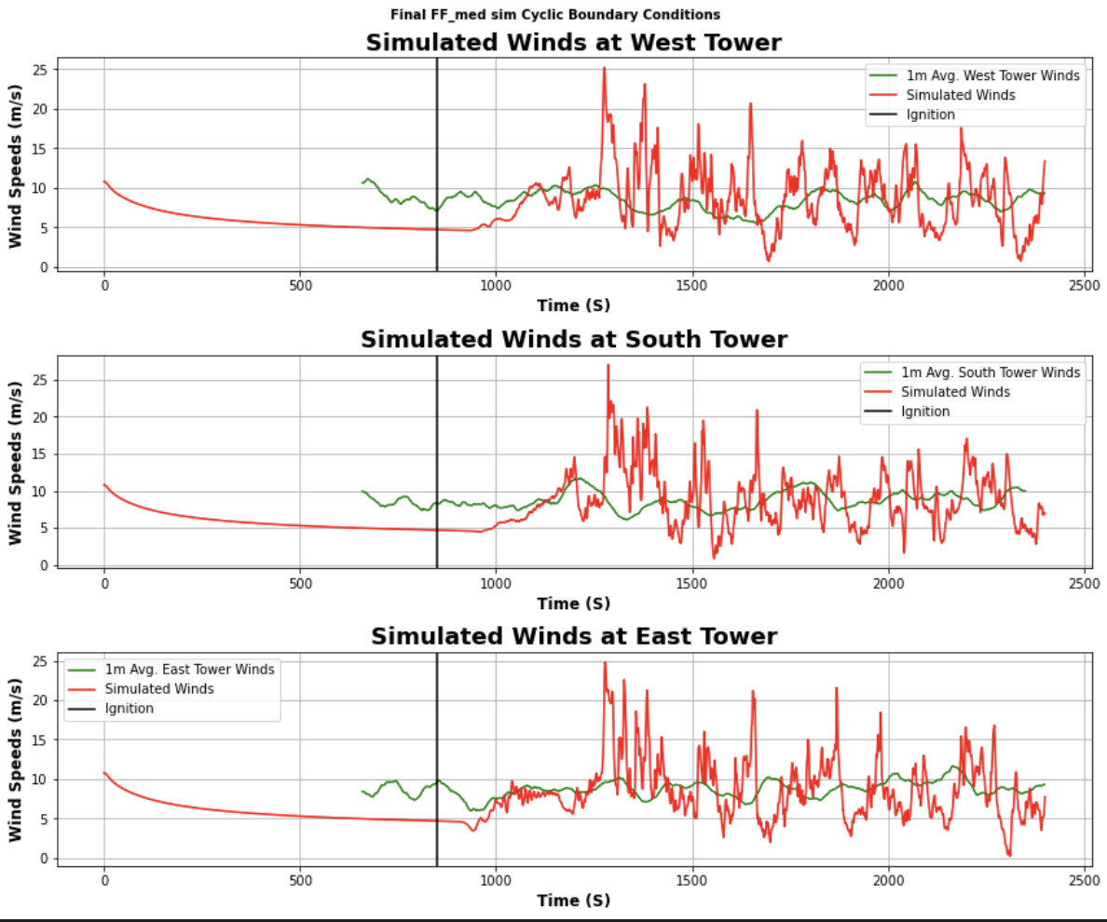
Cyclic Boundary conditions

Slide 5

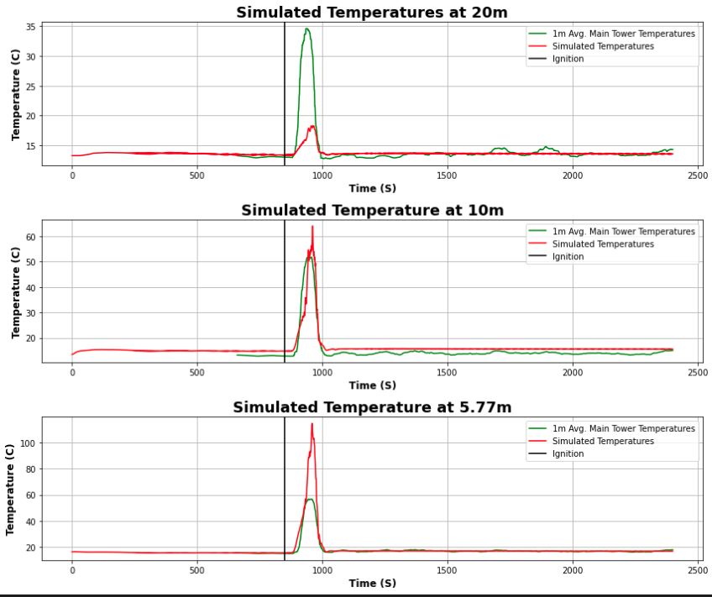
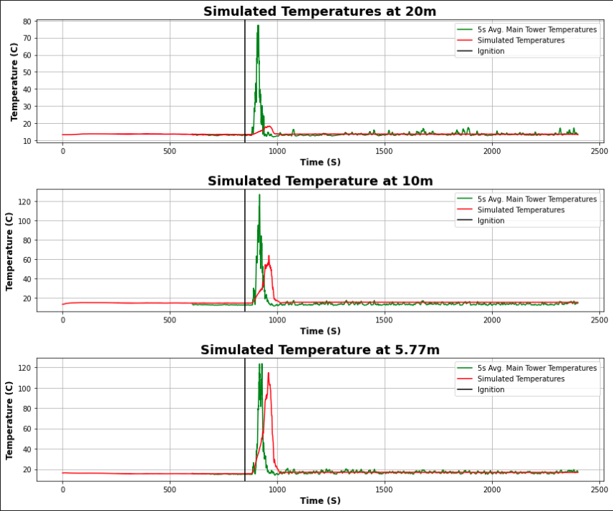
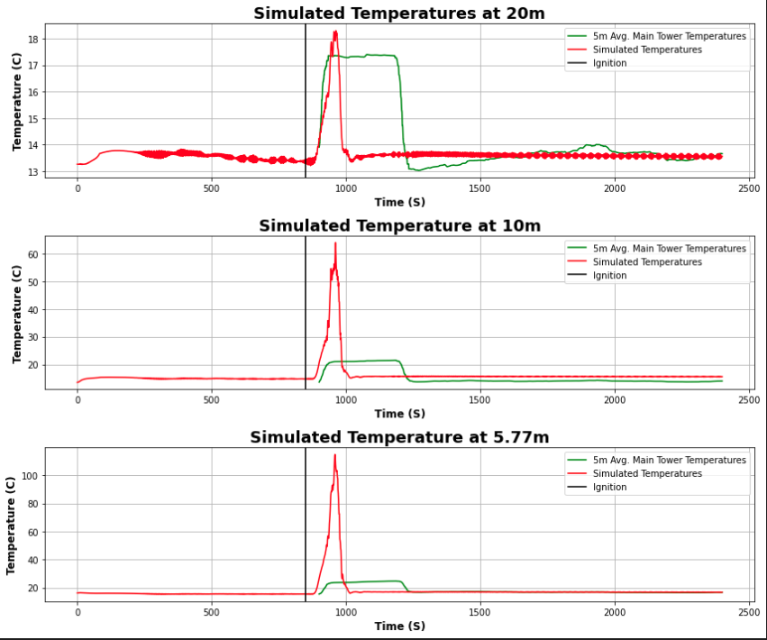

New simulation Temperature

Slide 6
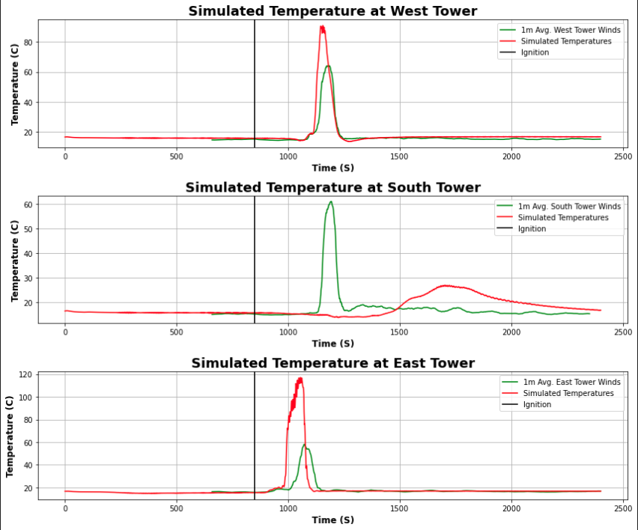
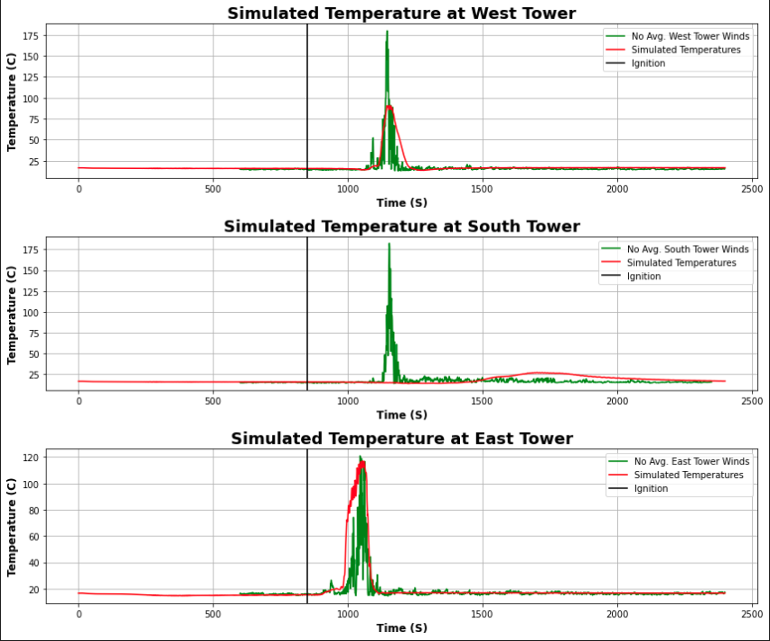
Short tower temperature

Slide 7
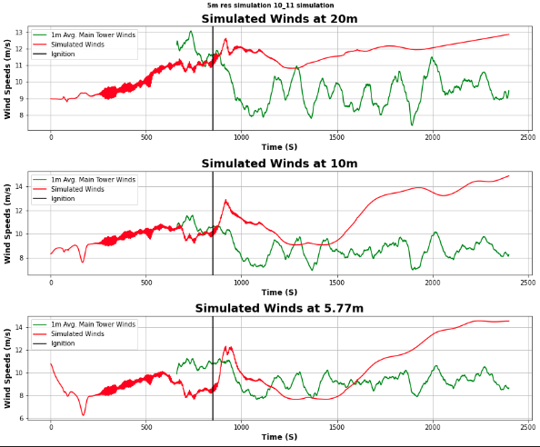
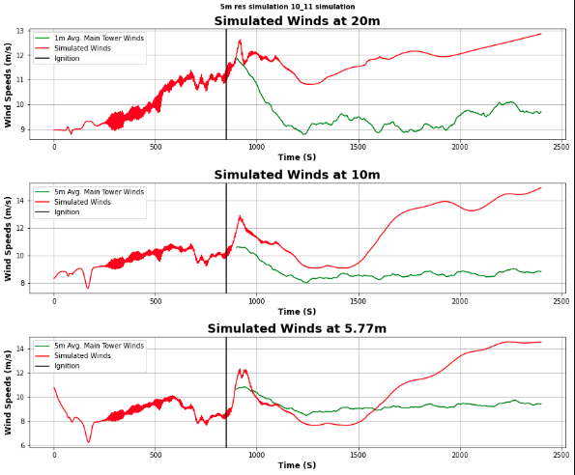
5m resolution simulation winds

Slide 8
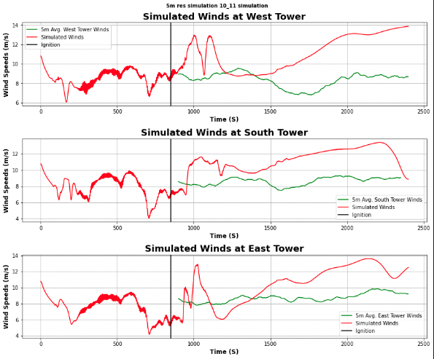
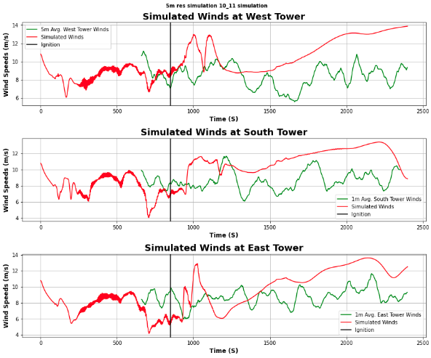
5m resolution simulation winds

Slide 9
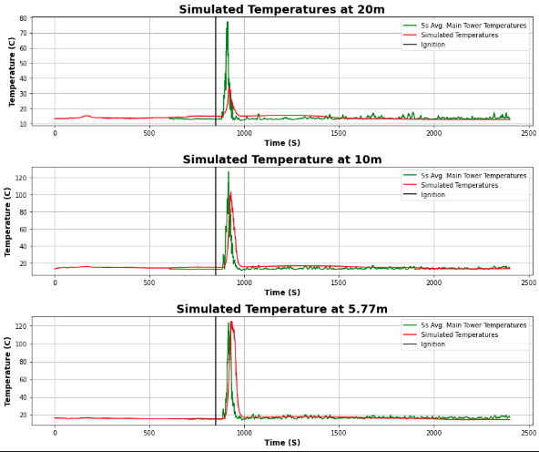
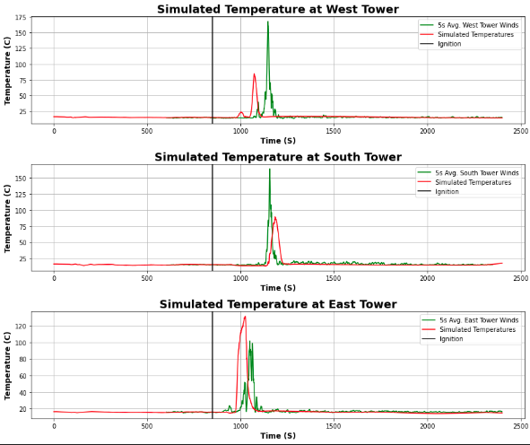
5m sim temperatures 5s averages

Slide 10
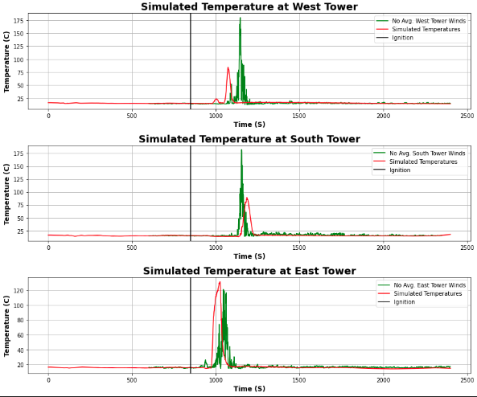
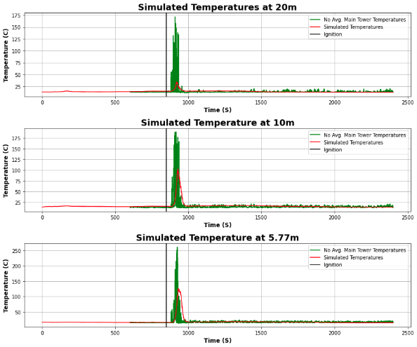
5m sim temperatures

Slide 11
Nasa server updates
This week on the Nasa server, I downloaded and began installing wrfxpy
I also installed Anaconda
This is where I ran into some issues
The home directory is only 8gb and the scratch (nobackupp12) is only 1tb
To get more storage, I would need to use Lou, but I’m not able to run on there as that’s a storage server
If there’s a way to get the storage on lou, and have the necessary files (WRF-SFIRE, anaconda, WPS, WPS_GEOG), then I can install and run wrfxpy

Slide 12
Nasa server updates
To fix these issues, I emailed the support for more storage, and I moved installed globus on their server
I have transferred WPS_GEOG over to the server and am awaiting my swbuild account to install anaconda, WRF-SFIRE, WPS, and wrfxpy
Now I can really start to build wrfxpy

Slide 13
WRF and wrf-sfire namelist.fire
After taking a look at the WRF directory, there are only two test cases that I can use
Rain
Two_fires
The ultimate goal of this task is to compare the namelist.fire files
After running diff on them, it turns out they are the same file and they did not implement the 40 Scott and Burgan categories
I looked through the different branches as well and the last update to the namelist.fire file was 12 years ago, even in the most recent branches

Slide 14
To do
Install anaconda on the nasa server (again)
Waiting on my swbuild
Configure and compile WRF-SFIRE with dmpar
Waiting on my swbuild
Install wrfxpy
Waiting on my swbuild
Update the fuel categories in the namelist.fire based on the Scott and Burgen fuel categories
Analyze the 5m resolution FF2 simulation
In progress
Analyze the 10m FF2 simulations and compare the fire and no fire run
Create a presentation about my Balbi model findings
Identify the flame length in the videos from Aurelien
Generalization of Balbi model for WRF-SFIRE
Look at the backfire ROS and the flank ROS observed during the FF2.
Generalization of Balbi model for WRF-SFIRE
Read and analyze the Balbi 2007 paper (164)
Test the Rothermel model (164)
Go to Canyon Burn
Cross section plot
Horizontal wind and temperature, and fire location (animation.py)
Thermocouples
Check differences between 5m and 10m run
Fire propagation is different among the plots (the south and west tower)

Slide 15
To do
Analyze the 5m resolution FF2 simulation
In progress
Analyze the 10m FF2 simulations and compare the fire and no fire run
Create a presentation about my Balbi model findings
Identify the flame length in the videos from Aurelien
Generalization of Balbi model for WRF-SFIRE
Look at the backfire ROS and the flank ROS observed during the FF2.
Generalization of Balbi model for WRF-SFIRE
Read and analyze the Balbi 2007 paper (164)
Test the Rothermel model (164)
Go to Canyon Burn
Cross section plot
Horizontal wind and temperature, and fire location (animation.py)
Thermocouples
Check differences between 5m and 10m run
Fire propagation is different among the plots (the south and west tower)

