Slide 1
Weekly Meeting 10/28/22
By: Jeremy Benik

Slide 2
Last week To do
Install anaconda on the nasa server (again)
Got swbuild and storage
Configure and compile WRF-SFIRE with dmpar
Got swbuild and storage
Install wrfxpy
Got swbuild and storage
Update the fuel categories in the namelist.fire based on the Scott and Burgen fuel categories
Complete
Analyze the 5m resolution FF2 simulation
In progress
Analyze the 10m FF2 simulations and compare the fire and no fire run
Create a presentation about my Balbi model findings
Identify the flame length in the videos from Aurelien

Slide 3
Last week To do
Look at the backfire ROS and the flank ROS observed during the FF2.
Generalization of Balbi model for WRF-SFIRE
Read and analyze the Balbi 2007 paper (164)
Complete
Go to Canyon Burn
Complete
Cross section plot
Complete
Thermocouples
Trying to find them on the database
Check differences between 5m and 10m run
Complete

Slide 4
Accomplishments this week
Got swbuild directory and more space on the nasa server so I can start building wrfxpy
Created multiple cross sections of the temperature vs height vs time to see how the fire progresses at the towers
Compared the temperature from the 10m resolution and the 5m resolution simulation to the observations to see if the difference in resolution is changing the ROS within the model
Plot the thermocouple data
Update the namelist.fire in WRF with the 40 Scott and Burgen fuel categories
Met with Aurélien about the Balbi model

Slide 5
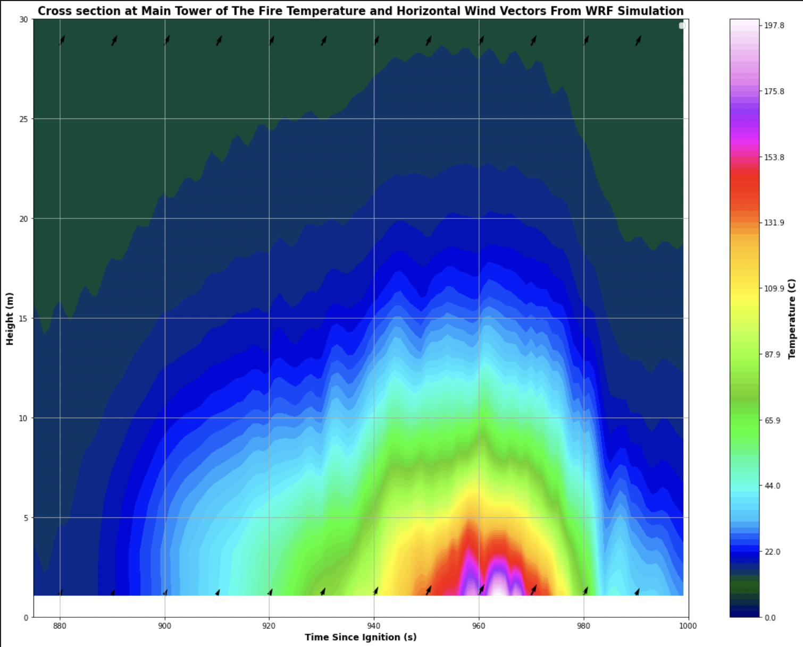
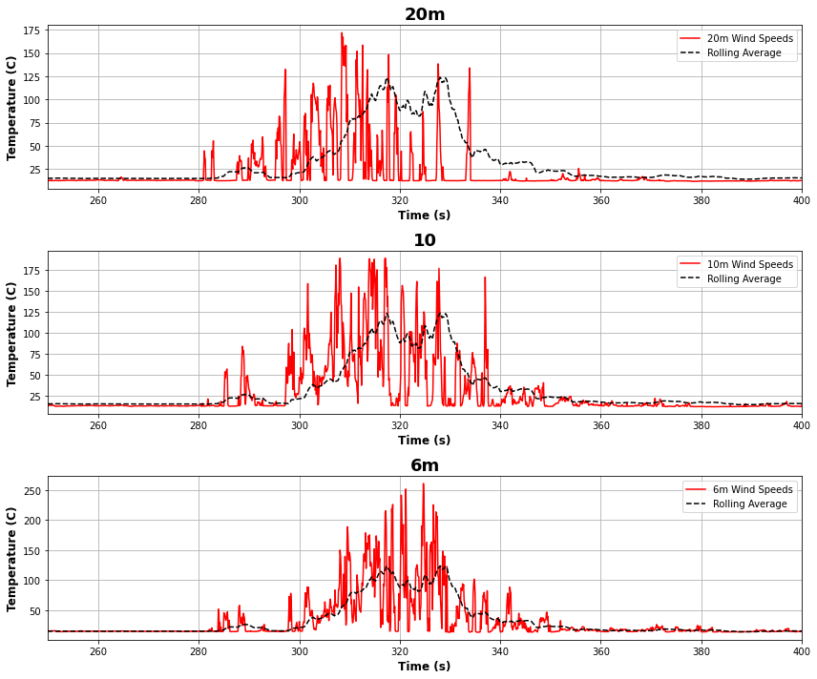
Cross section of temperature 10m res

Slide 6
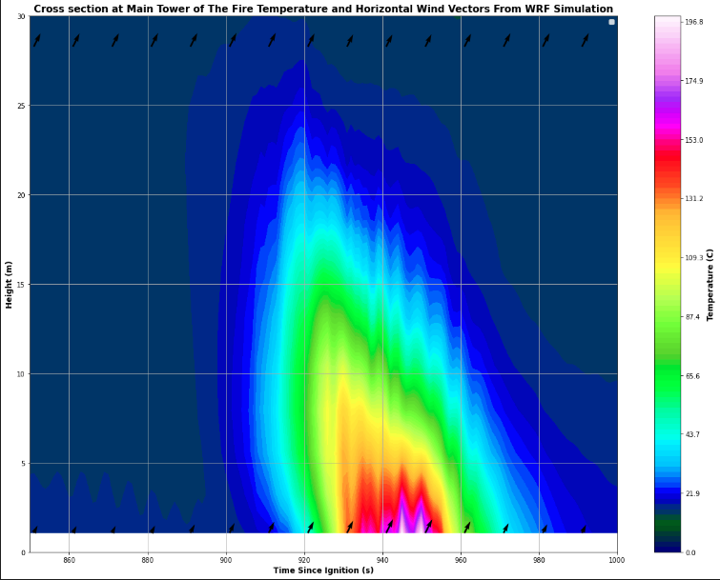
Cross section of temperature 5m res

Slide 7
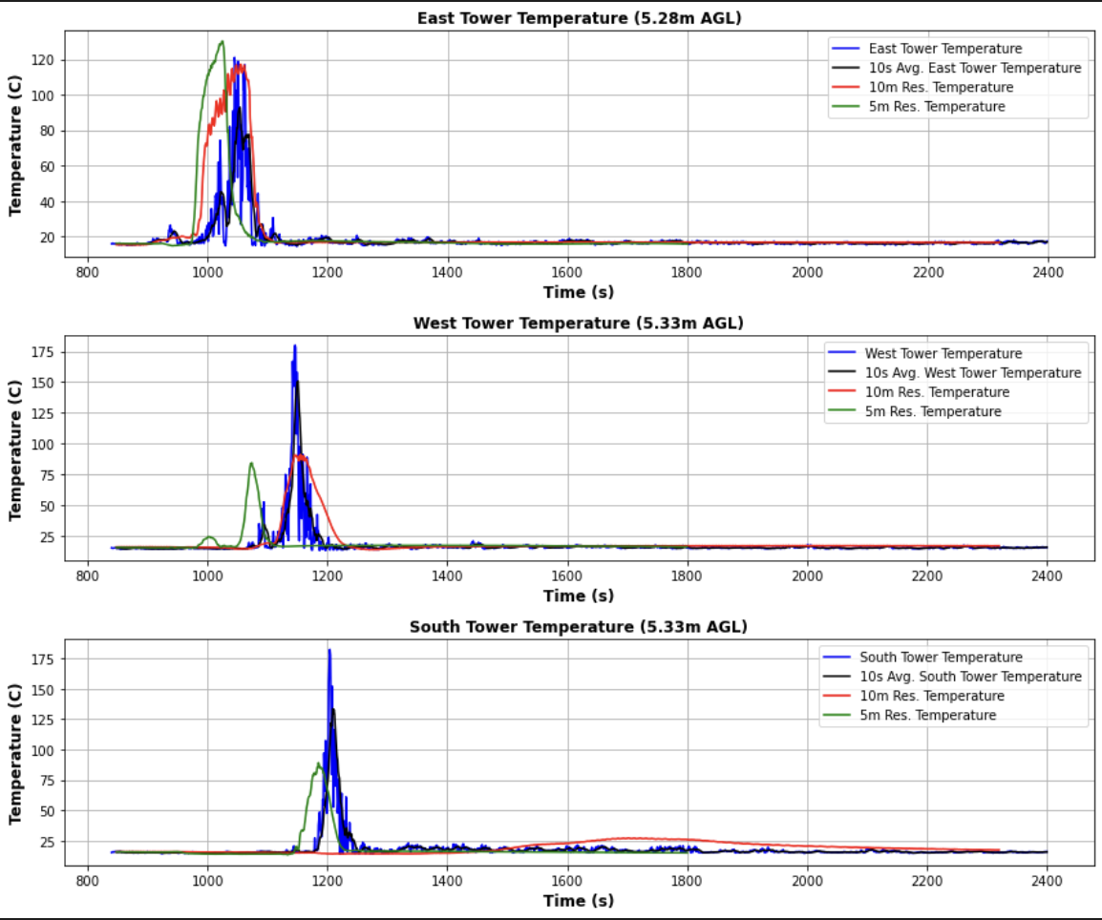
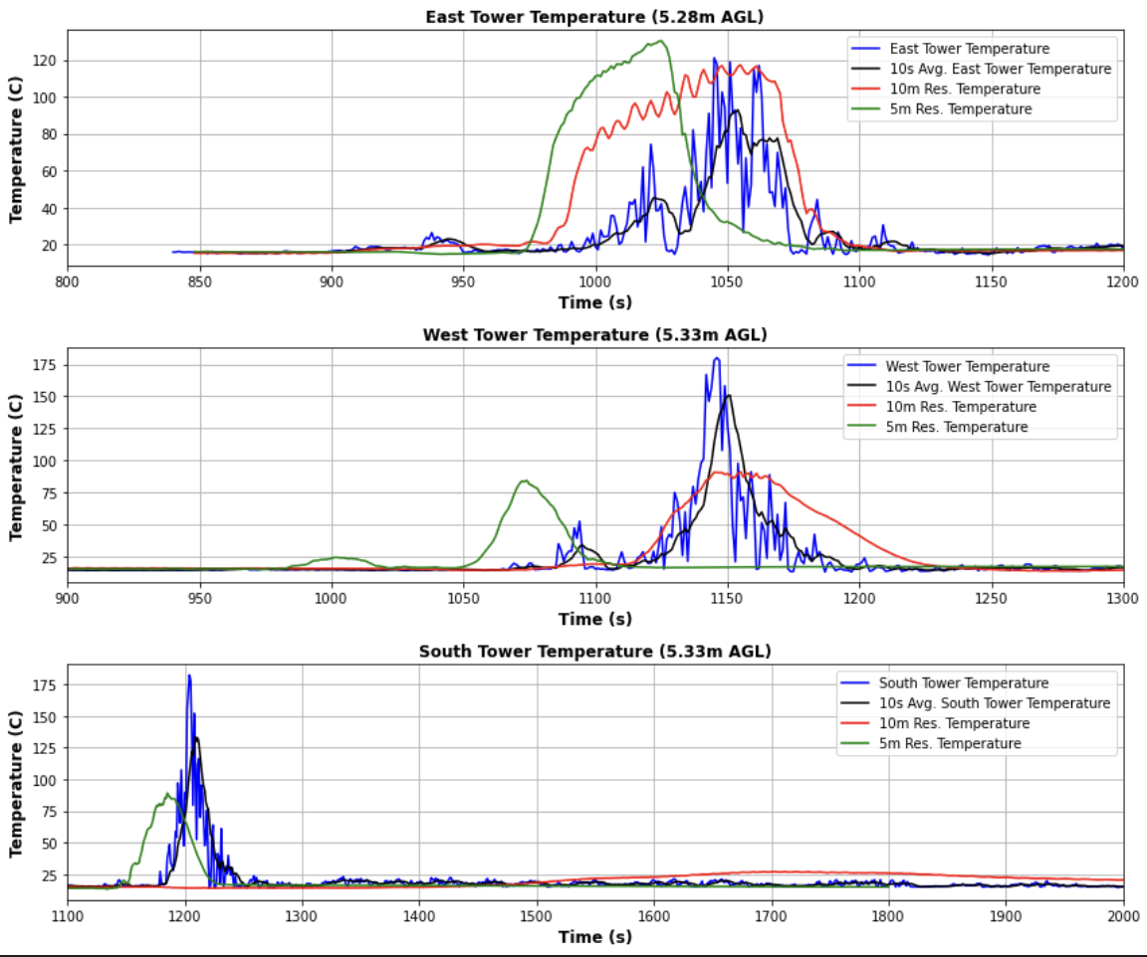
Comparing 5m to 10m res simulations

Slide 8
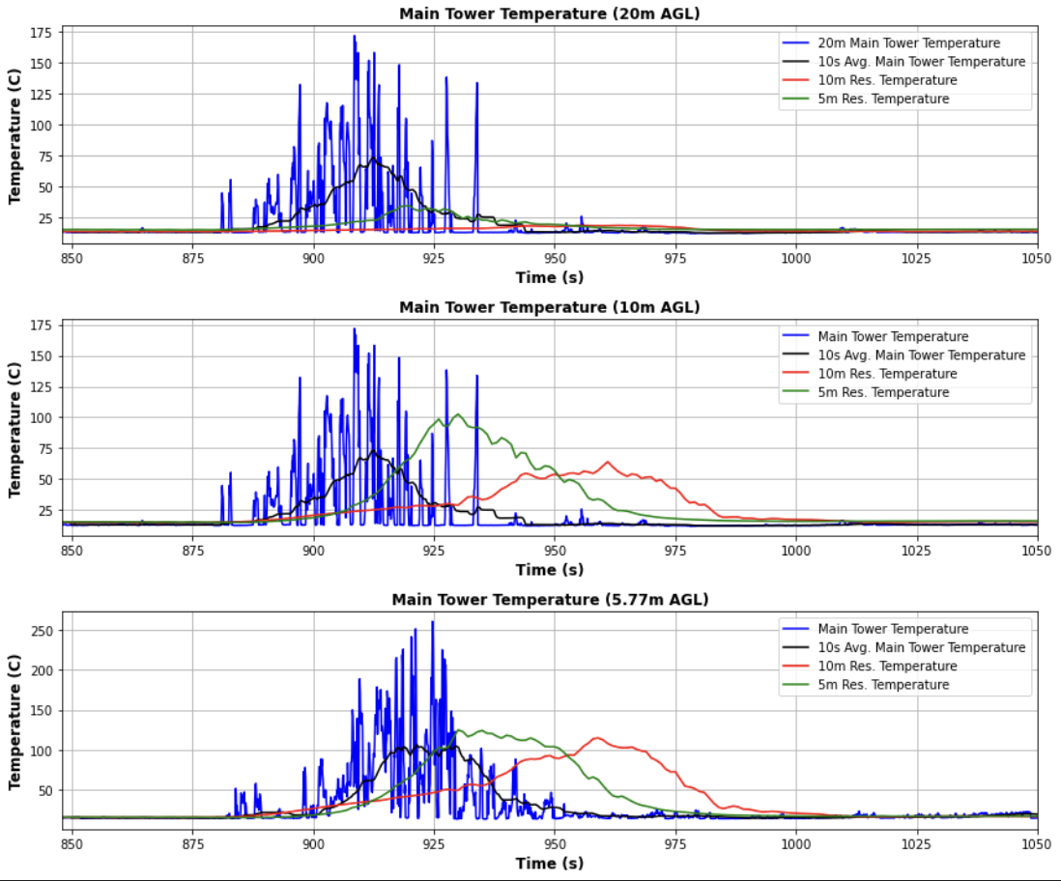
Comparing 5m to 10m res simulations

Slide 9
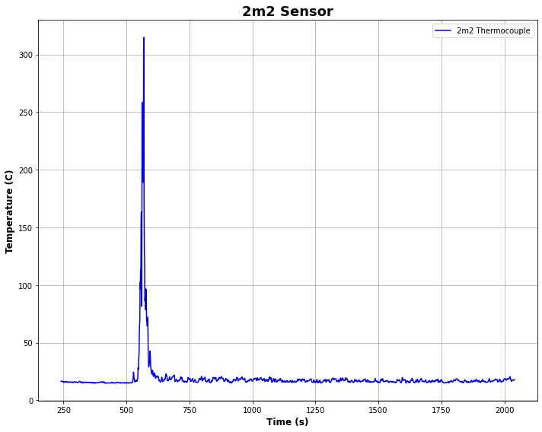
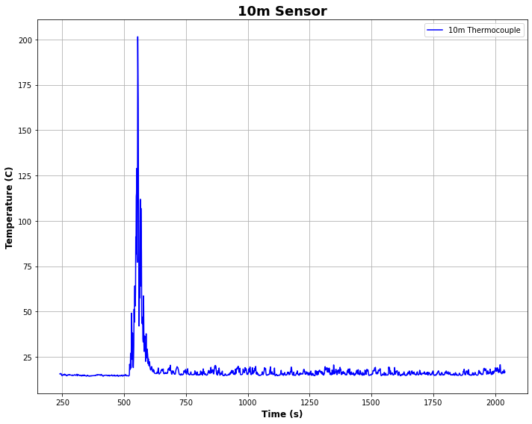
Thermocouple data

Slide 10
Tasks for next week
Compare the thermocouple data to the simulation
Perform an in-depth analysis on the 2009 Balbi paper (like what we did in our meeting Aurélien)
Learn about LaTeX
Analyze the wind speeds from the 10m and 5m resolution
Analyze the fire-induced circulations at the head fire (using the main tower and East tower)
Look at flanks/backfire of the burn (wind speed, temperature, ROS)

Slide 11
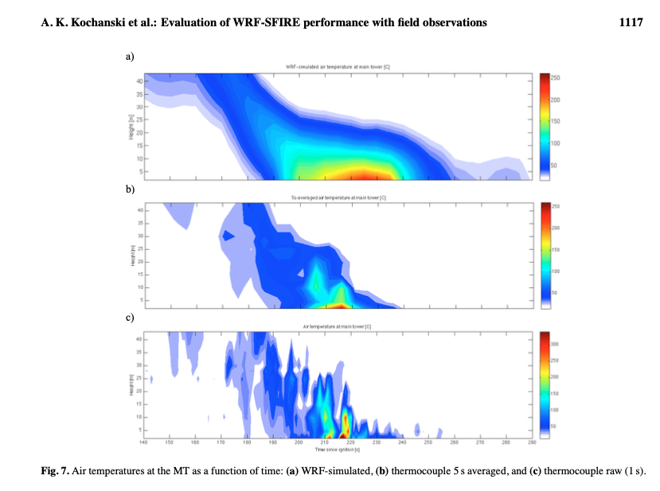
questions
Where is the thermocouple data for the short towers?
I have found some data but nothing during the ignition
How do I create a contour plot using the observations collected from the thermocouples and the towers?
Like this plot

