Slide 1
Weekly Meeting 11/04/22
By: Jeremy Benik

Slide 2
Tasks for Last Week
Compare the thermocouple data to the simulation
Complete
Perform an in-depth analysis on the 2009 Balbi paper (like what we did in our meeting Aurélien)
Learn about LaTeX
Analyze the wind speeds from the 10m and 5m resolution simulations
Analyze the fire-induced circulations at the head fire (using the main tower and East tower)
Look at flanks/backfire of the burn (wind speed, temperature, ROS)

Slide 3
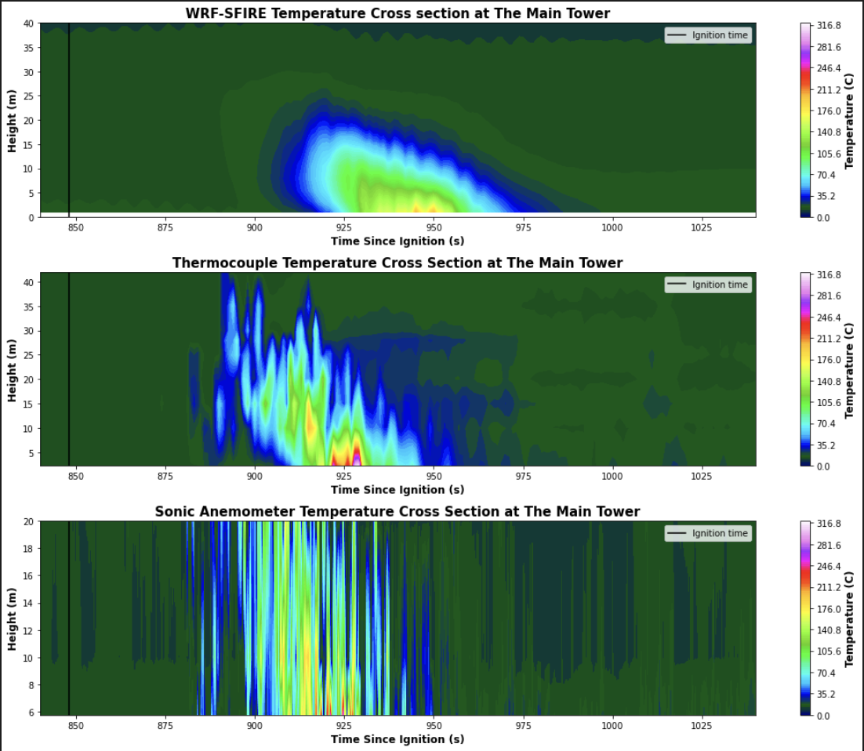
Compare the Thermocouple data to the simulation

