Slide 1
Weekly Meeting 08/19/22
By: Jeremy Benik

Slide 2
Last Week To Do
Rerun FireFlux_med with new sounding
Currently being worked on
Re-test the Rothermel code
Done
Write report on pressure sensors
Waiting for final FF2 simulation before I can write the report
Fix xquartz
Reset my laptop and that worked
Finish powerpoint for Jan
Now that the Rothermel code is finished, I can start working on this and showing him the errors
Be sure to mention how I calculated the backfire ROS for the FF2 simulations
Write my abstract
In progress
SODAR Data
Read into python and added to original sounding

Slide 3
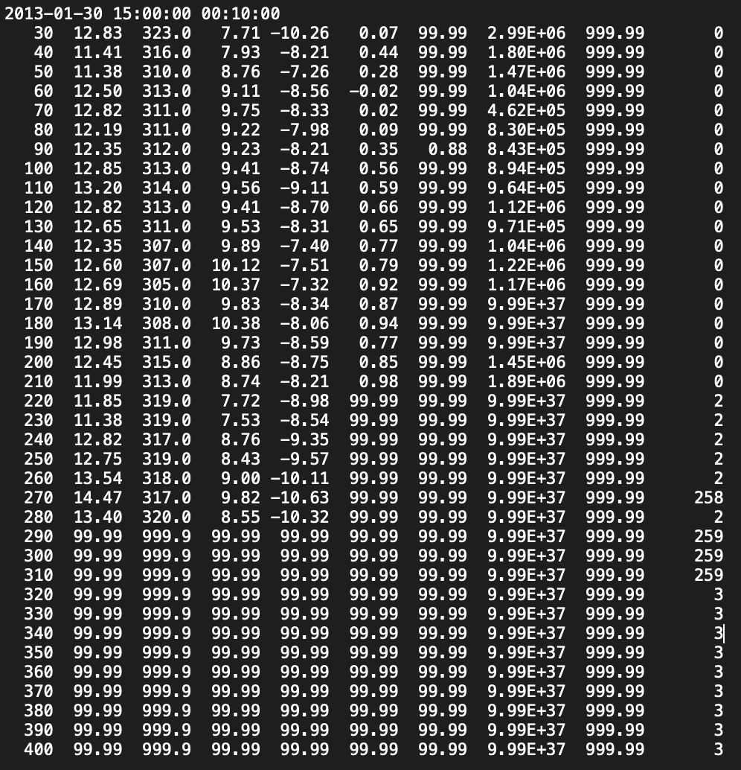
SODAR Data
Since the SODAR data only has data from 30m - 280m (there are nan values after 280m), those are the heights I added into the sounding
The sounding only goes up until 20m, then increases to 259.9m which is a large jump without any wind data
Now I must find the potential temperature and the water vapor mixing ratio for all those heights before it can be implemented into the sounding
One issue is the data has a lot of nan values, meaning I may need to pick a time other than 15:00 so there aren’t as many nan values

Slide 4
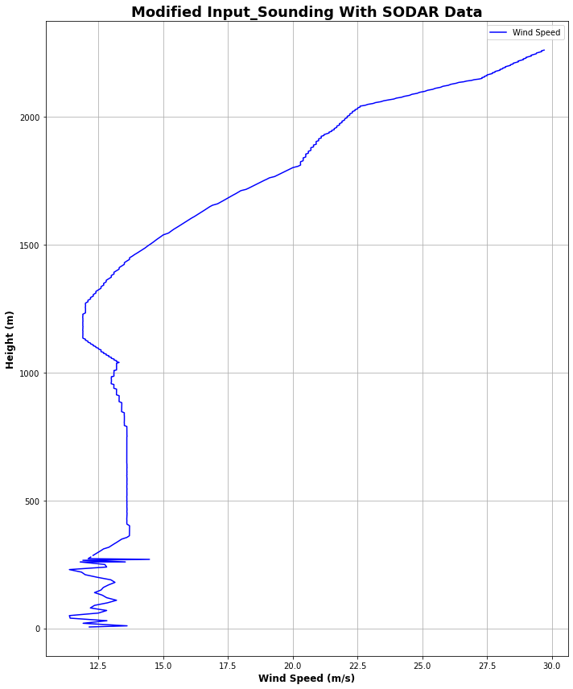
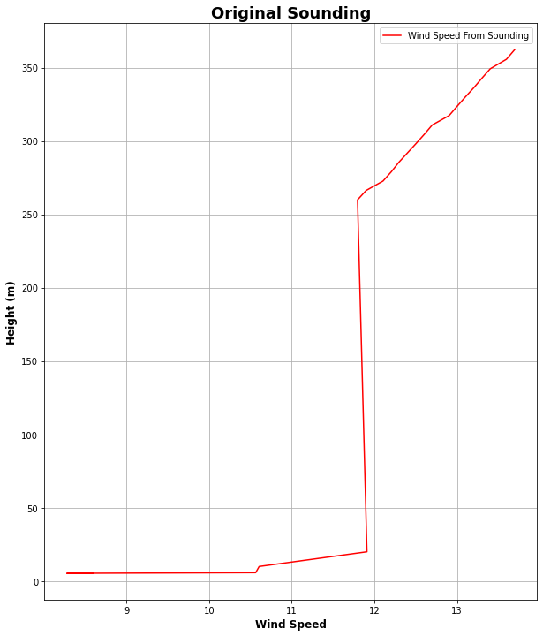
SODAR Data
I added in the data from Jan 30, 15:00 to the original input_sounding to see how it would affect it

Slide 5
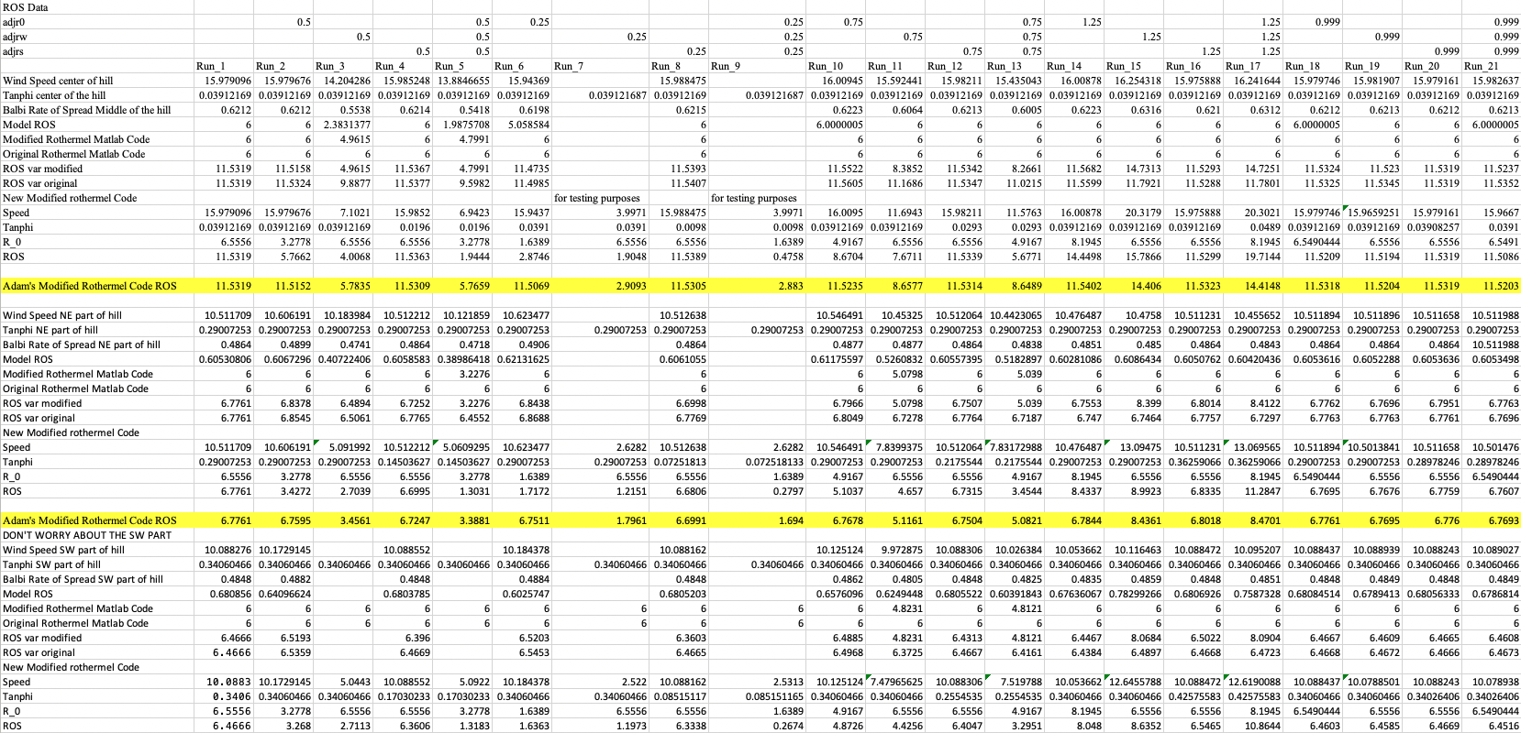
Rothermel Code
After modifying the code to take in the adjustment factors as inputs, and adding them to the code, there is a much greater difference among the rate of spread
Now adjustment factors will better change the variables in the code
I.e. 0.5 adjw will cut the wind speeds in half

Slide 6
Checking my initial Z0 value
Since z_0 was put in the incorrect location in the file, I changed it to be in the winter location of the LANDUSE.TBL (line 91)
To verify the z_0 value, I input them into the roughness length equation with the different height values

Slide 7
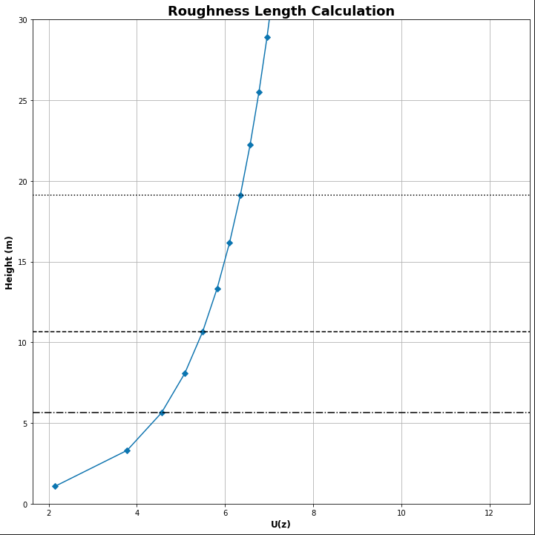
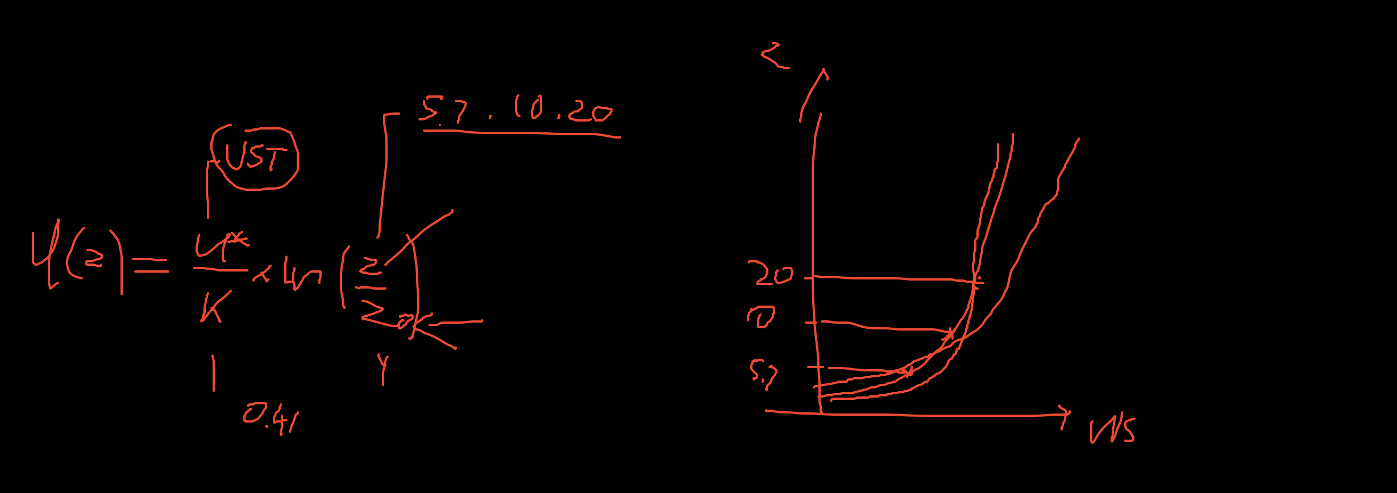
Roughness Length Calculation
https://www.eol.ucar.edu/content/calculation-roughness-length-and-displacement-height

Slide 8
Questions
For computing the roughness length, I modified the equation to solve for z_0, and I’m getting varying results per height level, are there any specific results I should stick with for this experiment?
Should I use the result closest to the ground or should I average them all out?

Slide 9
To Do
Run the new sounding with open and cyclic boundary conditions
Both fire_atms = 0
Modify the input_sounding
Verify the wrfinput file
Write my abstract
Finish powerpoint for Jan
Write report on pressure sensors
Waiting for final FF2 simulation before I can write the report

