Slide 1
Weekly Meeting 09/02/22
By: Jeremy Benik

Slide 2
Last Week to do
Modify the input_sounding
Done
Finish powerpoint for Jan
Completed: It can be found at: https://github.com/Jeremy-Benik/Meeting_Notes/blob/main/Presentations/Adjustment_Factors.pptx
Write report on pressure sensors
Waiting for final FF2 simulation before I can write the report

Slide 3
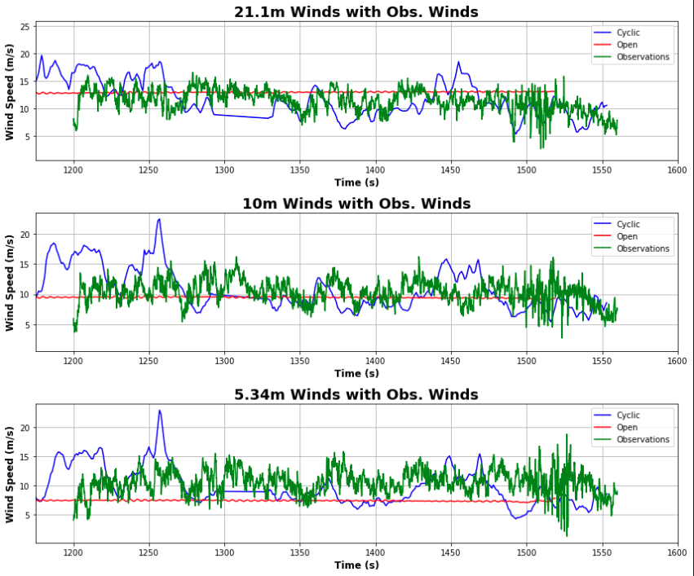
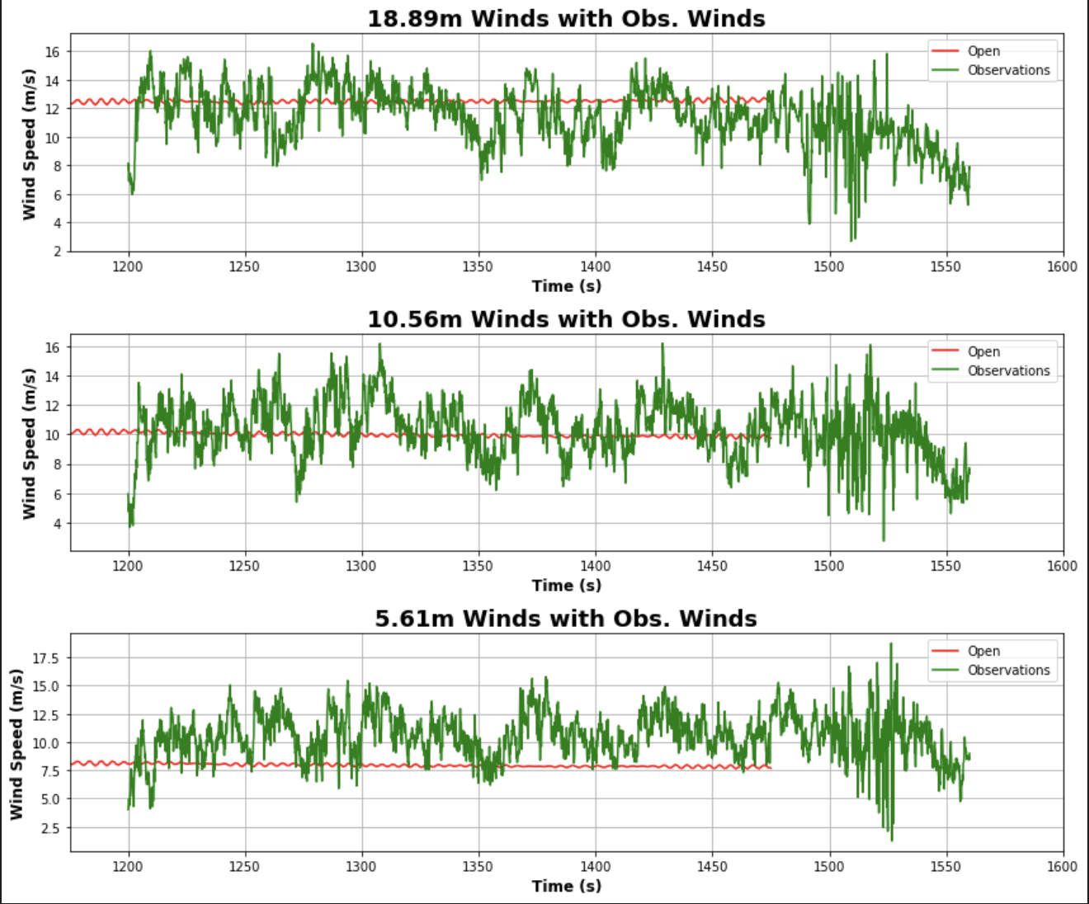
New input_sounding and z0 Comparison
Base Run (0.5 z0 and observations for sounding)
New Run (0.4 z0 and 1m/s added to 5.46m in sounding)

Slide 4
Statistics
For the new simulation, I decreased the z0 by .1 (0.4 instead of 0.5), and I increased the overall wind speed at 5.46m by 1m/s
Old sounding and z0
New sounding an z0
Input_sounding
Height | Wind Speed
21.1m | 12.81
10m | 9.50
5m | 7.41
Height | Wind Speed
22m | 13.11
10m | 10.17
5m | 8.12
Height | Wind Speed
20m | 11.91
10m | 10.61
5.46m | 9.15
Something to keep in mind, the levels are different since the heights vary with the simulations
Just focusing on the 5m winds here, these changes increased the winds by about 0.71

Slide 5
Organizing codes
This week I also went through all my codes on the server and my github and organized them so they are easier to identify and find

