Slide 1
LLNL Presentation 08/26/2022
By Jeremy Benik

Slide 2
outline
SODAR Data
Verifying z0 value
Running code to calculate the z0 value based on an array of different possibilities
Re-running the fireflux_med case to verify the new z0 value
Verifying the input_sounding with the wrfinput
Updates on the Rothermel Code
To Do

Slide 3
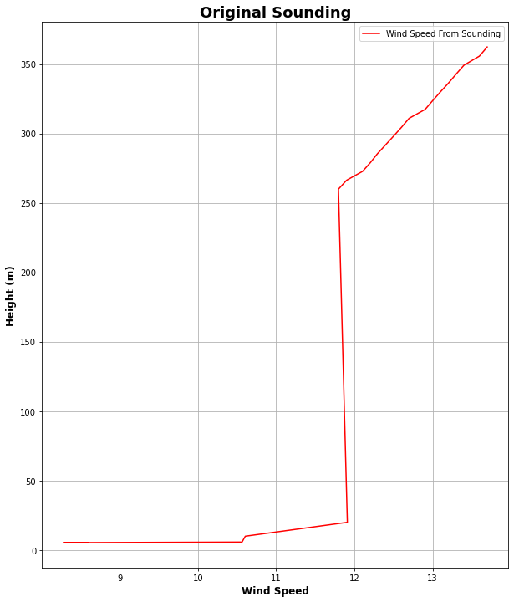
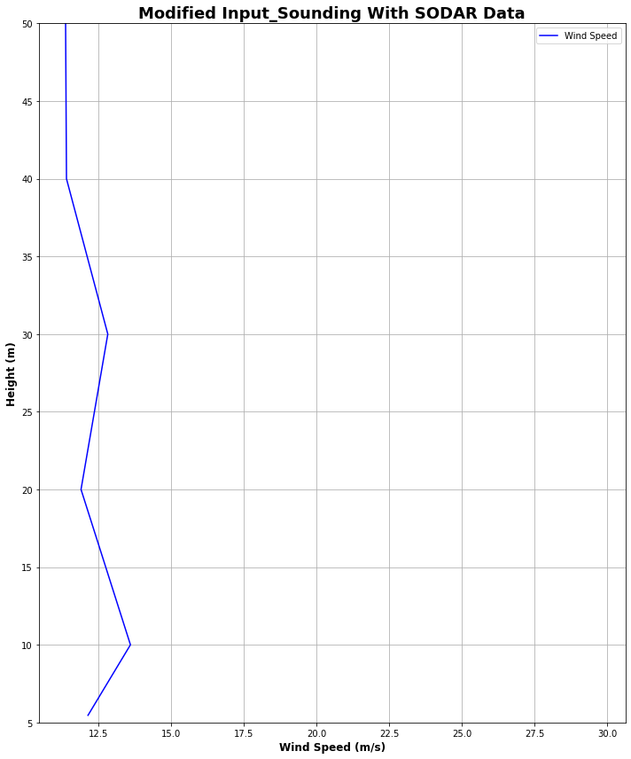
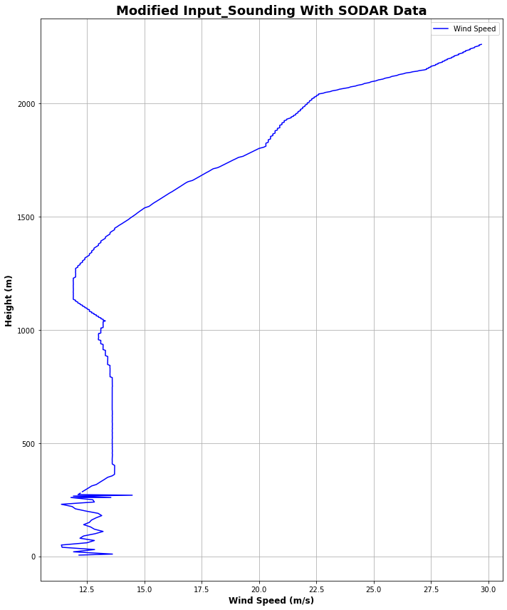
SODAR Data
Using SODAR Data collected during the burn, I added those winds to the sounding file to fill in the gaps between 20m and 259m since the original sounding had a gap there

Slide 4
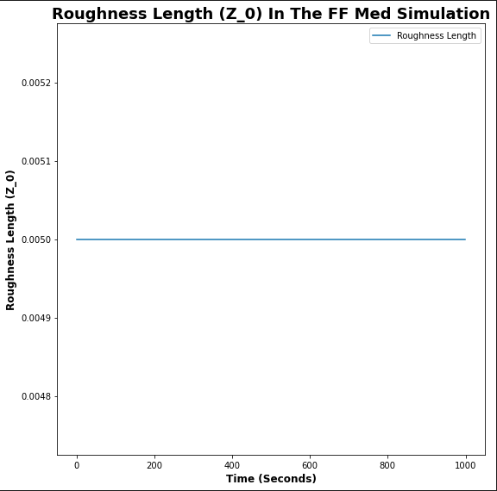
Checking my initial Z0 value
Since z_0 was put in the incorrect location in the file, I changed it to be in the winter location of the LANDUSE.TBL
To verify the z_0 value, I input them into the roughness length equation with the different height values

Slide 5
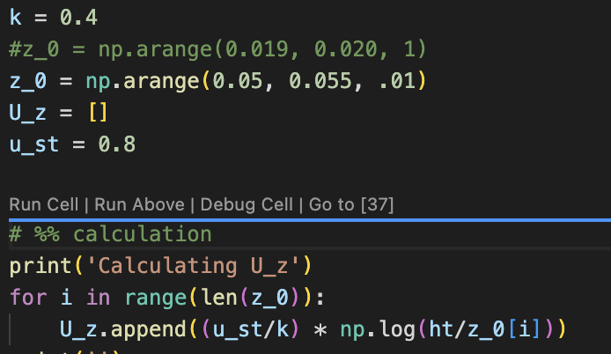
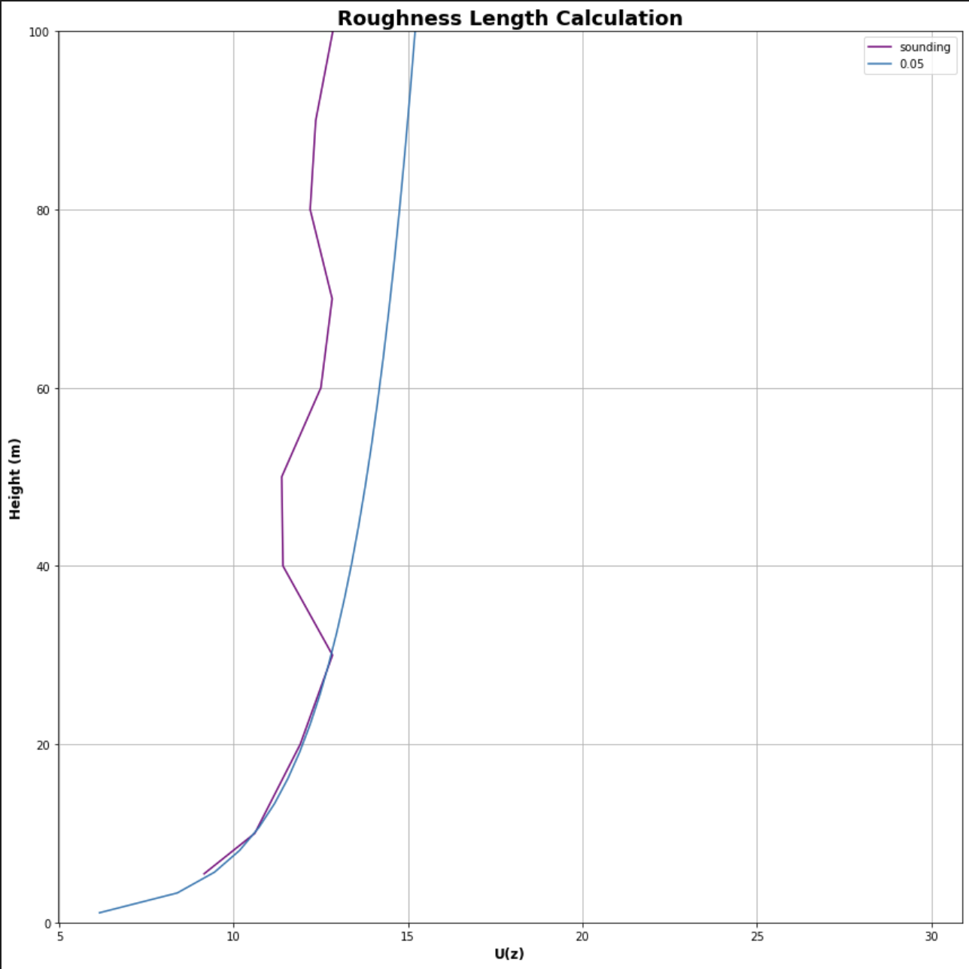
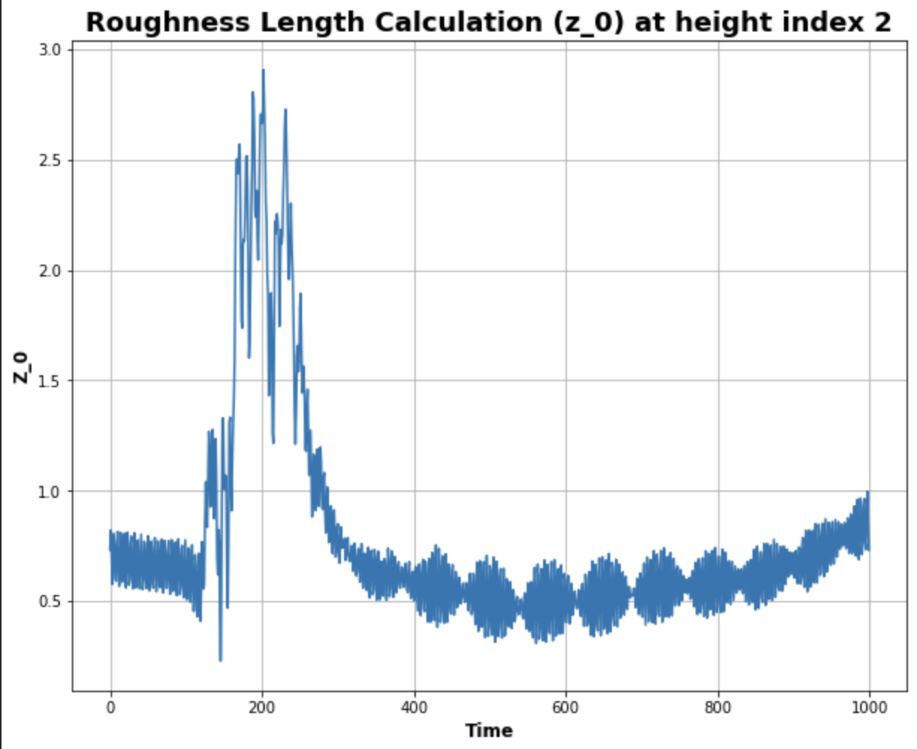
Roughness Length Calculation
https://www.eol.ucar.edu/content/calculation-roughness-length-and-displacement-height

Slide 6
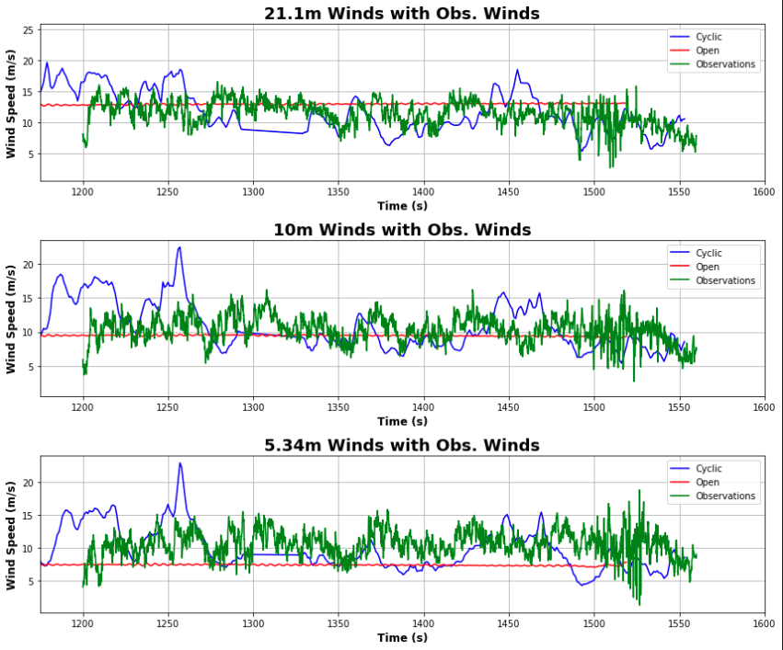
ff_med run
With the modified z_0 value, I reran the ff_med simulation with both cyclic and open boundary conditions to see how the new sounding would impact the run
This graph is much closer to the observations than previous runs, indicating the roughness length has an impact on the wind speeds

Slide 7
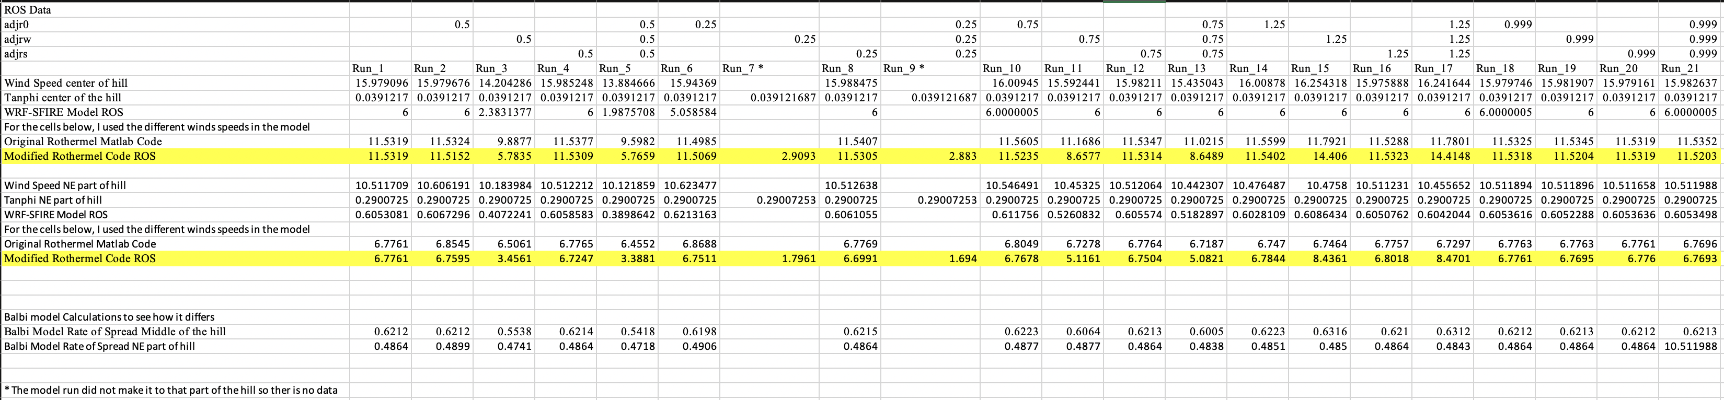
Rothermel Code
After modifying the code to take in the adjustment factors as inputs, and adding them to the code, there is a much greater difference among the rate of spread
Now adjustment factors will better change the variables in the code
i.e. 0.5 adjw will cut the wind speeds in half

Slide 8
To do
Modify the input_sounding file
Modify the z_0 value
Finish powerpoint for Jan
In progress and can be found on my github at: Meeting_Notes/Presentations/Adjustment_Factors.pptx
Write report on pressure sensors
Waiting for final FF2 simulation before I can write the report

