Slide 1
Weekly Meeting 08/19/22
By: Jeremy Benik

Slide 2
Last Week To Do
Rerun FireFlux_med with new sounding
That is currently being ran
Re-test the rothermel code
Re-testing has been done, and results are posted on this slide or on my github at: https://github.com/Jeremy-Benik/Hill_Runs/blob/main/ROS_calculations.xlsx
Write report on pressure sensors
In progress
File can be found on github at:
Fix xquartz
Reset my laptop and that worked
Finish powerpoint for Jan
Write my abstract
SODAR Data
Read into python and added to original sounding

Slide 3
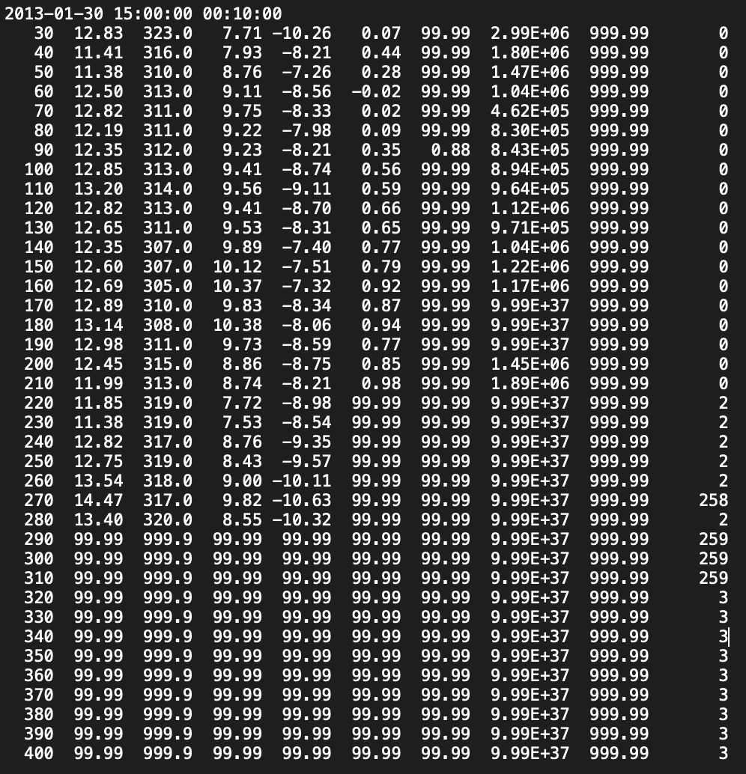
SODAR Data
Since the SODAR data only has data from 30m - 280m (there are nan values after 280m), those are the heights I added into the sounding
The sounding only goes up until 20m, then increases to 259.9m which is a large jump without any wind data
Now I must find the potential temperature and the water vapor mixing ratio for all those heights before it can be implemented into the sounding
One issue is the data has a lot of nan values, meaning I may need to pick a time other than 15:00 so there aren’t as many nan values

Slide 4
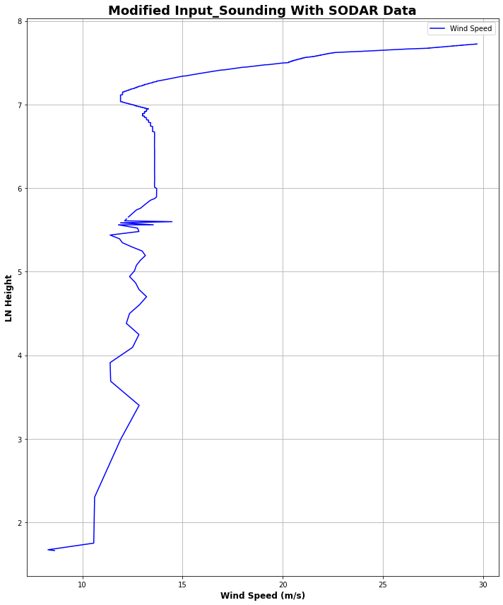
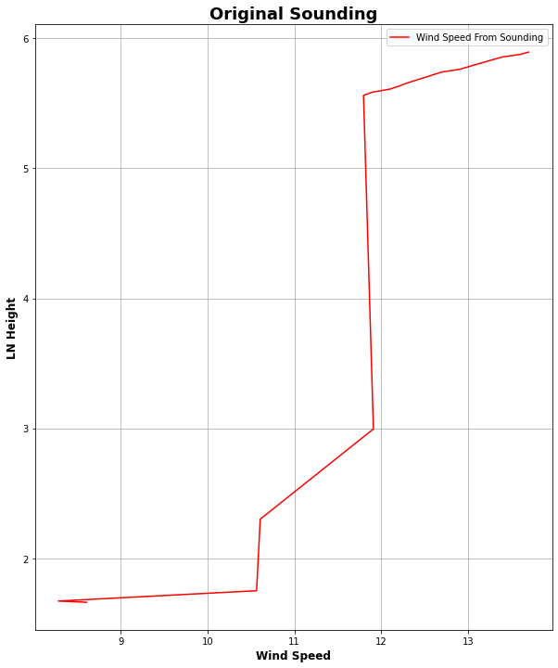
SODAR Data
I added in the data from Jan 30, 15:00 to the original input_sounding to see how it would affect it

Slide 5
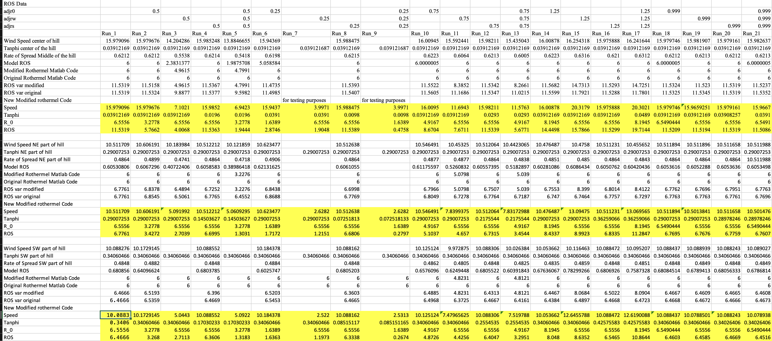
Rothermel Code
After modifying the code to take in the adjustment factors as inputs, and adding them to the code, there is a much greater difference among the rate of spread
Now adjustment factors will better change the variables in the code
I.e 0.5 adjw will cut the wind speeds in half

