Slide 1
Rothermel model
By: Jeremy Benik

Slide 2
abstract
Adjustments were made by Frank A. Albini in 1976
It has been used in fire and fuels management systems since 1972

Slide 3
intro
The Rothermel model is the most commonly used model in the U.S. fire management systems, with a lot of use outside USA
Physics models attempts to represent both the physics and chemistry of fire spread, quasi-physical model attempts to represent only the physics, empirical model is one that contains no physical basis at all and is generally statistical in nature, and quasi-empirical is one that uses some form of physical framework on which the statistical modeling is based
Rothermel’s model is categorized as quasi-empirical
It is based on a heat balance model developed by Frandsen(1971), data from wind tunnel experiments in artificial fuel beds of varying characteristics (rothermel and Anderson 1966), and Australian wildfire data in grasses (McArthur 1969)

Slide 4
intro
The basic Rothermel model with some minor modifications by albini has been used in the same form for decades
The model is based on the conservation of energy described by a heat sink (Fransden 1971)
It assumes a linear flame front and calculates spread rate of a head fire with or without wind or slope
The model is meant for fire burning through uniform fuel (both live and dead)
This model only addresses fire in surface fuel, does not work in crown fires, smoldering ground fires, or post-frontal combustion of fuels
It’s strengths are simplicity of input requirements and calculations and the possibility of changing many driving variables such as fuel

Slide 5
Development and application
The lab was in the Missoula fire science laboratory, dedicated in the 1960s which had a combustion lab and two wind tunnels where researchers could xamine the rate of spread under various conditions
Rothermel and Anferson were brought in from Chief Jack Barrows who recognized there is a need for understanding the basics of fire behaviour and he wanted a physical scientists and engineer
Took 10 years to produce a fire behaviour model, and 10 more years to learn how to obtain the inputs and interpret the outputs for use by the “man on the ground”
Experimental burning was done in fuel beds of a single size class

Slide 6
Section 3 the surface fire spread model
The Rothermel model is based on a foundation provided by Fransden (1971) who applied the conservation of energy to a unit volume of fuel ahead of a steadily advancing fire in a homogeneous fuel bed
Changes from the Rothermel model from Albini
Correction for mineral content
Mineral damping coefficient
Reaction velocity correlation
Weighting factors for fuel load
Moisture of extinction of live fuels
Weighting factor on intensity by category

Slide 7
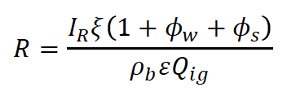
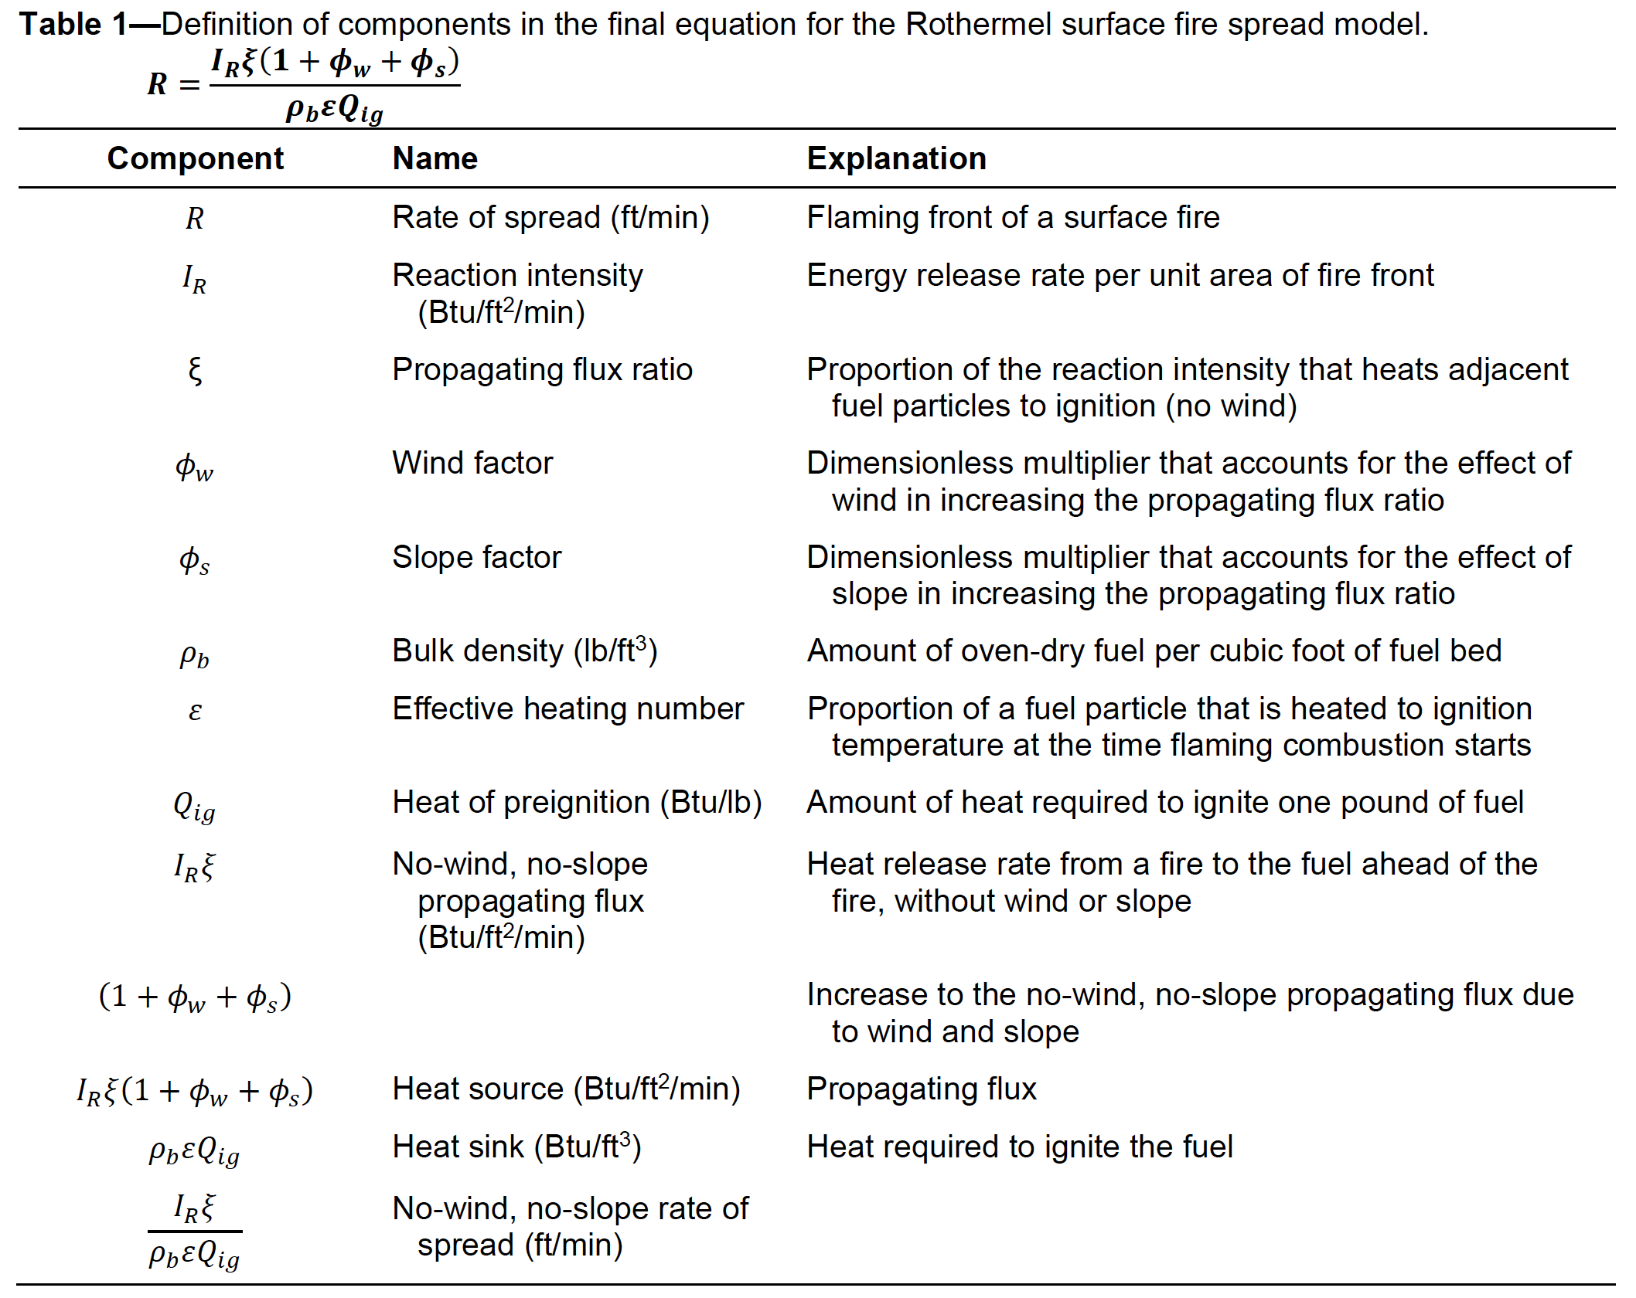
Section 3
The final ROS equation is heat source divided by heat sink and applies to one size class of dead fuel

Slide 8
Section 3
The model was designed so that the ROS can be calculated from conditions that can be known before the fire
The equations for the basic fire spread model in table 3 apply to a single size class of dead fuel
This isn’t useful however since it can’t be applied to a field, so it was modified to fit fuels composed of heterogeneous mixtures of particle sizes and equations and a weighting concept which are based on mathematical data
The model assumes that live fuel will burn only if dead fuel is present
The live fuel moisture of extinction calculation used by Rothermel was provided by Fosberg and Schroeder. It is based on the ratio of live-to-dead fuels, the mopisture of fine dead fuels, and dead fuel moisture of extinction

Slide 9
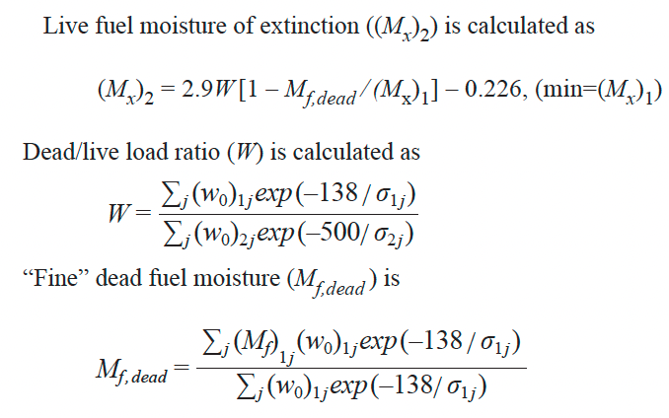
Section 3
Various size fuels are assumed to be uniformly distributed within the fuel array
Larger fuels have a negligible effect on fire spread
The spread model uses weighting factors for the fuel

