Slide 1
Adjustment Factors in WRF-sfire
By: Jeremy Benik

Slide 2
ADjr0 adjustments in wrf-sfire
Initially, we wanted to match the backfire rate of spread in the simulation to the observed backfire rate of spread in the FireFlux2 experimental burn
To calculate the observed backfire rate of spread, I used videos of the burn and google earth
A more in depth explanation of how this was calculated can be found on YouTube at: https://www.youtube.com/watch?v=nI3wS8YHofM
Please do not make this video public without permission

Slide 3

ADjr0 adjustments in wrf-sfire
As an attempt to match the simulations to the observed backfire rate of spread, we added in an adjr0 adjustment factor to the namelist.fire to slow down the simulation
In this experiment, fuel category 3 was the only one used (tall grass)
Example of the adjustment factors in the namelist.fire

Slide 4
Attempting to match observations
The observed backfire ROS was about 0.02m/s, and the simulation was at 0.021 m/s
In an attempt to slow the rate of spread of the simulation down, an adjustment factor was added to the simulation
The adjustment factor used in the initial run is 0.90677
With this adjustment factor, we were expecting the backfire ROS to be closer to 0.02, but instead the new backfire ROS was calculated to be 0.015m/s

Slide 5
Attempting to match observations
To try to better correct the model, another run was performed this time with a different adjustment factor of 0.93
This did increase the backfire ROS, but not as much as we had hoped
The new backfire ROS was 0.016
We ran many more simulations to try to match the observed backfire ROS, but nothing was close
With an adjr0 of 0.9999, that yielded a backfire ROS of 0.018m/s

Slide 6
Possible issues in the code
After looking in the WRF-SFIRE, it appears that the adjr0 is multiplied over and over again in the code, meaning any small adjustment factor will be amplified

Slide 7
How was the backfire ROS calculated?
To calculate the backfire ROS, I picked a time in simulation where all the initial runs made it (all simulations made it about 900 seconds)
I then found a point where the fire_area had just touched the grid cell but had not fully engulfed it (fire_area < 1)
With this location, I calculated the distance to the point using the fxlat and fxlong location, and the location of the ignition point since that is specified on the grid
With the time and distance, I then calculated the backfire ROS

Slide 8
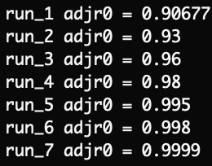
results
run 1 Backfire ROS was 0.015989734039574453 m/s
run 2 Backfire ROS was 0.016798221788879665 m/s
run 3 Backfire ROS was 0.01709021600282394 m/s
run 4 Backfire ROS was 0.01720178385015444 m/s
run 5 Backfire ROS was 0.01767115575900313 m/s
run 6 Backfire ROS was 0.017712621441470035 m/s
run 7 Backfire ROS was 0.017739540319040657 m/s

Slide 9
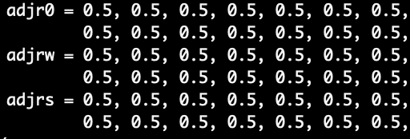
Adjustment factors in wrf-sfire
To further test the adjustment factors in WRF-SFIRE, I tested the adjustment factors on the small hill case
This simulation was picked since it had a slope, and it was small enough to be able to run in a couple minutes
There were 21 simulations run
1 simulation was done with no adjustment factors, and the other 20 had different adjustments factors applied in the namelist.fire
Example of one of the runs:

Slide 10
Adjustment factors in wrf-sfire using the small hill runs
To see how the rate of spread was impacted, I found three points along the burn plot
Centre of the hill
North East part of the hill
South west part of the hill
With these points, I found where the fire_area was greater than 0 and the time this occurred
Then I found the wind speed at those points at the time the fire reached those points
To calculate the distance, I took the ignition point and found the distance from there to those locations

Slide 11
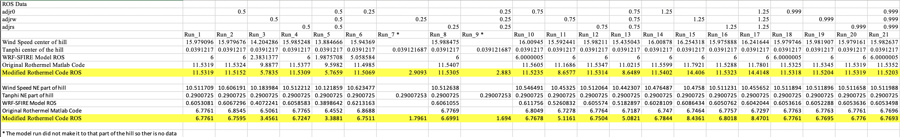
Adjustment factors results
This excel sheet can be found on my github at: https://github.com/Jeremy-Benik/Hill_Runs/blob/main/ROS_calculations.xlsx
The modified Rothermel code can be found at: https://github.com/Jeremy-Benik/Hill_Runs/blob/main/Codes/ros_rothermel.m
The original Rothermel code can be found at: https://github.com/Jeremy-Benik/Hill_Runs/blob/main/Codes/ros_rothermel_og.m
The sensitivity analysis code can be found at: https://github.com/Jeremy-Benik/Hill_Runs/blob/main/Codes/adjustment_factor_sensitivity.m
The modified fuel code can be found at: https://github.com/Jeremy-Benik/Hill_Runs/blob/main/Codes/fuels.m

Slide 12
Adjustment factors in wrf-sfire
For comparison, I have the ”original” Rothermel code (all that was changed is the model doesn’t max out at 6m/s) and the ROS variable from the model to see how the modified Rothermel model compares
The modified Rothermel code takes the adjustment factors as an input, and is integrated in the code during the rate of spread calculation
Please note: the columns that do not have any data are because the simulation never reached those locations on the burn plot

Slide 13
Sensitivity analysis

Slide 14


Sensitivity analysis

