Slide 1



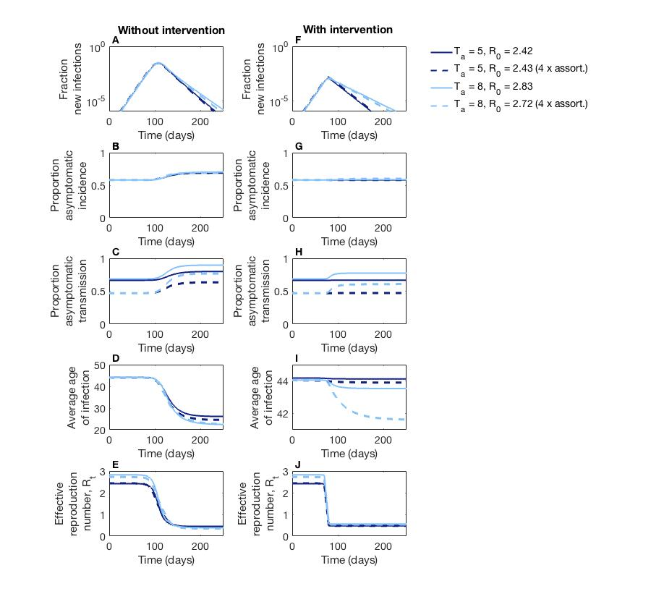
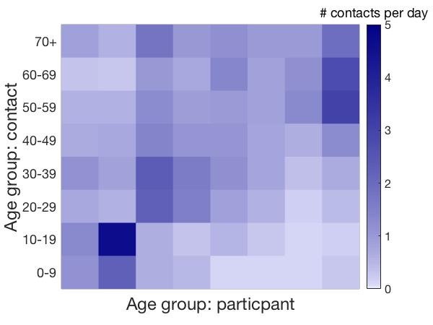
Modeling asymptomatic transmission in COVID-19 dynamics
Jeremy Harris¹, Sang Woo Park², Jonathan Dushoff^{3,4,5} and Joshua S. Weitz^{1,6}
School of Biological Sciences¹ and School of Physics⁶, Georgia Institute of Technology
Department of Ecology and Evolutionary Biology, Princeton University²
Department of Biology³, Department of Mathematics and Statistics⁴, and
M. G. DeGroote Institute for Infectious Disease Research⁵, McMaster University
Work supported by
email: jeremy.harris@gatech.edu
poster content: https://github.com/Jeremy-D-Harris/poster_NSFstudentConference_covid19
1. Overview
The generation interval shapes epidemic growth
3. Asymptomatic transmission
5. Changes in the average age of infection
A
T: generation interval
transmission event
B
R0 = 2
…
incubation period
symptom onset
Index
case
incubation period
Time
Figure 5. Age-dependent effects of mixing and infection outcomes lead to changes in the average age of infection.
(A-E) no intervention; (F-J) with intervention. An increase in the proportion of asymptomatic transmission can cause an increase in the relative incidence. Hence, due to age-dependent assortativity, shifts in the age distribution of new infections may be concomitant with case counts, shown here by the average age of infection. When there is no intervention, susceptible depletion occurs through the age groups, and the average age of infection decreases by about 20-23 years as case counts decrease (D); with intervention, the decrease is about ~2.5 years (I) (light blue, dashed line), but little change is seen with normal contact rates or without time-scale differences.
serial interval
T₁
T₁
T₁
T₁
Figure 1. (A) The generation interval (T) is the time between when an individual is infected and when that individual infects another person. (B) T connects the reproduction number R₀ (an individual-level quantity measuring the “strength” of the epidemic) to the exponential growth rate r (a population-level quantity measuring the “speed” of the epidemic) [1]. Two scenarios in which the r’s are the same but the R₀’s differ: R₀ = 2 with T₁ (top) vs. R₀ = 4 with T₂ = 2T₁ (bottom). (Adapted from [2].)
R0 = 4
…
Index
case
Time
T₂
T₂
Asymptomatic carriers are important to consider for disease transmission and estimates of epidemic burden [3]
Asymptomatic carriers may have similar potential to transmit [4], but are not aware → they do not isolate
Symptomatic individuals isolate shortly after the onset of symptoms
If asymptomatic carriers have longer generation intervals relative to symptomatic individuals, what is their impact on disease dynamics at the population level? How do the relative proportions of asymptomatic transmission and incidence change with new cases?
Figure 3. Longer infectious periods of asymptomatic individuals affect the proportion of asymptomatic transmission. (A-D) without intervention, the susceptible population is depleted. (E-H) changes observed in the proportion of asymptomatic transmission are lessened with intervention.
6. Conclusions
Consequences of asymptomatic individuals transmitting for longer periods (relative to symptomatic individuals):
the fraction of new cases attributed to asymptomatic transmission can decrease when total case counts are increasing and increase when total case counts are decreasing (Fig. 3C,G).
Due to assortative mixing, the fraction of new cases that are asymptomatic may also increase when total case counts decrease (Fig. 4B,F).
With age-dependent contacts and susceptibility estimates, longer infectious periods of asymptomatic carriers may explain shifts in the age distribution of infection:
case counts increase then the average age of those infected should go up, whereas as case counts decrease then the average age of those infected should go down (Fig. 5 D,I; see data from CDC, Fig. 1 of [7])
Overall, these results show the importance of the relative contribution of asymptomatic transmission toward overall disease dynamics in COVID-19.
2. SEIR model: asymptomatic/symptomatic infections
Asymptomatic transmission
4. Asymptomatic transmission & assortative mixing
variables:
parameters:
: susceptible individuals
: exposed individuals
: infected individuals
: recovered individuals
: transmission rate
including assortative mixing
: exposed period
: infectious period
subscripts:
: asymptomatic individuals
: symptomatic individuals
The SEIR model with age-dependent contacts and susceptibility
A
B
C
References:
Park, S. W., Champredon, D., Weitz, J. S., & Dushoff, J. (2019). A practical generation-interval-based approach to inferring the strength of epidemics from their speed. Epidemics, 27, 12-18.
Powers, K. A., Kretzschmar, M. E., Miller, W. C., & Cohen, M. S. (2014). Impact of early-stage HIV transmission on treatment as prevention. Proceedings of the National Academy of Sciences, 111(45), 15867-15868.
Park, S. W., Cornforth, D. M., Dushoff, J., & Weitz, J. S. (2020). The time scale of asymptomatic transmission affects estimates of epidemic potential in the COVID-19 outbreak. Epidemics, 31, 100392.
Lee, S., Kim, et al. ..., & Kim, T. H. (2020). Clinical course and molecular viral shedding among asymptomatic and symptomatic patients with SARS-CoV-2 infection in a community treatment center in the Republic of Korea. JAMA internal medicine, 180(11), 1447-1452.
Zhang, J., et al. …, Ajelli, M., & Yu, H. (2020). Changes in contact patterns shape the dynamics of the COVID-19 outbreak in China. Science, 368(6498), 1481-1486.
Davies, N. G., Klepac, P., Liu, Y., Prem, K., Jit, M., & Eggo, R. M. (2020). Age-dependent effects in the transmission and control of COVID-19 epidemics. Nature medicine, 26(8), 1205-1211.
Boehmer, T. K., et al. ..., & Gundlapalli, A. V. (2020). Changing age distribution of the COVID-19 pandemic—United States, May–August 2020. Morbidity and Mortality Weekly Report, 69(39), 1404.
Figure 2. Parametrization of the age-dependent SEIR model. (A) contact matrix from Wuhan [5] by age, showing the average number of contacts one age group makes with another age group. (B) probability of being susceptible to infection by age (solid) and probability of having a symptomatic infection by age (dashed) [6]. (C) Age distribution of Wuhan.
Figure 4. Addition of assortative mixing to longer time-scales of asymptomatic transmission increases the proportion of asymptomatic incidence. (A-D) no intervention; (E-H) with intervention, increases in the proportion of asymptomatic incidence (as well as transmission) are lessened.
Acknowledgments: Simons Foundation, award number AWD-001014
Notes:
Figure 2 notes: looking in ‘modeling folder’ – script: ‘main_contact_susceptibility_wuhan_Davies_update012721_ave’
Fig 3 notes: in ‘present-mathbio-111920’ --script: ‘main_SEIR_twodiseases_sameR0s_plt_figure1_update012721_4pan’
Fig. 4 notes: in ‘present-mathbio-111920’ --script: ‘main_SEIR_twodiseases_sameR0s_plt_figure2_5and8_update012721’
Fig. 5 notes: in ‘’modeling – matlab script: ‘main_SEIR_twodiseases_agedep_plt_wuhanf3_T5and8_update012721_ia’

