Slide 1

R0 = 2
growth rate
…
Infections
Index
case
T₁
T₁
T₁
Time

Slide 2
Longer generation intervals slow the progression of the epidemic
R0 = 2
…
Infections
Index
case
A longer generation interval (T₂ > T₁) means a longer time between transmission events
Time
T₁
T₁
T₁
R0 = 2
…
Infections
Index
case
T₂
T₂
T₂
Time
T₁ , T₂: generation interval is the (average) time between transmission events

Slide 3
R0 = 2
Index
case
…
Time
T₁
T₁
T₁
T₁
R0 = 4
Index
case
…
Time
T₂
T₂

Slide 4
R0 = 2
growth rate
…
Infections
Index
case
T₁
T₁
T₁
Time

Slide 5
T: generation interval
incubation period
incubation period
serial interval
adapted from Nishiura et al., International journal
of infectious disease (2020)

Slide 6
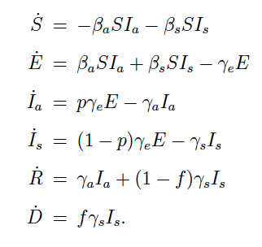
One parameter, p: proportion asymptomatic incidence
d
asymptomatic transmission
E_{a}
I_{a}
R_{a}
p
p
S
(1-p)
d
E_{s}
I_{s}
R_{s}
(1-p)
symptomatic transmission

Slide 9
variables:
parameters:
: susceptible individuals
: exposed individuals
: infected individuals
: recovered individuals
: transmission rate
: exposed period
: infectious period
subscripts:
: asymptomatic individuals
: symptomatic individuals

Slide 10
One parameter, p: proportion asymptomatic incidence
d
asymptomatic transmission
E_{a}
I_{a}
R_{a}
p
p
(1-p)
d
E_{s}
I_{s}
R_{s}
(1-p)
symptomatic transmission

Slide 11
p(a|a), p(a|s): proportion asymptomatic incidences conditioned on the symptom type of the infector
d
asymptomatic transmission
E_{a}
I_{a}
R_{a}
P_{a|a}
p_{a|s}
S
(1-p_{a|a})
d
E_{s}
I_{s}
R_{s}
(1-p_{a|s})
symptomatic transmission

