Slide 1




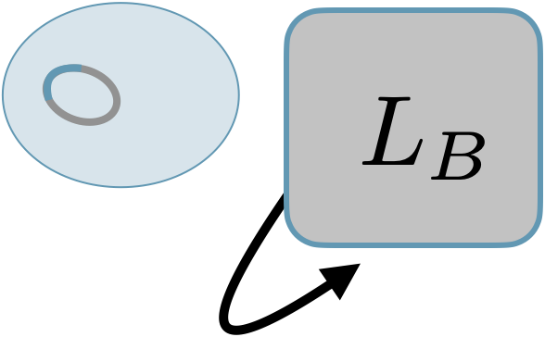
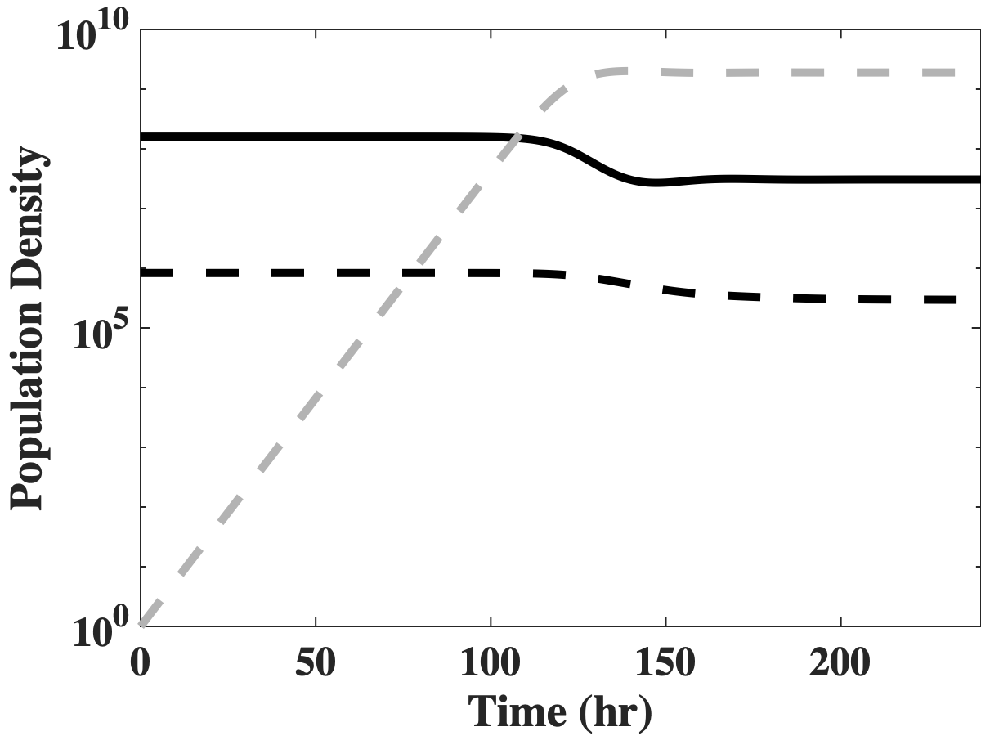
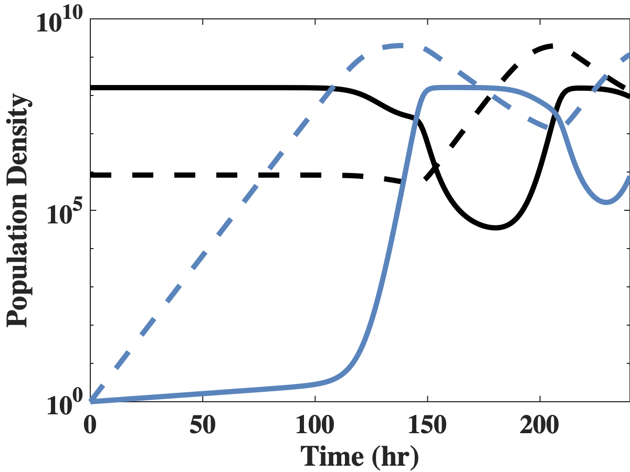
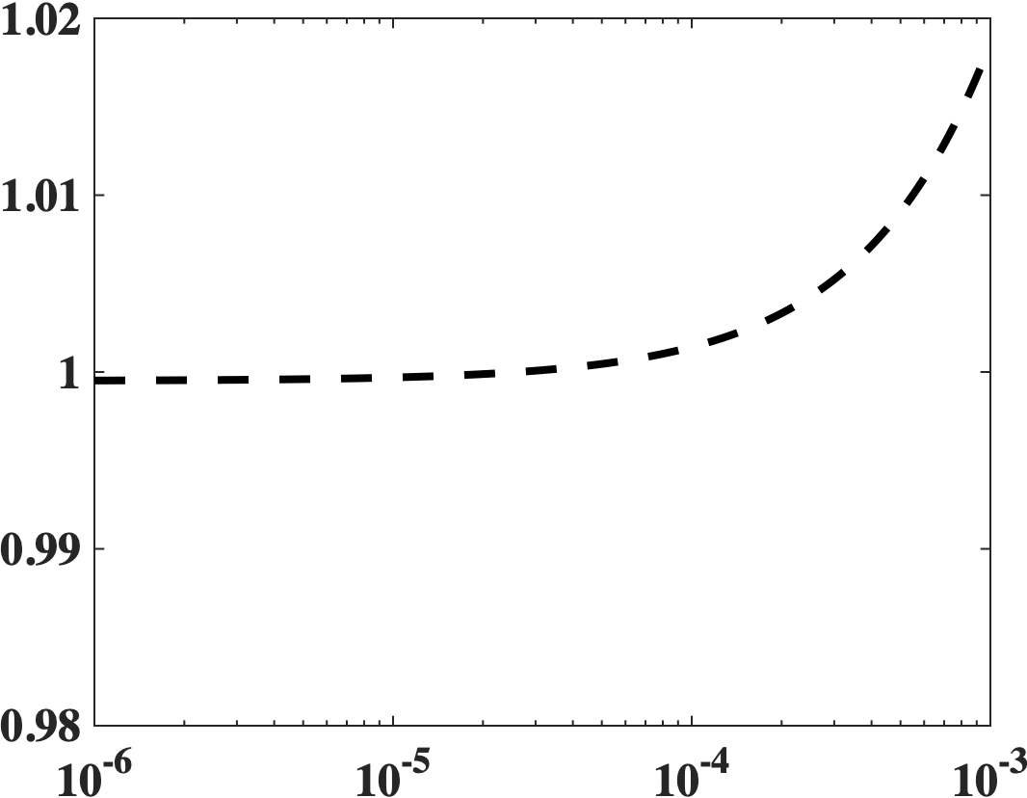



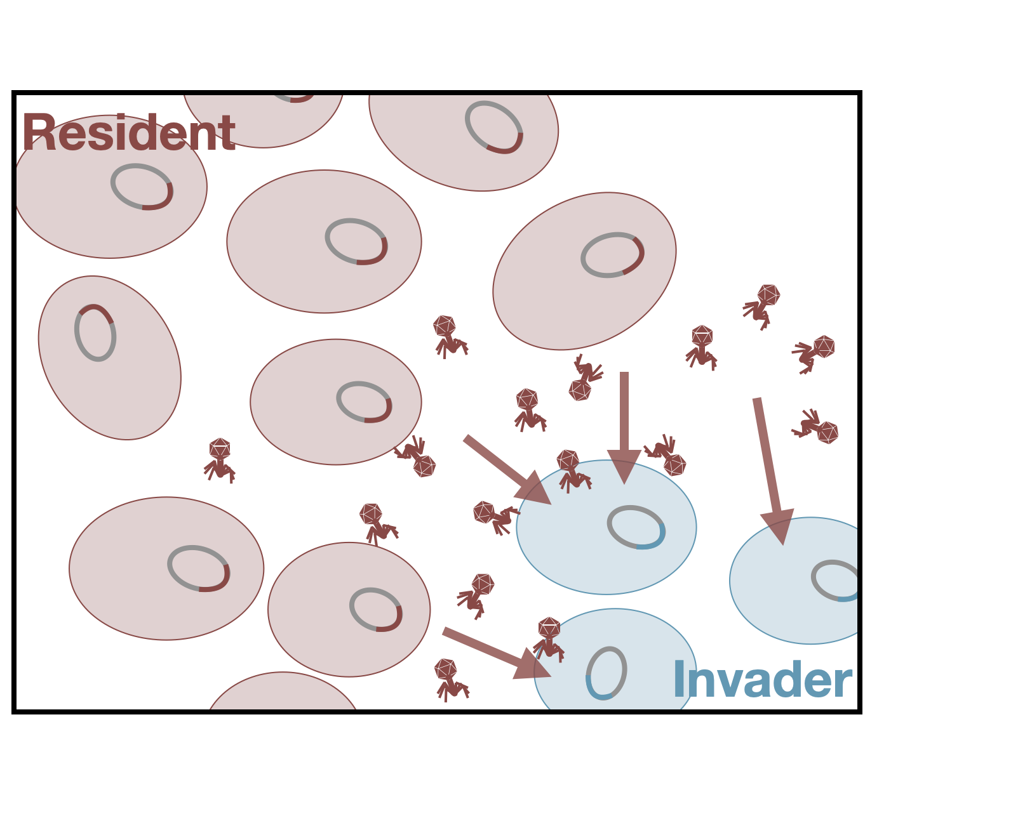
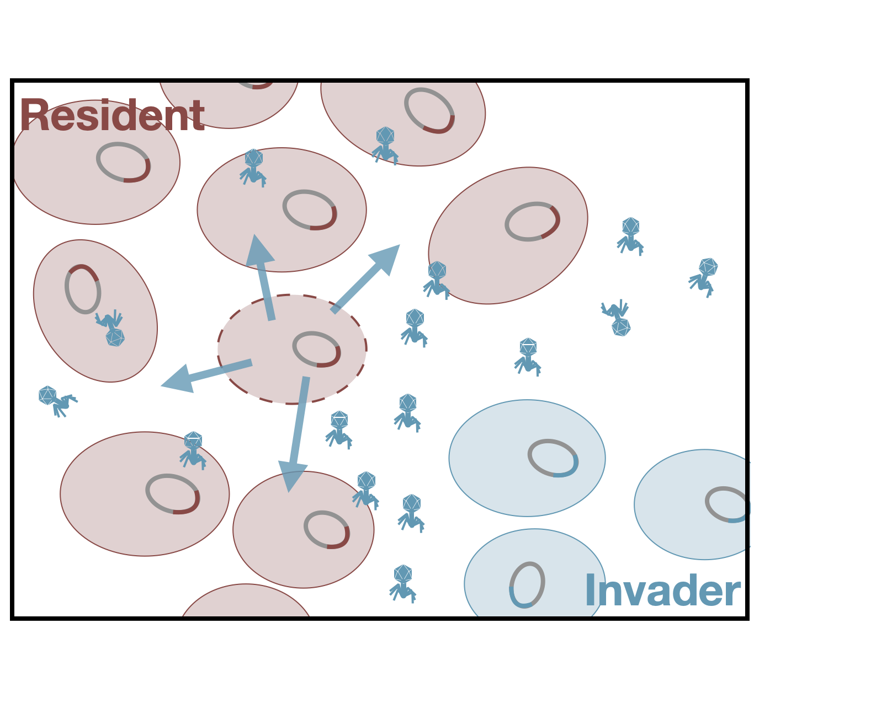


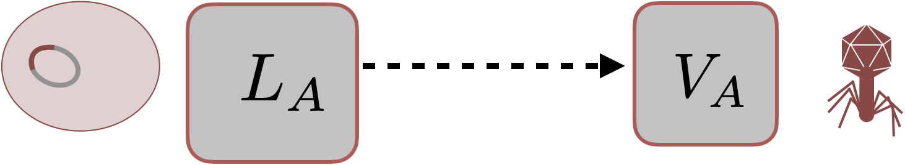
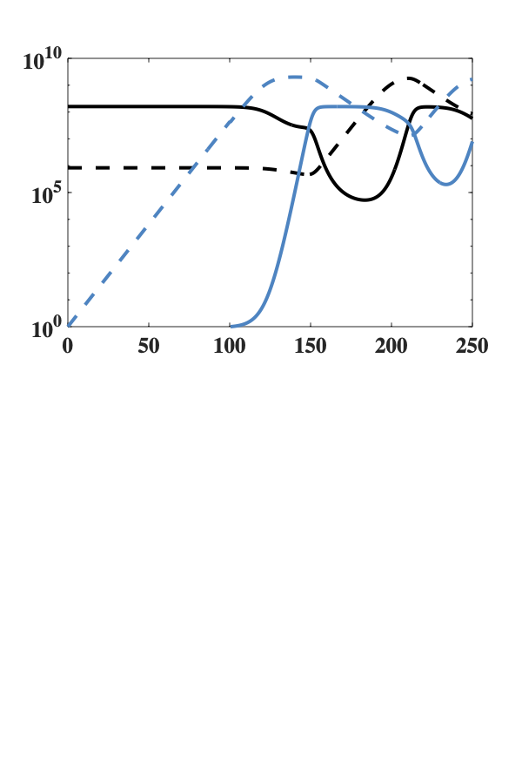
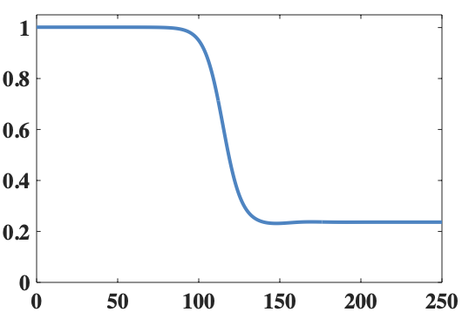
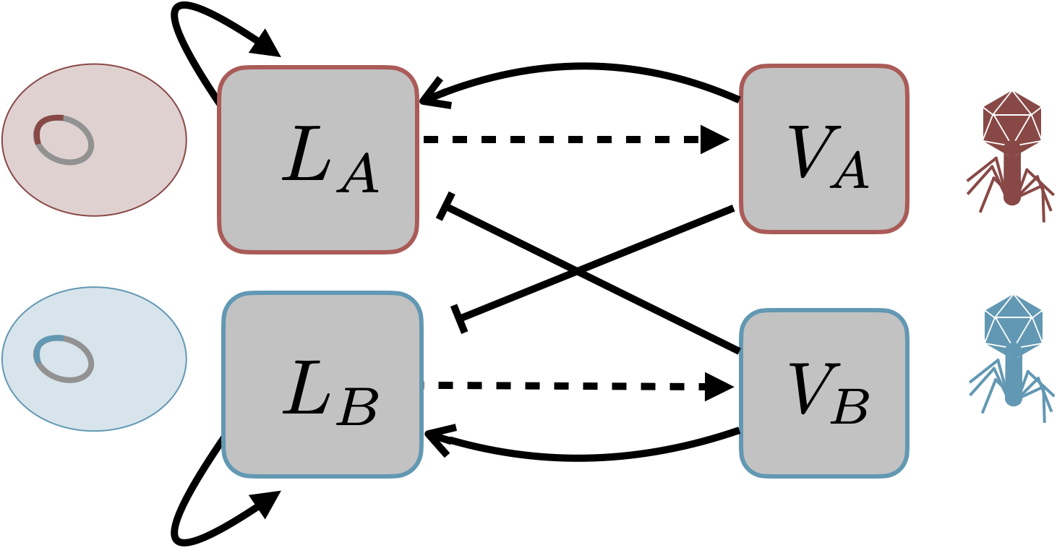
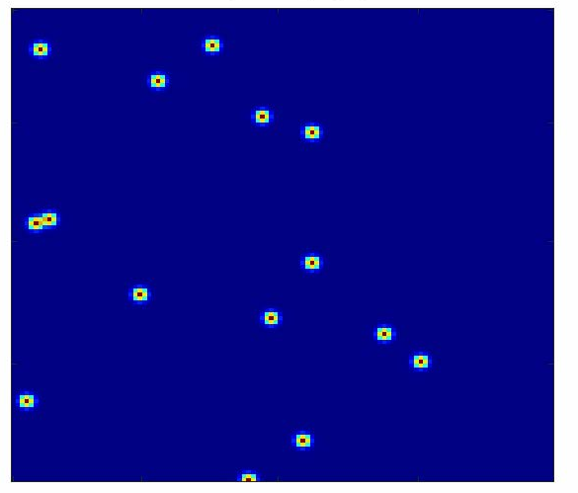
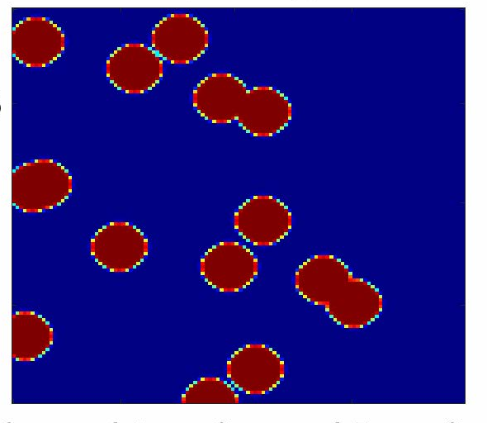
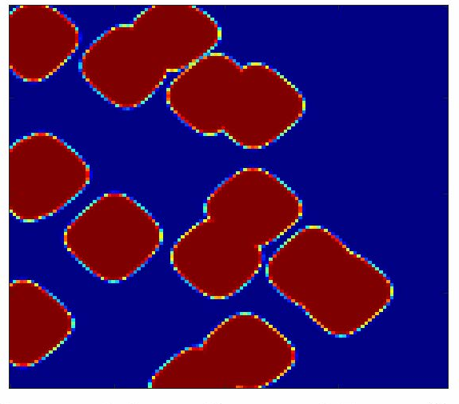
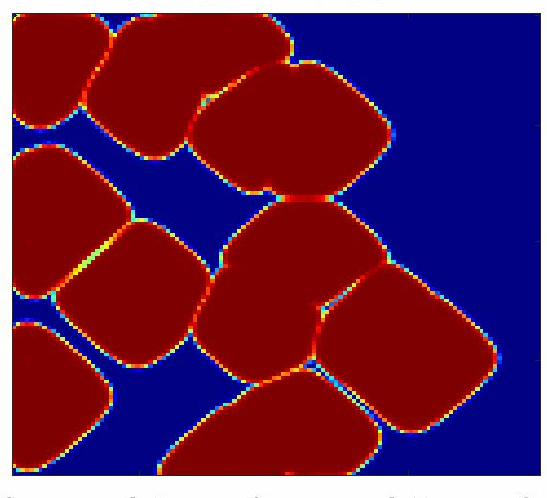
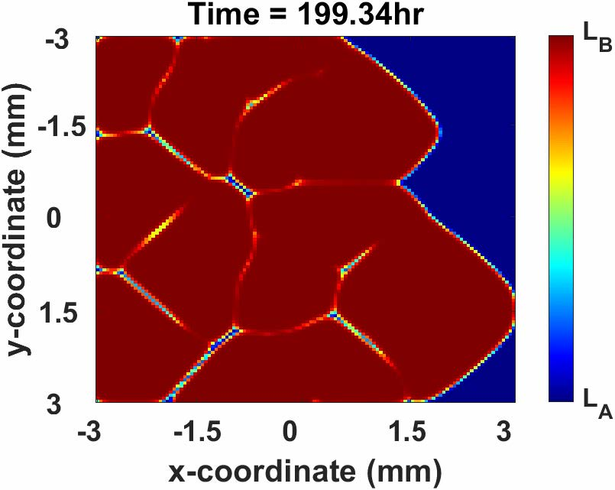
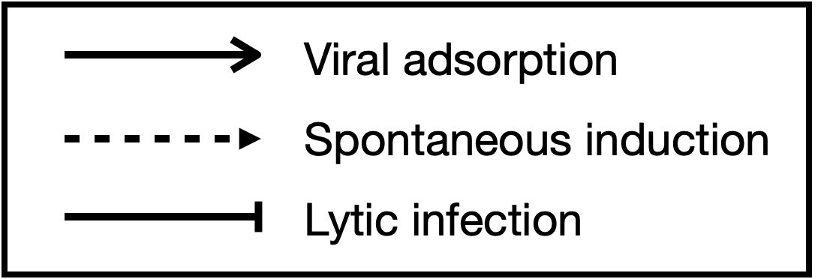
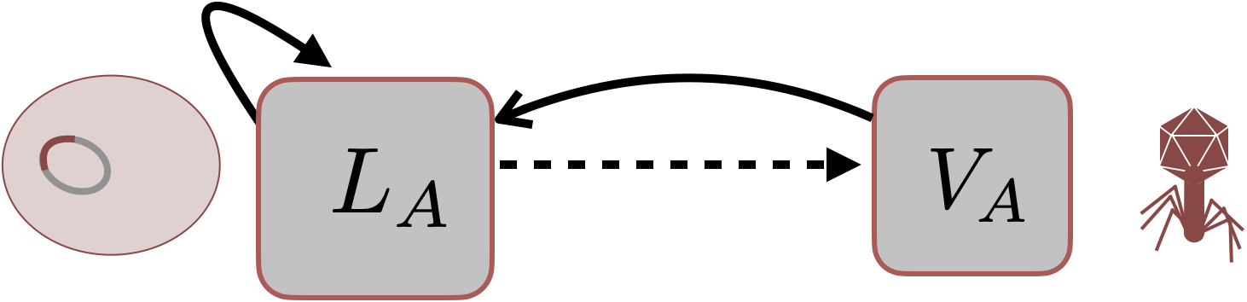
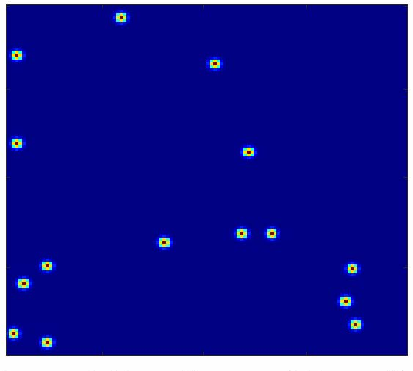
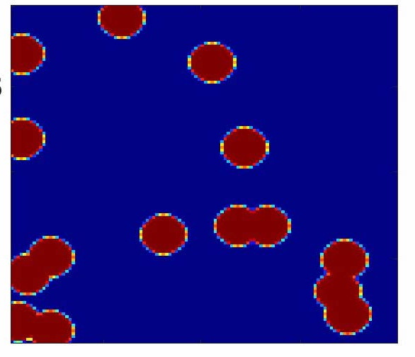
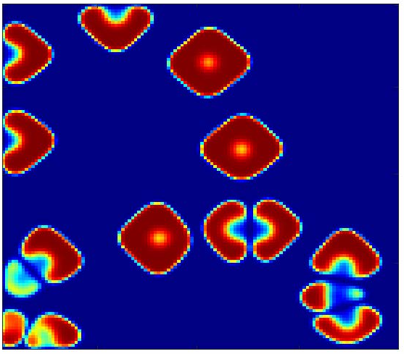
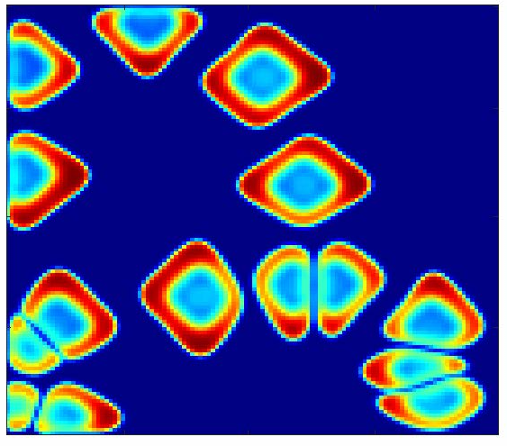
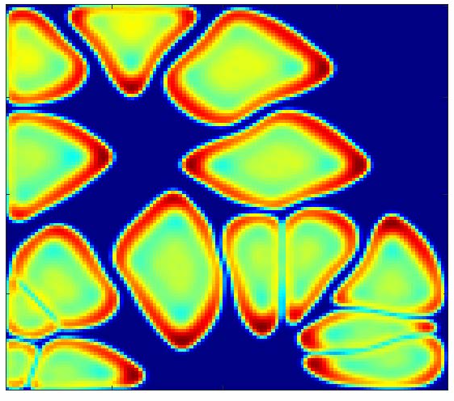
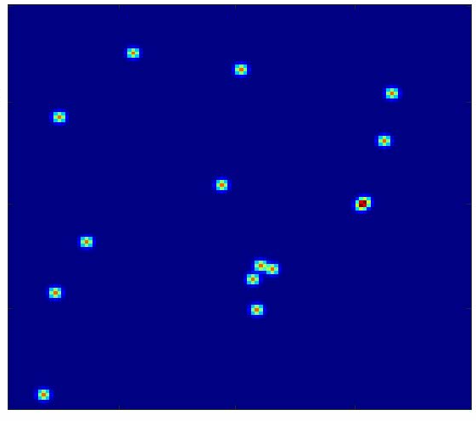
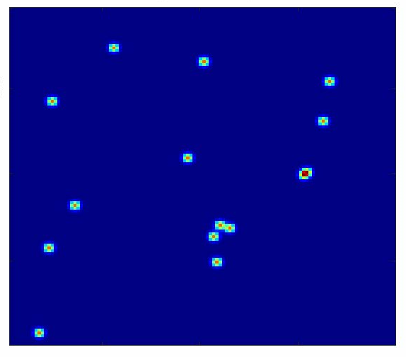

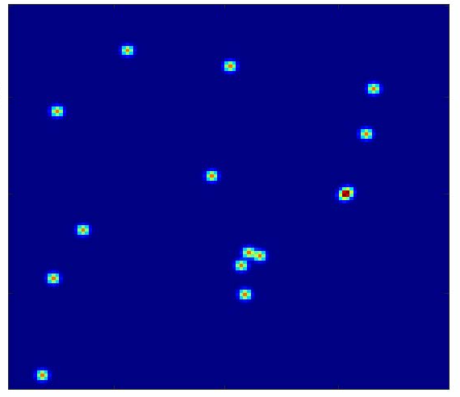

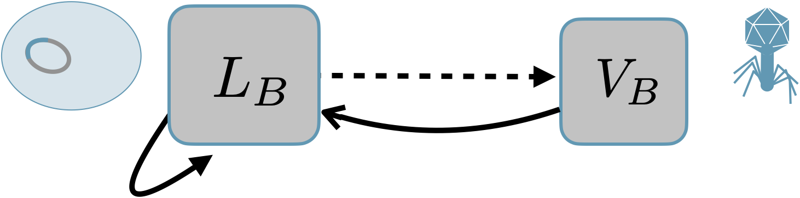
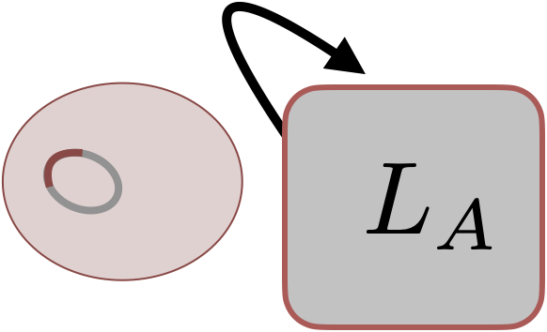
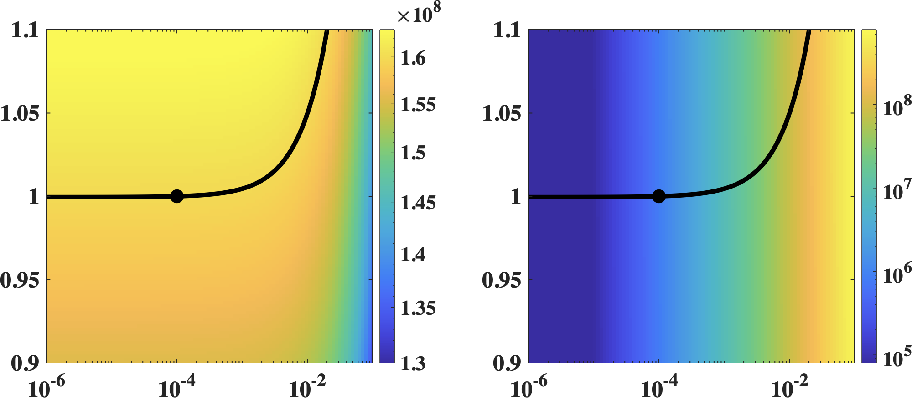
Population Dynamics of Temperate Phage and the Potential Emergence of Phage-Host Coalitions
Jeremy D. Harris¹, Tapan Goel¹, Frank May², Cameron Jackson², Mustafa Guzel²,
Alison Buchan², Joshua S. Weitz^{1,3}
¹ School of Biological Sciences, Georgia Institute of Technology, Atlanta, GA, USA
² Department of Microbiology, University of Tennessee, Knoxville, Tennessee, USA
³ School of Physics, Georgia Institute of Technology, Atlanta, GA, USA
email: jeremy.harris@gatech.edu
website: https://jeremy-d-harris.github.io/
project repository: https://github.com/
Jeremy-D-Harris/coalitions_working
Funding:
Life Sciences Foundation
Introduction
III. Results
What role do temperate phages play in competing lysogen populations?
(a)
A “buffer” to defend against invasion?
A “weapon” to clear space for invasion?
Both L_{B,} V_{B}
Invade
Population Density
(a)
(b)
Only V_{B}
Invades
L_{A} Induction Rate,
Time, hr
Time, hr
Minimal Growth Rate for L_{B} to Invade,
(b)
Population Density
Figure 1. Two roles of temperate phages when lysogens are in competition. (a) Temperate phages are released through spontaneous induction, preventing the invasion of an opposing susceptible lysogen population. (b) Temperate phages can lyse opposing lysogens which clears space and reduces competition. In both cases, large numbers of free phages are released, proliferating the “buffer” or “weapon” through subsequent rounds of lytic infections.
Lag Time Introduction of L_{B}, hr
Time, hr
Time, hr
Figure 4. “Buffers” and ”weapons” in a well-mixed model. (a) The minimal growth rate required for L_{B} to invade when L_{A} is at the steady-state growth-induction trade off (left). V_{A} lyses L_{B}, preventing it from invading (gray), but L_{B} can invade when L_{A} induction rate is lower (blue). (b) Effective minimal growth rate required for L_{B} to invade (left). V_{B} lyses L_{A}, decreasing the population over time. L_{B} cannot invade at 50 hours post (gray) introduction of V_{B} but can after 100 hours (blue).
II. Model system
(a)
No L_{A} Induction
(b)
L_{A,} L_{B} Induction
Figure 2. Nonlinear dynamical systems model: temperate phages, V_{A} and V_{B}, with their lysogenized hosts, L_{A} and L_{B}. Lysogens spontaneously induce at rates slower than lytic infections (dashed arrows), leaving small pools of free phages. These temperate phages can adsorb to their corresponding lysogens (solid arrows) and predate on opposing lysogens via lytic infection (blunt arrows).
(c)
No L_{B} Induction
Figure 4. “Buffers” and ”weapons” in a spatial model. Invasion dynamics in a 2D grid (6 mm x 6 mm) shown at: 0, 24, 72, 120, 200 hours. With LA induction (a), LB colony expansion is inhibited compared to without LA induction (b). Invasion dynamics without LB induction (c) is unsuccessful.
(a) Lysogen Population (b) Phage Population
IV. Conclusions
Lysogen Growth Rate,
Phages act in cahoots with hosts in competition:
a “buffer” against invasion
“weapons” to deploy during invasion
Future Directions:
Steady-state analysis for coexistence
Phase separation and an emergence of a length scale
Lysogen Induction Rate,
Figure 3. Steady-state trade off between growth and induction. (a) For the steady-state lysogen population to remain constant, the growth rate must increase with increasing induction rate (black line). (b) The steady-state phage population increases with increasing induction. We perform invasion analysis from this growth-induction trade off to show the role of free phage given a fixed lysogen population density.
References
[1] Basso, Jonelle, et al., Buchan, Alison. "Genetically similar temperate phages form coalitions with their shared host that lead to niche-specific fitness effects." The ISME journal 14.7 (2020): 1688-1700.
[2] Harrison, Ellie, and Michael A. Brockhurst. "Ecological and evolutionary benefits of temperate phage: what does or doesn't kill you makes you stronger." BioEssays 39.12 (2017): 1700112.

