Slide 1


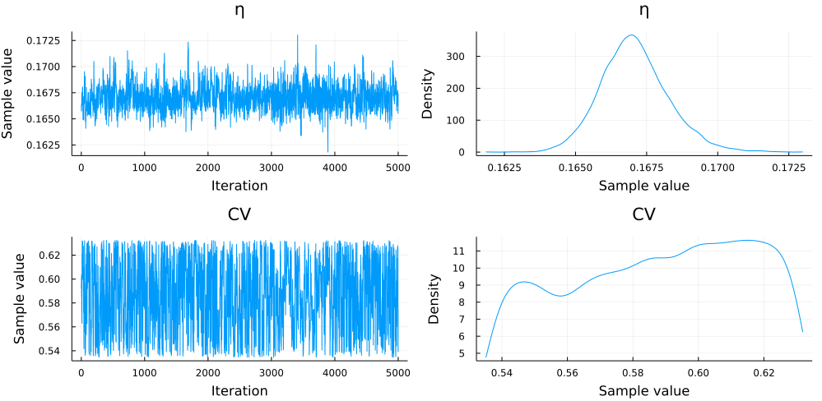
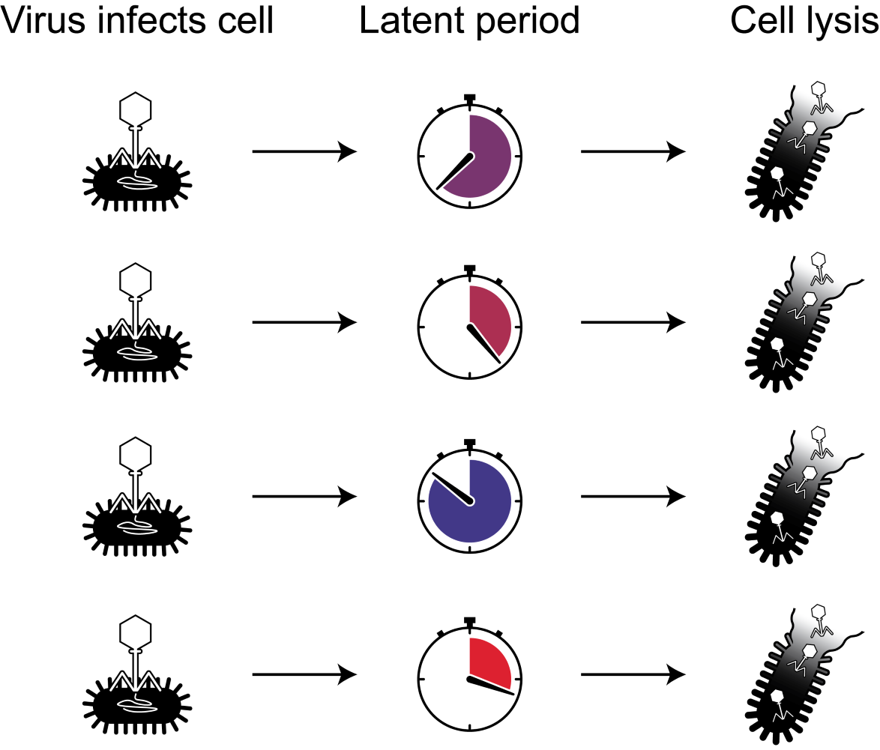
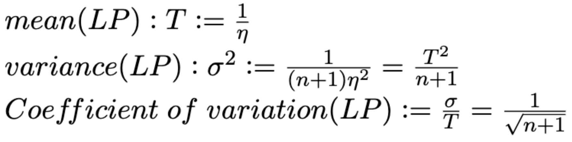
Latent period variability impacts microbe-virus dynamics
Marian Dominguez-Mirazo¹, David Demory¹, Jeremy D. Harris¹, Joshua S. Weitz^{1,2}
¹ School of Biological Sciences, Georgia Institute of Technology, Atlanta, GA, USA
² School of Physics, Georgia Institute of Technology, Atlanta, GA, USA
email: mmirazo3@gatech.edu
Introduction
IV. Estimating the latent period mean and variance from host and free virus in silico data
Our understanding of virus-microbe dynamics largely depends on the study of viral traits, e.g., the latent period, which is the time between viral adsorption and burst [1].
For a single virus-cell pair, the latent period is a single value, whereas in a population with cell-to-cell variability, denoted by stopwatches with different times in (Figure 1a), it is better described as a distribution (Figure 1b) [2].
Latent period variability has been studied for a few organisms [2,3], but generally, the latent period is studied as a single-value trait calculated from one-step experiments (Figure 1c) [4].
Here, we use nonlinear dynamical models with latent period variability to understand how population variation of the latent period impacts virus-host dynamics.
a)
b)
a)
b)
c)
c)
Figure 1. a,b) There is latent period variability in cell-virus populations. c) In one-step experiments a host population is infected and synchronized. Free virus is measured at different time points. The time of first visible burst is regarded as the latent period for the cell-virus pair. Figure recovered from [5]
Figure 4. Using MCMC methods (a) we fit in silico host and free-virus data with added noise (b) to a nonlinear model (Figure 2) to predict the population latent period distribution along with other host and viral traits. The predicted distribution (b) has a mean (dashed line) close to the original population mean (solid line).
II. Model framework for incorporating latent period distribution
a)
b)
Figure 2. The model incorporates latent period variance through intermediate (E) compartments. Increasing n, decreases the variance and the coefficient of variation, creating a narrower distribution with peak centered around the mean.
III. One-step experiments fail to recover the population’s latent period mean
Figure 5. Prediction accuracy for latent period distribution mean (a) and coefficient of variation (b) for multiple sets of host and free-virus data with added noise and varying latent period coefficient of variation.
a)
b)
V. Conclusions
Latent period variability in a population can have a profound impact on virus-microbe dynamics.
Estimates typically used in one-step experiments can deviate substantially from the mean latent period and are highly sensitive to latent period variability.
We present a computational framework to estimate latent period mean and variability using host and free-virus data.
References
[1] Joshua S Weitz. Quantitative viral ecology. Princeton University Press, 2016.
[2] Dennehy, J. J., & Wang, I. N. (2011). Factors influencing lysis time stochasticity in bacteriophage λ. BMC microbiology, 11(1), 1-12.
[3] Singh, A., & Dennehy, J. J. (2014). Stochastic holin expression can account for lysis time variation in the bacteriophage λ. Journal of The Royal Society Interface, 11(95), 20140140.
[4] Tianyi Jin and John Yin. “Patterns of virus growth across the diversity of life”. Integrative Biology 13.2 (2021), pp. 44–59.
[5] Cao, F., Wang, X., Wang, L., Li, Z., Che, J., Wang, L., ... & Xu, Y. (2015). Evaluation of the efficacy of a bacteriophage in the treatment of pneumonia induced by multidrug resistance Klebsiella pneumoniae in mice. BioMed Research International, 2015.
Figure 3. a) Latent period distributions with different variance but same mean. b) Free-virus dynamics and first visible burst (dotted lines) are impacted by the latent period variance. Smaller variances correspond to more precise lysis times, as a result, the first visible burst (dotted lines) is closer to the mean of the underlying distribution (dashed line) for smaller variances.

