Slide 1
The Technology Value Stream
Jeremy Lates
03/23/2024

Slide 2
What is technology value stream?
Definition
The process required to deliver technical value from business requirements
Components of the stream
Product Management
QA
IT Operations
Information Security

Slide 3
Lead Time
Used to measure performance in the value stream.
The time it takes to complete a task from when the request was made to completion of the task.
Omits the time the work is sitting idle in queue to be processed.
It is what the customer experiences as they wait for the product to be finished.

Slide 4
Process Time
Also known as touch time or task time.
Starts when work is started
Ends when work is complete
Lead time includes process time.
The proportion of process time to lead time
An important measure of efficiency
Important to reduce waiting time in queues

Slide 5
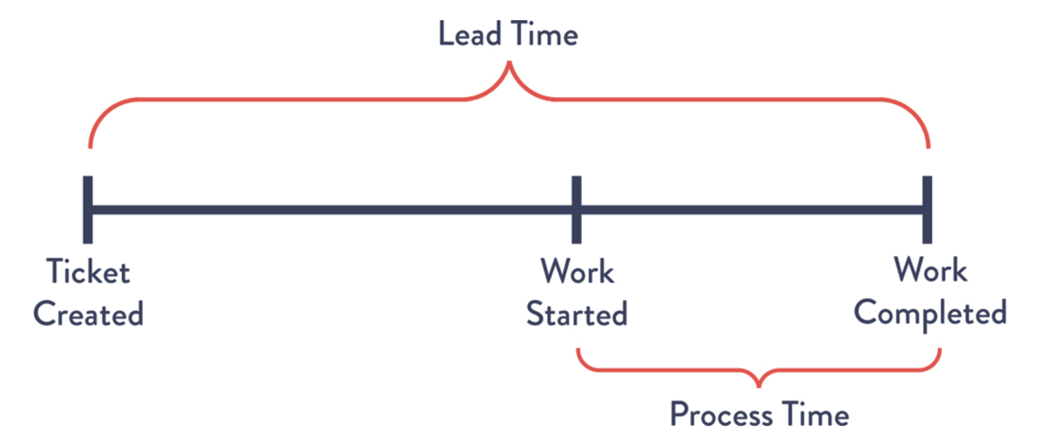

Slide 6
Deployment Lead Times of Minutes
Add small code changes into repository
Perform automated testing
Perform automated deployment
Increases confidence in release
Defects can be quickly detected
Defects can be corrected quickly
Small change is easier to identify the bug
How to achieve this?
Code is modular
Code is encapsulated
Code is loosely coupled

Slide 7
Deployment lead timers requiring months
Many organizations are in the situation where deployment lead times are in months
Tightly coupled code in application
Manual testing
A lengthy time consuming approval Process
Errors in deployment
Found at the end of the deployment
Code does not pass tests anymore
Investigations into who made the problem
Time to correct the problem
Results in less than desired customer outcomes

Slide 8
Thoughts on Technology Value Stream
Make work visible
Kanban Boards
Scrum Boards
Limit work in progress
Shared services can be challenging
Many different stakeholders
Urgent work appears in the queue
Reduce multitasking
Reduce Batch Sizes
High batch sizes increase work in process
Lower lead times
Items are processed one at a time

Slide 9
Thoughts on Technology Value Stream cont.
Reduce the number of handoffs
Handoffs can distort requirements
Additional communication is required with handoff
Eliminate Hardship and waste
Waste is a threat to delivering value
Waste Impacts lead times
Continuous learning and sharing with the organization those learnings can counter waste

Slide 10
Conclusion
Technology value stream is the process of delivering technical value
Lead Time is used to measure performance in the value stream
The difference of process time to lead time is an important measure of efficiency
Deployment lead times can be reduced and can be achieved with small code changes to the repository
Make work visible
Limit work in progress
Reduce batch sizes
Reduce the number of handoffs
Eliminate hardship and waste

Slide 11
References:
Kim, G., Humble, J., Debois, P., Willis, J., & Forsgren, N. (2023, July 3). The devops handbook. IT Revolution. https://itrevolution.com/product/the-devops-handbook-second-edition/

