Slide 1

DigiDrive
Checkpoint 2

Slide 2

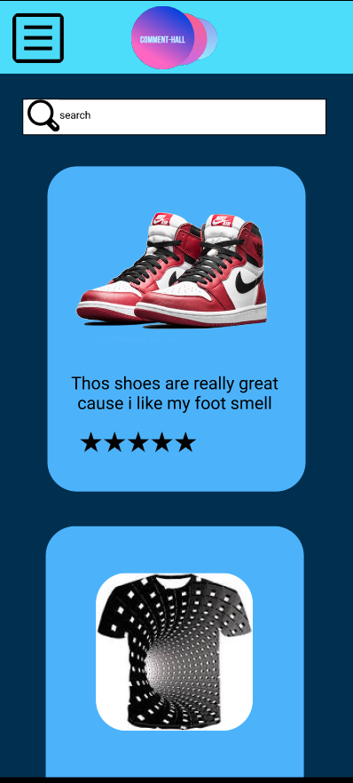
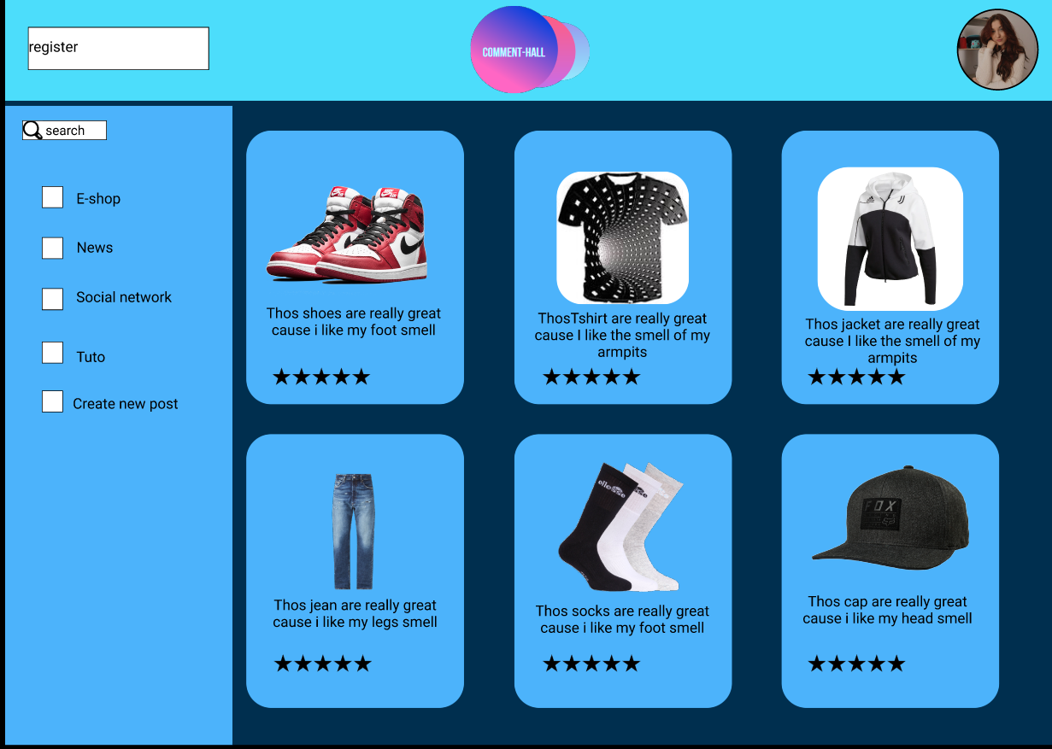
OUR PROTOTYPE
Made with FIGMA

Slide 3

OUR KPI

Slide 4
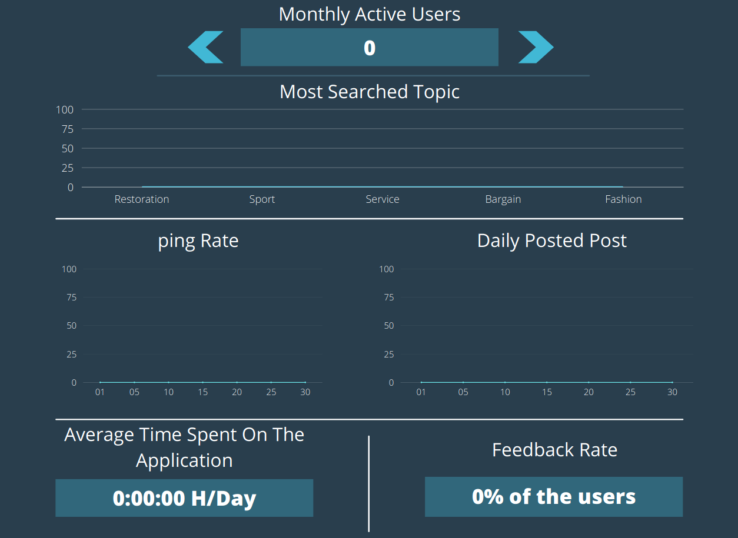
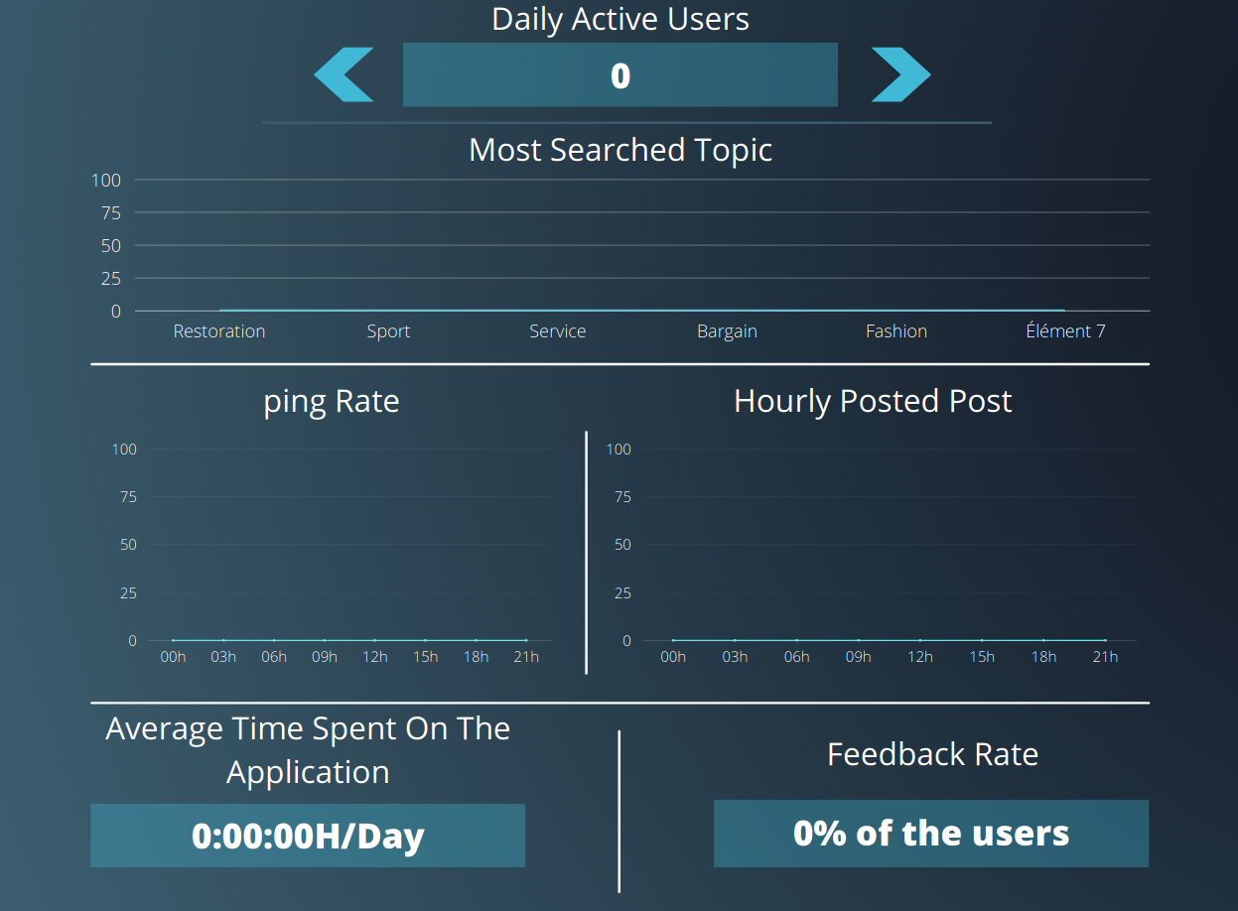
OUR KPI

Slide 5
ANY QUESTIONS ?

