Slide 1
Water Quality Cluster Analysis
Random Forest Classification Outcomes

Slide 2
Dataset Overview
- Total samples: 219
- Total features: 19
- Target: Cluster
- Numeric features used for modeling

Slide 3
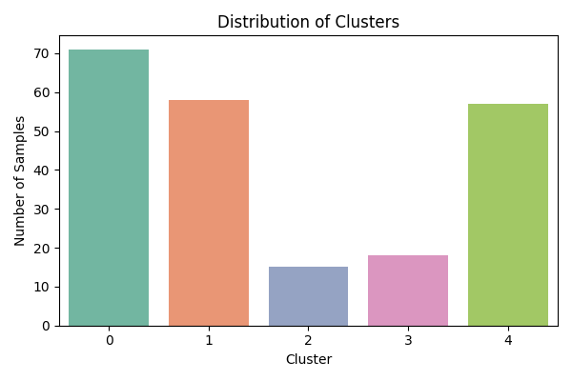
Cluster Distribution

Slide 4
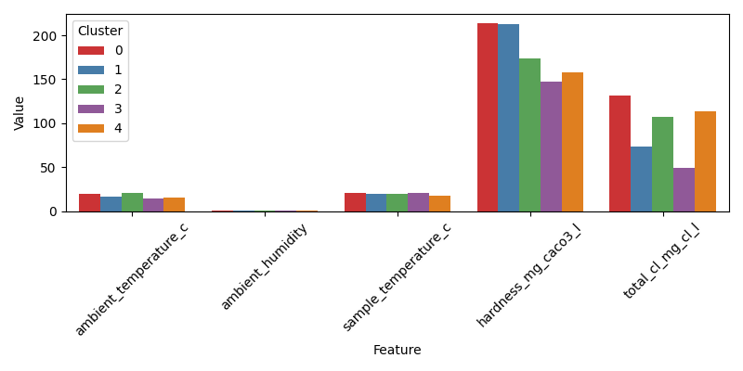
Feature Comparison Across Clusters

Slide 5
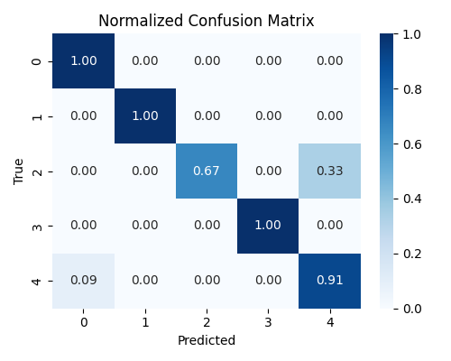
Normalized Confusion Matrix

Slide 6
Model Evaluation Metrics
Accuracy: 0.9545
Weighted Precision: 0.9561
Weighted Recall: 0.9545
Weighted F1-score: 0.9527
Cross-validation mean F1-score: 0.912

Slide 7
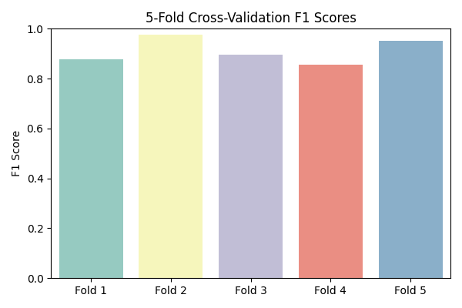
Cross-Validation F1 Scores

Slide 8
Key Takeaways
- Random Forest achieved high accuracy (~95%) and strong F1-scores.
- Clusters with fewer samples (e.g., Cluster 2) showed some misclassifications.
- Numeric features such as hardness, chlorine, temperature, and pH are highly predictive.
- Model generalizes well across folds; can be deployed for water quality prediction.
- Future improvements: collect more data, engineer additional features, explore other ensemble models.

