Slide 1
Water Quality Prediction Outcomes
Random Forest Model Results

Slide 2
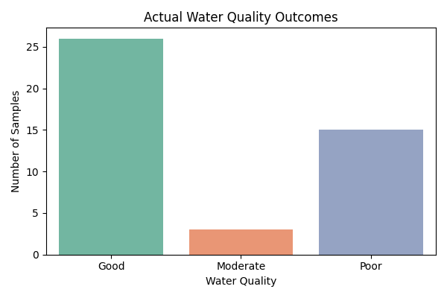
Actual Water Quality Outcomes

Slide 3
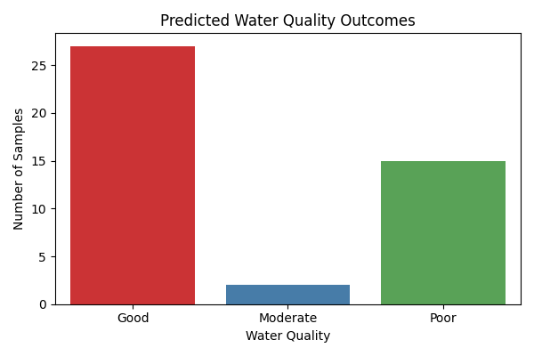
Predicted Water Quality Outcomes

Slide 4
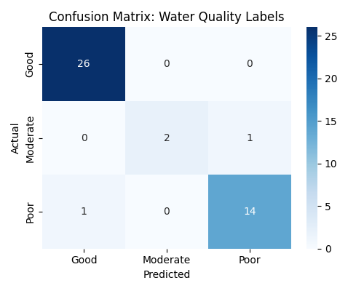
Model Performance: Confusion Matrix

Slide 5
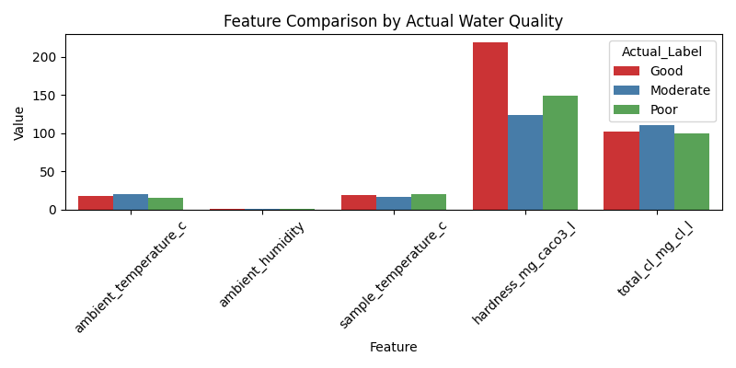
Feature Comparison by Actual Water Quality

Slide 6
Key Takeaways
- Random Forest model predicts water quality with high accuracy: 95.45%
- 'Good' and 'Poor' water quality samples are predicted accurately.
- Minor misclassifications occur in 'Moderate' samples.
- Features like hardness, chlorine, temperature, and pH are highly predictive.
- The model can support water quality monitoring and decision-making.

