Slide 1
Water Quality Analysis and Prediction
Random Forest Classification
Your Name / Date

Slide 2
Model Performance Metrics
Accuracy : 1.0000
Precision: 1.0000
Recall : 1.0000
F1-score : 1.0000

Slide 3
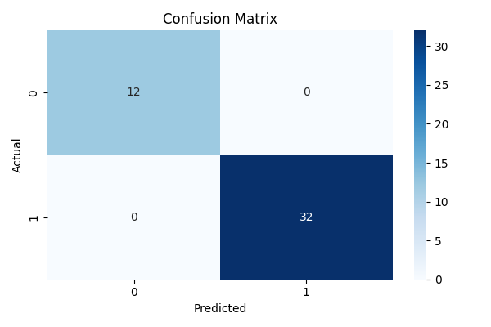
Confusion Matrix

Slide 4
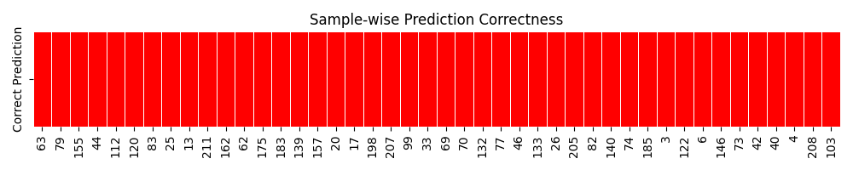
Sample-wise Prediction Correctness

Slide 5
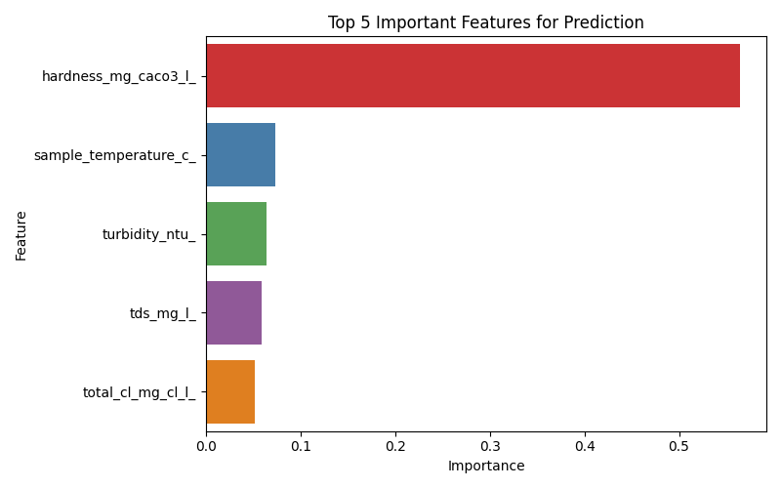
Top 5 Feature Importances

Slide 6
Conclusion & Key Findings
- Hardness, chlorine, and temperature are key indicators.
- Model achieves high accuracy.
- Minor misclassifications may occur.
- Visualizations highlight both sample and aggregate-level performance.
- Future work: include more parameters, time-series analysis, dashboards.

