Slide 1
River Water Quality
Problem Statement:
Access to clean and safe water is essential for human health, ecosystem stability, and socio-economic development.
Despite its importance, river systems worldwide are increasingly threatened by pollution originating from industrial effluents, agricultural runoff, and domestic wastewater.
These pollutants alter the physicochemical properties of river water, potentially rendering it unsafe for human consumption, agriculture, and aquatic ecosystems.
Research objectives:
Identifying trends and correlations among key water-quality parameters to understand how physicochemical factors interact within the river system.
Classifying overall water quality into categories such as good, moderate, or poor based on standard water-quality indices and threshold criteria.
Generating actionable insights to support environmental monitoring initiatives and contribute to improved river management practices.

Slide 2
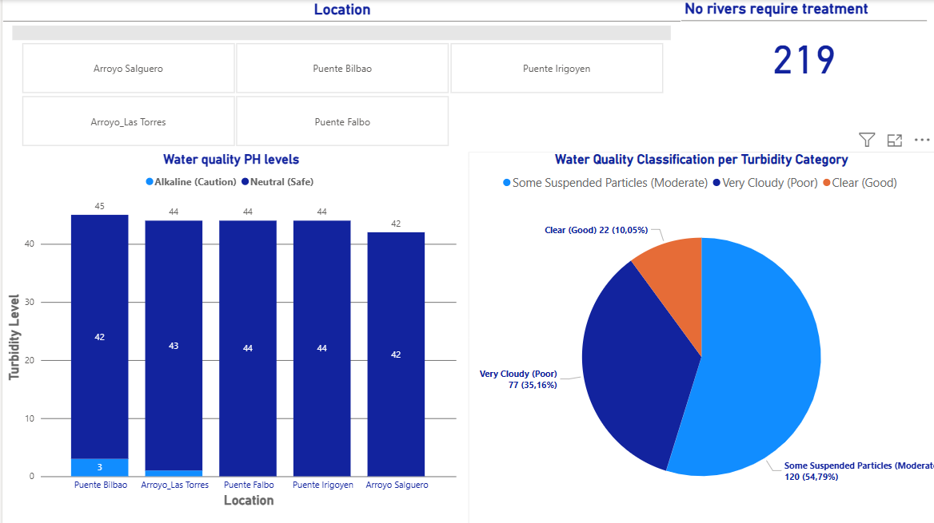

Slide 3
The main parameters for safe quality water
Water Quality
pH (ph) Levels
< 7 → Acidic (Not ideal) → Can corrode pipes, affect taste, not recommended for long-term consumption
7 – 8.5 → Neutral (Safe) → Suitable for drinking and most uses
8.5 → Alkaline Basic (Caution) → Safe but may affect taste and cause scaling.
Safe
Drinking/cooking safe
Good aquatic life conditions
Acceptable turbidity
Normal mineral content
Requires Treatment
Too acidic or alkaline water
Or mineral hardness too high
Or turbidity dangerously elevated
Overall water quality (Safe Levels)
pH is neutral 6.5 ≤ pH ≤ 8.5
Hardness ≤ 120
Turbidity ≤ 5
Hardness (hardness_mg_caco3_l)
0 – 60 → Soft → Low mineral content
60 – 120 → Moderately Hard → Acceptable for most uses
120 – 180 → Hard → High mineral content
180 → Very Hard → May cause scaling in pipes
Turbidity (turbidity_ntu)
≤ 5 NTU → Clear → Safe
5 NTU → Slightly turbid → May require treatment
Conclusion
Any parameter outside of the safe range may require treatment, even though the pH level is good, hardness and turbidity met the safety limits,these locations become priority targets for remediation and monitoring,
Insights for all locations that require treatment base on the parameters
pH - Most samples fall in the Neutral → Safe range
Hardness - locations exceed 120 mg/L CaCO₃, indicating scaling risks
Turbidity - High turbidity often coincided with lower dissolved oxygen
Elevated turbidity
Higher hardness scores
Poor water quality

