Slide 1


Introduction to C++ Loops
Jeremy Castagno

Slide 2


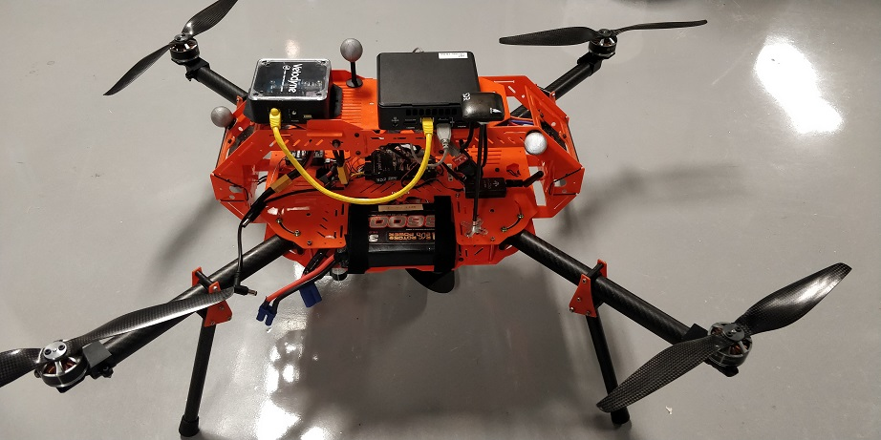

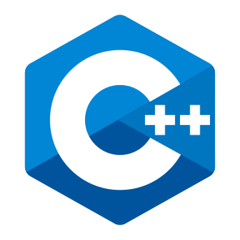

About Me
Chemical Engineering and Computer Science @ Brigham Young University
3 years as a control systems engineer @ Valero
5th Year PhD Robotics @ University of Michigan
Research focused on urgent landing for Unmanned Aerial Vehicles
Love C++ and Python!

Slide 3
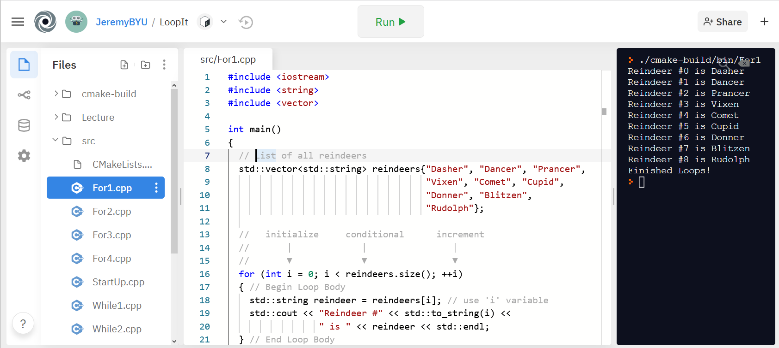
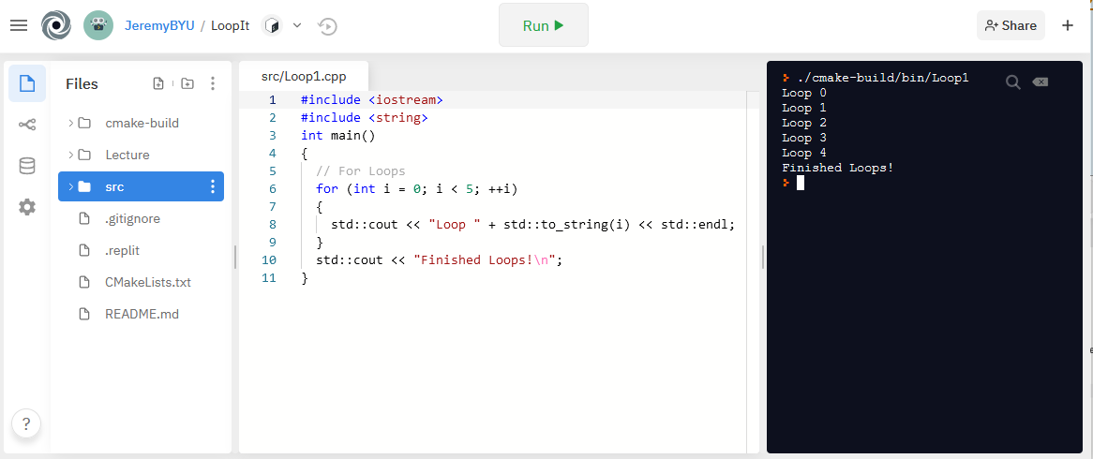
Getting Started
Entire lecture and source code are hosted on Github - https://github.com/JeremyBYU/LoopIt
Examples can be run in your browser using Repl.it , C++ compiler and editor
Lecture assumes students have a basic knowledge of basic C++ datatypes and declaring variables
int, string, vector

Slide 4
What We Are Learning - Loops
Often need to repeat a body of code when programming
C++ has two main types of loops: for & while
Keywords we will be learning: for, while, do, break, continue
Will not learn about go to flow control
At the end we will learn about new C++ 11 loops
Examples are not meant to be optimal or efficient; demonstrate principles
Conditional
Loop Body

Slide 5
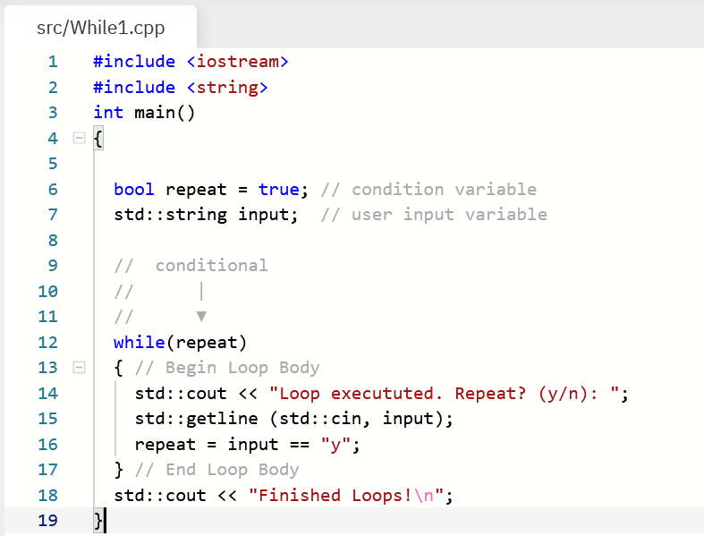
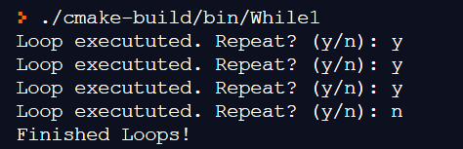
While Loops - Basic
Loop forever until a condition is met
Start
Conditional Variable
Conditional
T
Loop
Body
While Loop Keyword
Condition Statement
F
End
Update Variable
Example Program Output:

Slide 6
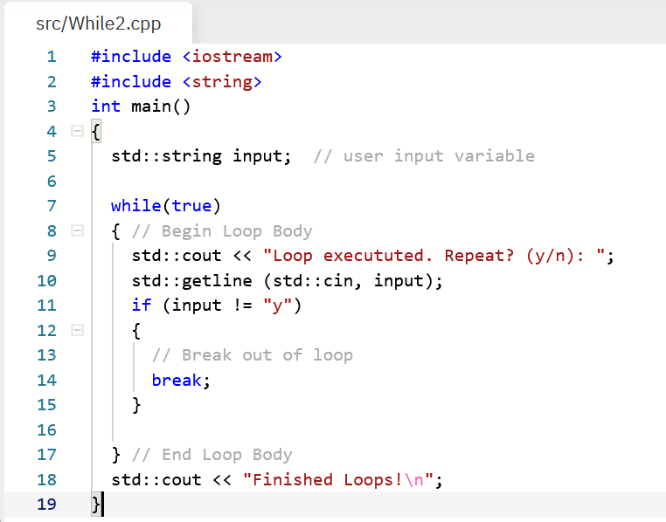
While Loops – Break Statement
You can also use the break keyword to exit a loop
When to use while loops?
Don’t know how many times to repeat code
Infinitely repeating until user input exit
Often used for game loops: Get Input, Update Game, Render
Start
Conditional
Condition Statement
T
Loop
Body
F
End
Update Variable

Slide 7
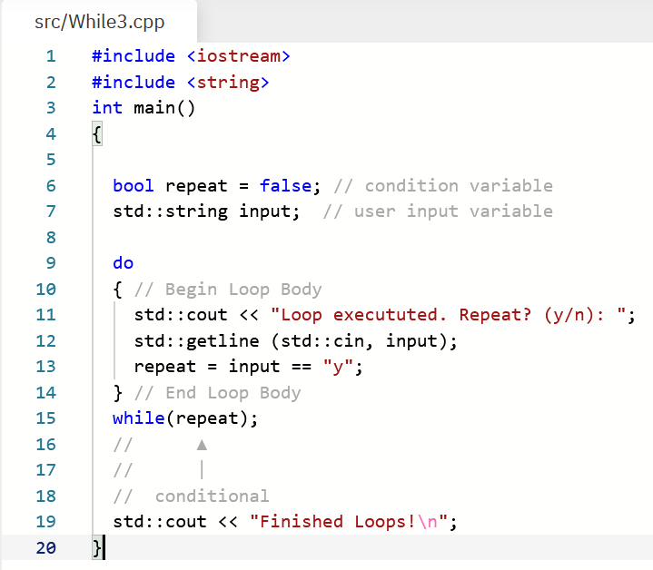
While Loops – Do While
Do while loops execute Loop Body first, then conditional
It doesn’t matter that repeat is set to False in Line 6
Loop Body is executed at least once
Often used for game loops: Get Input, Update Game, Render
Start
T
Conditional
Condition Variable
Loop
Body
F
End
Update Variable
Condition Statement

Slide 8
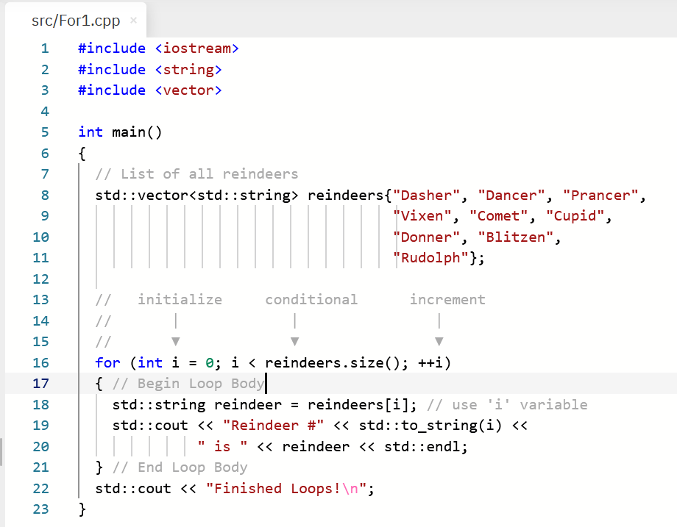
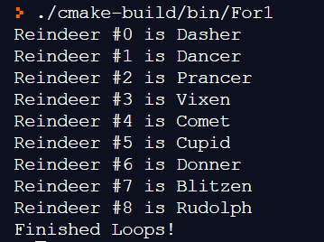
For Loops – Holiday Special
For loops have an initialization, conditional, and update
Start
List of Reindeers
Initialization
Update
Conditional
T
Initialization
Loop Body
For Loop Keyword
Update Statement
Condition Statement
Use index
F
End
Example Program Output:

Slide 9
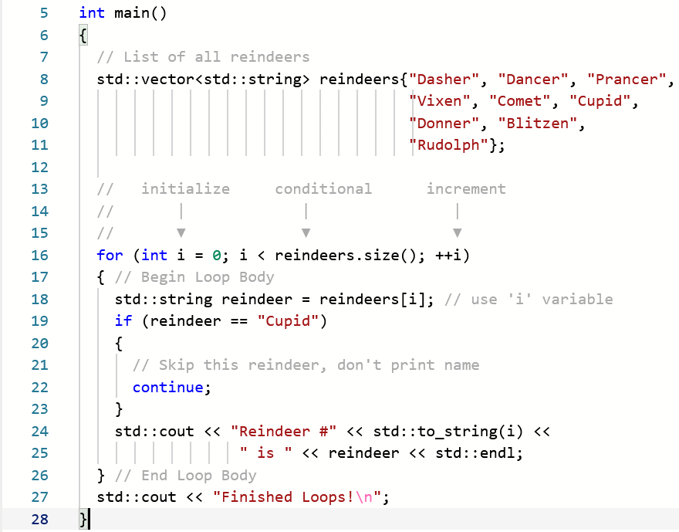
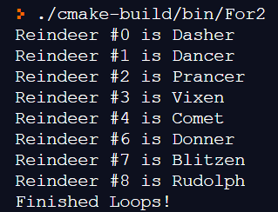
For Loops – Continue Statement
You can skip execution of remaining loop with continue
Start
Initialization
Update
Conditional
T
Conditional in Loop Body
Loop Body
F
End
Example Program Output:

Slide 10
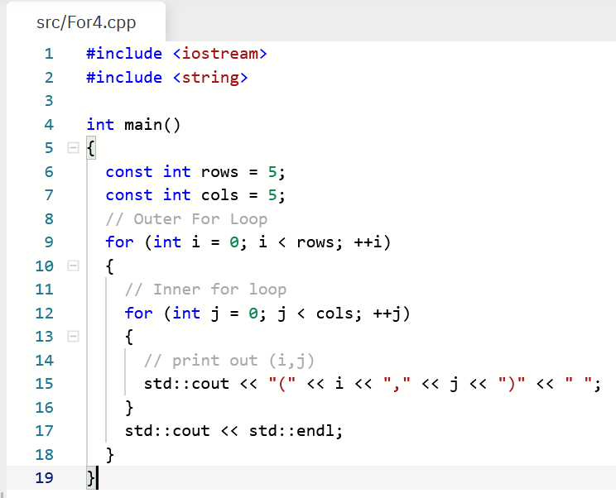
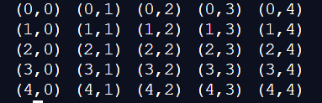
Nested For Loops
For loops can be nested, a loop inside a loop
Two for loops: outer & inner
Example printing a square
Outer loop = rows, Inner loop = columns
Column 0
Column 4
Row 0
Variable ‘i’ stays constant in inner loop
Row 4

Slide 11
Modern C++
C++ is a language with a formal specification. However, it is a living language!
C++ 98, C++ 03, C++ 11, C++ 14, C++ 17, C++20
Strong backwards compatibility!
C++11 introduced many enhancements that greatly improved code quality and efficiency
C++ 11 and after is considered Modern C++
We will review a new for loop constructs introduced in C++11: Range-based for loops
These don’t replace previously discussed patterns; they simply augment them

Slide 12
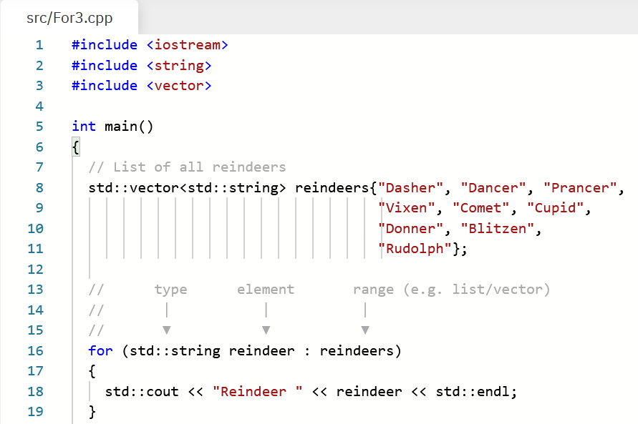
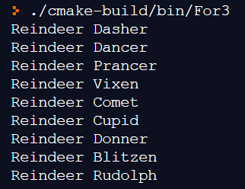
Range-based For Loop
Execute loop body for each element inside Range
A Range is a sequence of elements, e.g., [1, 2, 3]
Start
Range
Loop Body
Next
range (list)
Element
type
element variable
Use element
End
Example Program Output:

Slide 13
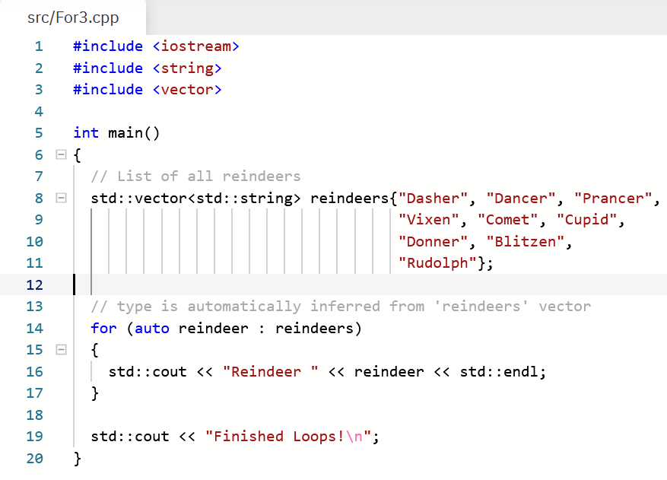
Range-based For Loop – Auto!
C++ 11 introduced the auto keyword
auto declares a variable whose type is deduced/inferred
auto n = 10 ; The variable n is of type int
Range-based for loops can use auto to deduce the type of the element inside of the range
This makes code less verbose
type

