Slide 1


Introduction to C++ Loops
Jeremy Castagno

Slide 2


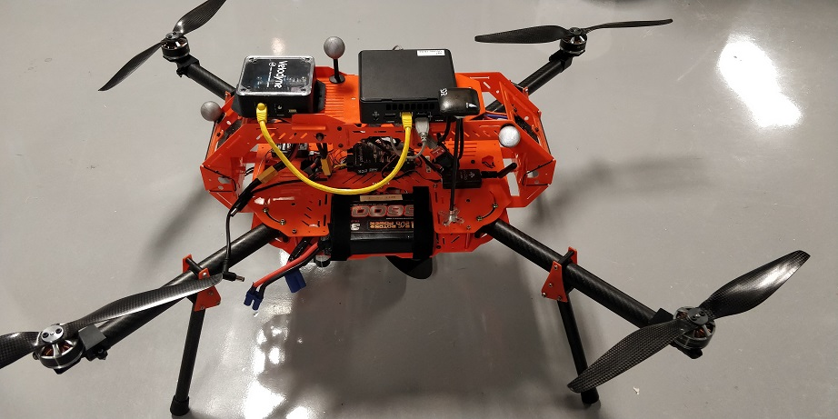

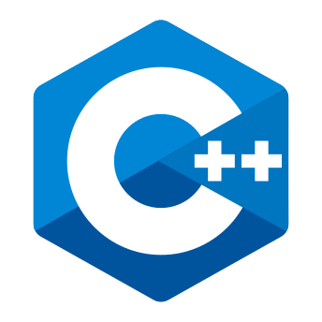

About Me
Chemical Engineering and Computer Science @ Brigham Young University
3 years as a control systems engineer @ Valero
5th Year PhD Robotics @ University of Michigan
Research focused on urgent landing for Unmanned Aerial Vehicles
Love C++ and Python!
Notes:
I thought I would start off introducing myself .
My undergraduate background is in Chemical Engineering and Computer Science at Brigham Young University
Afterwards I worked as a control systems engineer at an oil refinery in Memphis. Basically, I managed the computer hardware and software that ran the plant. The center picture is of the H2 plant in the refinery.
I really loved working with these cyber-physical systems so much I decided to go back to graduate school. I am finishing up my PhD in Robotics at the University of Michigan
My research is focused on urgent landing of Unmanned Aerial Vehicles/ aka drones
My favorite programming languages are C++ and Python, and I love using them together!

Slide 3
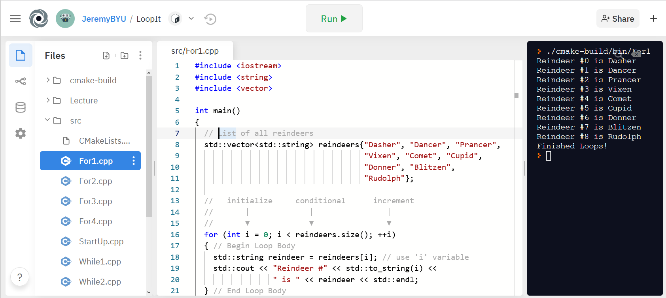
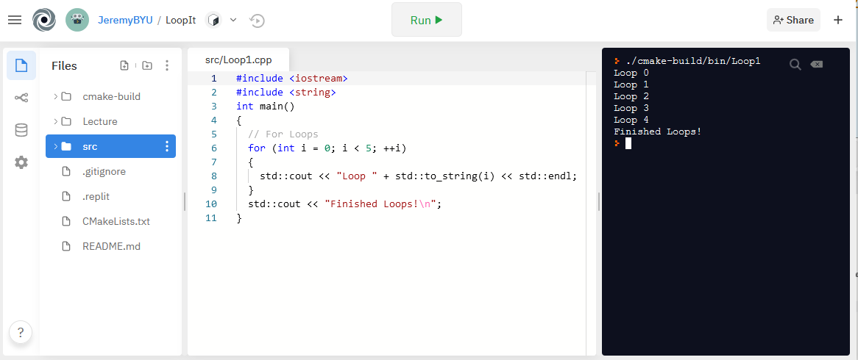
Getting Started
Entire lecture and source code are hosted on Github - https://github.com/JeremyBYU/LoopIt
Examples can be run in your browser using Repl.it , C++ compiler and editor
Lecture assumes students have a basic knowledge of basic C++ datatypes and declaring variables
bool, int, string, vector
Notes:
So a couple of getting started details:
This entire lecture and source code for examples is available on Github right now. If you are not familiar with Github it is the largest code sharing website in the world.
All the examples shown in this lecture can actually be run in your browser using a website called Repl.it. This website puts a C++ compiler and editor right in your browser and looks like this picture.
This lecture assumes that the students have a basic knowledge of basic C++ data types and being able to declare variables. This lecture only uses the data types int, string, and vector.
So if that’s all you know you are pretty much good.

Slide 4
What We Are Learning - Loops
Often need to repeat a body of code when programming
C++ has two main types of loops: for & while
Keywords we will be learning: for, while, do, break, continue
Will not learn about goto flow control
At the end we will learn about modern C++ for loops
Examples are not meant to be optimal or efficient; demonstrate principles
Q: What is a Conditional?
A: Something that evaluates to either true (T) or false (F)
Conditional
Loop Body
Notes:
Today we are learning all about C++ Loops!
What are Loops used for?
Often times we need to repeat a procedure, or a block of code over and over.
Instead of duplicating that code, we can use a loop
C++ has two main types of loops: the for loop and the while loop
However they both generally have this type of structure.
A conditional statement is evaluated and if true, code contained in the Loop Body is executed. The conditional is then re-evaluated and the process repeats
This creates a repeating pattern where the loop body may be executed multiple times.
The C++ keywords we will be learning are: for, while, do, break, and continue
We will not be learning about go to flow control. This is not used as much today and is generally frowned upon when used in higher level languages.
We will also learn about some new loops introduced in modern C++
The examples presented here are not meant to optimal or effeceint; they are to be simple and demonstrate principals
https://homepages.cwi.nl/~storm/teaching/reader/Dijkstra68.pdf

Slide 5
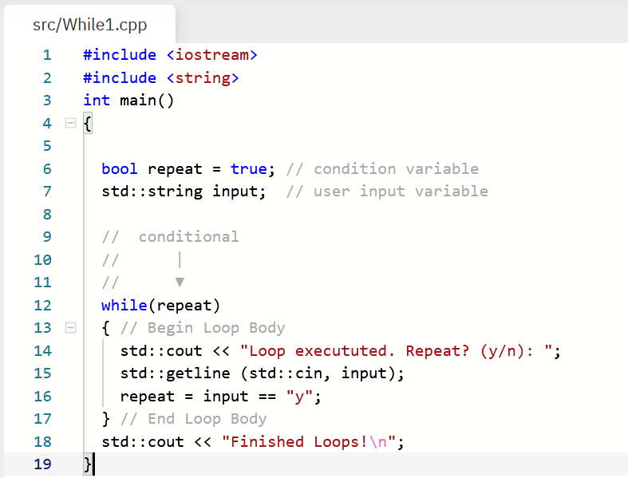
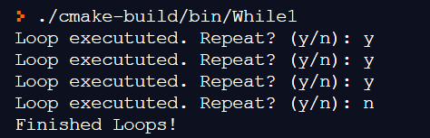
While Loops - Basic
Loop forever until a condition is met
Start
Condition Variable
Conditional
T
Loop
Body
While Loop Keyword
Condition Statement
F
End
Loop Body
Update Variable
Example Program Output:
Notes:
First lets being with the while loop
You can see the control flow diagram on the left for a while loop.
You begin at the start label and move to a conditional statement. If the condition is true you continue to the loop body, if false you end the loop.
If true the Loop body is executed where control flow returns back to the condition statement. The process then repeats.
An example program is shown on the right.
First we need some sort of condition variable that is usually defined outside the while loop. Here we name that condition variable repeat and set it to true.
Then we need to use the while keyword and place a parentheses,
Everything inside of the parentheses is considered the conditional statement. In this example, we put a variable repeat inside which will evaluate to either true or false
Next we insert the Loop Body which begin and ends with an opening and closing bracket respectively. Everything in between these brackets is code that may be repeated.
Our loop body is quite simple. We output text to the terminal in Line 14, take input from the terminal in line 15 which is placed in the ‘input’ variable
Then line 16 does something important. We update the repeat variable! If the user enters the letter ‘y’ then repeat is true, anything else will evaluate to false.
Question:
Why is line 16 so important. What happens if we skip it?
Question:
How do you stop a program that is in an infinte loop?
Ctrl-c!!!
Example output of this program would look like this:

Slide 6
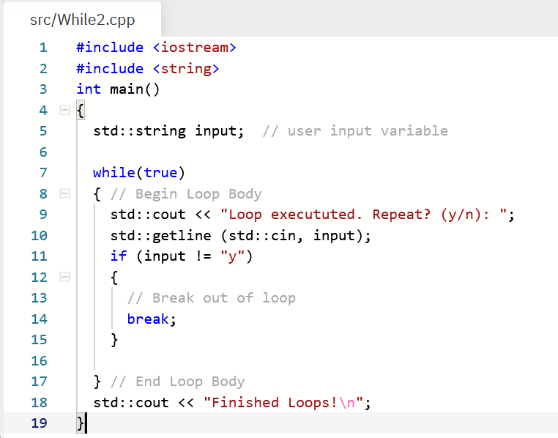
While Loops – Break Statement
You can also use the break keyword to exit a loop
When to use while loops?
Don’t know how many times to repeat code
Infinitely repeating until user input exit
Often used for game loops: Get Input, Update Game, Render
Start
Conditional
Condition Statement
T
Loop
Body
F
End
Exit Loop
Notes:
Next we will learn about the break statement
This program is the exact same as before except now the while loop is always true. That means this is an infinite loop!
To exit the loop we check if the input is not ‘y’ and use the break statement in line 14 to exit the loop.
So when do we generally use whle loops?
Don’t know how many times to repeat code
Maybe we want an infitely repeating loop until a user input exit
Its also very often used for game loops -. Get User Input, Update, Game Render, Screen. We do this forever until the user exits the game.

Slide 7
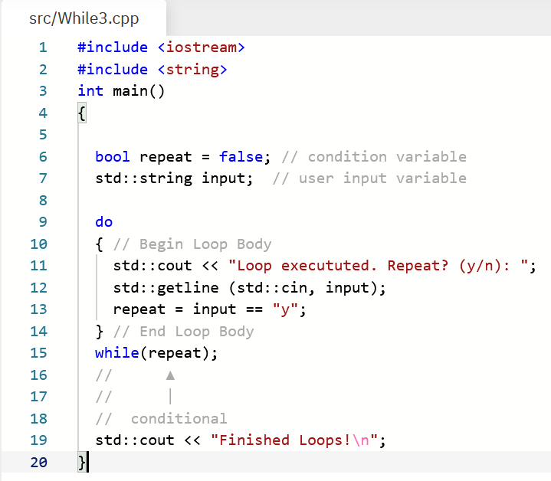
While Loops – Do While
Do while loops execute Loop Body first, then conditional
It doesn’t matter that repeat is set to False in Line 6
Loop Body is executed at least once
Start
T
Conditional
Condition Variable
Loop
Body
do keyword
F
End
Update Variable
Condition Statement
Notes:
This next example is for a do while loop, but it slightly different.
You can see the control flow diagram on the lft. Can anyone tell me what's different about in this diagram from the one of the previous page.
Yep the only difference is the order of the coniditonal and the loop body. In the do while loop the Lopo body is exuctued first.
We still have the same condition variable, then we place down the ‘do’ keyword
Then the loop body begins to execute. It doesn’t matter that repeat is false, this loop body is still executed at least once.
We update the repeat variable in Line 13, and then perform the condition statement on line 15.
So basically that’s it for while loops. Does anyone have any questions about while loops so far?

Slide 8
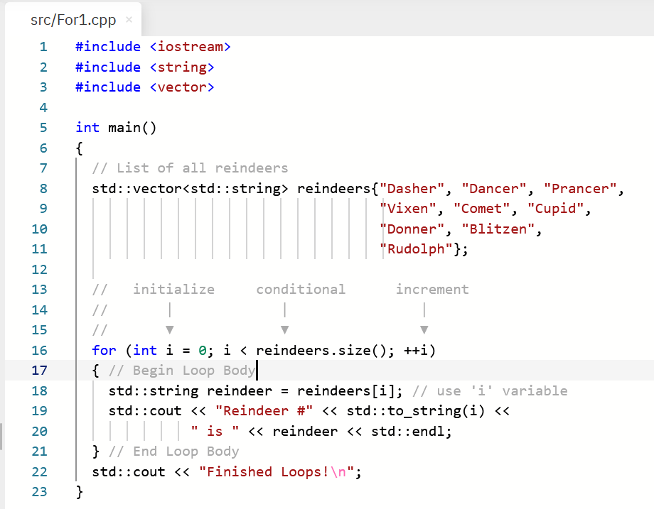
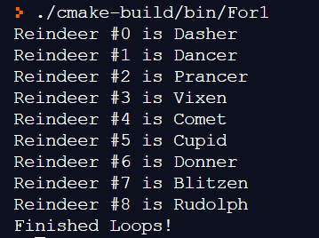
For Loops – Holiday Special
For loops have an initialization, conditional, and update
Start
List of Reindeers
Initialization
Update
Conditional
T
Initialization
Loop Body
For Loop Keyword
Update Statement
Condition Statement
Use index
F
End
Example Program Output:
Notes:
Next up is for loops
For loops have a few more steps than while loops as we can see in control flow diagram.
Once again we begin at the start, but move first to an initialization statement, after initialization we then perform a conditional, we execute the loop body if true,
And finally we perform and update statement.
So the two new things are the initialization and update statements.
Lets see an example of how this all players
Let look at the code on the right.
First things first we create a vector of strings. This is just a list of reindeer names.
Next we begin with the for loop
First we start with for loop keyword. Then we have a parenthesis that will have 3 statements separated by semilcolons!
The first statement is the initialization statement. Literally the most common initialization is a counter variable that that starts at 0, in this case call the variable i.
Next we have the conditions statement. This condition statement evaluates to true if ‘i’ is less than the size of the reindder vector. And as we all know, there are 9 reindeer, including Rudolph, so this evalutes to true if I is less than 9
Next we have the update statement. In a for loop this generally means to increment the count variable. This means each time the loop body is executed the variable ‘I’ increments by 1.
Next within the body of the for loop you may want to use the ‘I’ variable. In this example we use it to retrieve the reindeer at the I position in the list
The output of this program is as expectd and simply prints out the reindeers to the terminal.
Does anyone have any questions about this for loop example?

Slide 9
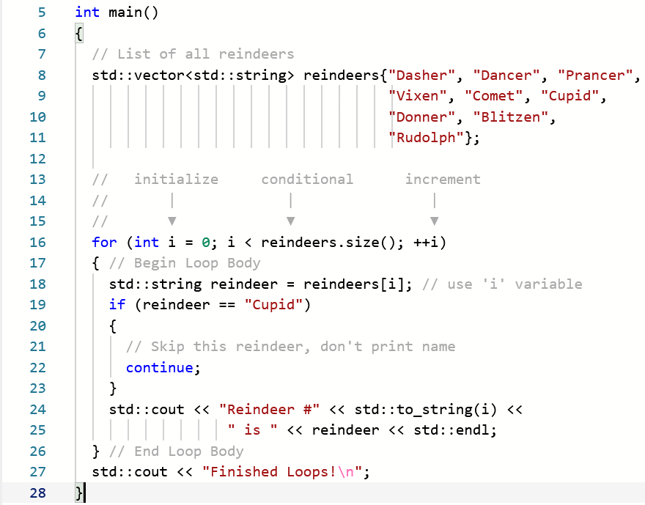
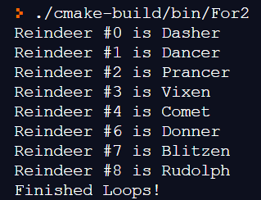
For Loops – Continue Statement
You can skip execution of remaining loop with continue
Start
Initialization
Update
Conditional
T
Conditional in Loop Body
Loop Body
F
End
Example Program Output:
Notes:
Next we will learn about the continue keyword.
The continue keyword is used to skip execution of the remaining body
Lets look at that same for lop example.
The only difference here is if branch that checks to see if the reindeer being inspected is “cupid”. If it is we execute the continue statement.
When this continue statemtnis reached it does not execute the remaining loop, which is the printing to erminal and return flow back to the start of the loop.
To be clear, it will update the count variable, check the condition, and then execute boyd loop.
The example output of the program is below, and as you can see Reinder #5, cupid, is not printed.

Slide 10
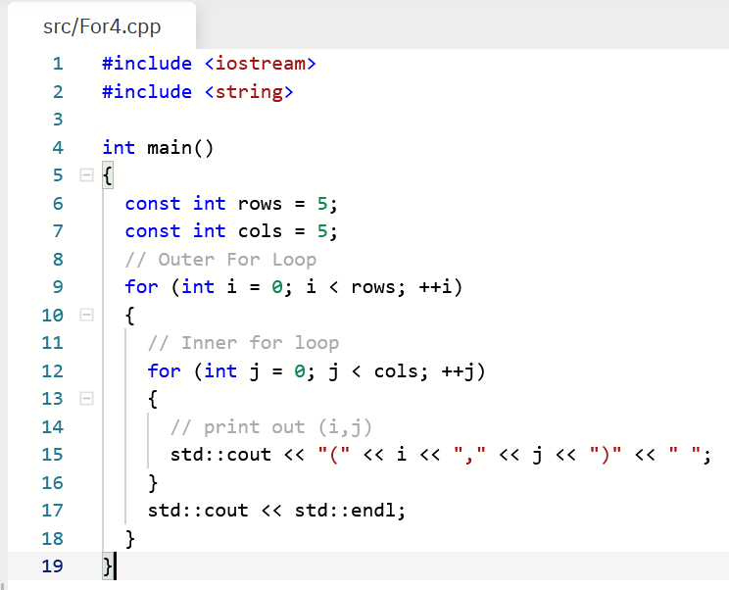
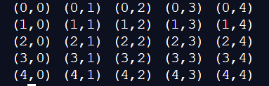
Nested For Loops
For loops can be nested, a loop inside a loop
Two for loops: outer & inner
Example printing a square
Outer loop = rows, Inner loop = columns
Column 0
Column 4
Row 0
Variable ‘i’ stays constant in inner loop
Row 4
Notes:
Next we are going to talk about nested for loops.
For loop can be inside one another, often called nested.
Generally, when you have two for loop, the first was is called the outer loop ,and the second is called the inner loop
Lets look a the example on the right that prints the coordinates for a 5X5 square
The first, or outer for lop is shown here. Note that our count variable is the variable I in this for loop
Next inside the this loop body is another for loop, this is the inner for loop, Notice that its counting variale is called j. It generally needs to be different that the other for lop.
Now inside the loop body of the inner for loop is our code to output to terminal. Here you can see it is printing out the I,j coordinates of the loop.
At each j iteration a new column is printed you see to the right. So first it prints out (0,0, then it prints (1,1)
The ‘i’ variable is staying constant during this iteration, because it it not incremented unit the outer loop body terminates.
Eventually all the columns are printed and the inner for loop terminates. Line 17 then gets executed creating a new line.
The control then flow back to the outer for loop and repeated, except on the second row, or i=1.
Does anyone have any question about nested for loops.
Scoping, variable shadowning.

Slide 11
Modern C++
C++ is a language with a formal specification. However, it is a living language!
C++98, C++03, C++11, C++14, C++17, C++20
Strong backwards compatibility!
C++11 introduced many enhancements that greatly improved code quality and efficiency
C++11 and after is considered Modern C++
We will review a new for loop constructs introduced in C++11: Range-based for loops
These don’t replace previously discussed patterns; they simply augment them
Specifically meant for ranges, aka sequences/lists
Notes:
C++ i

Slide 12
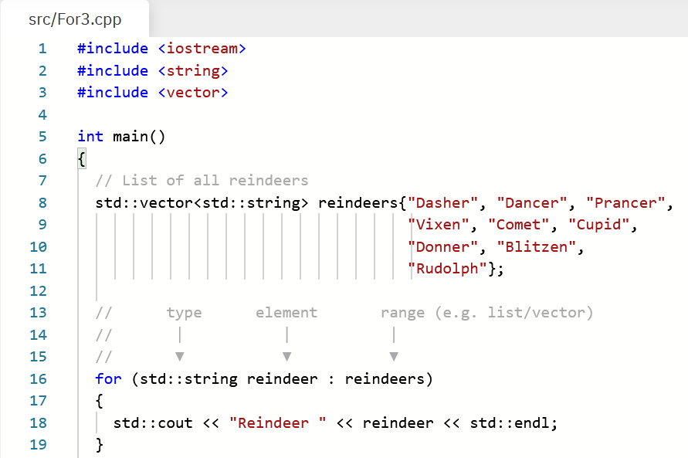
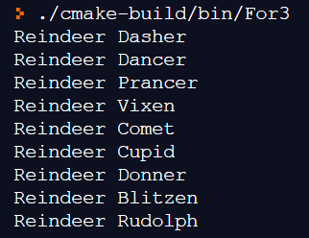
Range-based For Loop
Execute loop body for each element inside Range
A Range is a sequence of elements, e.g., [1, 2, 3]
Reindeer vector is not modified/changed
Start
Range
Loop Body
Next
range (list)
Element
type
element variable
Use element
End
Example Program Output:
Notes:
A range based for loop executes a the lop body for each element that is inside a range
Looking at the control flow diagram on the left you can see that we input a range, it calls some abstract “next” procedure. It produces an element from that list, and then the loop body is executed with access to this element.
The process then repeates again . If there are not more elements left in the range, then the loop finishes and ends.
Lets see an example here on the right executed on our list of reindeers.
The for loop begisn with keyword for, then in paranthsis you have:
The datatype of an element in the range, a variable name to give for this element, then a colon, then finally the actually range itself, which in our case is the vector of reindeer neames.
Inside the loop body we can then the element that.
A couple things to note. The items inside the reindeer list are still there. They have not been removed. We are simply accessing them in a iterative manner.

Slide 13
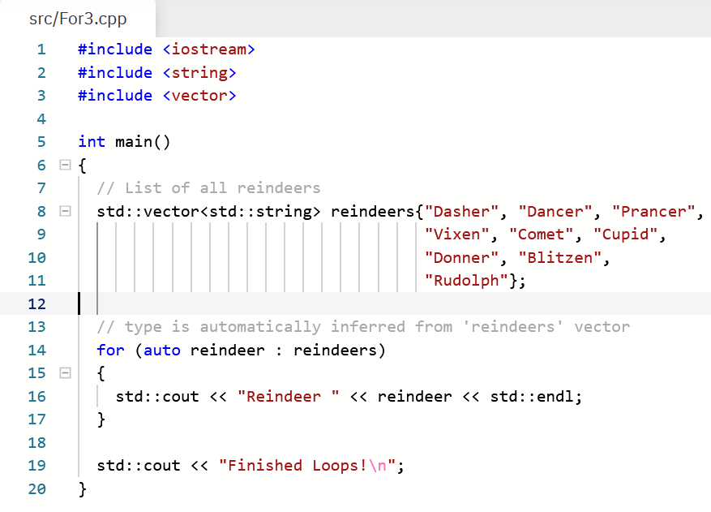
Range-based For Loop – Auto!
C++ 11 introduced the auto keyword
auto declares a variable whose type is deduced/inferred
auto n = 10 ; The variable n is of type int
Range-based for loops can use auto to deduce the type of the element inside of the range
This makes code less verbose
type
Notes:
A last little thing to talk about.
C++11 introduced a new keyword called auto
Auto declares a variable whose type is deduced or inferred from the expression on the right
For example is you type auto n = 10, the variable n will be deduced to be of type int
Range –based for lop can also use auto to deduce the type of the element inside of the range
So what type is the variable name reindeer. Exactly right its std::string
This benefits because the
https://docs.microsoft.com/en-us/cpp/cpp/auto-cpp?view=msvc-160
Robustness: If the expression’s type is changed—this includes when a function return type is changed—it just works.
Performance: You’re guaranteed that there will be no conversion.
Usability: You don't have to worry about type name spelling difficulties and typos.
Efficiency: Your coding can be more efficient.
Conversion cases in which you might not want to use auto:
When you want a specific type and nothing else will do.

Slide 14
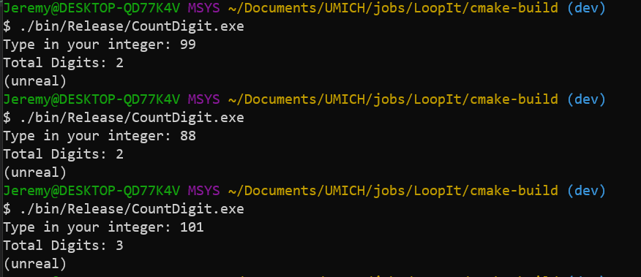
Assignment – Count Digits
Create a program that reads an integer and counts the number of digits; display the result
Solve this problem using loops
Think about which type of loop would work best in this example
Hints: The decimal place of a number is moved left by dividing by 10

