Slide 1


C++ Loops
Jeremy Castagno

Slide 2

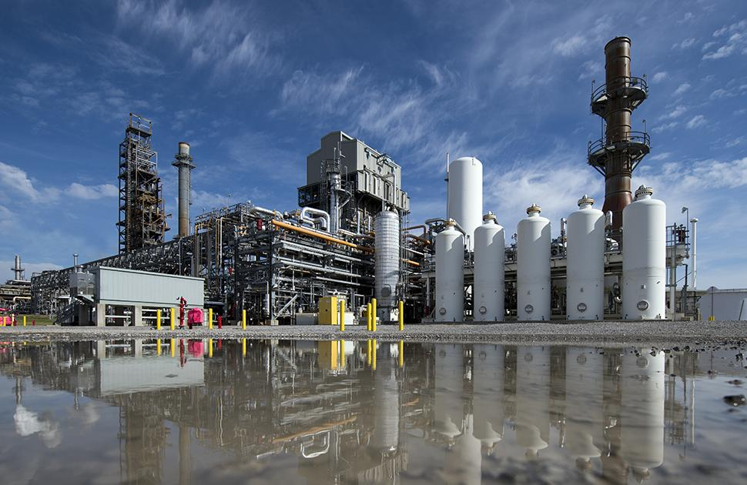
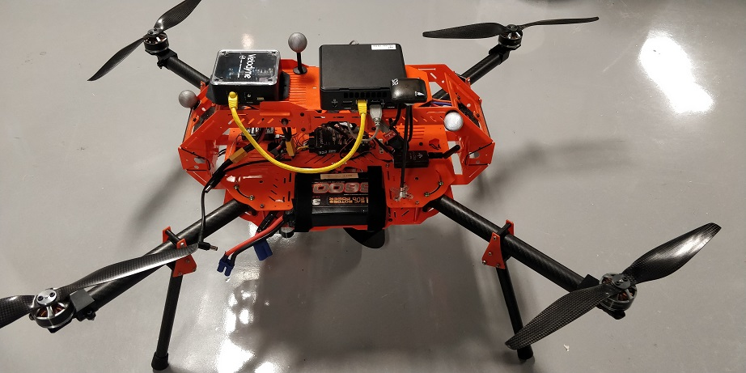

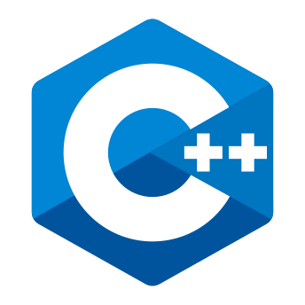

About Me
Chemical Engineering and Computer Science @ Brigham Young University
3 years as a control systems engineer @ Valero
5th Year PhD Robotics @ University of Michigan
Research focused on urgent landing for Unmanned Aerial Vehicles
Love C++ and Python!

Slide 3
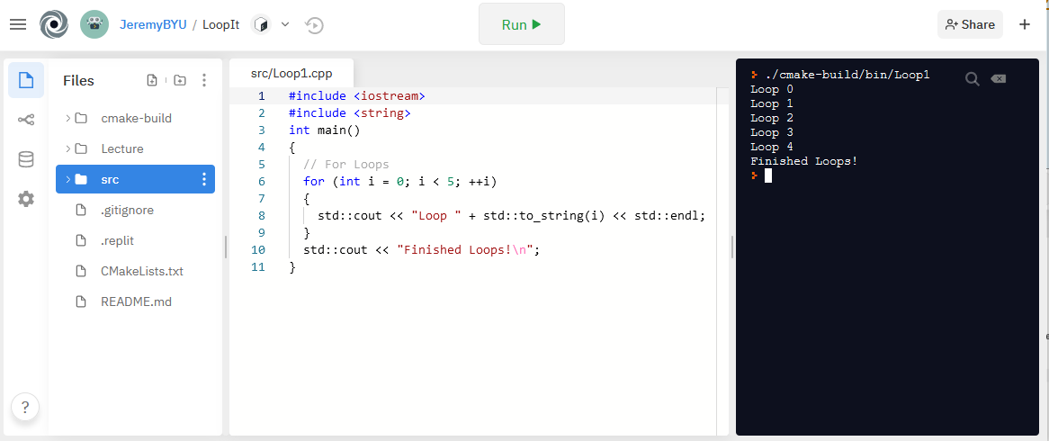
Getting Started
Entire lecture and source code are hosted on Github - https://github.com/JeremyBYU/LoopIt
Examples can be run in your in browser using Repl.it , C++ compiler and editor
Lecture assumes students have a basic knowledge of basic C++ datatypes and declaring variables
int, string, vector

Slide 4
What We Are Learning
Often need to repeat a body of code when programming
C++ has two main types of loops: for & while
Keywords we will be learning: for, while, do, break, continue
Will not learn about go to flow control
At the end we will learn about new C++ 11 loops
Examples are not meant to be optimal or efficient; demonstrate principles
Conditional
Code Block

Slide 5
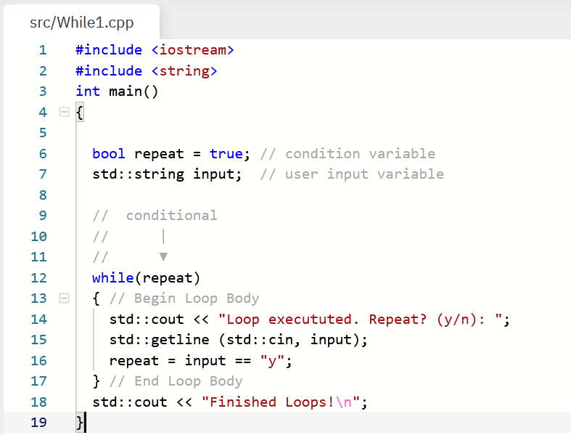
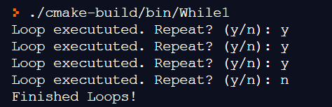
While Loops
Loop forever until a condition is met
Start
Conditional Variable
Conditional
T
Code Block
While Loop Keyword
Condition Statement
F
End
Update Variable
Example Program Output:

Slide 6
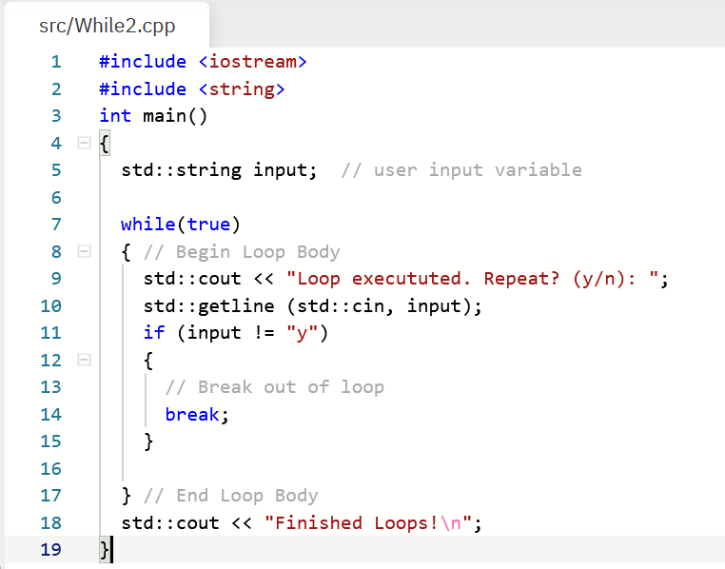
While Loops – Break Statement
You can also use the break keyword to exit a loop
When to use while loops?
Don’t know how many times to repeat code
Infinitely repeating until user input exit
Often used for game loops: Get Input, Update Game, Render
Start
Conditional
Condition Statement
T
Code Block
F
End
Update Variable

Slide 7
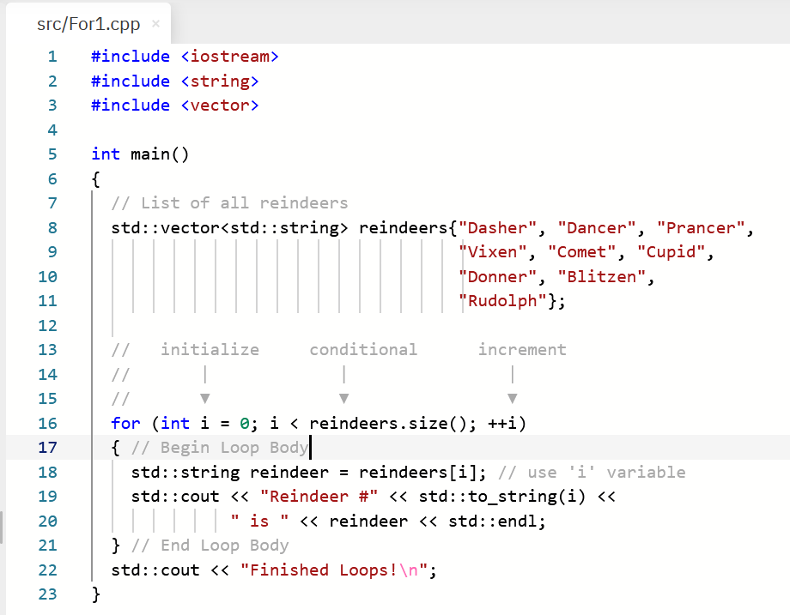
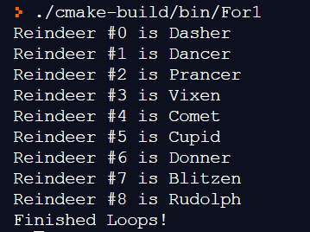
For Loops – Holiday Special
For loops have an initialization, conditional, and update
Start
List of Reindeers
Initialization
Update
Conditional
T
Initialization
Code Block
For Loop Keyword
Update Statement
Condition Statement
Use index
F
End
Example Program Output:

Slide 8
For Loops – Continue Statement
For loops have an initialization, conditional, and update
Start
List of Reindeers
Initialization
Update
Conditional
T
Initialization
Code Block
For Loop Keyword
Update Statement
Condition Statement
Use index
F
End
Example Program Output:

