Slide 1
Does it have fur?
Y
N
Does it bark?
Does it fly?
Y
N
Y
N
Dog
Cat
Bird
Fish

Slide 2
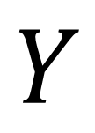
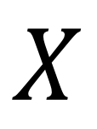


Nature or System
$$X$$
$$Y$$
$$f(X)$$
$$\hat{f}(X)$$

