Slide 1
Obfuscation
Jeremy Blackthorne
10/29/2014

Slide 2
Obfuscation
What is it intuitively?
Obfuscation vs. Cryptography

Slide 3
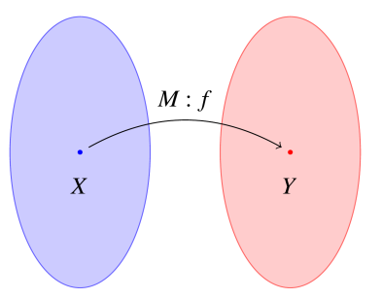
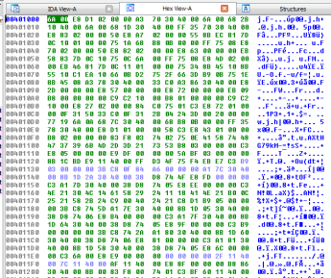

Spectrum of Abstraction
Functions
Programs
Ideal
Real World

Slide 4

Simplified Program Model

Slide 5

Virtual Black-box Obfuscation

Slide 6
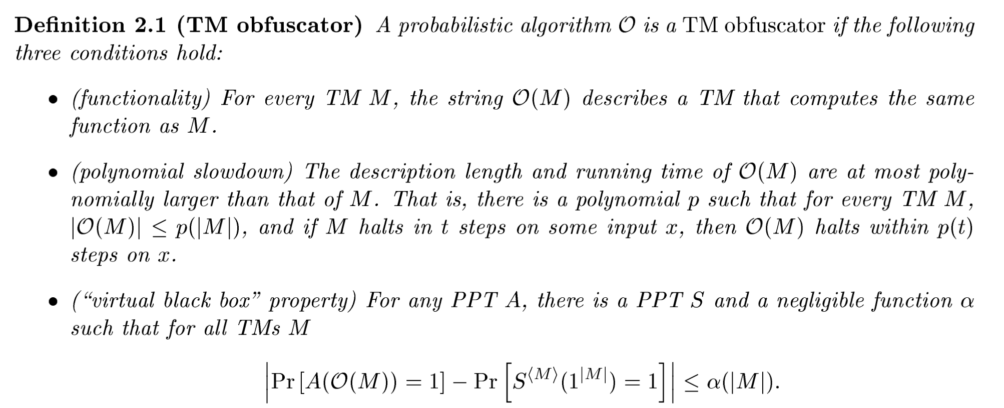
VBB Definition
Notes:
http://eprint.iacr.org/2001/069

Slide 7
Obfuscation Results
Multilinear Maps
Indistinguisability Obfuscation
Virtual Black-Box Obfuscation

Slide 8
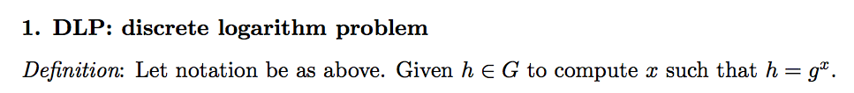

Hardness Assumptions
Notes:
http://www.ecrypt.eu.org/documents/D.MAYA.3.pdf

Slide 9
Bilinear Hardness Assumption
DBDH: Decision Bilinear Diffie-Hellman problem
Definition: Given gª,g^{b},g^{c},g^{ab},g^{ac},g^{bc}, h in G to determine whether or not h = g^{abc}
Notes:
http://www.ecrypt.eu.org/documents/D.MAYA.3.pdf

Slide 10
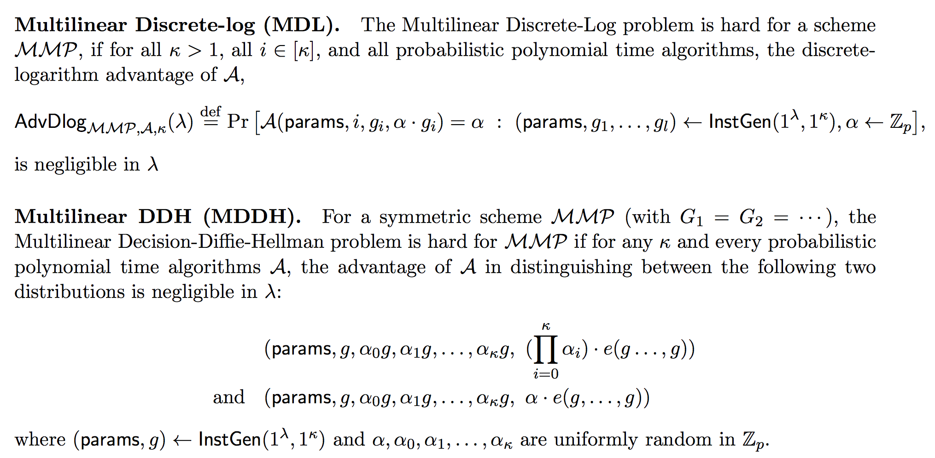
Multilinear Hardness Assumptions
Notes:
http://www.ecrypt.eu.org/documents/D.MAYA.3.pdf

Slide 11
Algebraic Structures
Standard:
Sets
Groups
Rings
Fields
Advanced:
Polynomial Quotient Rings

Slide 12
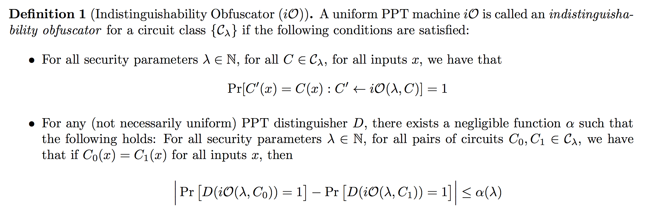
iO Definition

Slide 13
Indistinguishability Obfuscation Process
Functionality
Boolean Formula/Circuit
Binary Decision Diagram
Branching Program (BP)
Oblivious Linear Branching Program through Barrington’s Theorem
Branching Program represented with permutation matrices
Security
Dummy Program and Random Scalar multiplication of A_{i,b}
Small Matrix in Big Matrix
Sandwich Vectors
Flank by Random Matrices
Encode all Matrix elements in multilinear map

Slide 14
Indistinguishability Obfuscation Process
Functionality
Boolean Formula/Circuit
Binary Decision Diagram
Branching Program (BP)
Oblivious Linear Branching Program through Barrington’s Theorem
Branching Program represented with permutation matrices
Security
Dummy Program and Random Scalar multiplication of A_{i,b}
Small Matrix in Big Matrix
Sandwich Vectors
Flank by Random Matrices
Encode all Matrix elements in multilinear map

Slide 15
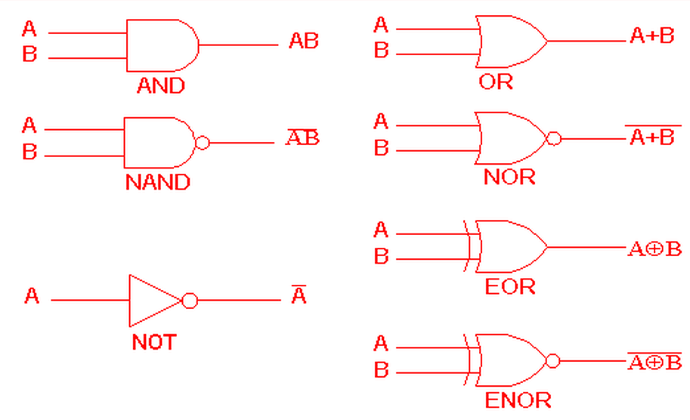
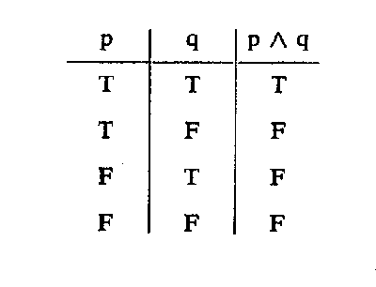
1) Boolean Circuit/Formula
Notes:
*http://www.ee.surrey.ac.uk/Projects/CAL/digital-logic/gatesfunc/graphics/symtab.gif

Slide 16
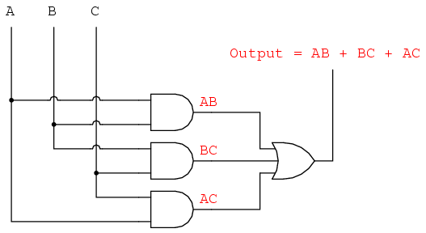
Circuit and Formula
Notes:
http://www.ibiblio.org/kuphaldt/electricCircuits/Digital/04366.png

Slide 17
Complexity Class
NC: Nick's Class
(Named in honor of Nick Pippenger.)
NC^{i} is the class of decision problems solvable by a uniform family of Boolean circuits, with polynomial size, depth O(log^{i}(n)), and fan-in 2.
Notes:
https://complexityzoo.uwaterloo.ca/Complexity_Zoo:N#nc

Slide 18
Complexity Class
NC: Nick's Class
(Named in honor of Nick Pippenger.)
NC^{i} is the class of decision problems solvable by a uniform family of Boolean circuits, with polynomial size, depth O(log^{i}(n)), and fan-in 2.
We are working in NC¹
Notes:
https://complexityzoo.uwaterloo.ca/Complexity_Zoo:N#nc

Slide 19
Indistinguishability Obfuscation Process
Functionality
Boolean Formula/Circuit
Binary Decision Diagram
Branching Program (BP)
Oblivious Linear Branching Program through Barrington’s Theorem
Branching Program represented with permutation matrices
Security
Dummy Program and Random Scalar multiplication of A_{i,b}
Small Matrix in Big Matrix
Sandwich Vectors
Flank by Random Matrices
Encode all Matrix elements in multilinear map

Slide 20
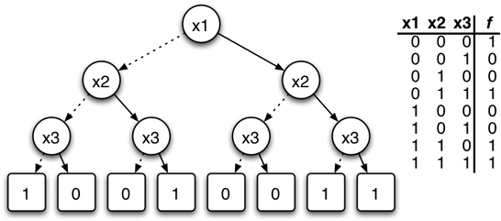
2) Binary Decision Diagram
Notes:
http://upload.wikimedia.org/wikipedia/commons/thumb/9/91/BDD.png/546px-BDD.png

Slide 21
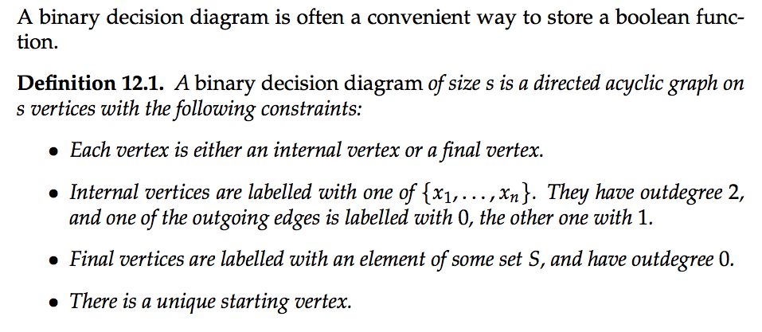
Binary Decision Diagram
Notes:
http://www.complexity.ethz.ch/education/Lectures/ComplexityHS10/ScriptChapterTwelve

Slide 22
Indistinguishability Obfuscation Process
Functionality
Boolean Formula/Circuit
Binary Decision Diagram
Branching Program (BP)
Oblivious Linear Branching Program through Barrington’s Theorem
Branching Program represented with permutation matrices
Security
Dummy Program and Random Scalar multiplication of A_{i,b}
Small Matrix in Big Matrix
Sandwich Vectors
Flank by Random Matrices
Encode all Matrix elements in multilinear map

Slide 23
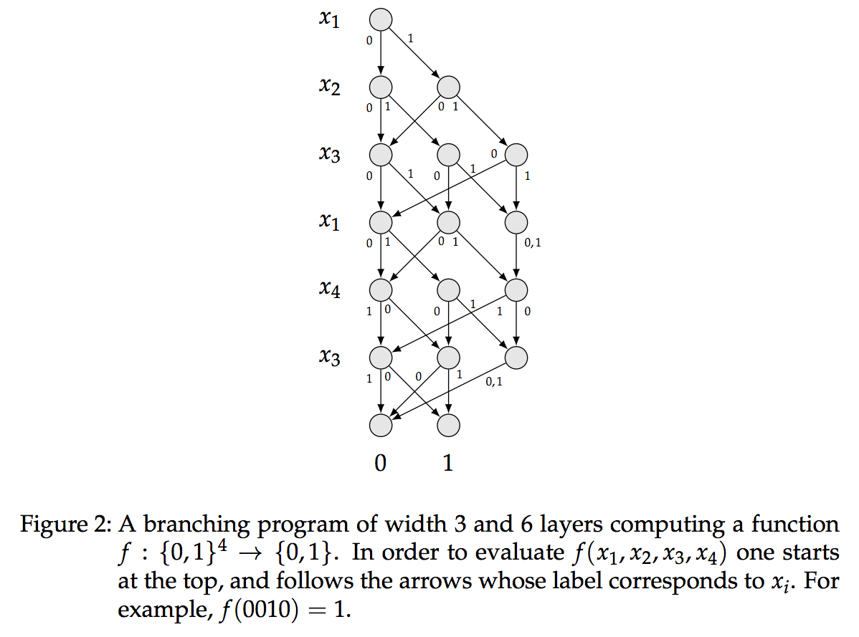
3) Branching Program
Notes:
http://www.complexity.ethz.ch/education/Lectures/ComplexityHS10/ScriptChapterTwelve

Slide 24
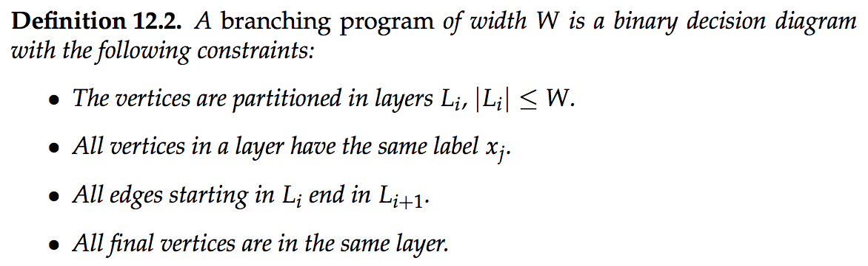
Branching Program
Notes:
http://www.complexity.ethz.ch/education/Lectures/ComplexityHS10/ScriptChapterTwelve

Slide 25
Indistinguishability Obfuscation Process
Functionality
Boolean Formula/Circuit
Binary Decision Diagram
Branching Program (BP)
Oblivious Linear Branching Program through Barrington’s Theorem
Branching Program represented with permutation matrices
Security
Dummy Program and Random Scalar multiplication of A_{i,b}
Small Matrix in Big Matrix
Sandwich Vectors
Flank by Random Matrices
Encode all Matrix elements in multilinear map

Slide 26
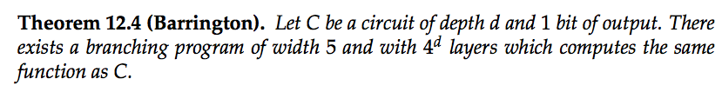
4) Barrinton’s Theorem

Slide 27
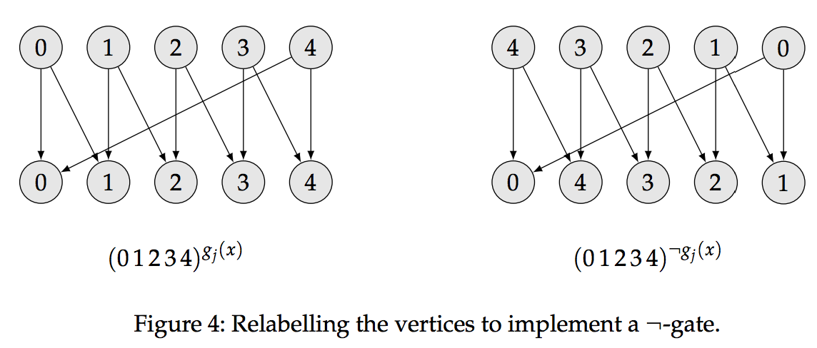
Not-Gate

Slide 28
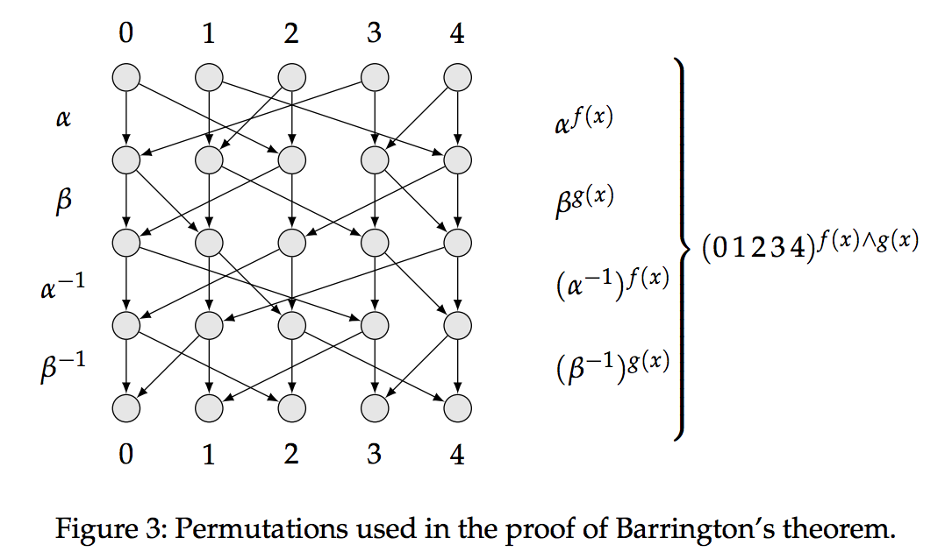
Barrington’s Commutator

Slide 29
Oblivious Linear Branching Program

Slide 30
Indistinguishability Obfuscation Process
Functionality
Boolean Formula/Circuit
Binary Decision Diagram
Branching Program (BP)
Oblivious Linear Branching Program through Barrington’s Theorem
Branching Program represented with permutation matrices
Security
Dummy Program and Random Scalar multiplication of A_{i,b}
Small Matrix in Big Matrix
Sandwich Vectors
Flank by Random Matrices
Encode all Matrix elements in multilinear map

Slide 31




5) Oblivious Linear Branching Program with Matrices
…
0
1

Slide 32
Oblivious Linear Branching Program
Input = 0101
…
0
1

Slide 33

Oblivious Linear Branching Program
Input = 0101
…
=
1
0
1

Slide 34
Indistinguishability Obfuscation Process
Functionality
Boolean Formula/Circuit
Binary Decision Diagram
Branching Program (BP)
Oblivious Linear Branching Program through Barrington’s Theorem
Branching Program represented with permutation matrices
Security
Dummy Program and Random Scalar multiplication of A_{i,b}
Small Matrix in Big Matrix
Sandwich Vectors
Flank by Random Matrices
Encode all Matrix elements in multilinear map

Slide 35

6) Dummy Branching Program
…c
0
1
0
1

Slide 36


Dummy Program with Scalar Multiplication
3x
7x
…
7x
3x
0
1
0
1

Slide 37
Small Matrix in Big Matrix

Slide 38
Indistinguishability Obfuscation Process
Functionality
Boolean Formula/Circuit
Binary Decision Diagram
Branching Program (BP)
Oblivious Linear Branching Program through Barrington’s Theorem
Branching Program represented with permutation matrices
Security
Dummy Program and Random Scalar multiplication of A_{i,b}
Small Matrix in Big Matrix
Sandwich Vectors
Flank by Random Matrices
Encode all Matrix elements in multilinear map

Slide 39

7) Small Matrix in Big Matrix

Slide 40

Small Matrix in Big Matrix

Slide 41




Small Matrix in Big Matrix

Slide 42
Indistinguishability Obfuscation Process
Functionality
Boolean Formula/Circuit
Binary Decision Diagram
Branching Program (BP)
Oblivious Linear Branching Program through Barrington’s Theorem
Branching Program represented with permutation matrices
Security
Dummy Program and Random Scalar multiplication of A_{i,b}
Small Matrix in Big Matrix
Sandwich Vectors
Flank by Random Matrices
Encode all Matrix elements in multilinear map

Slide 43
8) Sandwich Vectors
S
S
S’
S’
…
…
…
…
T
T
T’
T’
0
1
0
1

Slide 44
Sandwich Vectors
S
S’
T
T’

Slide 45
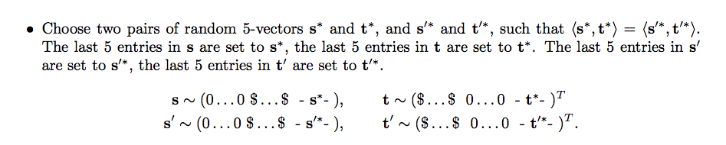
Sandwich Vectors

Slide 46
Sandwich Vectors
$...$ 0…0 S* S* S* S* S*
$...$0…0 S*’ S*’ S*’ S*’ S*’
0…0$$...$ T* T* T* T* T*
0…0$$...$T*’T*’T*’T*’T*’

Slide 47
Sandwich Vectors
S
S
S’
S’
…
…
…
…
T
T
T’
T’
0
1
0
1

Slide 48
Indistinguishability Obfuscation Process
Functionality
Boolean Formula/Circuit
Binary Decision Diagram
Branching Program (BP)
Oblivious Linear Branching Program through Barrington’s Theorem
Branching Program represented with permutation matrices
Security
Dummy Program and Random Scalar multiplication of A_{i,b}
Small Matrix in Big Matrix
Sandwich Vectors
Flank by Random Matrices
Encode all Matrix elements in multilinear map

Slide 49




9) Flanked by Random Matrices (Killian’s Protocol)
S
…
…
…
T
0

Slide 50



Flanked by Random Matrices
S
…
…
…
…
T
0
0

Slide 51
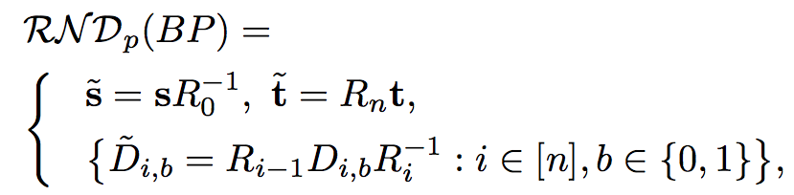
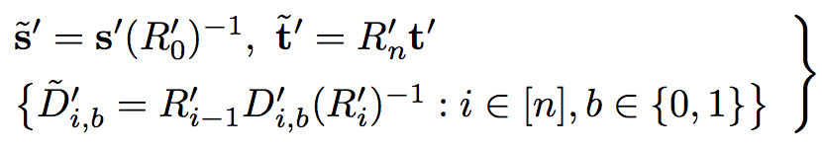
Randomized Branching Program

Slide 52
Indistinguishability Obfuscation Process
Functionality
Boolean Formula/Circuit
Binary Decision Diagram
Branching Program (BP)
Oblivious Linear Branching Program through Barrington’s Theorem
Branching Program represented with permutation matrices
Security
Dummy Program and Random Scalar multiplication of A_{i,b}
Small Matrix in Big Matrix
Sandwich Vectors
Flank by Random Matrices
Encode all Matrix elements in multilinear map

Slide 53
10) Encode in Multilinear Map
gª
‘
‘
g^{b}
‘
‘
…
…
…
…
g^{y}
‘
‘
g^{z}
‘
‘
0
1
0
1

Slide 54
Encode in Multilinear Map
gª
‘
‘
g^{b}
‘
‘
…
…
…
…
g^{y}
‘
‘
g^{z}
‘
‘
0
1
0
1
g^{abc…z}

Slide 55
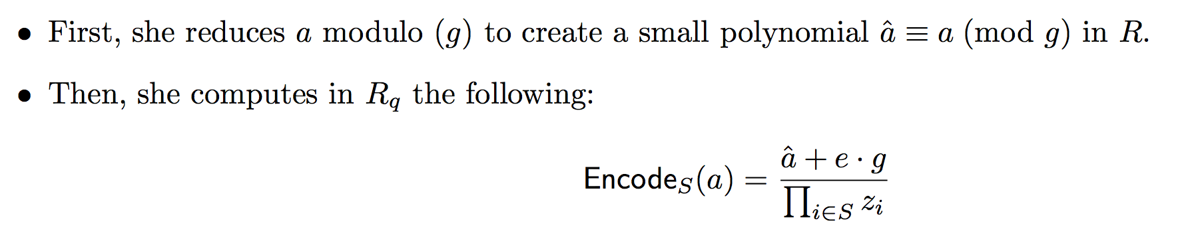
Encoding in Multilinear Map

Slide 56
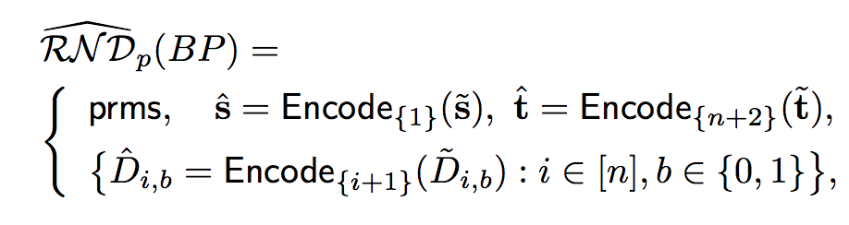
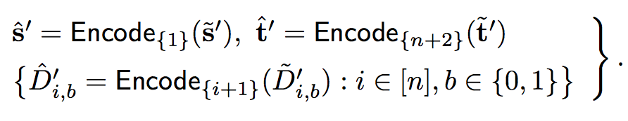
Garbled Branching Program

Slide 57
Program Evaluation

Slide 58
Program Evaluation
-Publish 0 encoded at g^{abc…z}
-Compare result of program to 0

Slide 59
Fix Inputs in Program
‘
‘
‘
‘
…
…
…
…
…
‘
‘
‘
‘
0
1
0
1

Slide 60
Fix Inputs in Program
Fix x1 = 0
‘
‘
‘
‘
…
…
…
…
…
‘
‘
‘
‘
0
1
0
1

Slide 61
Fix Inputs in Program
Fix x1 = 0
‘
‘
‘
‘
…
…
…
…
…
‘
‘
‘
0
1
0
1

Slide 62
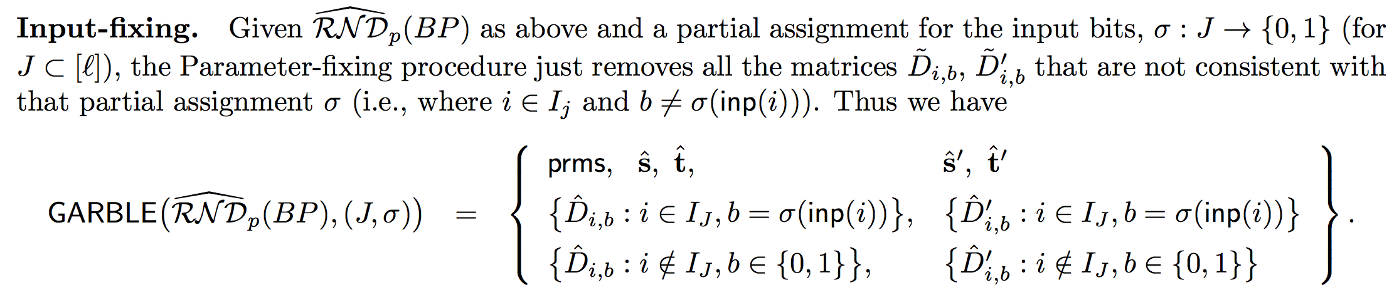
Input Fixed Program

Slide 63
Indistinguishability

Slide 64
Obfuscation Results
Multilinear Maps
Barrington’s Theorem
Killian’s Protocol
Indistinguishability Obfuscation in NC¹

Slide 65
Obfuscation Results
Multilinear Maps
Barrington’s Theorem
Killian’s Protocol
Perfectly Sound Non-interactive Witness Indistinguishable Proofs
Indistinguishability Obfuscation in NC¹
Fully Homomorphic Encryption
Indistinguishability Obfuscation in P

Slide 66
Papers
On the (Im)possibility of Obfuscating Programs [http://eprint.iacr.org/2001/069]
Candidate Multilinear Maps from Ideal Lattices [http://eprint.iacr.org/2012/610]
Candidate Indistinguishability Obfuscation and Functional Encryption for all circuits [http://eprint.iacr.org/2013/451]
Virtual Black-Box Obfuscation for All Circuits via Generic Graded Encoding [http://eprint.iacr.org/2013/563]
Protecting Obfuscation Against Algebraic Attacks [http://eprint.iacr.org/2013/631]
Implementing Cryptographic Program Obfuscation [http://eprint.iacr.org/2014/779]

Slide 67
SafeWare Broad Agency Annoucement
DARPA is spending millions $$$
“The goal of the SafeWare research effort is to drive fundamental advances in the theory of program obfuscation and to develop highly efficient and widely applicable program obfuscation methods with mathematically proven security properties”
Notes:
https://www.fbo.gov/index?s=opportunity&mode=form&id=a303af332a90b1e84fdb91d7dd382396&tab=core&_cview=0

Slide 68
Obfuscation Crackme
Implementing Cryptographic Program Obfuscation [http://eprint.iacr.org/2014/779]
https://www.dropbox.com/s/85d03o0ny3b1c0c/point-14.circ.obf.60.zip
23.96 GB

