Slide 1
Precision Farming
With Jeremy Bolster

Slide 2
Precision farming – Why?
Precise climate control
Allows growing plants:
Out of season
Out of their climate zone
Indoors

Slide 3
Precision farming – Why?
Plan was to replicate MIT’s machine for later refinement

Slide 4
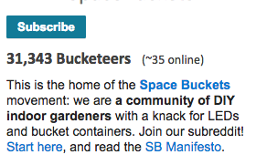

Precision farming - demand
Large demand
eg. Spacebuckets, MIT Open Agriculture

Slide 5
Precision farming - demand
Large demand
eg. Spacebuckets, MIT Open Agriculture
Demand likely to increase next July

Slide 6
Precision farming – Building - Hardware
High Level => Sensor and Control Network
A Robot

Slide 7
Precision farming – Building - Hardware
High Level => Sensor and Control Network
A Robot
Low Level => Lots and Lots of Wires

Slide 8
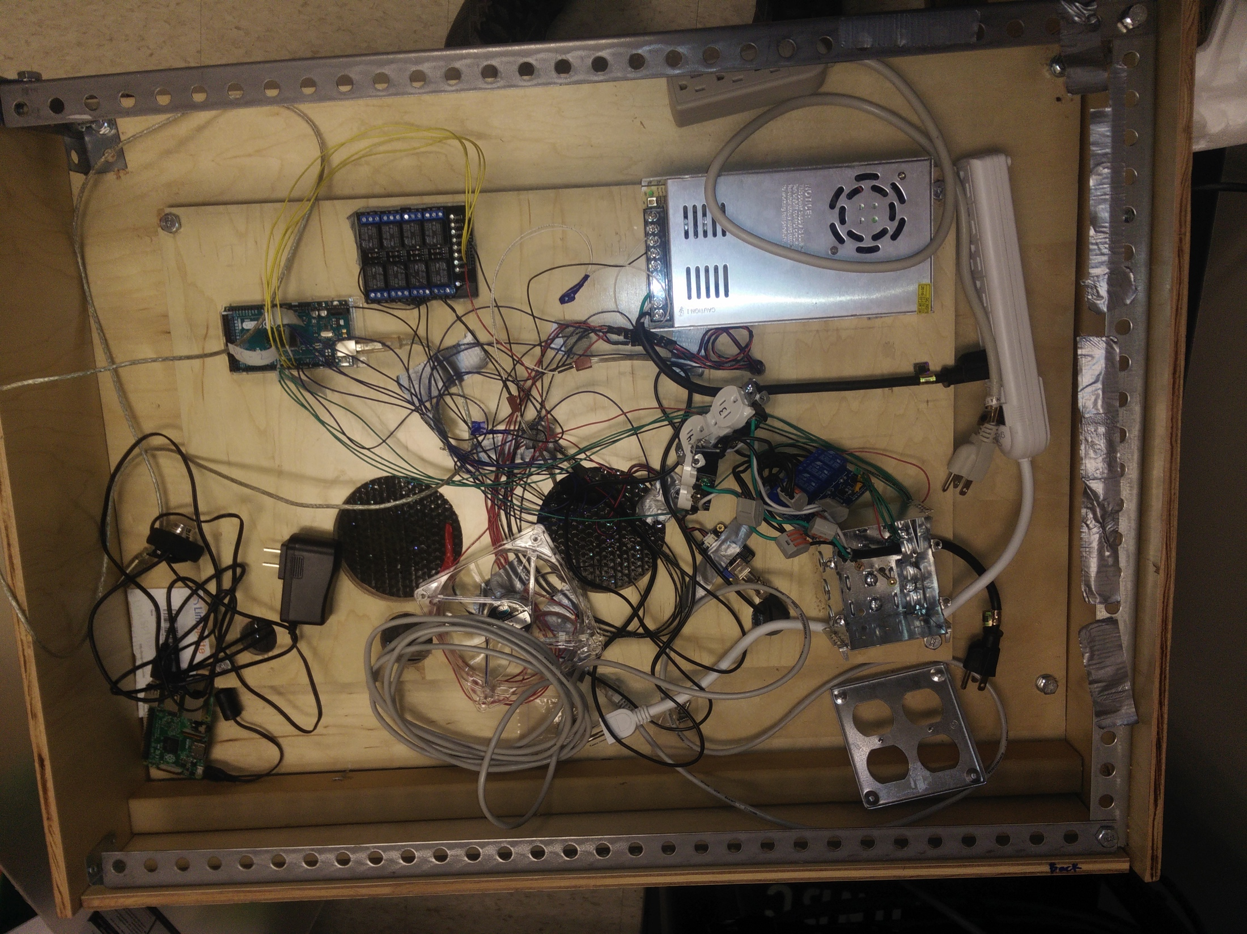
Precision farming – Building - Hardware
High Level => Sensor and Control Network
A Robot
Low Level => Lots and Lots of Wires

Slide 9
Precision farming – Building - Software
Started with MIT’s Software

Slide 10
Precision farming – Building - Software
Started with MIT’s Software
Code quality is poor
No modularity

Slide 11
Precision farming – Building - Software
Decided To Build My Own Software
Cons
Pros
Buggy
Tons of work
More rewarding
Actually functions
Allows for easier improvement

Slide 12
Precision farming – Current Status
Functions adequately
Still has bugs

Slide 13
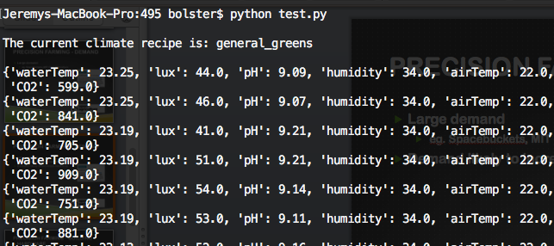
Precision farming – Current Status
Functions adequately
Still has bugs

Slide 14
Precision farming – Future
Fix bugs
Extend feature support
Make it easier for end users

