Slide 1
Restaurant Rush
A turn-based restaurant manager in Java · CT2003 group presentation
1
Speaker 1
2
Speaker 2
3
Speaker 3
4
Speaker 4
CT2003 · Group presentation
Notes:
Introduce the group and say each member’s name aloud. Explain that you will launch the final Java build and then walk through how the design developed.

Slide 2
Four speakers, seven brief segments
1
1
Speaker 1
2
Speaker 2
3
Speaker 3
4
Speaker 4
The game and its architecture
Stage 1: running the restaurant
Stage 2: customers with personality
Stage 3, results and the final design
about 3.5 min
about 4 min
about 3.5 min
about 4 min
Brief segment 1: launching the game
Segments 2 and 3: constrained staff choices; READY → SERVED → payment
Segments 4 and 7: VIP and Critic behaviour; stage-1 → stage-2 comparison
Segments 5, 6 and 7: a Stage 3 feature; victory and defeat; final diagram and stage-2 → stage-3 comparison
About 15 minutes, including demos and replays
Notes:
Speaker 1 (about 25 s)
SAY: Each of us presents one part. I will introduce the game and its architecture and launch it. Speaker 2 covers Stage 1 and how the staff limit your choices. Speaker 3 covers the VIP and Critic customers in Stage 2. Speaker 4 covers Stage 3, shows a victory and a defeat, and walks through the final class diagram.
BACKGROUND: This slide maps every part to the seven segments the brief asks for, so the markers can tick them off.

Slide 3
The game and its architecture
1
Part 1 · Speaker 1 · about 3.5 minutes
Brief segment 1: launching the game
Notes:
Speaker 1 (about 5 s)
SAY: Let us start with the game itself.

Slide 4
You run the floor; customers choose the food
1
18
2
6
To win after turn 18
≥ 4 customers paid
≥ $45.00 revenue
≥ 60 average satisfaction of paid customers
turns, always played in full
tables
customers, one every 3 turns
W
C
$
H
Waiter
Chef
Cashier
Host (Stage 3)
One task per turn: seat, take an order or serve
One preparation unit per turn
Automatic: one payment per turn, oldest first
Seats one extra customer per turn
Only five customers can ever pay: the turn-16 arrival runs out of time, as the brief intends.
Notes:
Speaker 1 (about 40 s)
SAY: You are the manager. The game always runs for 18 turns, with two tables and six customers, one arriving every three turns. You never choose the food: each customer chooses for themselves. To win, after turn 18 you need at least four paying customers, at least 45 dollars of revenue, and an average satisfaction of at least 60 among the customers who paid. You control the Waiter and the Chef, and in Stage 3 also a Host. The Cashier works on its own.
BACKGROUND: Only five customers can ever pay: the one arriving on turn 16 cannot finish before turn 18. The brief says this is intended. Money is stored as whole cents so rounding is exact.

Slide 5
Every turn runs the same six steps
1
1
2
3
4
5
6
Arrival
Choices
Kitchen and serving
Eating and payment
Waiting
Result
The scheduled customer joins the queue at satisfaction 100
You pick each staff task, or Wait
Waiter acts before Chef; a dish READY now is served next turn
Eat one full turn, then the Cashier takes one payment
Unserved customers lose satisfaction; at 0 they walk out
After turn 18: victory only if all three targets are met
The timing that matters
The brief's Pasta example, tested
Dish READY on turn t → served on turn t + 1 at the earliest
Served on turn t → READY_TO_PAY on t + 1 → pays on t + 2 at the earliest
Invalid choice → explained, and the staff task is not used up
Turn | 1 | 2 | 3 | 4 | 5 | 6
Satisfaction | 92 | 84 | 76 | 76 | ready | paid $18.00
The automated checks verify the Pasta example turn by turn.
Notes:
Scheduled arrivals begin at satisfaction 100. The Waiter acts before the Chef. A ready order can be served on a later turn. A served customer eats for one full turn and can pay on the following turn at the earliest. The current build passes the automated Pasta example.

Slide 6
Key classes and methods
1
Boundary
Control
Entity
Main
GameController
Restaurant / Table
main()
run(), playTurn()
seat(), openOrder(), completePayment() / isFree(), release()
ConsoleInput
Game
Customer → RegularCustomer, VIPCustomer, CriticCustomer
readInt(), readYesNo()
startTurn(), waiterTakeOrder(), waiterServe()
loseSatisfaction(), getSatisfactionLoss(), chooseItem(), applyDiscount()
ConsoleView
Scenario
Order
showState(), showFinalResult()
createMenu(), createArrival()
prepareOneUnit(), markServed(), markPaid(), cancel()
PixelGame
GameStats
Staff → Waiter, Chef, Cashier, Host
open(), refresh()
recordPayment(), getAverageSatisfaction()
ensureAvailable(), completeTask(), resetForTurn()
PixelRoom
Objective
Waiter / Chef
showGame(), paintComponent()
evaluate()
takeOrder(), serve() / prepare()
PriceCalculator
Cashier / Host
quote(), addModifier()
processPayment() / seat()
HappyHour implements PriceModifier
Menu / MenuItem → Dish, ComboMeal
activate(), adjust(), endTurn()
mostExpensive() / getPrice(), getPrepUnits()
Money
plus(), percent(), isAtLeast()
Example: the interface calls Game.waiterServe(), which delegates to Waiter.serve() to validate and update the order.
Notes:
Point to the three layers, then trace Serve. The interface passes an order ID to Game.waiterServe(). Game finds the order and calls Waiter.serve(). The Waiter checks whether it can act and whether the order was ready before this turn. The Order and Customer update their states, and the interface shows the result. Explain one design decision: both interfaces use these same domain operations. The method list is there for questions.

Slide 7
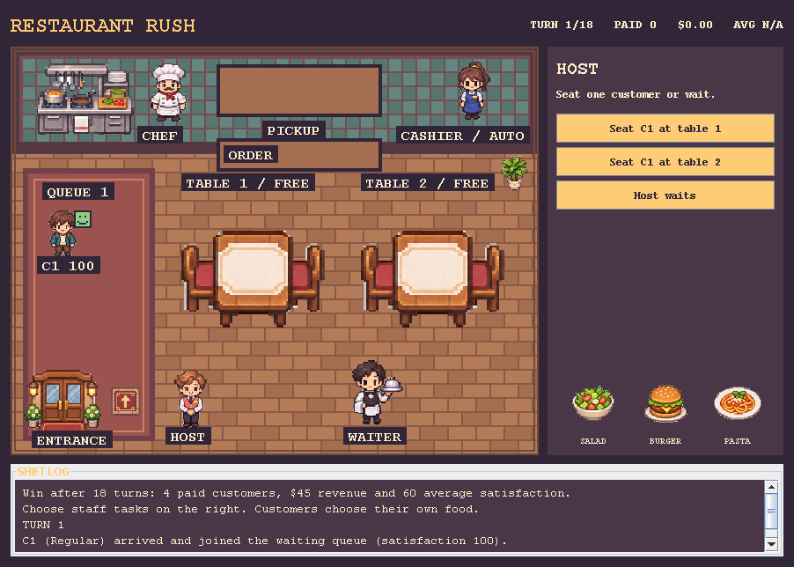
Launching the game from the submitted project
1
LIVE DEMO
1
.\build.bat
Build from the project folder
2
.\run.bat --gui
Open the pixel-art window
3
Click Start turn
Show C1, two tables and Host actions
Needs only JDK 17+; works offline.
Notes:
In PowerShell, open the project on pixel-art-gui. With JDK 17 or later active, run .\build.bat before presenting. Launch with .\run.bat --gui. Click Start turn, then point out C1 at 100 satisfaction, two free tables, the Host buttons, and the three victory targets. If needed, use the screenshot on the slide. Hand over to Speaker 2. Source: https://github.com/JeremyChooCK/CT2003-Restaurant-Rush

Slide 8
Stage 1: running the restaurant
2
Part 2 · Speaker 2 · about 4 minutes
Segments 2 and 3: constrained staff choices; READY → SERVED → payment
Notes:
Speaker 2 (about 5 s)
SAY: Thank you. I will show how Stage 1 works and why the staff are the real limit.

Slide 9
One Waiter, three jobs, one task per turn
2
SAVED RUN
 | Turn 1 | Turn 2 | Turn 3 | Turn 4 | Turn 5 | Turn 6
Arrives | C1 |  |  | C2
Waiter | Seat C1 | Take order | Serve #1 | Seat C2 | Take order | Serve #2
Chef |  | Cook #1 |  |  | Cook #2
Cashier |  |  |  |  | C1 pays
With an arrival every three turns, the Waiter has no spare turn.
Stage 1 example, turns 1–2
Turn 1 Waiter 1,1,1 Chef 0
Turn 2 Waiter 2,1 Chef 1,1
Any slip, or a 2-unit Pasta, pushes serving into the next arrival's turn and costs satisfaction.
Notes:
Use the recorded Stage 1 run or the slide timeline. Open runs/stage1-victory-output.txt and point to the first three turns. Explain how a single Waiter must choose between seating, taking an order and serving. The separate Stage 1 tag is not published.

Slide 10
A dish from order to payment
2
SAVED RUN
Turn 2
Turn 3
Turn 4
Turn 5
1
2
3
4
ORDERED → READY
SERVED
READY_TO_PAY
PAID
Waiter takes the Burger order; the Chef cooks its one unit
Can't be served on the turn it's cooked; served now at 84
Ate for one full turn
Cashier collects $15.00 and frees the table
Turn 3 input example: invalid choices can be retried
Waiter: 1) Seat 2) Take an order 3) Serve a READY order 0) Wait > abc
! "abc" is not a whole number. Please try again.
Waiter: ... > 3 Order number to serve > 9
! Not allowed: There is no order #9. ! Please choose again.
Waiter: ... > 3 Order number to serve > 1
* Waiter served order #1 Burger for C1. C1 (Regular) is now eating (satisfaction 84).
Notes:
Walk through the recorded Burger lifecycle on the slide. The invalid input is an illustrative example of retry handling. In the GUI, only available actions appear. The terminal can show input validation.

Slide 11
Validate, act, then use up the task
2
// Waiter.java: every staff action has this shape
public void seat(Restaurant r, Customer c, Table t)
throws InvalidActionException {
ensureAvailable(); // already acted this turn?
r.seat(c, t); // queued? table free?
completeTask(); // only reached on success
}
Package-private state changes
Only Restaurant and Staff can move a customer through the visit: seatAt, serve, pay, leave.
Satisfaction stays 0 to 100
Changes only through loseSatisfaction() and recover(), which clamp the value.
A failed check throws before completeTask(), so the controller simply asks again.
Money is immutable
Whole cents with half-up rounding: $24.30 and $10.80 come out exact.
Notes:
Speaker 2 (about 50 s)
SAY: How does the code guarantee one task per turn? Every staff class follows the same pattern: first validate, then act, and only then mark the task as used. If any check fails, an exception with a clear message comes back before the task is used. The customer's state changes are package-private, so only the restaurant and its staff can move a customer through the visit, and satisfaction can only change through methods that keep it between 0 and 100.
BACKGROUND: Encapsulation examples to mention if asked: Money is immutable and stores cents; Customer.loseSatisfaction() is final; Staff hides the actedThisTurn flag behind ensureAvailable() and completeTask().

Slide 12
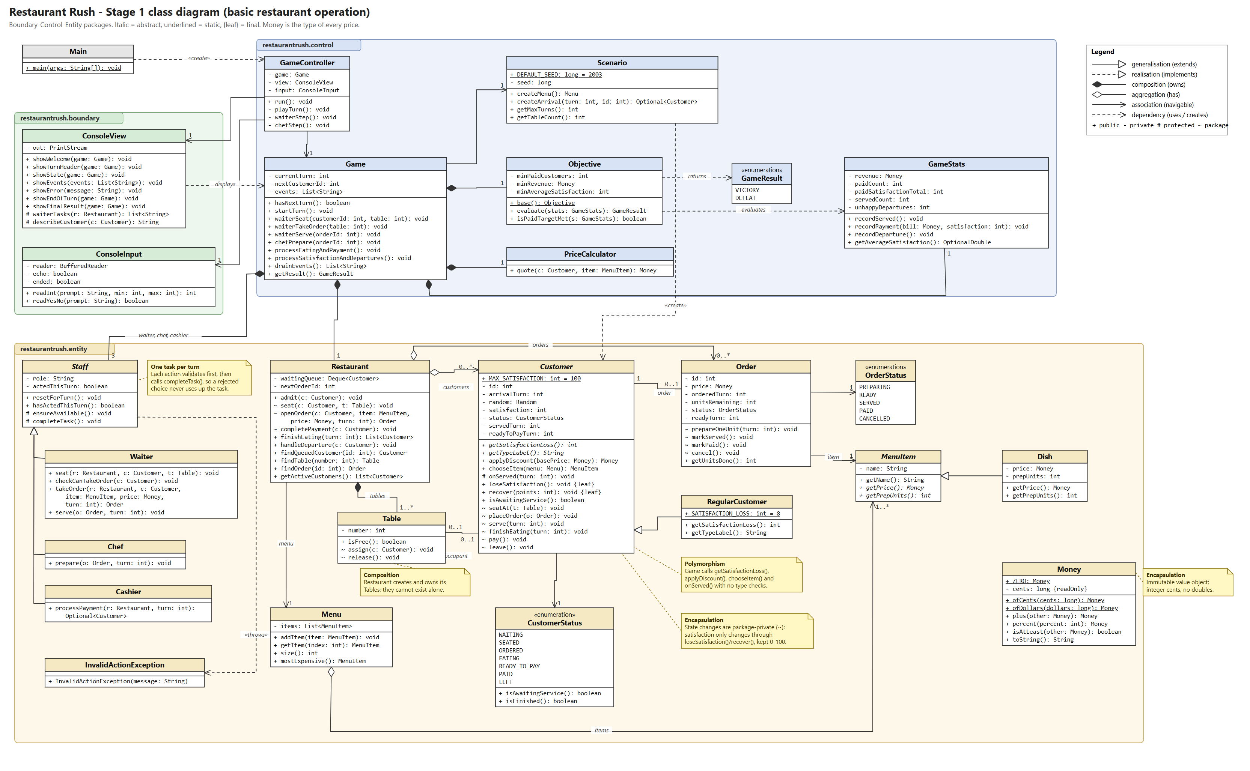
Stage 1 design
2
Notes:
Use the saved Stage 1 UML to explain Restaurant–Table composition, the abstract Customer and MenuItem types, and where Game and the console fit. Present it as the Stage 1 design, since the tag is not published.

Slide 13
Stage 2: customers with personality
3
Part 3 · Speaker 3 · about 3.5 minutes
Segments 4 and 7: VIP and Critic behaviour; stage-1 → stage-2 comparison
Notes:
Speaker 3 (about 5 s)
SAY: Thanks. Stage 2 gives our customers their own personalities.

Slide 14
Three customers, one set of rules
3
R
Regular
V
VIP
C
Critic
−8
−5
−12
satisfaction per waiting turn
satisfaction per waiting turn
satisfaction per waiting turn
Pays full price
10% off the bill
Pays full price
No special behaviour
More patient. In our run: a $21.60 combo costs the VIP $19.44.
Orders the most expensive item. Served on the earliest possible turn: +10. Any delay: −10.
Base game: the VIP arrives on turn 4 and the Critic on turn 10; there are still six arrivals.
Notes:
Speaker 3 (about 40 s)
SAY: In Stage 1, every customer was a Regular. They lose 8 satisfaction for every turn they wait, and pay full price. Stage 2 adds two new types. The VIP is more patient, losing only 5 per turn, and gets 10 percent off the bill. The Critic is the type we designed ourselves. The Critic is impatient, losing 12 per turn, and always orders the most expensive item, to test the kitchen. They also judge the service. If the dish arrives on the earliest possible turn, which is the order turn plus its cooking time, the Critic gains 10 satisfaction. Any delay at all, and they lose 10.
BACKGROUND: "Earliest possible turn" means order turn plus preparation units: the Chef started at once and never paused. In the base game turn 4 brings the VIP and turn 10 the Critic, so there are still six arrivals.

Slide 15
VIP and Critic, live
3
LIVE DEMO
Turn 4 · VIP
Turns 4–5
Turn 10 · Critic
Turn 13
C2 orders the Salad + Burger Combo: $21.60 on the menu, pays $19.44.
Waiting for food: 100 → 95 → 90. Only −5 a turn.
Most expensive item: Burger + Pasta Combo, $29.70, 3 units.
Served on 10 + 3 = 13, the earliest possible: +10, 64 → 74.
Pixel-art shift log · Demo jump → Turn 4, then Demo jump → Turn 10
Waiter took order #2: C2 (VIP) ordered Salad + Burger Combo (2 prep units) for $19.44 (menu price $21.60).
Waiting: C2 (VIP) satisfaction 100 -> 95 (-5) Waiting: C4 (Critic) satisfaction 76 -> 64 (-12)
Bill for C2 (VIP): DISCOUNTED: paid $19.44 instead of menu price $21.60
Waiter served order #4 Burger + Pasta Combo for C4. C4 (Critic) is now eating
(satisfaction 64 -> 74 (reaction to service)).
One turn late, the same dish gives −10. Backup: runs/stage3-victory-output.txt, turns 4–6 and 10–13.
Notes:
Speaker 3 (about 100 s) - LIVE DEMO in the pixel-art window
DO: .\run.bat --gui (or ./run.sh --gui). Demo jump -> "Turn 4: VIP arrives" -> Jump. Play turns 4-6 (Host seats C2, Waiter takes the order, Chef cooks; serve on turn 6). Then Demo jump -> "Turn 10: Critic arrives" -> Jump. Play turns 10-13 (Host seats C4, Waiter takes the order, Chef cooks every turn; serve order #4 on turn 13).
SAY (VIP): Let me show both of them live. We start at turn 4, when the VIP, C2, arrives. The VIP has chosen the Salad and Burger Combo. The menu price is 21.60, but the VIP's price is 19.44, which is exactly 10 percent off. The price is locked in when the order is taken. Look at the log while they wait for their food: 100 to 95, then 95 to 90. That's minus 5 per turn, where a Regular would lose 8. The food is served, and the bill confirms it: 19.44, down from 21.60.
SAY (Critic): Now I'll jump ahead to turn 10, when the Critic arrives. The Host seats the Critic, and the Waiter takes the order. As promised, they pick the most expensive item, the Burger and Pasta Combo at 29.70. It needs three cooking units, and the Chef starts on it straight away. While it cooks, watch the Critic's patience: 100, 88, 76, 64. That's minus 12 every turn, the fastest of all three types. It was ordered on turn 10, and needs three units, so turn 13 is the earliest it can possibly arrive. I serve it now, and the Critic is impressed: satisfaction goes from 64 up to 74, a +10 reaction. If I'd served it one turn later, it would have been minus 10 instead.
BACKGROUND: Each demo jump starts a fresh game and replays runs/stage3-victory.txt up to that turn, so the numbers are always the same and you can jump back at any time. If the window fails, show the same turns in runs/stage3-victory-output.txt.

Slide 16
No type checks: each customer answers for itself
3
// Game: one loop for every type
for (Customer c : restaurant.getActiveCustomers()) {
if (!c.isAwaitingService()) continue;
c.loseSatisfaction(); // 8, 5 or 12
if (c.getSatisfaction() == 0)
restaurant.handleDeparture(c);
}
Method | Regular | VIP | Critic
getSatisfactionLoss() | 8 | 5 | 12
applyDiscount() | – | 90% | –
chooseItem() | random | random | most expensive
onServed() | – | – | +10 / −10
Overrides per subclass; Game, Waiter and Cashier never ask the type.
Alternative we rejected
A CustomerType enum with switch statements in Game is shorter for three types, but every new type would mean editing the turn rules again, breaking the open/closed principle.
Notes:
Speaker 3 (about 50 s)
SAY: So how does the code do this? Customer is an abstract class. It's never created on its own, only as a Regular, a VIP or a Critic. It defines four methods, and each subclass overrides only what makes it different. The VIP overrides two methods: the loss and the discount. The Critic overrides three: the loss, the food choice and the reaction. Everything else, like seating, ordering and paying, is inherited from Customer, so all three types follow exactly the same flow. The game itself never checks a customer's type. At the end of every turn, one loop tells every waiting customer "lose satisfaction", and each object answers with its own number: 8, 5 or 12. That's polymorphism. The Game, Waiter and Cashier never ask what type of customer they're talking to.
BACKGROUND: Alternative we rejected: a CustomerType enum with switch statements in Game. It is shorter for three types, but every new type would mean editing the turn rules again. That breaks the open/closed principle.

Slide 17
Stage 1 to 2: adding customer behaviour
3
Stage 2
New
Changed
Unchanged
VIPCustomer
CriticCustomer
Scenario: VIP on turn 4, Critic on turn 10
Game: clearer serve message only
Customer
Order
Waiter, Chef, Cashier
Restaurant
GameController
Design comparison
GitHub stage tags pending
See README stage summary
Customer subclasses supply their own patience, pricing and service behaviour through shared methods.
Notes:
Speaker 3 (about 30 s)
SAY: And here's what that bought us. Stage 2 added just two new classes, VIPCustomer and CriticCustomer, plus one setup line in Scenario that brings a VIP on turn 4 and a Critic on turn 10. Game only got a clearer serve message. Customer, Order, Waiter, Chef, Cashier and Restaurant weren't modified at all. The Stage 1 design was open to new customer types without being changed. That's the open/closed principle. [Speaker 4] will now take you through Stage 3.
BACKGROUND: The stage tags are still pending, so there is no live GitHub comparison to open; the README lists the Stage 1 -> 2 changes. Source: https://github.com/JeremyChooCK/CT2003-Restaurant-Rush

Slide 18
Stage 3, results and the final design
4
Part 4 · Speaker 4 · about 4 minutes
Segments 5, 6 and 7: a Stage 3 feature; victory and defeat; final diagram and stage-2 → stage-3 comparison
Notes:
Speaker 4 (about 5 s)
SAY: Thank you. Stage 3 adds a new role, a new kind of menu item and a promotion.

Slide 19
A new role, a combo menu and a promotion
4
H
Host
M
ComboMeal
%
Happy Hour
+1 seat
$24.30
20% off
per turn, before the Waiter acts, so the order can be taken the same turn
Salad + Pasta: (9 + 18) × 0.9, and 1 + 2 = 3 preparation units
Once per game for 2 turns, after the VIP discount (VIP Burger: $10.80); waiting customers recover 15
ComboMeal is a MenuItem built from two MenuItems; HappyHour is a PriceModifier plugged into PriceCalculator. Orders, the Chef and the Waiter did not change.
Notes:
Speaker 4 (about 45 s)
SAY: The Host seats one extra customer per turn, before the Waiter acts, so the Waiter can take that order in the same turn. A ComboMeal is two existing dishes: it costs 90 percent of their price and needs both preparation times, so Salad plus Pasta is 24.30 and three units. Happy Hour can be used once per game for two turns: 20 percent off new orders, applied after the VIP discount, and everyone still waiting recovers 15 satisfaction at the start of each turn.
BACKGROUND: ComboMeal is itself a MenuItem made of two MenuItems, so orders and the Chef needed no change. Happy Hour is a PriceModifier plugged into PriceCalculator: a VIP Burger in Happy Hour is 15 × 0.9 × 0.8 = $10.80. Prices lock when the order is taken.

Slide 20
Turn 13: one Waiter, two urgent jobs
4
REPLAY
The Critic's combo is ready as C5 arrives on turn 13. C5's three-unit order must start this turn to be paid by turn 18.
A · Serve the Critic now
B · Happy Hour + Host + take the order
Critic on time: +10
C5's order slips to turn 14
C5 is still eating when the game ends
Host seats C5; Waiter takes the order at 20% off
Critic served on turn 14: −10, but +15 twice from Happy Hour
C5 pays on turn 18
4 paid · $73.14 · avg 87.0
5 paid · $92.58 · avg 86.0
Victory, but C5 never pays
Victory with every possible customer paid
Notes:
Compare the two decisions on turn 13. Serving the Critic first gives four payments, $73.14 and 87.0 satisfaction. Starting C5’s order with Happy Hour gives five payments, $92.58 and 86.0. Both results were replayed on the current game. Show turn 13 in runs/stage3-victory-output.txt for the Happy Hour path. Use the full replay on the next slide. Source: https://github.com/JeremyChooCK/CT2003-Restaurant-Rush

Slide 21
Same game, two managers
4
LIVE DEMO
VICTORY
DEFEAT
5
$92.58
0
$0.00
paid
revenue
paid
revenue
86.0
0
N/A
2
avg satisfaction
walk-outs
avg satisfaction
walk-outs
Seat on arrival, order while the Chef cooks, Happy Hour on turn 13
Happy Hour wasted on turn 1; the Chef never cooks
java -cp out restaurantrush.Main < runs/stage3-victory.txt | tail -8 (and stage3-defeat.txt)
The current Stage 3 build reproduces both results with seed 2003.
Notes:
For Git Bash use the command on the slide. In PowerShell use Get-Content runs/stage3-victory.txt | .\run.bat | Select-Object -Last 8. Substitute stage3-defeat.txt for the defeat. Both commands replay the same rules used in the GUI. Source: https://github.com/JeremyChooCK/CT2003-Restaurant-Rush

Slide 22
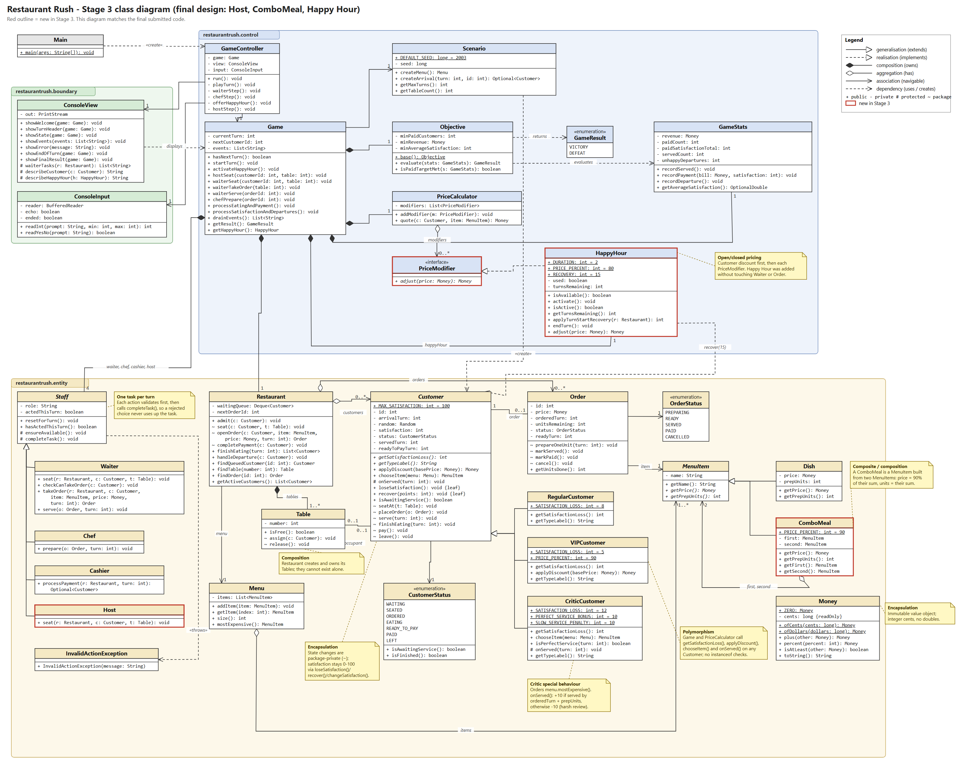
Stage 3 core design and GUI boundary
4
GUI boundary: PixelGame calls Game and updates PixelRoom, which draws the current state.
Notes:
The existing UML shows the Stage 3 core. PixelGame and PixelRoom are added boundary classes in the GUI branch. PixelGame calls Game and updates PixelRoom. PixelRoom reads game state to render the restaurant and animate characters. The original diagram is retained for the core class relationships. Source: https://github.com/JeremyChooCK/CT2003-Restaurant-Rush

Slide 23
Stage 2 to 3: new roles and pricing
4
Stage 3
New
Changed
Unchanged
Host
ComboMeal
PriceModifier
HappyHour
Scenario: combos
PriceCalculator: modifier list
Game, GameController: Host and Happy Hour
ConsoleView: status
Customer
Order
Waiter, Chef, Cashier
Restaurant
Design comparison
GitHub stage tags pending
See README stage summary
The Host and Happy Hour change turn flow. Existing customer and order types still use the same domain interfaces.
Notes:
Summarize the documented Stage 2 to Stage 3 changes in the README. Describe Host, ComboMeal and HappyHour and how they connect to existing abstractions. The stage tags are still pending. Source: https://github.com/JeremyChooCK/CT2003-Restaurant-Rush

Slide 24
What we take away
1
2
3
Behaviour lives in the objects
Two interfaces share the rules
The final shift is reproducible
Customers and menu items answer for themselves, so each stage mostly added classes.
The console and pixel-art window both call the same Game and entity methods.
The current build passes its automated rule checks and reproduces both Stage 3 endings.
Thank you. Questions?
Notes:
Close with shared rules, customer polymorphism, menu composition and the two verified final-build replays. Invite questions.

