Slide 1
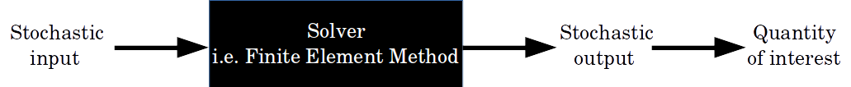

Slide 2
Random field of
Stochastic input
Linear elasticity
FEM
Displacements
Total elastic energy
(Quantity of interest)
Random field of
Stochastic input

Slide 3
