Slide 1
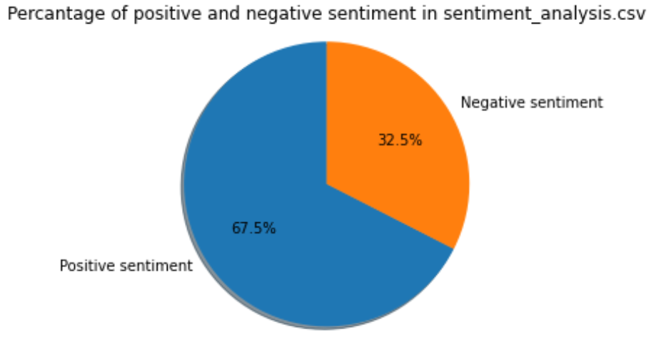
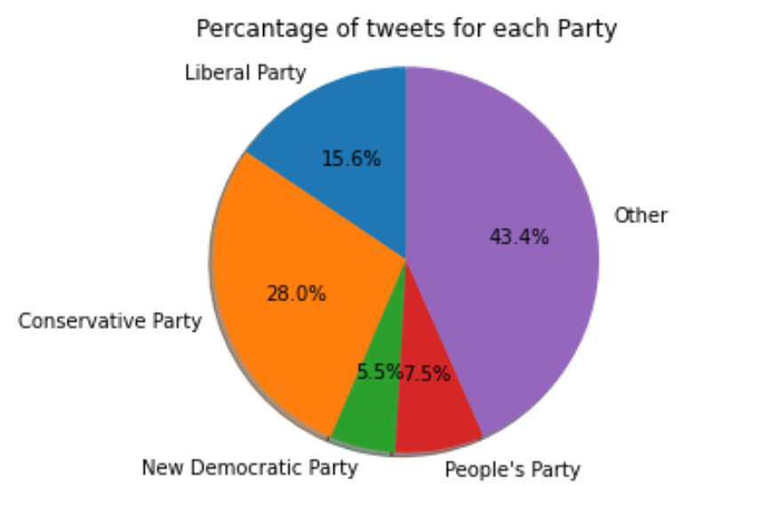
Exploratory analysis
There are about 67.5% positive and 32.5% negative tweets in all 550391 tweets in sentiment analysis data.
In Canadian election data, in all 1002 tweets, 28% are Conservative related and 15.6% are about Liberal Party. Besides, New Democratic Party and People’s Party take place of 5.5% and 7.5% correspondingly.

Slide 2
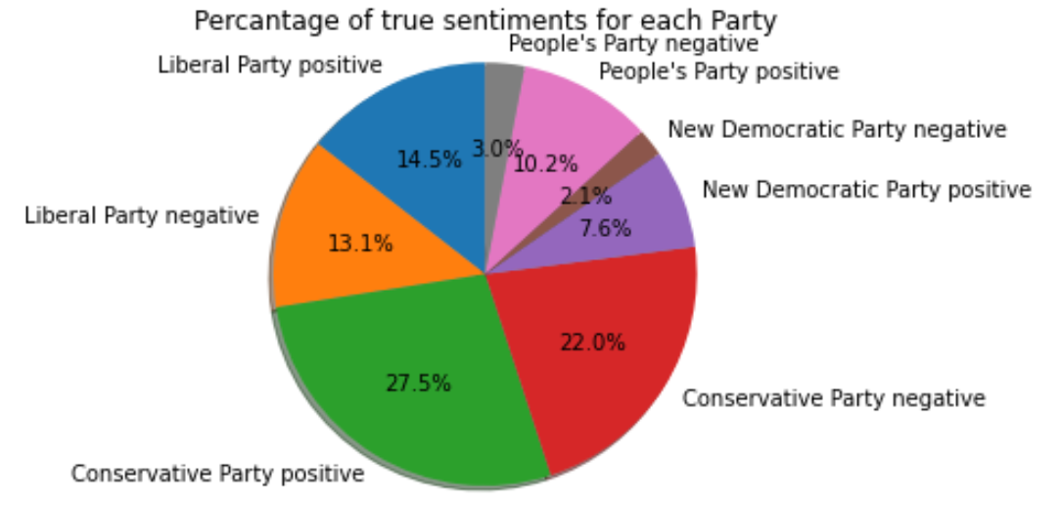
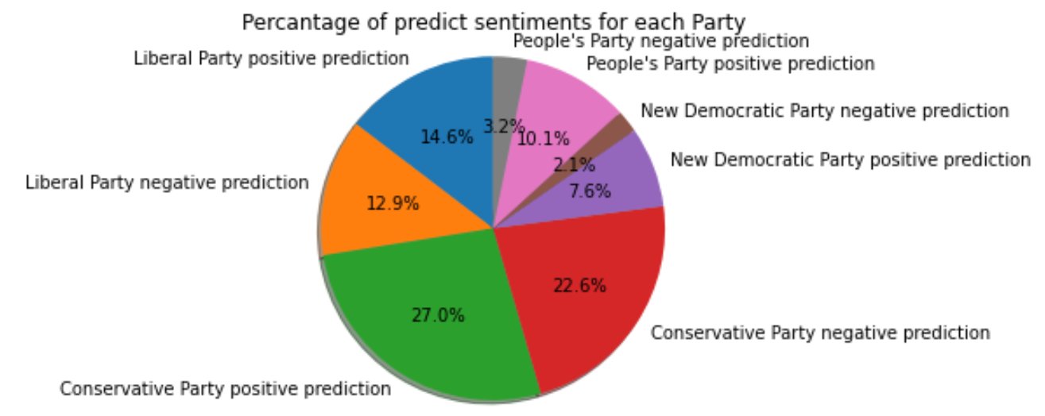
Model feature importance/results
Two different types of features: bag of words & TF-IDF
Classification algorithm: Highest accuracy: Logistic regression
Test accuracy on generic tweets is about 93%
Test accuracy on negative Canadian elections tweets is about 44%

